Slide 1

Research Question – Tutorial Presentation for Feedback Date :
Group Name: A 143 Name of Student Presenting:

Slide 2
This dataset is interesting to us because it reveals factors that contribute to the success of apps on the play store. Our Independent variable is: RATING This Independent variable datatype is Interval / Measurement Our Dependent variable is: TYPE This Dependent variable datatype is: Nominal / categorical
Dataset ID : DS 333 – GooglePlaystoreApps.csv
Notes:
Before specifying your Research Question you must define the type of data you are analysing. Are the variables you select interval data (measurement data you can divide, multiple, etc), OR are they ordinal (there is a definite order but the intervals between each variable are not necessarily equal, or the terms might be subjective like in a likert scale); OR are they just categorical/nominal (Items such as film names, cities, etc., that you can count numbers of occurrences? You also need to understand whether the variable is either dependent or independent and this will vary according to the context. Independent variables may cause an effect, whereas the dependent variable might be effected by the independent variable. Check the lecture notes on the RQ for more information and examples.
You will get only one opportunity to present your Research Question ahead of the submission date. Have your questions ready, and be ready to take notes on feedback.

Slide 3
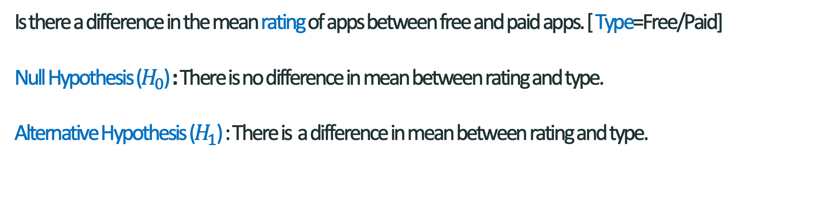
Is there a difference in the mean rating of apps between free and paid apps. [ Type=Free/Paid] Null Hypothesis ($H_{0}$) : There is no difference in mean between rating and type. Alternative Hypothesis ($H_{1}$) : There is a difference in mean between rating and type.
Our Research Question is

Slide 4
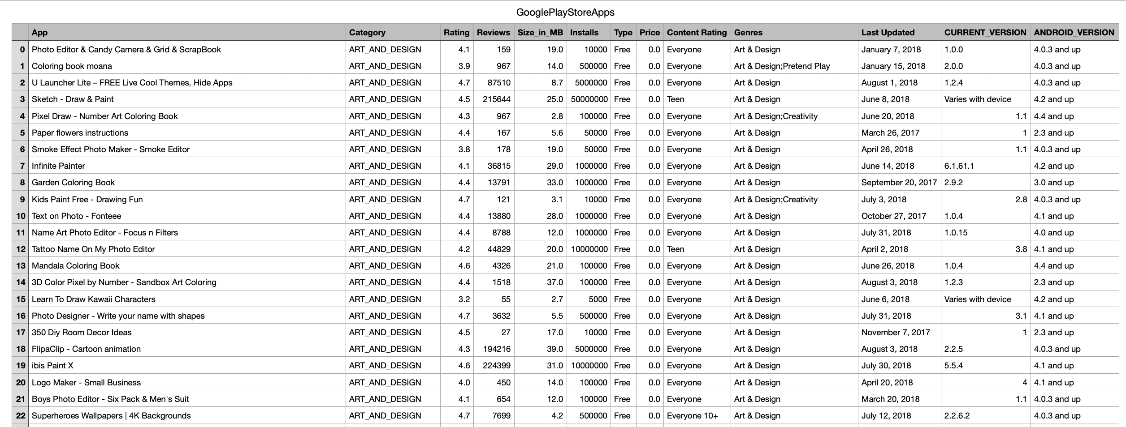
Dataset – Snippet

