Slide 1

Is there a difference in the mean rating of apps between free and paid apps Tutorial Presentation for Feedback Date : 22/11/202
Group Name: A143A Name of Student Presenting: NOEL JOHN PAUL

Slide 2
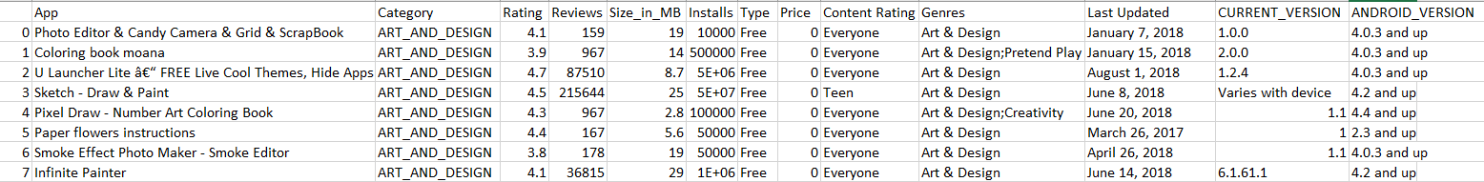
Dependent Variable – Rating
Independent Variable – Type
Total No: of rows – 10,841

Slide 3
This dataset is interesting to us because it offers an opportunity to check how a user choose free app or paid app based on their quality and performance from their ratings. Our Independent variable is: Type (free/paid) This Independent variable datatype is Nominal. Our Dependent variable is: Rating This Dependent variable datatype is an Interval variable.
Dataset ID: DS333, GooglePlayStoreApps.csv)
Notes:
Before specifying your Research Question you must define the type of data you are analysing. Are the variables you select interval data (measurement data you can divide, multiple, etc), OR are they ordinal (there is a definite order but the intervals between each variable are not necessarily equal, or the terms might be subjective like in a likert scale); OR are they just categorical/nominal (Items such as film names, cities, etc., that you can count numbers of occurrences? You also need to understand whether the variable is either dependent or independent and this will vary according to the context. Independent variables may cause an effect, whereas the dependent variable might be effected by the independent variable. Check the lecture notes on the RQ for more information and examples.
You will get only one opportunity to present your Research Question ahead of the submission date. Have your questions ready, and be ready to take notes on feedback.

Slide 4
Is there a difference in the mean rating of apps between free and paid apps?
Our Research Question is

Slide 5
Hypothesis Null hypothesis (H₀): There is no difference in the mean rating of apps between free and paid apps. Alternative hypothesis (H₁ There is a difference in the mean rating of apps between free and paid apps.

Slide 6
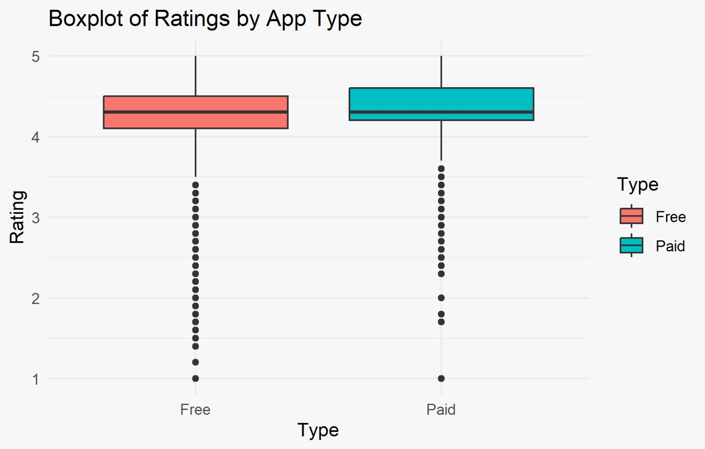

Slide 7
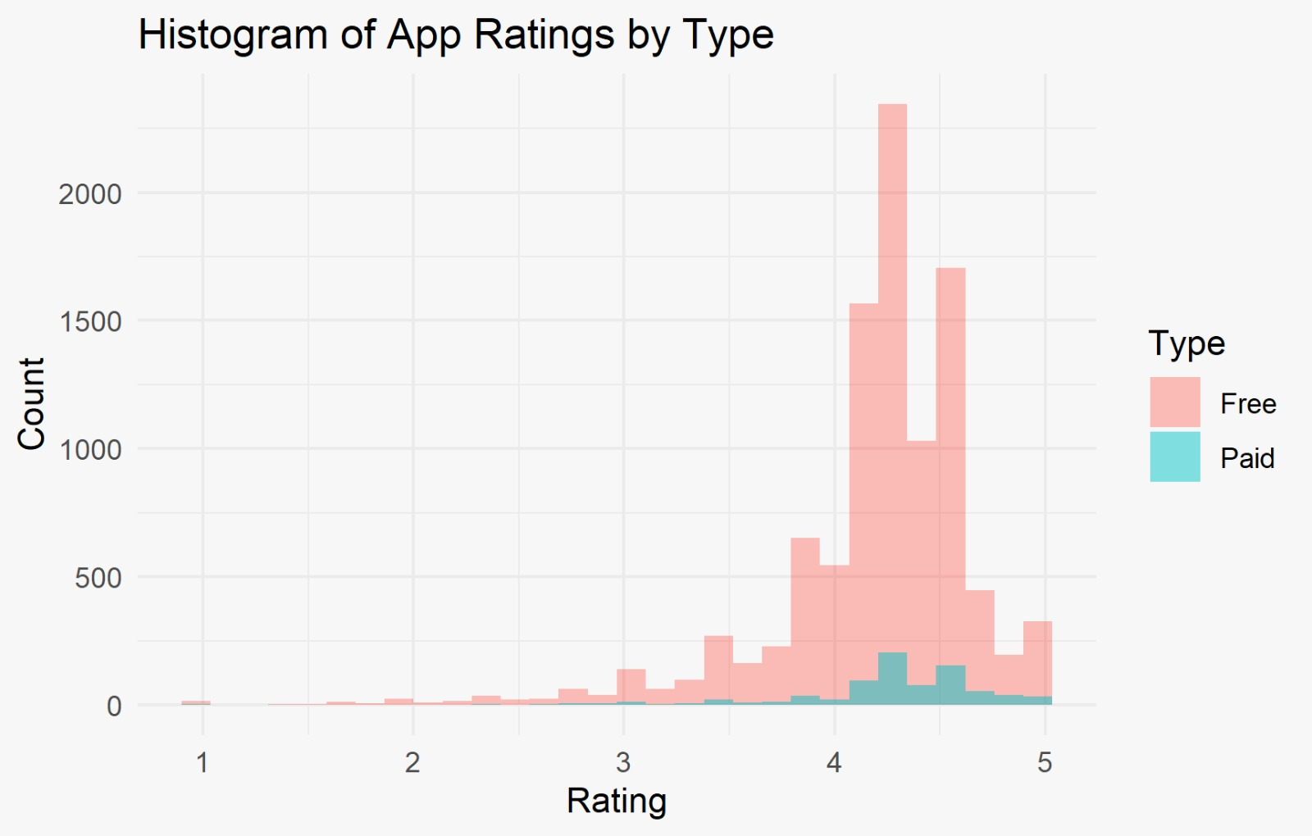

Slide 8
