Slide 1

Visualization and Analysis – Tutorial Presentation for Feedback Date:
Group Id: A143A Name of Student Presenting: Noel John Paul

Slide 2
.
Is there a difference in Mean rating of apps between free and paid apps

Slide 3
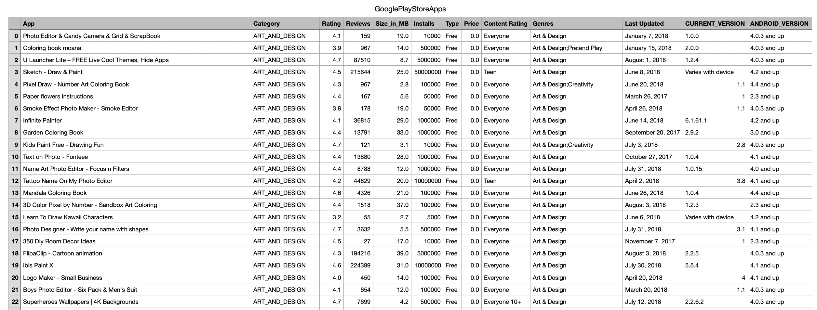
We are using the dataset DS333 and Googleplaystore.csv to answer our Research Question “ Is there a difference in mean ratings of apps between paid and free apps”
“The dataset has 10840 rows and the variables we use are Rating (dependent variable³) and Type (independent variable⁴).

Slide 4
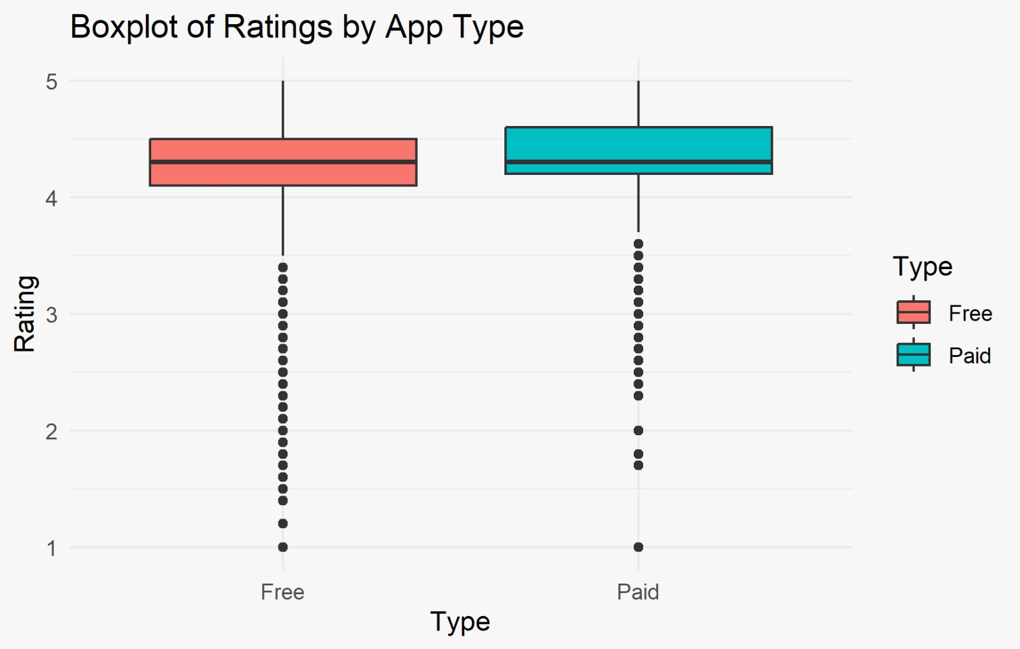
Comparison of means: Boxplot
Comparison of means analyses the difference between the mean (or median) value of a characteristic shared by members of two (or more) different populations.

Slide 5
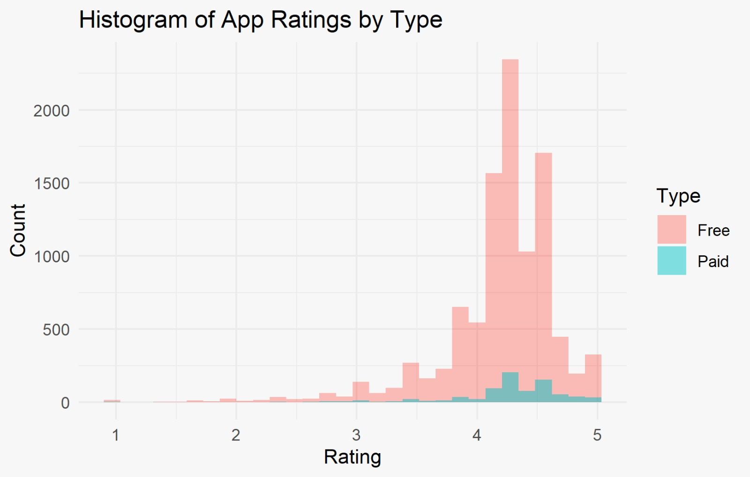
Comparison of Means: Histogram plot
Comparison of means analyses the difference between the mean (or median) value of a characteristic shared by members of two (or more) different populations.

Slide 6
Only attempt this Analysis part of the demo if you have completed your Visualization(s). Otherwise end your demo after the Visualization for feedback.
Part 2: Analysis (building on your Visualizations)

Slide 7
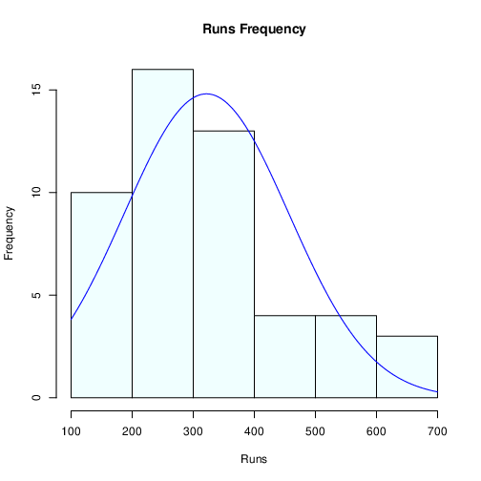
Here is a Histogram showing the frequencies of our dependent variable to include the normal curve overlay.
Our RQ asks about Correlation
For example:
Choose one:
1. The blue normal curve overlay follows the contours of the underlying data, so for our analysis we will use a parametric test for correlation: Pearson’s r
OR
The normal curve overlay does not follow the shape of the underlying data, so for our analysis we use the non-parametric test for correlation that does not assume normality: Spearman’s Rho or Kendal’s Tau
The example here is borderline, in terms of shape, so when in doubt choose the non-parametric equivalent.
7
Notes:
7

Slide 8
Here is a Histogram showing the frequencies of our dependent variable to include the normal curve overlay (shown in blue).
Our RQ asks about Differences in means/ medians
For example:
Choose one:
1. The normal curve overlay follows the contours of the underlying data, so we use the parametric test: t-test.
OR
2. The normal curve overlay does not follow the shape of the underlying data, so we use the non-parametric test that does not assume normality: Wilcoxon also known as the Mann Whitney U Test.
The example here is borderline, in terms of shape, so when in doubt choose the non-parametric equivalent.
8

Slide 9
Here is a table (matrix/cross tabulation) showing our dependent variable as rows, and our independent variable as columns. We have at least two values for both variables that are independent of each other (no overlap).
For example:
Our RQ is about Differences in proportions
Reason for absenteeism (Sample 16,550)
Age group | Operation | Stress | Physical Illness | Strike | Maternity / paternity | Holiday
16 -25 | 50 | 150 | 25 | 60 | 200 | 6000
26- 35 | 60 | 100 | 40 | 40 | 500 | 6000
36 -45 | 80 | 300 | 60 | 100 | 400 | 6000
46 -55 | 60 | 200 | 80 | 80 | 200 | 6000
56 - 65 | 100 | 250 | 100 | 120 | 100 | 6000
Over 65 | 90 | 80 | 80 | 55 | 0 | 6000
For comparison of proportions analysis, we will use a chi-square test to check for the likelihood that there is a relationship between the two nominal variables (reason for absenteeism and age group in example). This non-parametric test makes no assumptions about the shape of the data (which is nominal, not interval) so we do not include a histogram for this test.
9
Notes:
9

Slide 10
R Script and Results (For ALL types of test) – The Analysis
PRE 7COM1079-2022 Student Group No: ?????
10
Include a snippet of the R code you use to calculate your test statistic.
Give the value of the test statistic.
Tell us the p-value. Is it > or < 0.05?
Is the result significant?
Do you accept or reject the null hypothesis?
What does the result actually mean in the wider context of learning something useful / answering your RQ?
Notes:
10

