Slide 1
Multiband GNSS SDR
Noel Martinez
WES 207 Capstone
April 16 2022

Slide 2
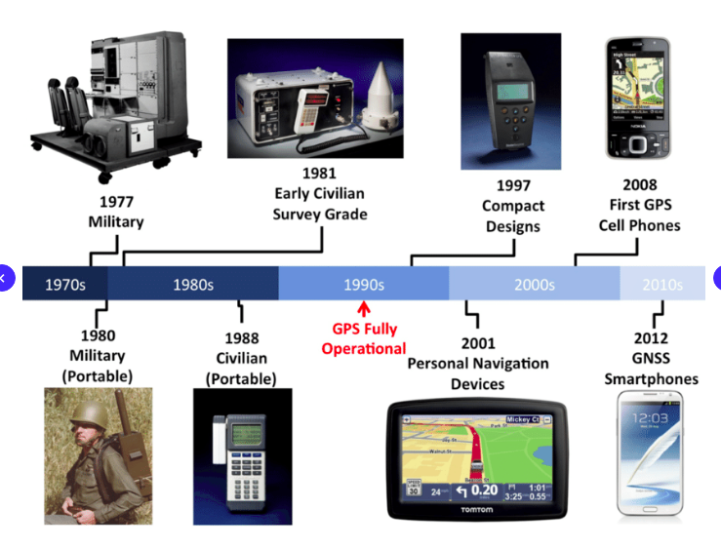
What is GNSS?
Global navigation satellite system (GNSS) is a general term describing any satellite constellation that provides positioning, navigation, and timing (PNT) services on a global or regional basis.

Slide 3
Motivation
GNSS receiver as an open source software defined radio gives us the ability to modify and use freely. Vs. using an ASIC receiver, where one may not be able to make changes/modifications (Garmin receiver, GPS cell phone apps).
Our playground is outside with many transmitting satellite vehicles in the sky transmitting at a low power, known codes.
We have an FPGA sitting on our radio that can help with processing! Lets put it to work!

Slide 4
Purpose of Project
Show how the PL can assist a software defined radio in a real time application. This, by having the PL do the heavy lifting.

Slide 5
What heavy lifting?
From our time in the WES program we have seen some of the computational demands of many DSP algorithms and operations.
In GNSS many are used like FFT, IFFT, complex multiplication and resampling. In real time these can quickly become a bottle neck.
In a CPU only SDR we need to DMA the baseband data over to the embedded processor then do our despreading of the data. Although possible to do, one may need to reduce sampling rates or look for an external CPU to do the processing and only use the SDR to receive the baseband signal samples then off load them via ethernet to another host machine. In this case the TCP port can become a bottle neck as well.

Slide 6
Solution
Do all the processing on the SDR itself my taking advantage of the PL on board by injecting the ADC samples directly to our hardware accelerators. Meanwhile, having the PS be the manager of our application. (i.e. no baseband data makes its way to the PS)

Slide 7
High Level Process of application
Samples to baseband (Front End)
Signal acquitsition (Determine if satellite is in sky)
Signal tracking (track evolution of synchronization parameters)
Demodulate the navigation message, message for knowing where sats. are. (result of tracking)
Observables, basis for PVT solution.(Position, Velo., Timing)

Slide 8
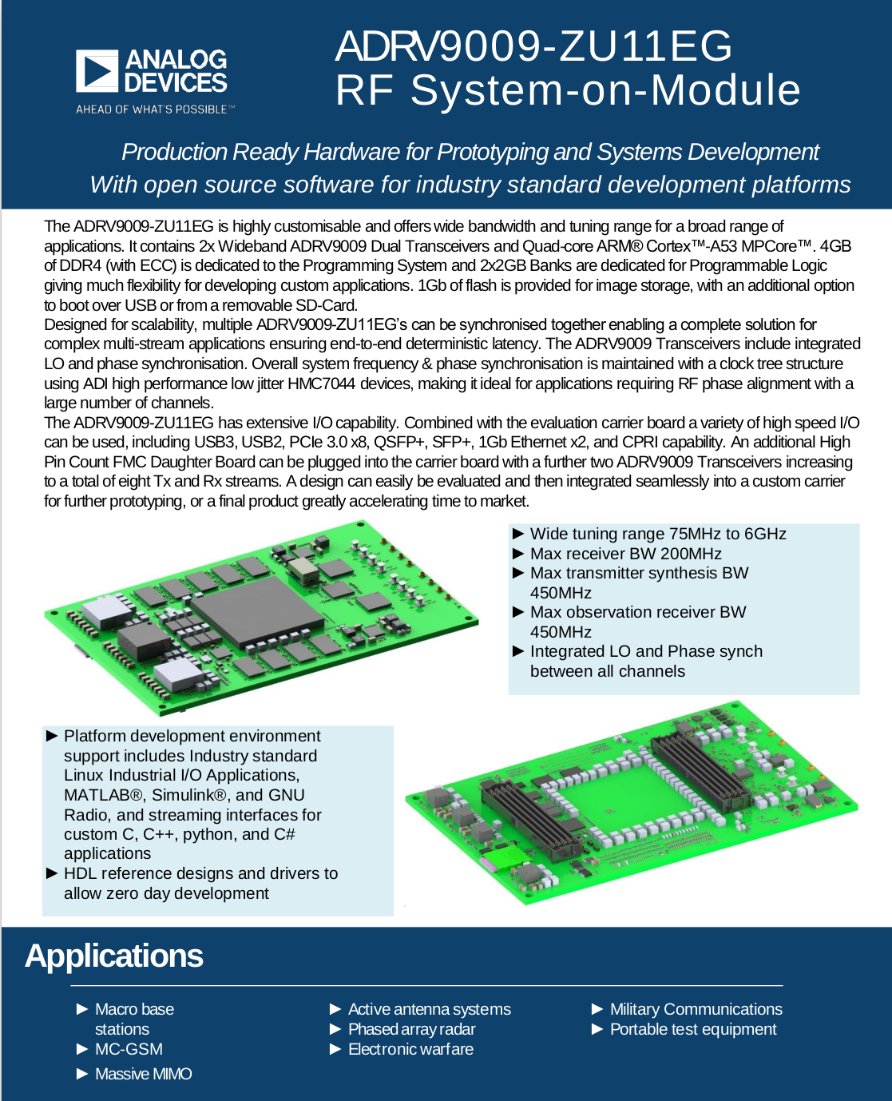
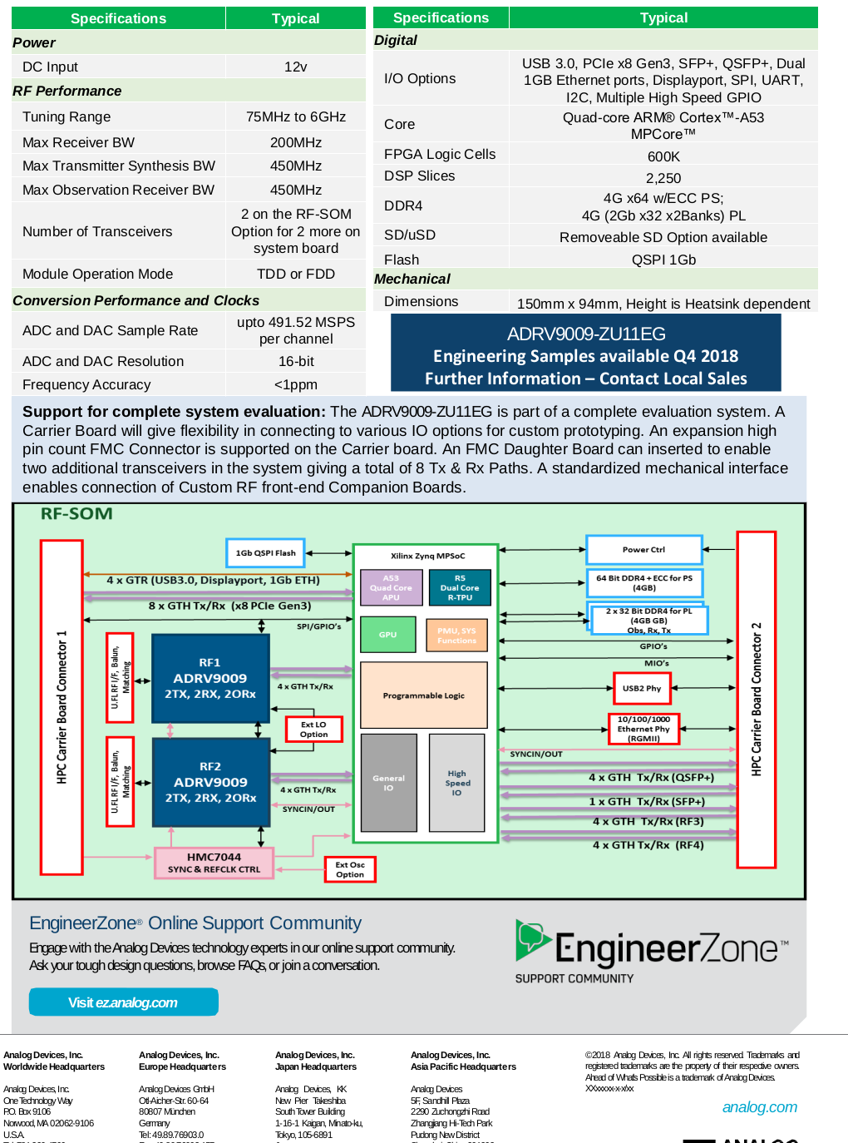
Targeted Hardware

Slide 9
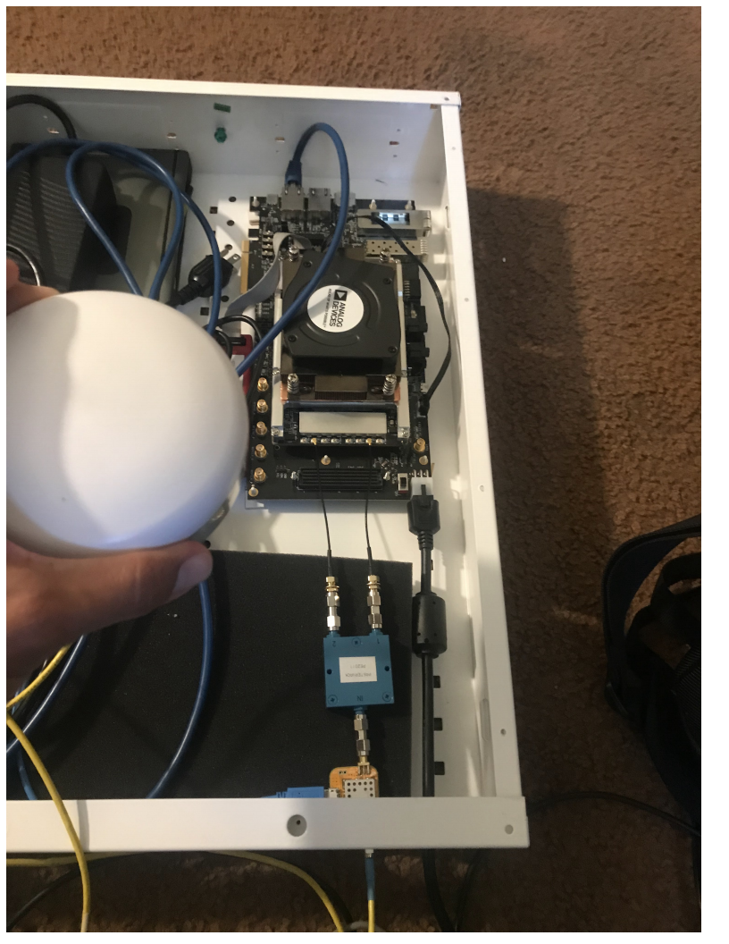
RF front end
Broadband Active Antenna
Bias Tee
Power splitter
Two Adrv9009 ADCs (tuned indep.)
ref clock of 122.88MHz with <1 ppm
AGC

Slide 10
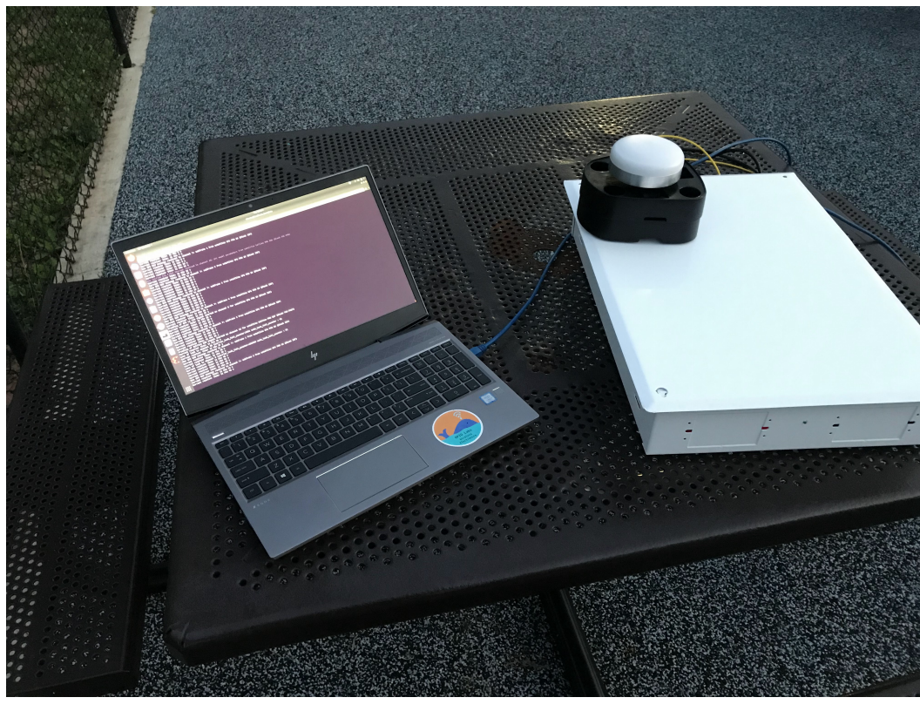
Receiver in the field

Slide 11
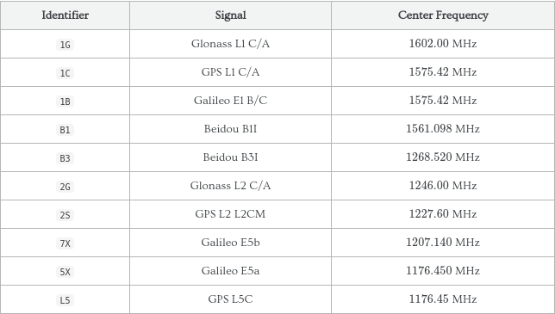
Possible Frequencies

Slide 12
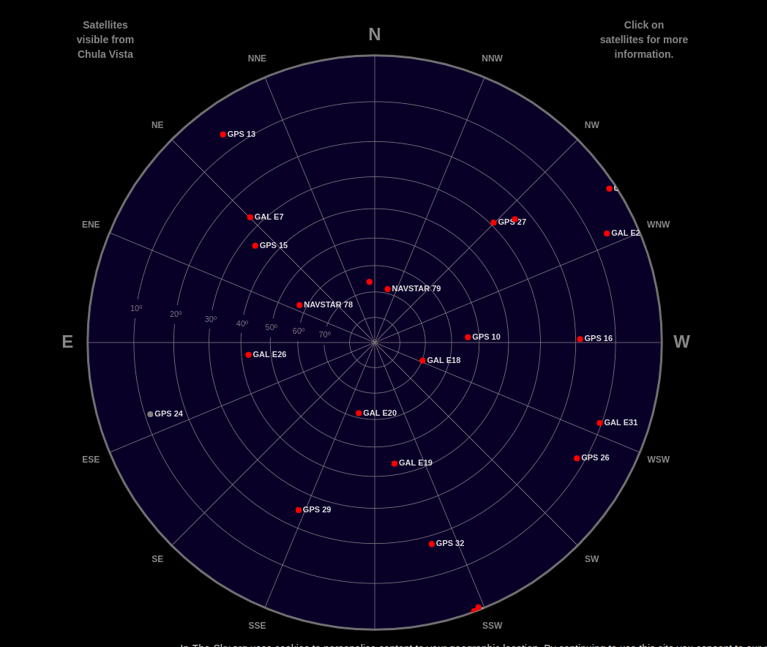
Satellites in our sky
We have a lot of traffic in space. The L1 and L5 satellites transmit at very low power ~-160dbW.
In-the-sky.org a website to see satellites
currently overhead.

Slide 13
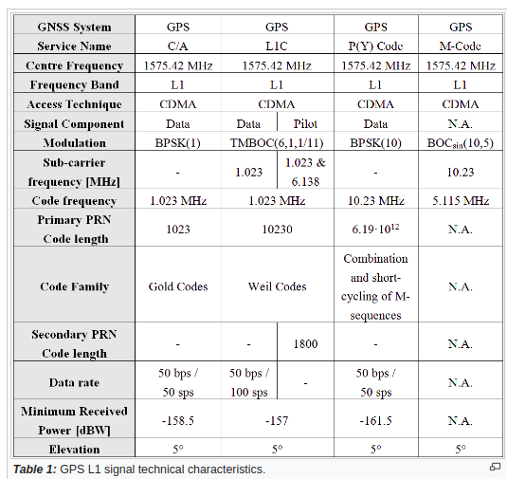
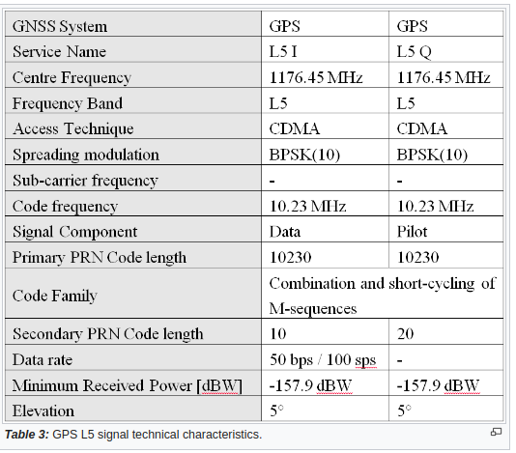
GPS L1 and L5

Slide 14
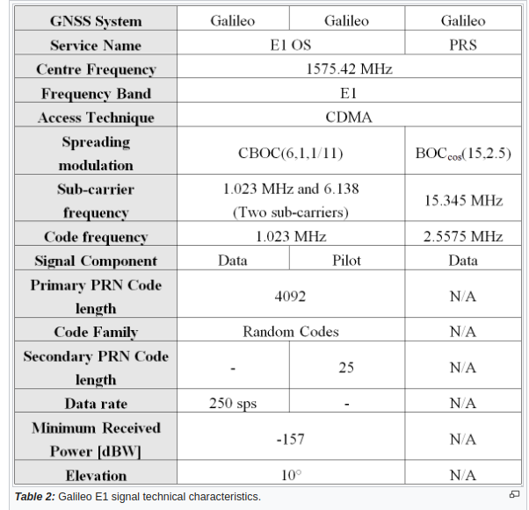
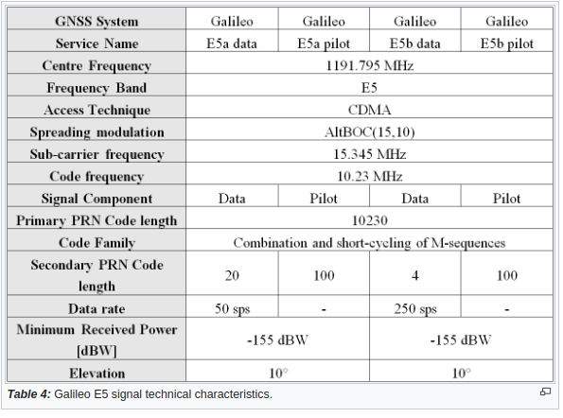
Galileo E1B + E5a

Slide 15
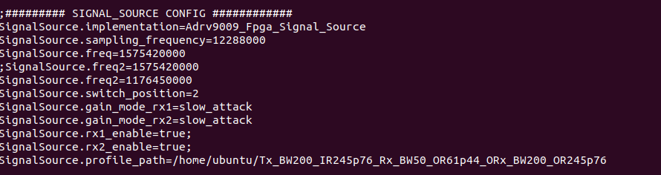
Configuring the Front End
Configuration is done in SW via config files. Thanks to ADI’s libiio
https://github.com/analogdeviceinc/libiio

Slide 16

Front End Block Diagram

Slide 17
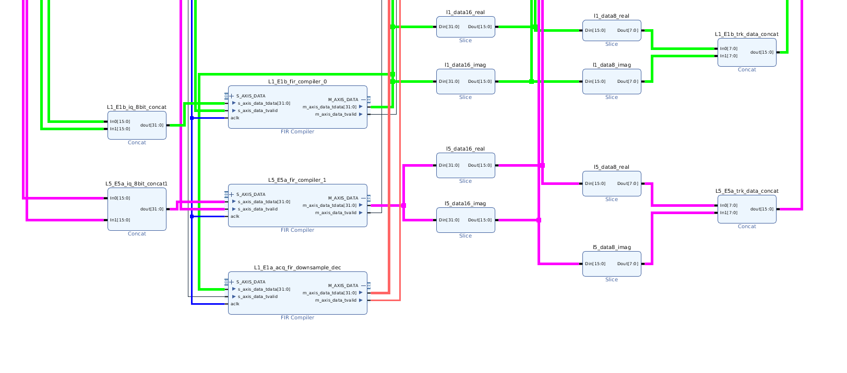
Front end data path

Slide 18
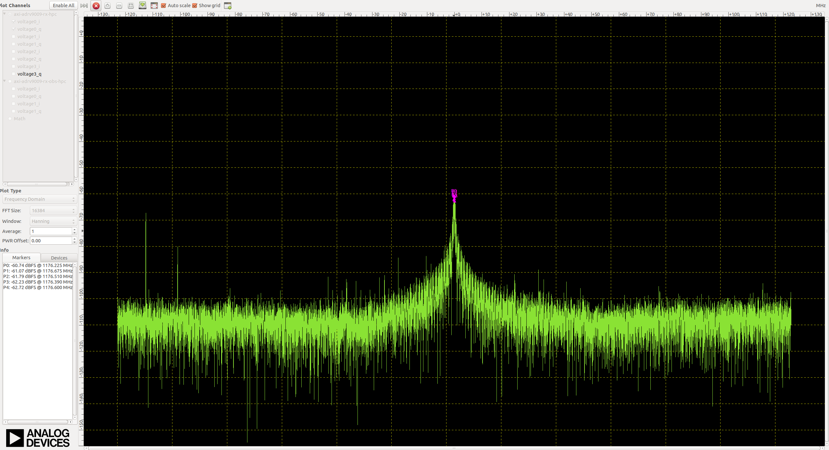
Frequency Domain Plot of GPS L1 BB signal siggen

Slide 19
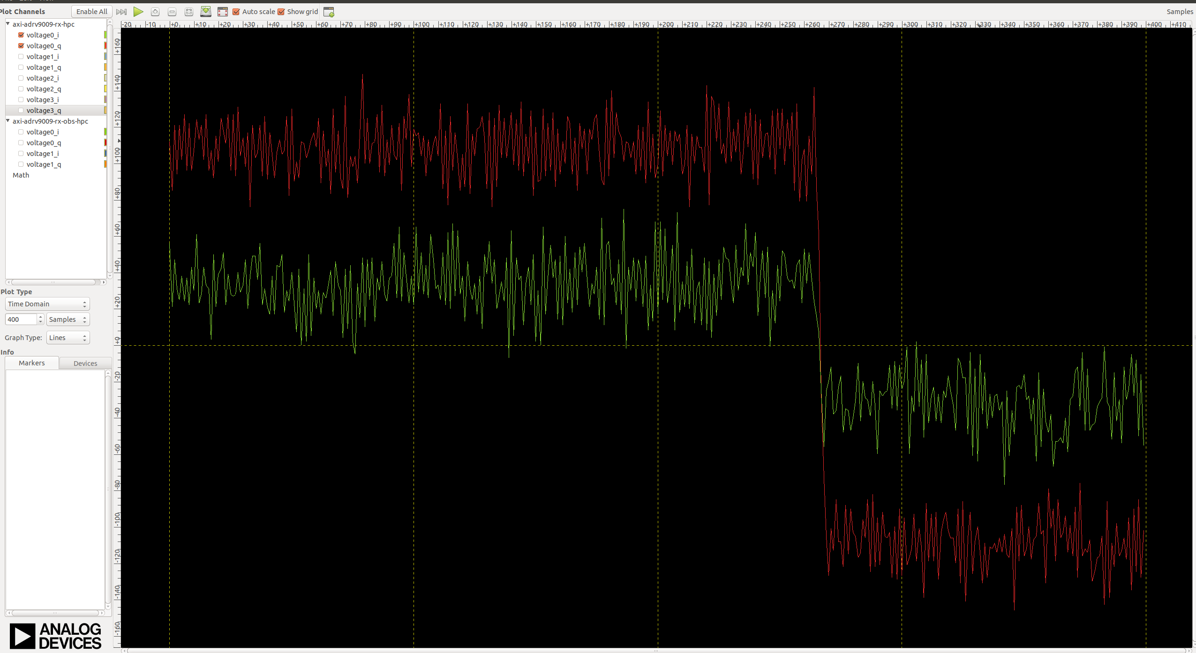
Time Domain Plot of GPS L1 BB signal siggen

Slide 20
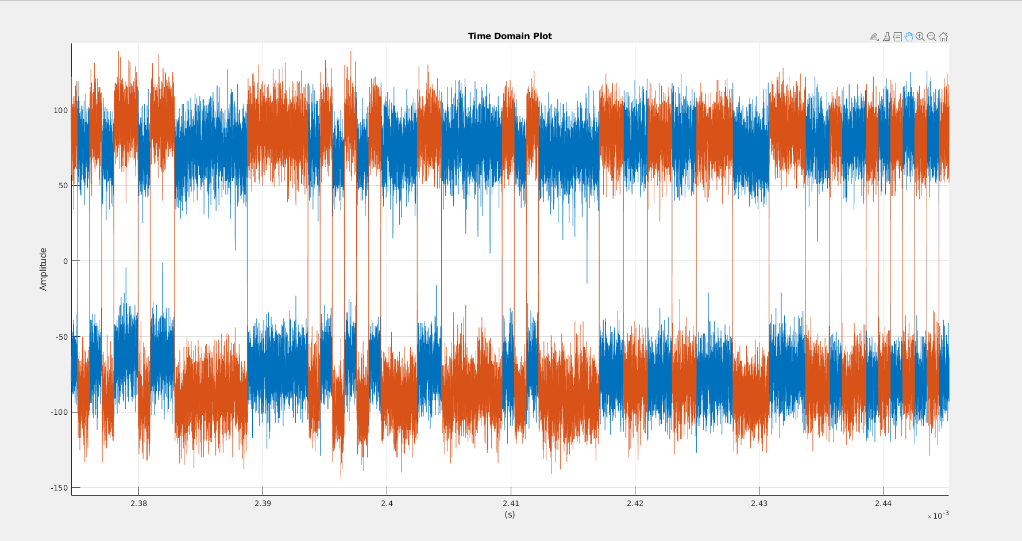
Time Domain Plot, siggen

Slide 21
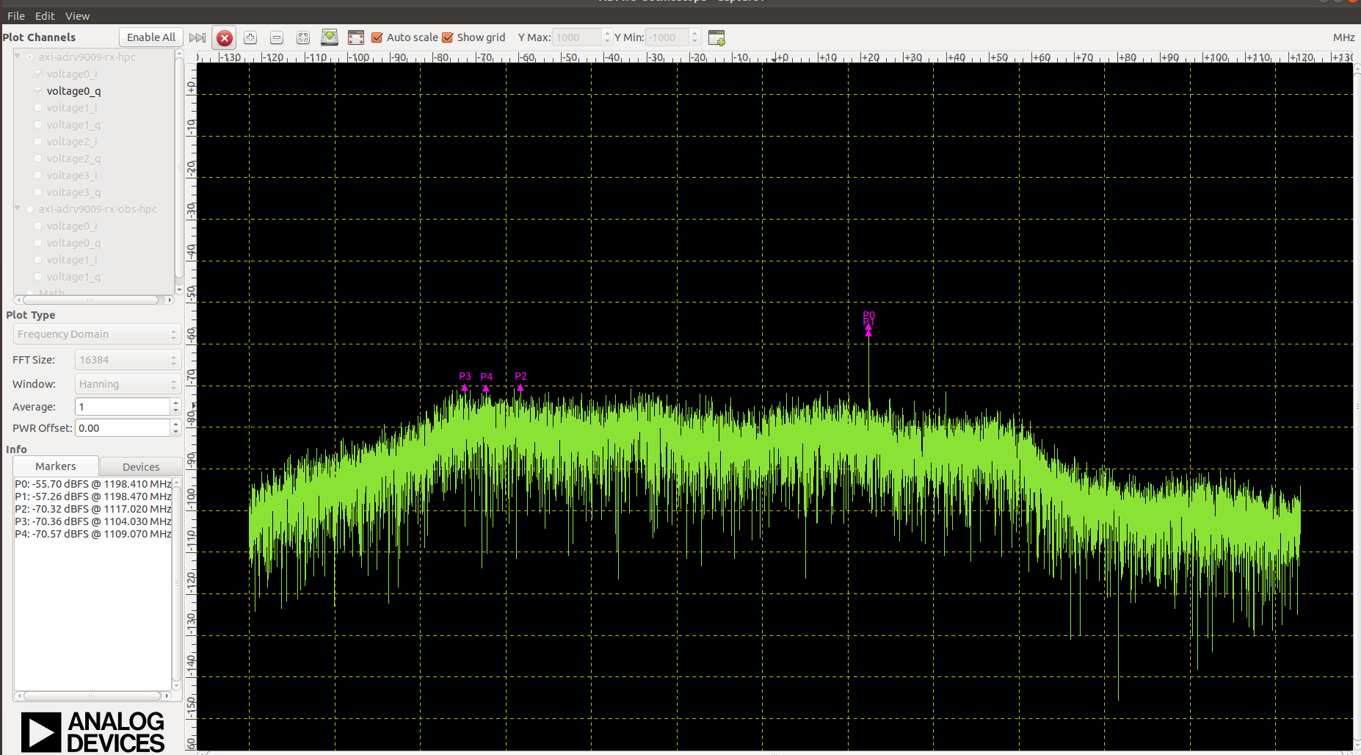
L1/E1b livesky

Slide 22
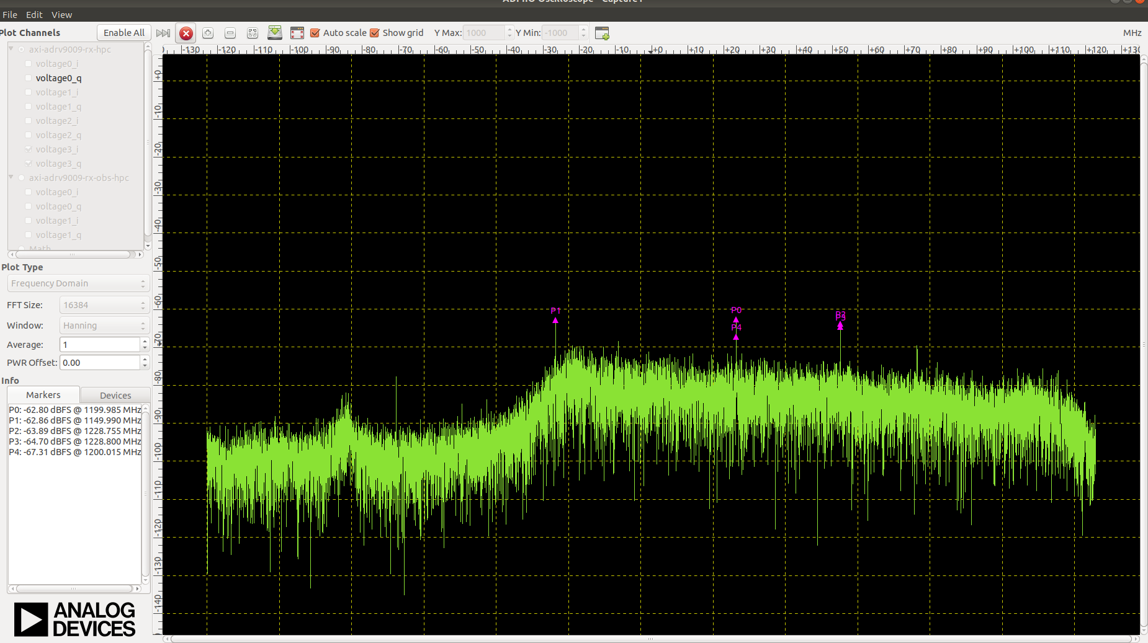
L5/E5a Frequency Domain Plot

Slide 23
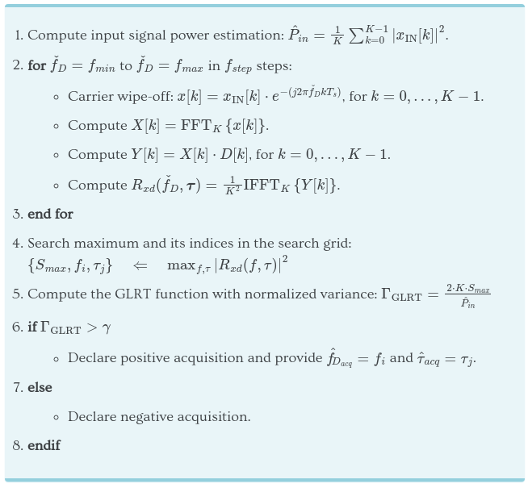
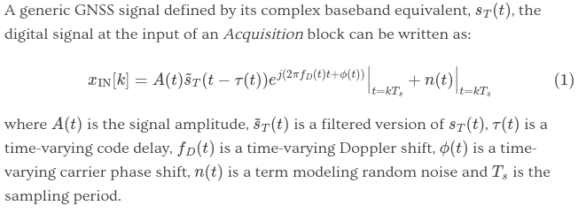
Acquisition
Problem of detection theory

Slide 24
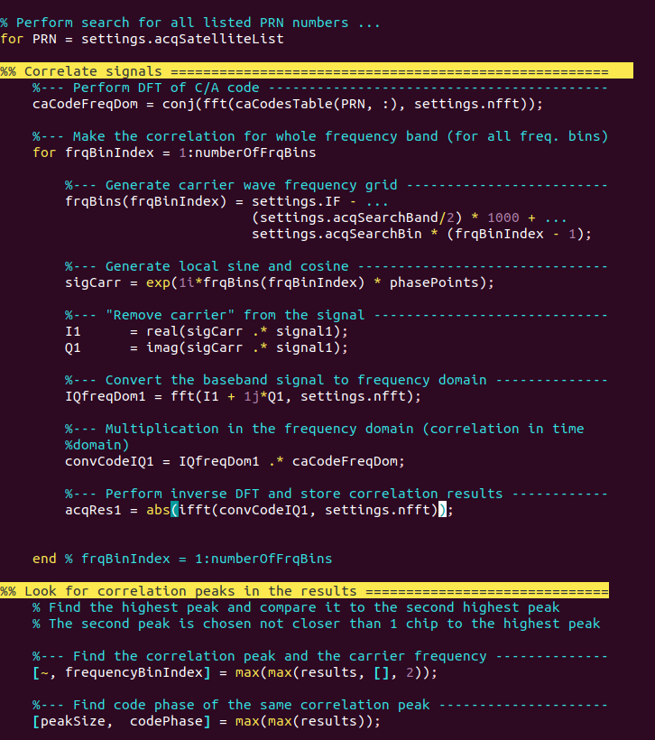
Matlab acquisition implementation

Slide 25
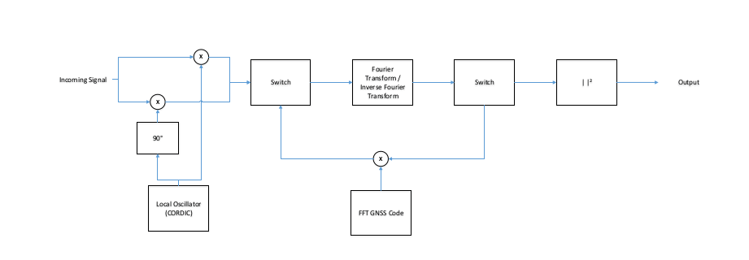
Acquisition

Slide 26
Acquisition in HW
Ideally the length of the FFT should be one code length exactly. But this would result in an FFT whose length is not a power of two. if we had IPs in the FPGA that perform fast DFTs whose length is not a power of two then we would not need to do any zero padding. The inverse FFT would result into the circular convolution of the two PRN codes (the received code and the local code) and we could directly search for the peak value and that would be all.
But when we do zero padding what we are doing is a circular convolution of the received signal with zero padding and the local code with zero padding. If the length of the FFT is not properly extended the zero padding distorts the results and the results are wrong.
A way to obtain the convolution of one code period of the received signal with one code period of the local code in a similar way as the circular convolution is the following:
capture two code lengths of one signal (signal A) and zero-extend this signal up to the length of the FFT.
capture one code length of the second signal (signal B) and zero-extend this signal up to the length of the FFT.
perform the FFTs, multiply the FFTs and perform the inverse FFT.
The results of the inverse FFT contain the circular convolution of two code lengths of signal A with zero padding and one code length of signal B with zero padding. But part of the output samples contain the convolution of one code length of signal A and one codelength of signal B, which is what we are looking for. Then we have to search the peak value of this particular fraction of the results of the inverse FFT.
You can use two code lengths of the local code and one code length of the received signal or the other way around. But the important thing is that you search for the peak value on the right samples in the output of the inverse FFT.

Slide 27
Acquisition in HW
Using Xilinx’ runtime configurable FFT because FFT sizes vary depending on constellation and frequency band.
L1 GPS 4K FFT at 2.048MHz, code period of 1ms thus 488 Hz Freq resolution
E1B Galileo 16K FFT at 2.048MHz, code period of 4ms thus 125Hz resolution
E5a and L5C 32KFFT at 12.288MHz, code period of 1ms thus 375Hz resolution.

Slide 28
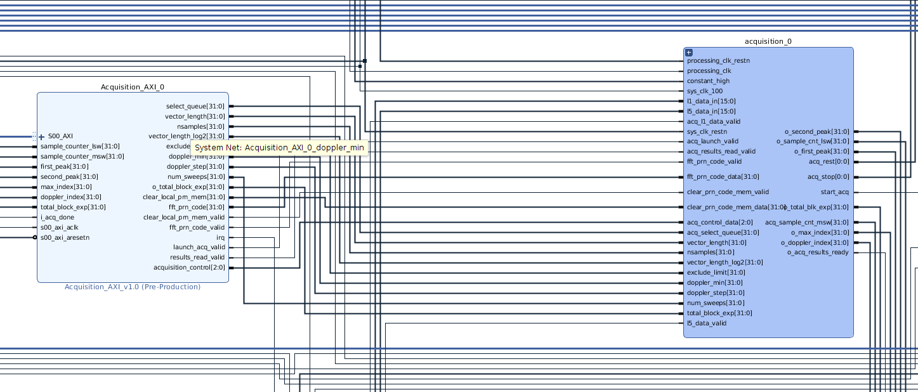
Acquisition in HW

Slide 29
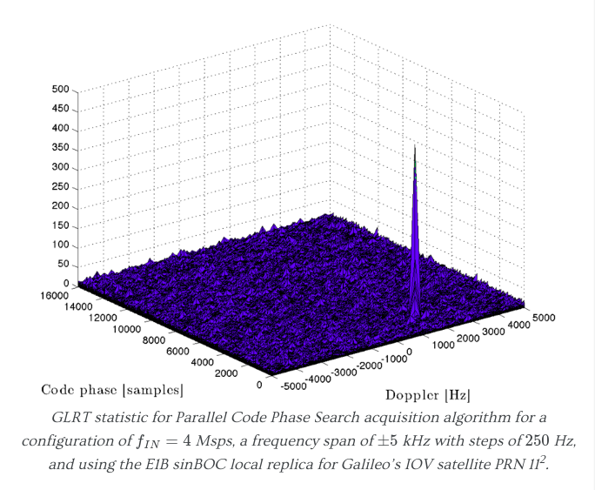
Acqusition 2D surface plot

Slide 30
Tracking
Problem of estimation theory
Frequency shift the baseband signal to the estimated frequency handed down from acquisition step.
Begin to correlate the frequency shifted baseband signal at correct sample (i.e. the time delay estimated in acquisition)
Correlation consists of integrating and dumping the resampled ca code with the baseband signal.

Slide 31
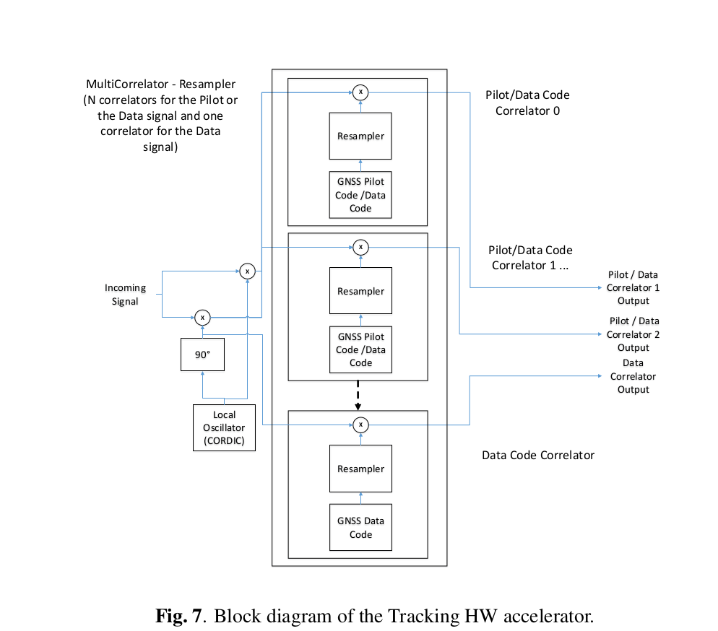
Block diagram Tracking HW

Slide 32
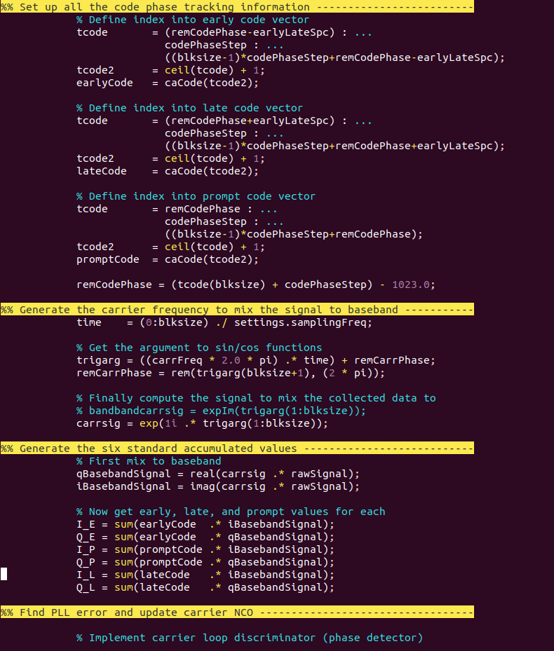
Tracking Matlab implementation

Slide 33
Tracking in HW
To begin tracking we need to begin correlating at the estimated code phase from acquisition. This is possible by having each correlator contain its own sample counter that counts all the valid signals that have occurred since the receiver was launched (i.e. the first acquisition attempt). This sample count is written to memory and is able to be read by the PS when necessary.
Each correlator has a 64KB fifo that is used to exert back pressure to the adc data. This allows samples to be processed in parallel and also allows the PS, after each code length of samples processed to.
1. read results
2. compute floating point computations of the pll and dll and determine if a lock exists or if we have loss lock of tracking.
3. Reconfigure the correlator for the next code length samples.
This is possible because we have a 1.3GHz CPU frequency and also are processing in the PL with a fabric clock rate of 200MHz (187.7 MHz actual) and our sampling rate is decimated to 12.288msps. For tracking it is important that not a single sample is dropped.

Slide 34
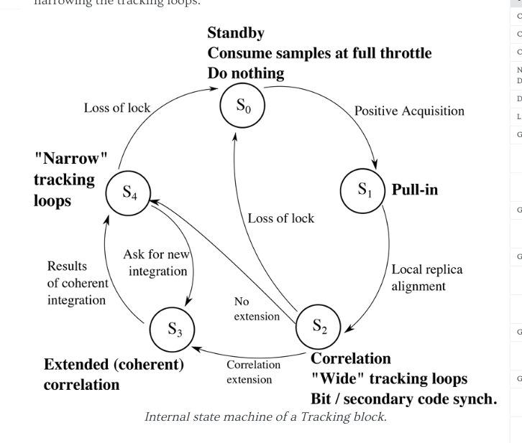
Tracking States in SW (manager)

Slide 35
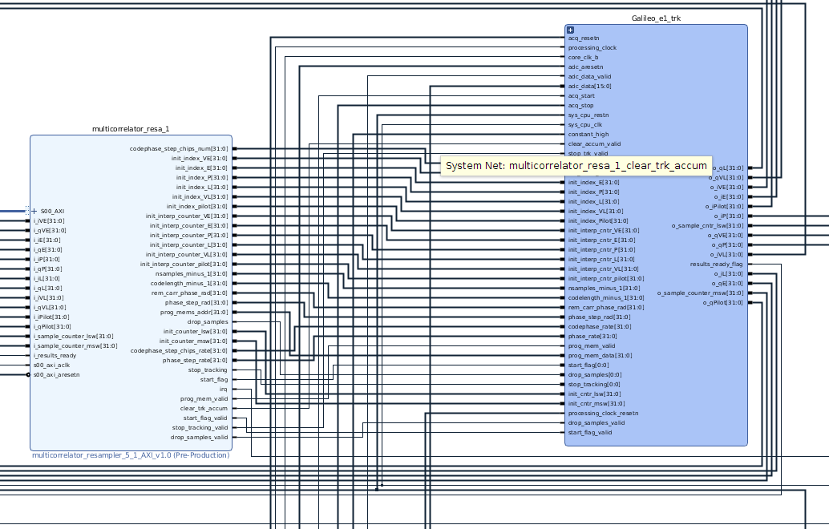
Galileo E1b correlator in HW

Slide 36
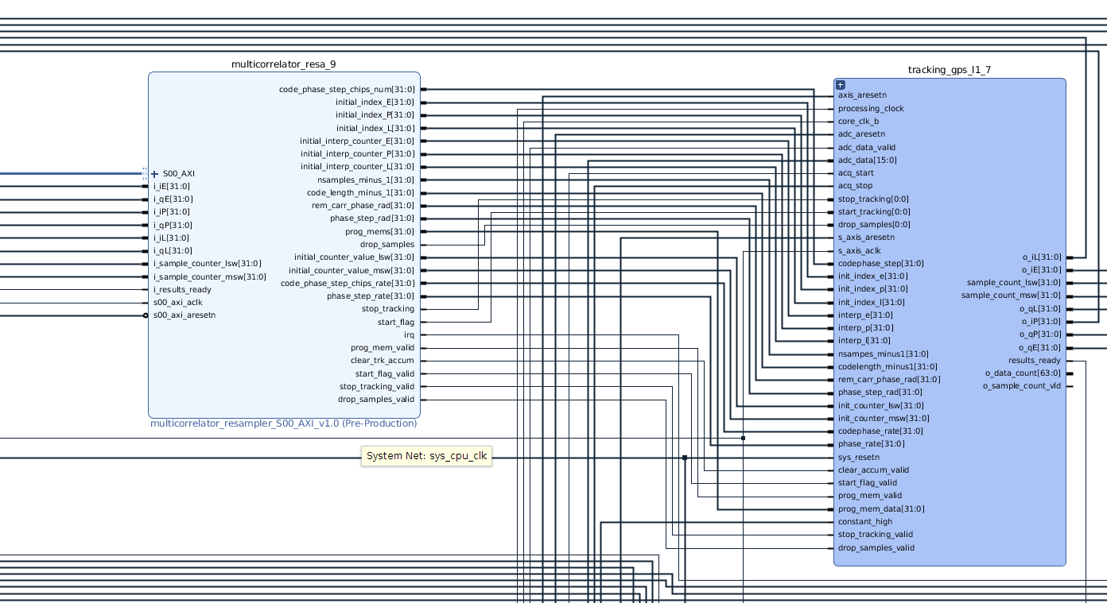
GPS L1 correlator in HW

Slide 37
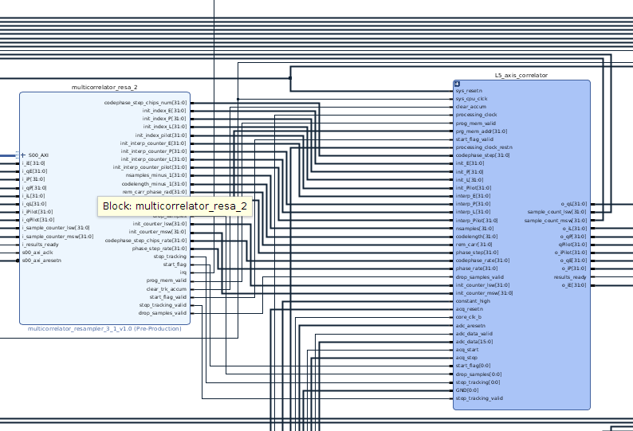
L5 and E5a correlator in HW

Slide 38
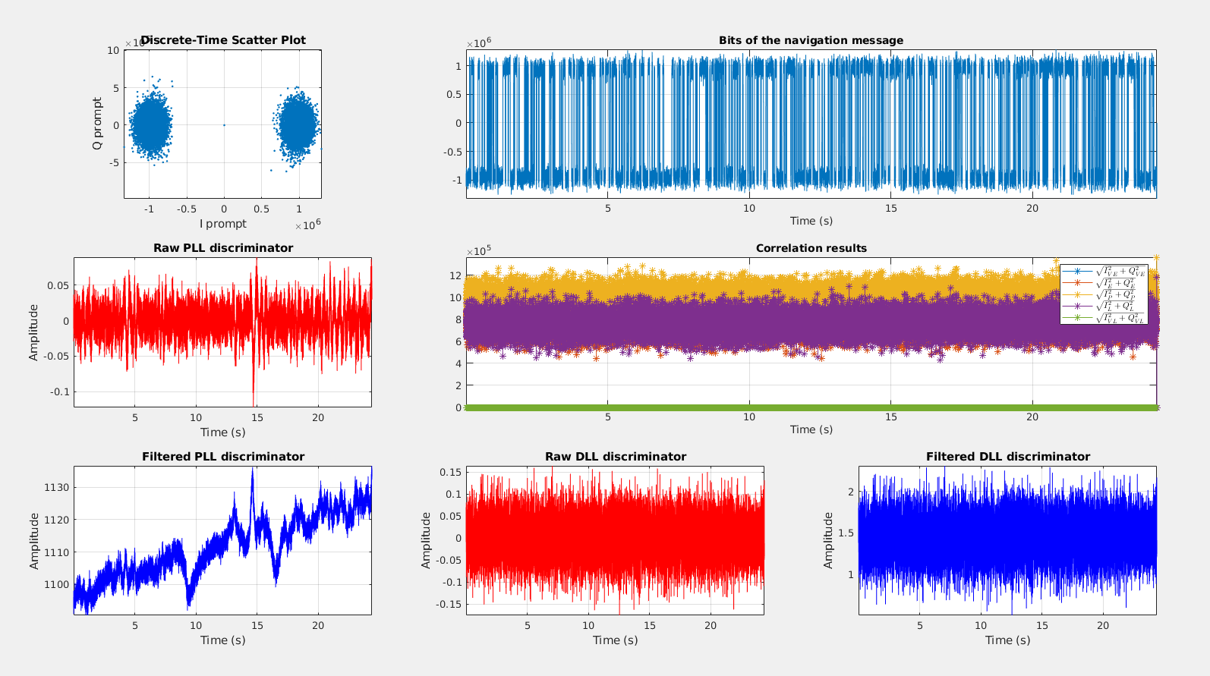
GPS livesky Tracking Results

Slide 39
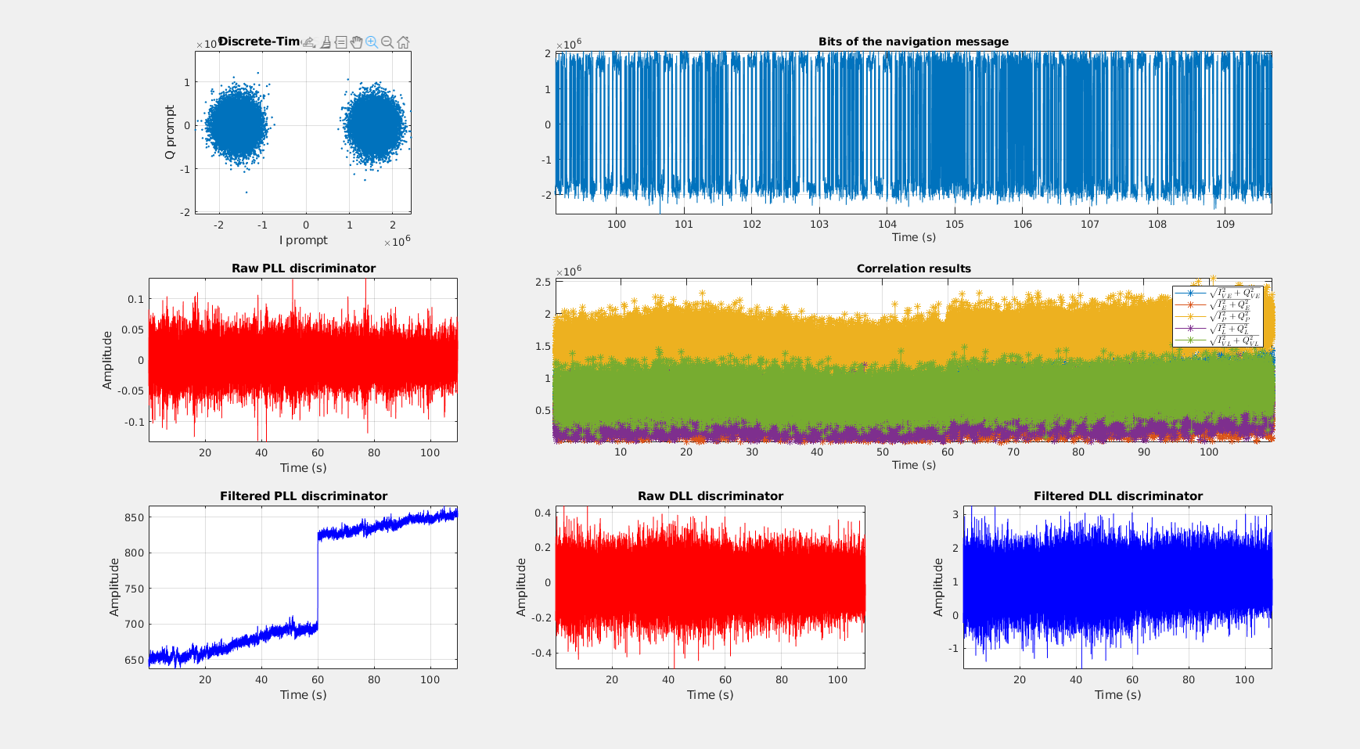
Galileo E1b Tracking Results, Livesky

Slide 40
Navigation
Demodulate the Navigation message
Ephemeris (describe the orbits)
This is done in Software

Slide 41
Issues
With a total of 24 correlators in the HW, one acquisition block, and one sample counter that all are generating interrupts when our receiver is running we have the potential of overflowing the PS with interrupts.
Each correlator alone generates 1 interrupt per ms. That is 1,000 interrupts per second.
Our sample counter generates an interrupt after every 20ms, That is 50 interrupts per second.
Whenever a channel is idle its attempting acquisition! Thus the acquisition is very busy and sending interrupts to the PS after each acquisition attempt.
Application also has ability to share data via TCP/UDP for monitoring and position plotting, seems so be a bottle neck right now.
PVT computations are computationally intensive in the CPU.

Slide 42
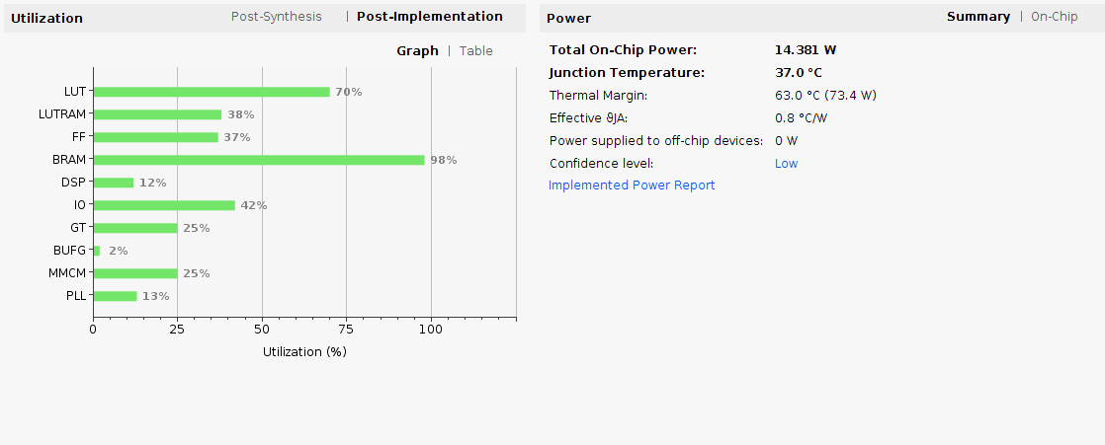
Utilization report

Slide 43
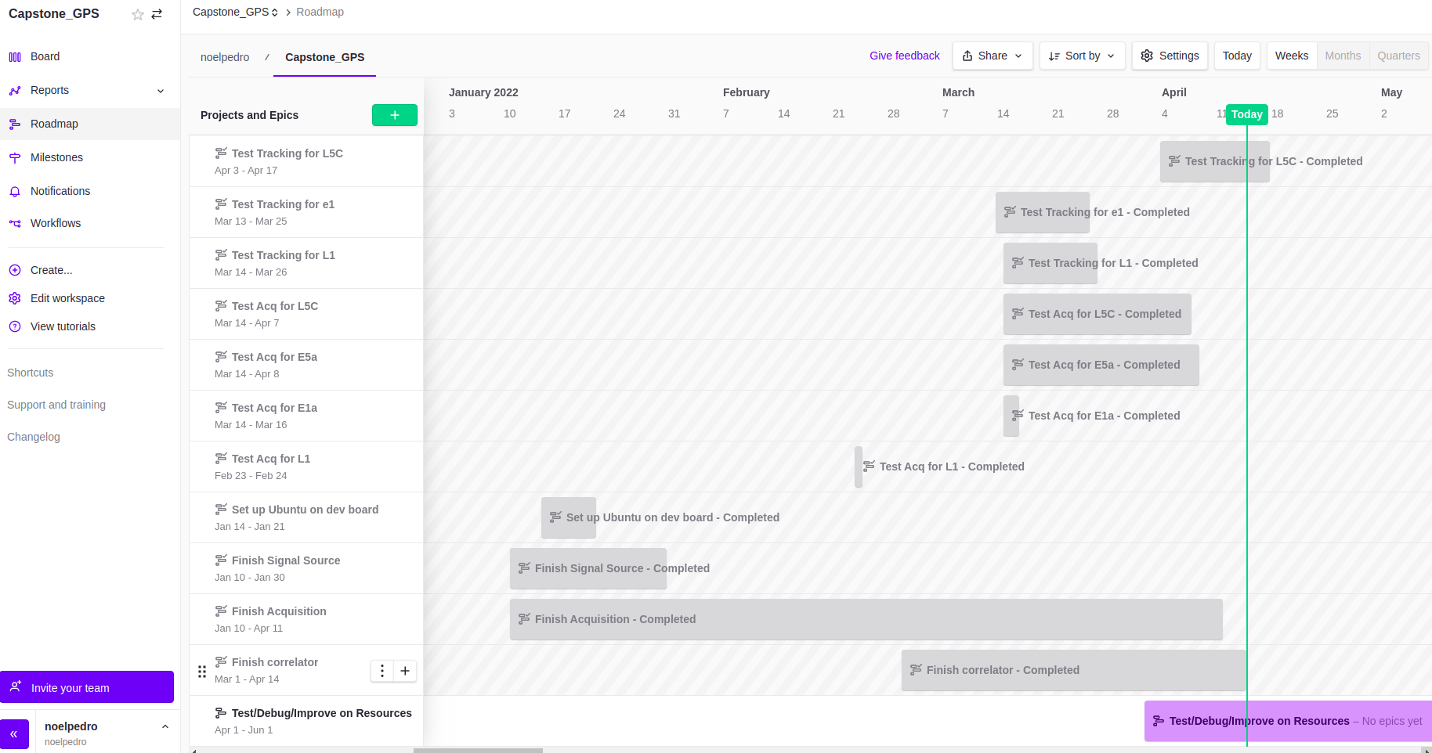
Roadmap via Zen Hub

Slide 44
Next two weeks
Explore L2 GPS signal. Can only be combined with L1 because of conflicting sampling rates with L5.
Try to save some block ram by reducing number of correlators of GPS L1 from 8 down to 6. Also the same for the other bands and constellations.
Have some plots for navigation like I did for Tracking.

