Slide 1
GNSS Multiband Receiver
Noel Martinez
WES 04/29/2021

Slide 2
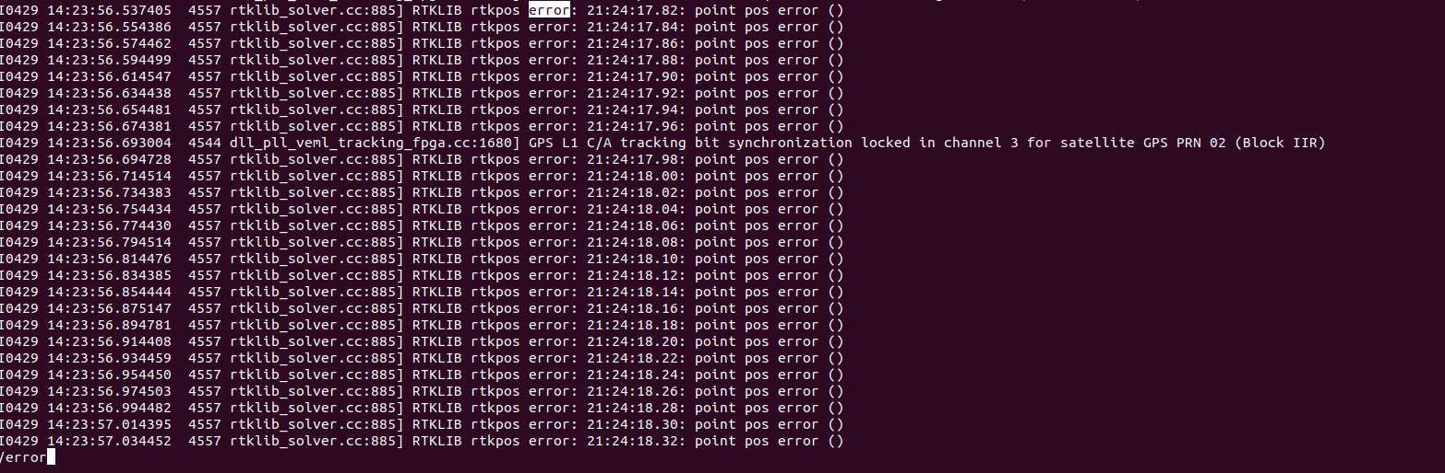
Last two weeks
I was having difficulty getting position fix. Being one of the more important tasks for demo purposes I shifted most of my attention to that.
I fixed the issue earlier this week, turns out the Hardware sample counter was sending interrupt to soon to the PS causing the RX clock to diverge from the sample counts of the individual satellites.

Slide 3
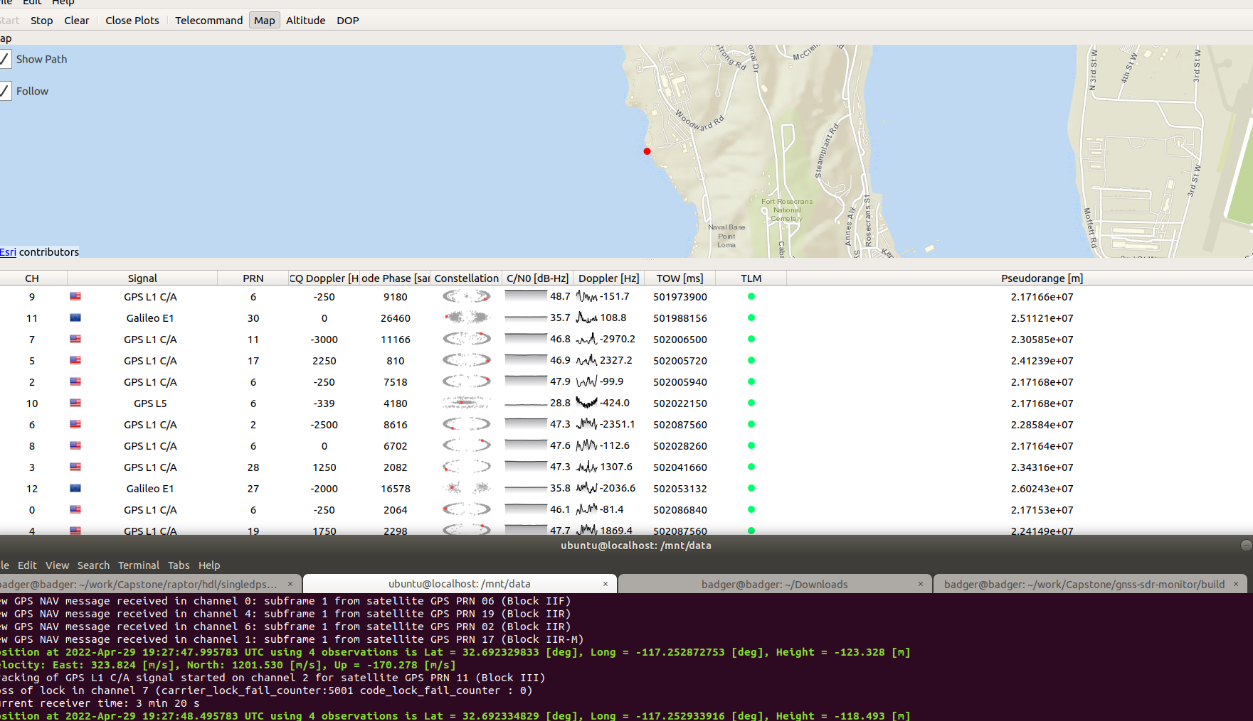
Current State
Displaying Position on Map.
Having Most success acquiring and tracking for L1 and E1B.
L5 is still weak (only one tracked on this picture)

Slide 4
Issues
Still Struggling with the L5 Signal only acquiring one vehicle at a time. Sometimes two.
Receiver is fixed at 491 msps with rf bandwidth of 200 Mhz
Because of such wide bandwidth I’m allowing too much interference in my signal?
Show you Live frequency Domain Plots.
Position at times is not accurate.

Slide 5
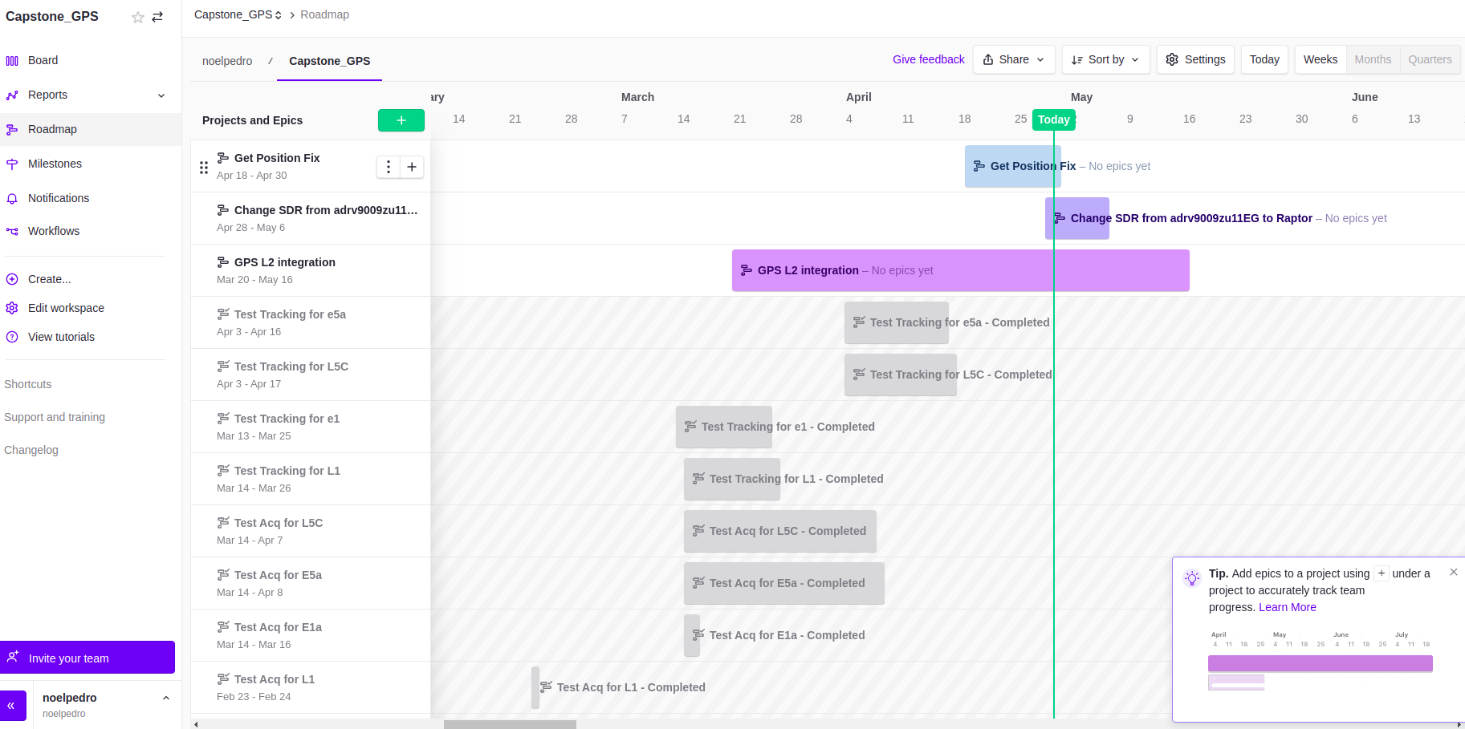
RoadMap

