Slide 1
Multiband GNSS receiver
Noel Martinez 05/14/2022

Slide 2
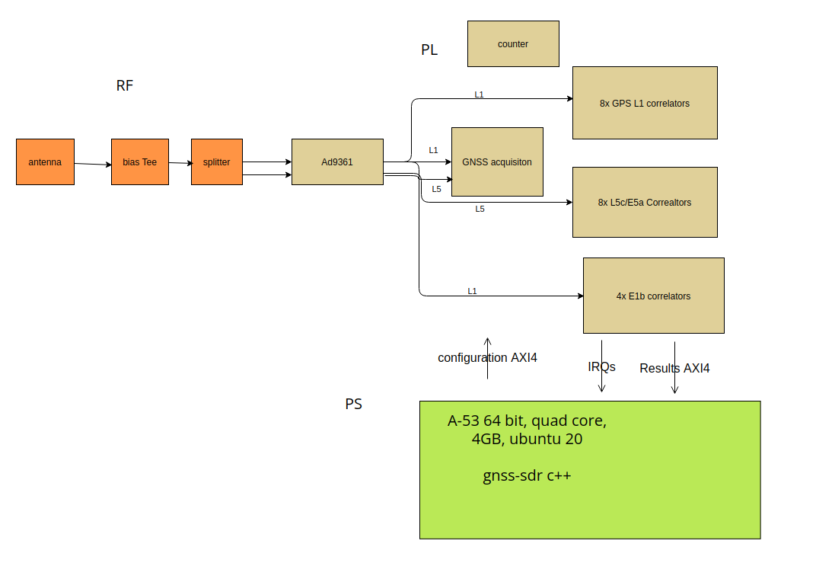
Block Diagram

Slide 3
Updates
Able to get position fix with GPS L1, GPS L1 + Galileo E1a and plot on map. (Demo)
Needed to use the adrv9009zu11eg for work, thus changed SDRs.

Slide 4
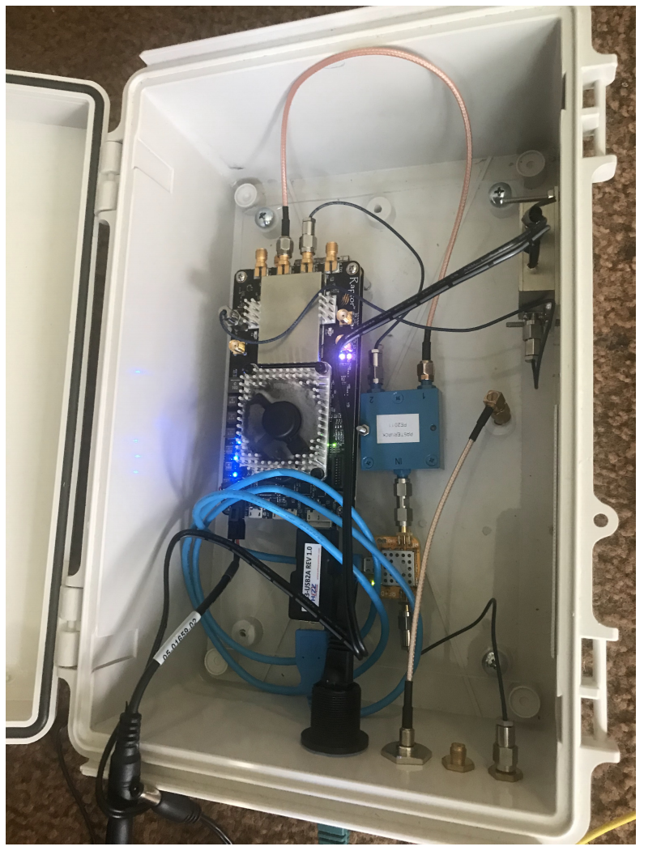
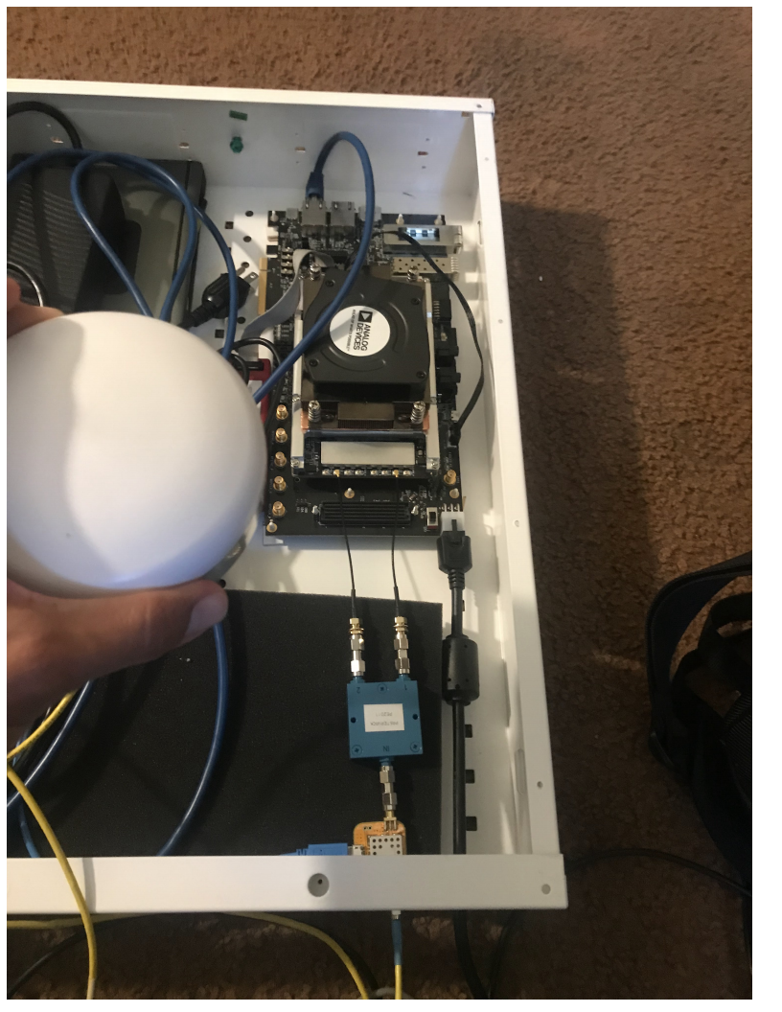
New Device
Decided to change devices from adrv9009zu11EG to ad9361zu9EG.

Slide 5

Benefits
Smaller form factor easier to test outdoors.
Less power consumption 16W vs 30W+
Sampling rate can be configured on the fly (currently receiver works on the fly for 12.288msps and 24.756msps. As long as sampling rate is suitable for the factor of 6 downsample at acquisition for L1 and E1b/c it will work.
Makes use of ext 10MHz ref clock for a more stable LO in tracking of GPS L1 when receiver is static this helps on giving us the ability to extend length of correlation symbols from 1ms to up to 20ms without losing lock (wasn’t able to do this on adv9009zu11eg had to stick to 1ms).
IP blocks and arm64 c++ code easily migrated over.

Slide 6
Caveats
Only one LO for both channels
Need RF mixer + LNA to get second channel to shift over (going to experiment with this)

Slide 7
Spent Time Debugging L5 signal
Only PRNs in blocks III and IIF transmit the signal thus less vehicles transmitting it.
Baseband Frequency domain plot very flat at DC compared to L1.
There exists data and ca codes that need to correlate the signal during tracking. I believe the data codes are for the imaginary component and the ca codes for the real component.

Slide 8
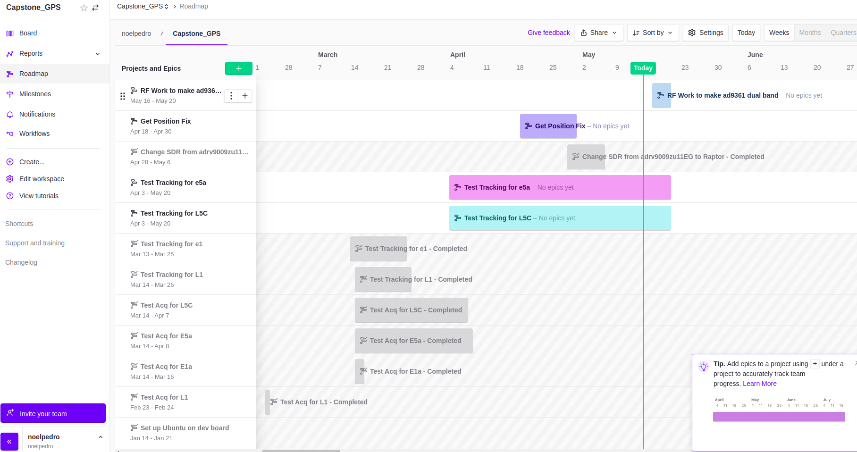
Roadmap

Slide 9
Demo of Galieo E1b only position Fix

