Slide 1
PPP 02/25/2022
Noel Martinez. Last week’s PPP was not saved

Slide 2
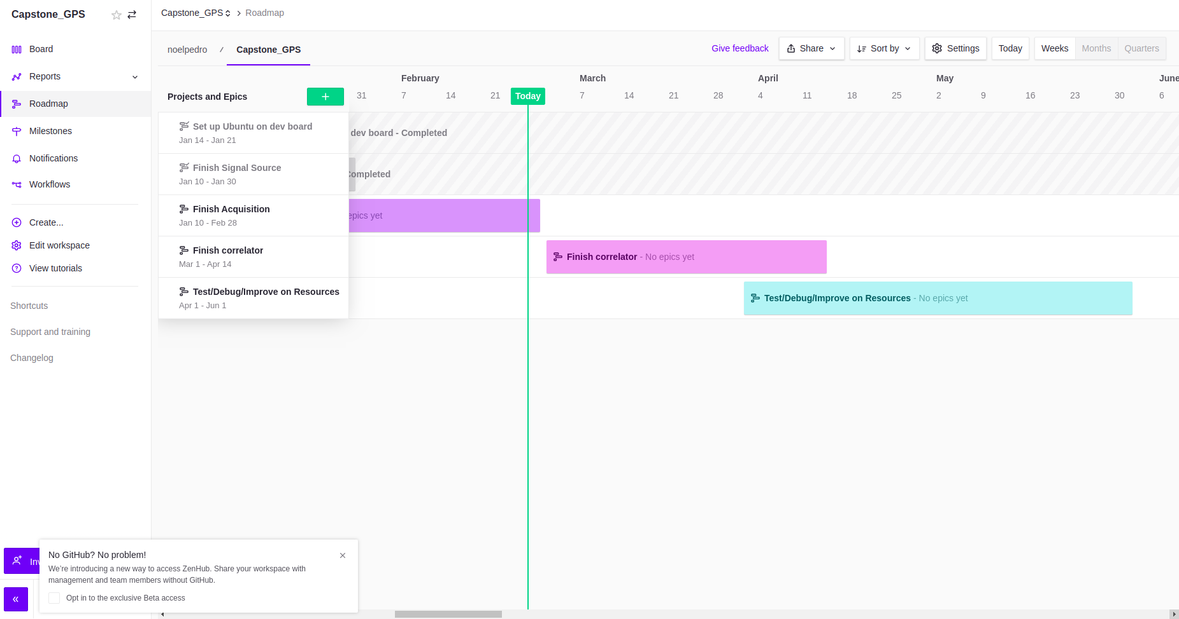
RoadMap

Slide 3
Made changes to the front end
New set up now has sampling rate at 61.44msps.
Began to use ADI’s profile wizard to configure front end. This allowed me to remove one of the two fir decimator that I had in the hardware. Now I only have one FIR decimator that down samples by factor of 30.
Nonetheless, the profile still uses an internal FIR decimator via the jesd204

Slide 4
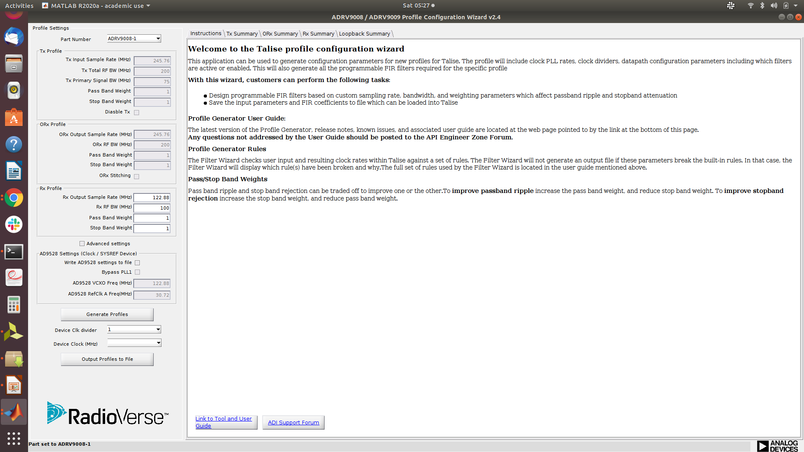
Profile Wizard for ADRV9009
Can only set sampling rates to 245Mhz /2 /4 or /8.
Create profile and copy over to device then $cat it to correct file.

Slide 5
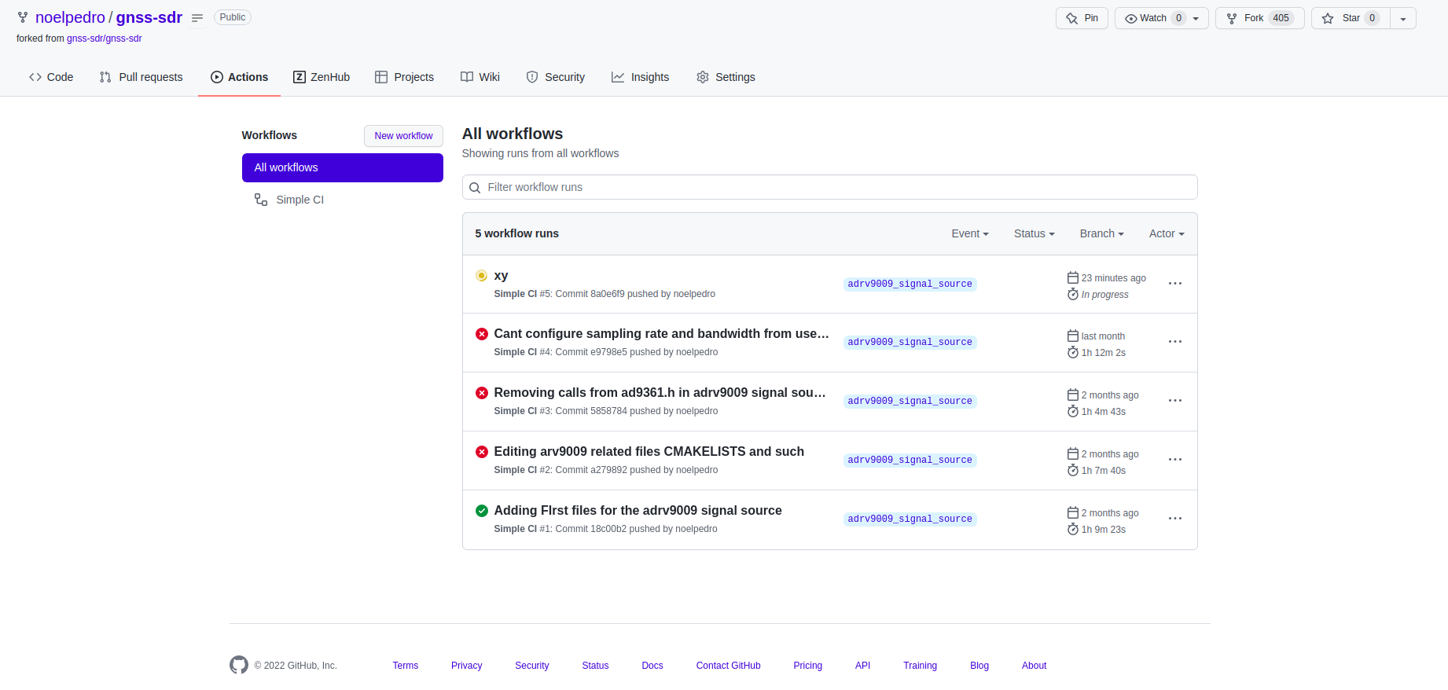
Pushed changes to my fork of gnss-sdr
https://github.com/noelpedro/gnss-sdr/tree/adrv9009_signal_source

Slide 6
Had successful acquisitions for L1 signal
Had success with acquisition with XFFT being run time configurable. Tested with L1 signal generator had most success using the 8 least significant bits of data prior I tried 8 MSB and also [11:4] bits.
Hope to test with real livesky data, L1 and e1 b/c.
Tested L1C with 8K and 4K FFT without having to regenerate bitstream nor power cycle board.

Slide 7
Working With interrupt Controller

Slide 8
Demos uploaded to google drive

Slide 9
Issues
Realized I dont have an L5 antenna.
Found one for $200.
If not purchased, Back up plan use only L1 but also do Galileo e1b/c

