Slide 1
Dual Band GNSS receiver L1 and L5 bands for GPS and Galileo Consetllations. WES Capstone
Noel Martinez

Slide 2
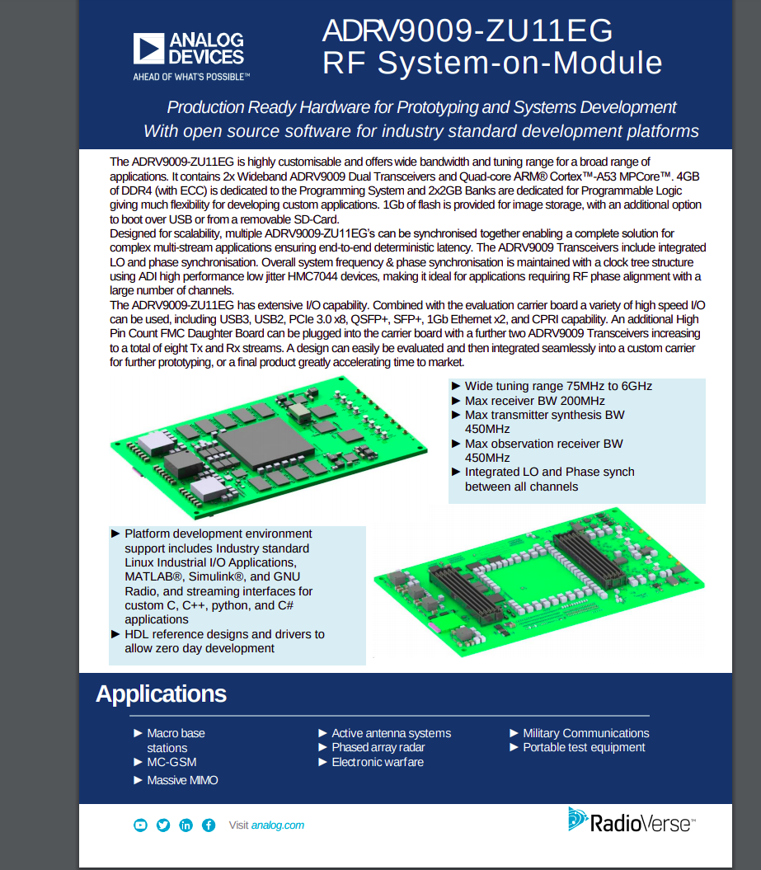
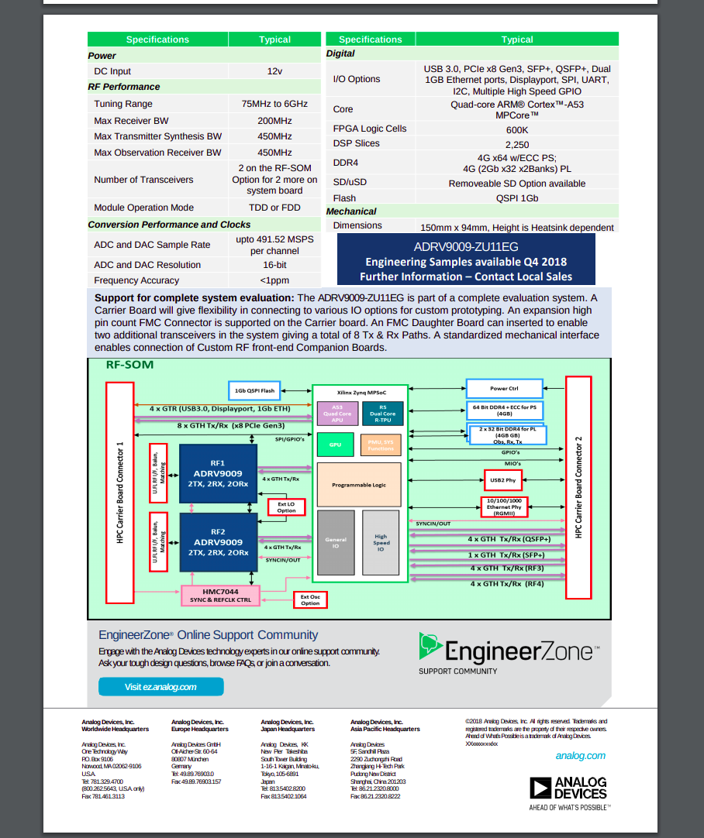
Targeted hardware

Slide 3
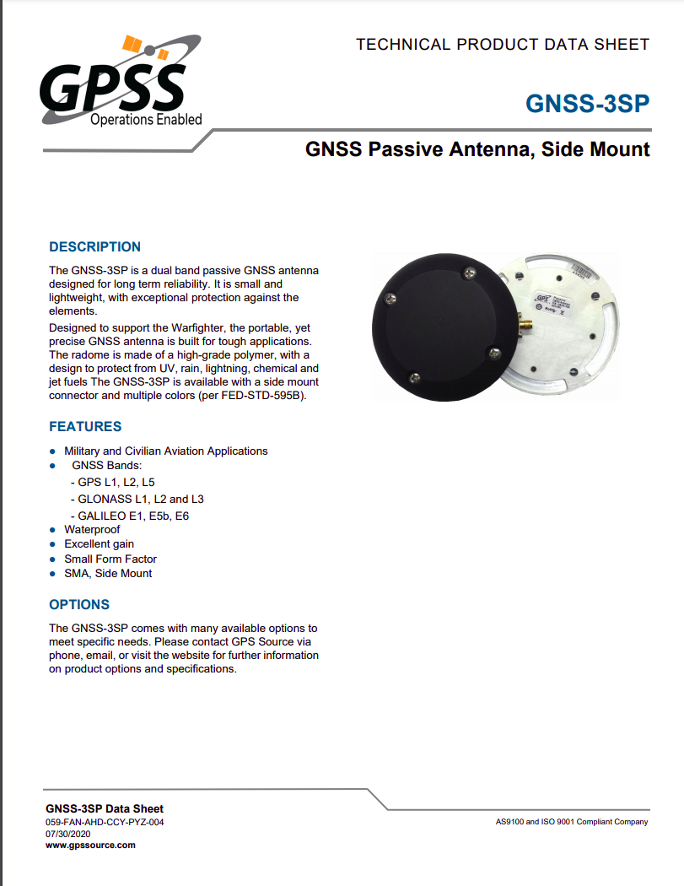
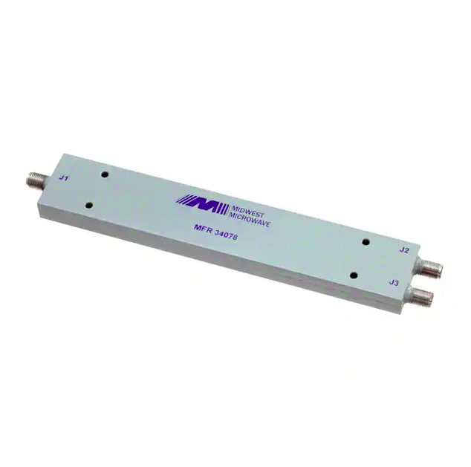
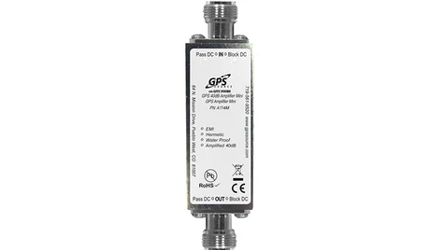

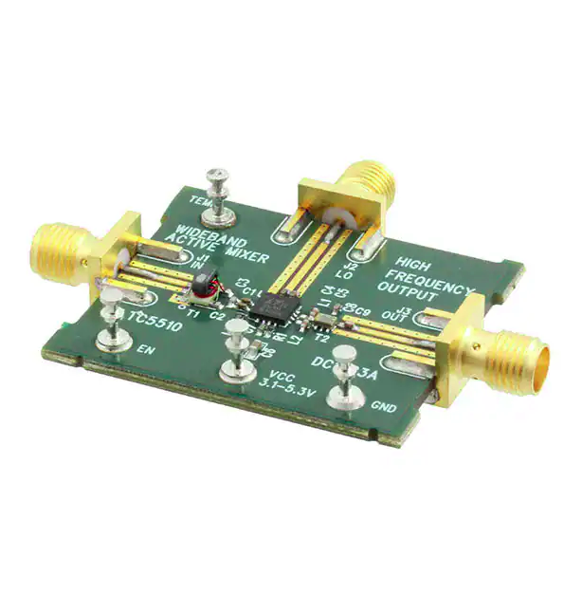
RF equipment

Slide 4
RF Front End Block diagram
Passive Ant.
ADRV9009
ZU11EG
Splitter
-3dB
AMP. 40dB
Bias tee
L1
L5
DC source

Slide 5
Software on ADRV9009ZU11EG
Ubuntu 20.04.1 arm 64 rootfs http://cdimage.ubuntu.com/ubuntu-base/releases/20.04/release/
iio driver via libiio https://github.com/analogdevicesinc/libiio
Gnss-sdr https://github.com/gnss-sdr/gnss-sdr

Slide 6
Software on Host Machine
Xilinx Petalinux 2019.1
Xilinx Vivado 2019.1
ADI meta-adi 2019_R2 release (adrv9009zu11eg Yocto layer for petalinux)
ADI HDL open source hardware files for adrv9009zu11eg 2019_r2 release.
Display gnss-sdr-monitor TCP/UDP Position on and SNR,doppler, pseudoranges monitoring

Slide 7
Development Workflow
Github
JTAG
USB
Development Laptop
Petalinux
Vivado
ADRV9009ZU11EG
Ethernet

Slide 8
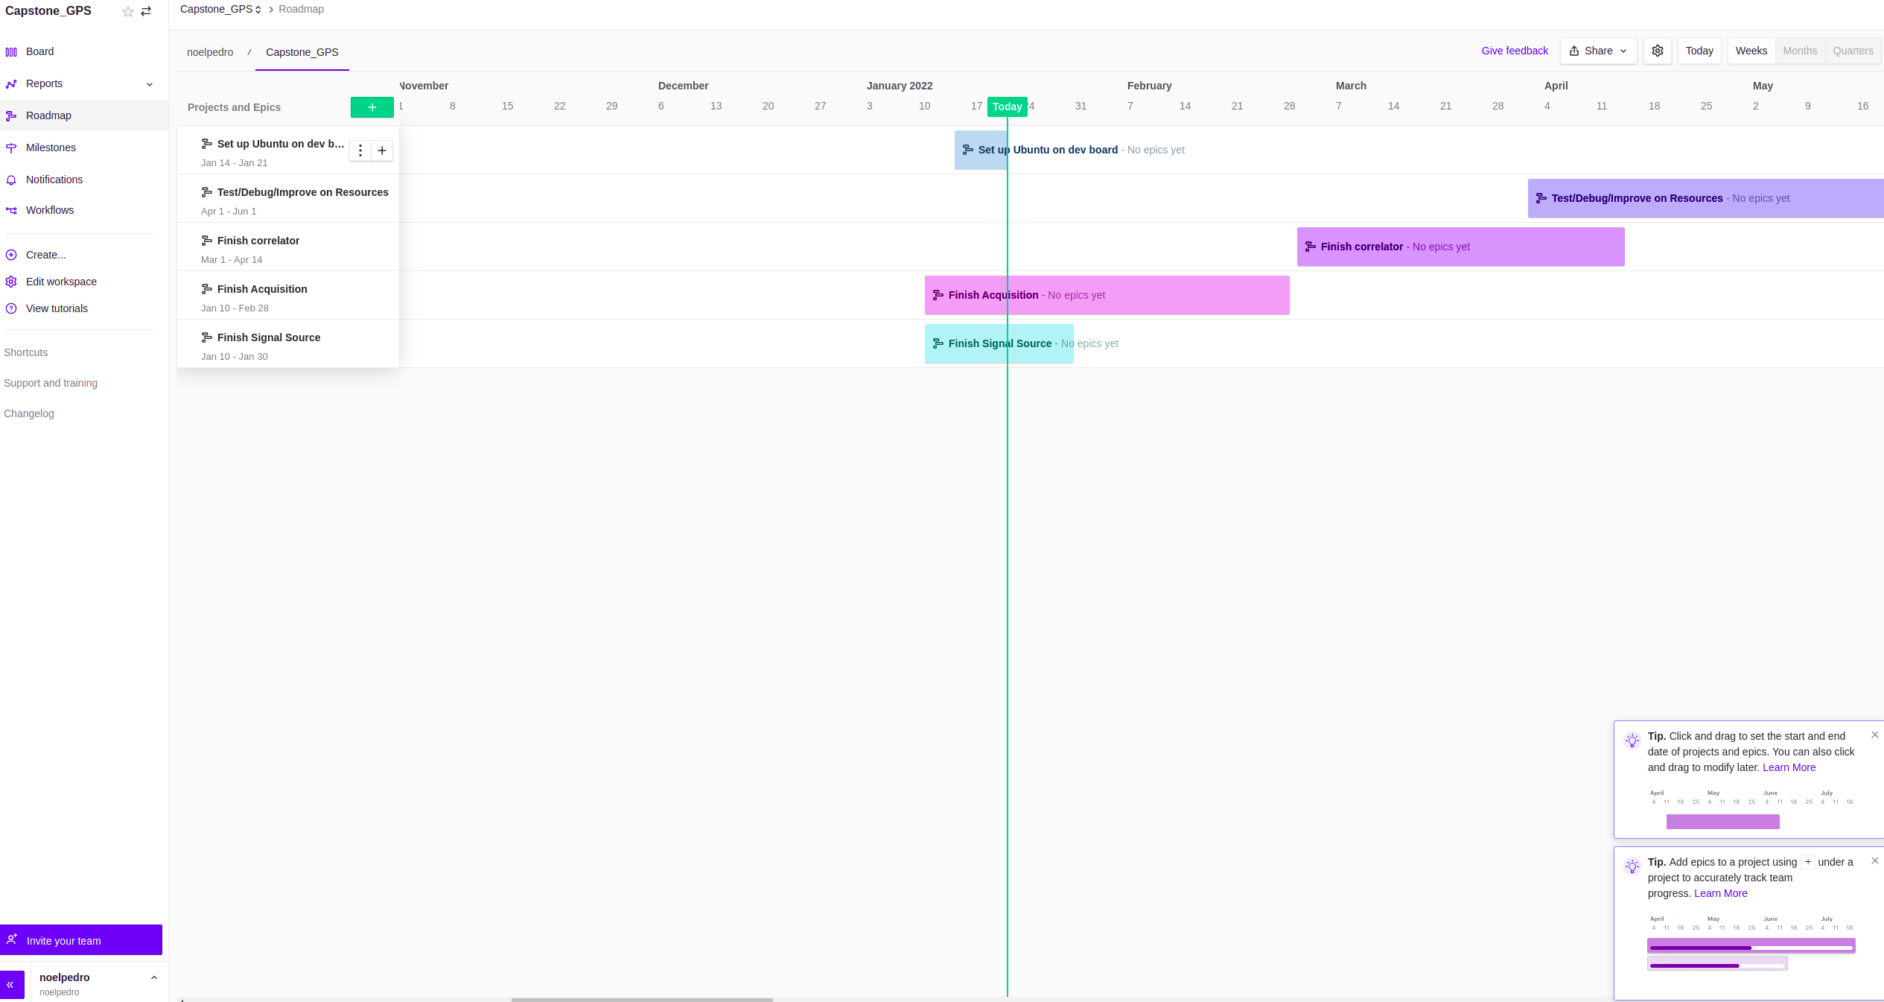
Zen Hub Deadlines

Slide 9
Resources Used
https://zenodo.org/record/2537011/files/Implementation%20of%20GNSS%20Receiver%20Hardware.pdf
https://zenodo.org/record/2539212/files/A_Software_Defined_Spaceborne_GNSS_Receiver.pdf

