Slide 1
PPP 02/04/2022
Noel

Slide 2
Things Worked on for these two weeks
Created c++ adapter and library to configure adrv9009 RF front end, namely set AGC, configure Frequency.
Get comfortable with Data path in hardware for I and Q of RX1A(L1 1.57542 GHz) and RX1B(L5 1.17645 GHz) rf ports.
Downsample the Data (6 and 20).
Configure uio driver to map AXI devices and take advantage of Interrupts.
Continue to work on Acquisition

Slide 3
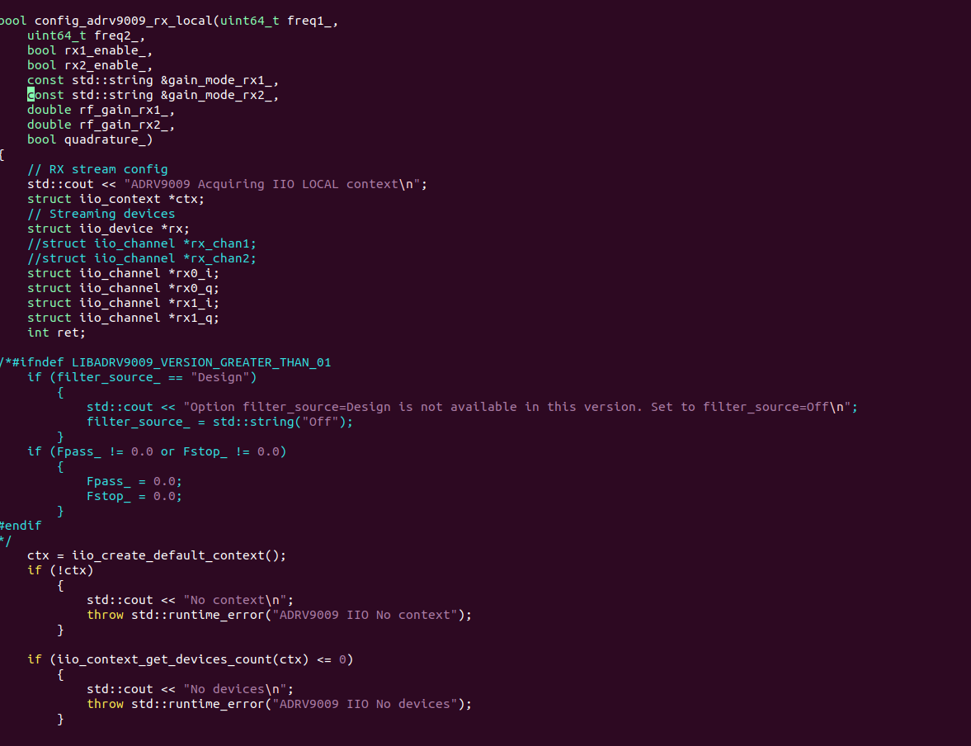
C++ code to configure RF front End

Slide 4
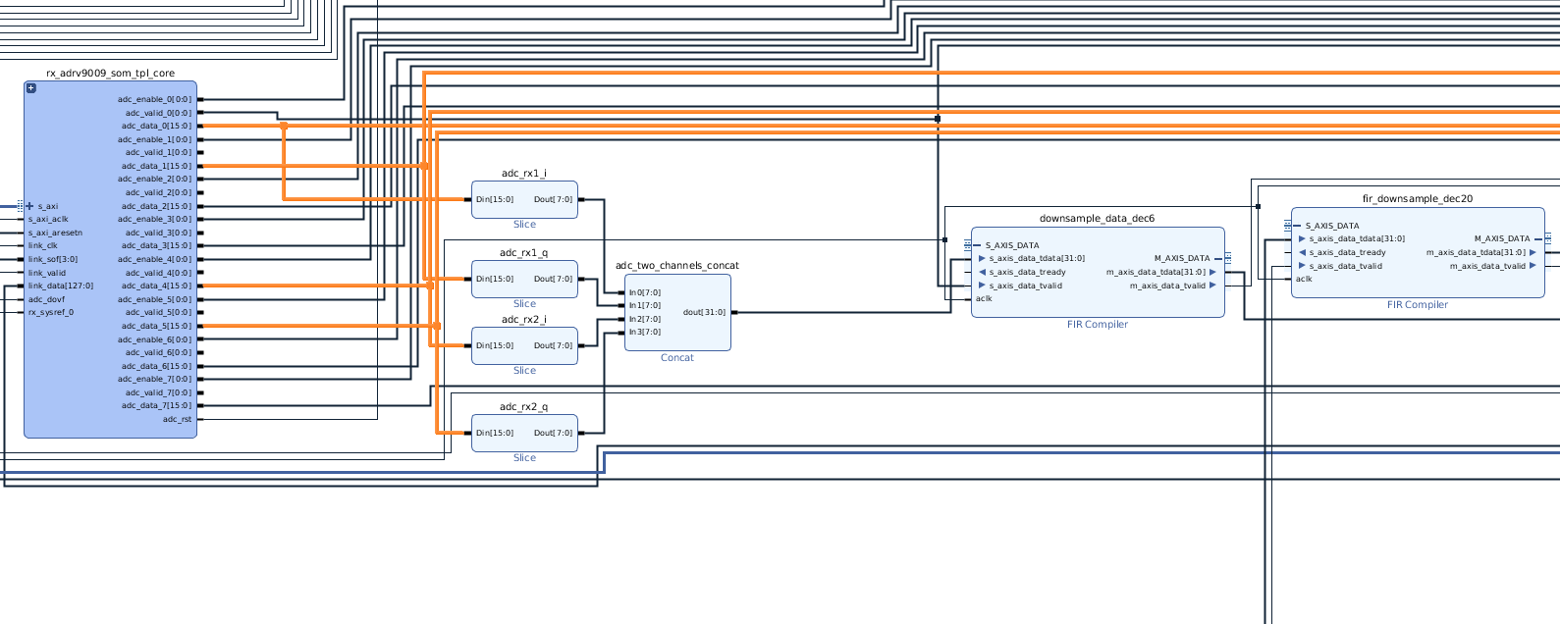
DATA PATH 491msps → 81.92msps(Tracking) → 4.096msps(acq)
Used Matlab to generate integer coefficients for Decimating Fir Filter.

Slide 5
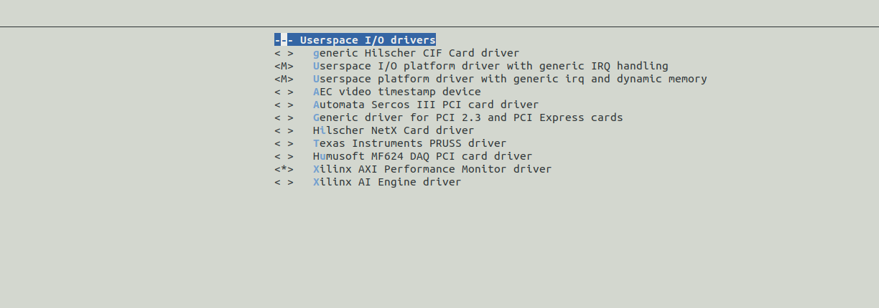
Taking advantage of UIO driver for rapid prototyping

Slide 6
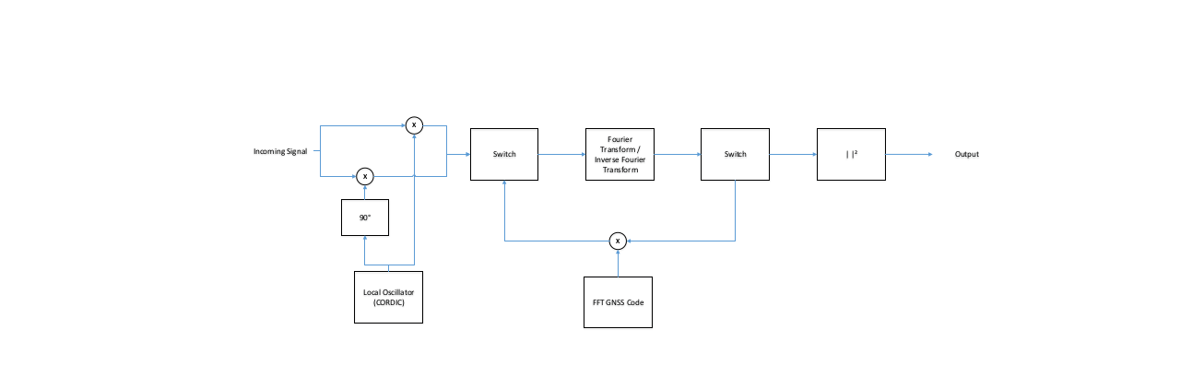
Acquisition Block diagram in hardware

Slide 7
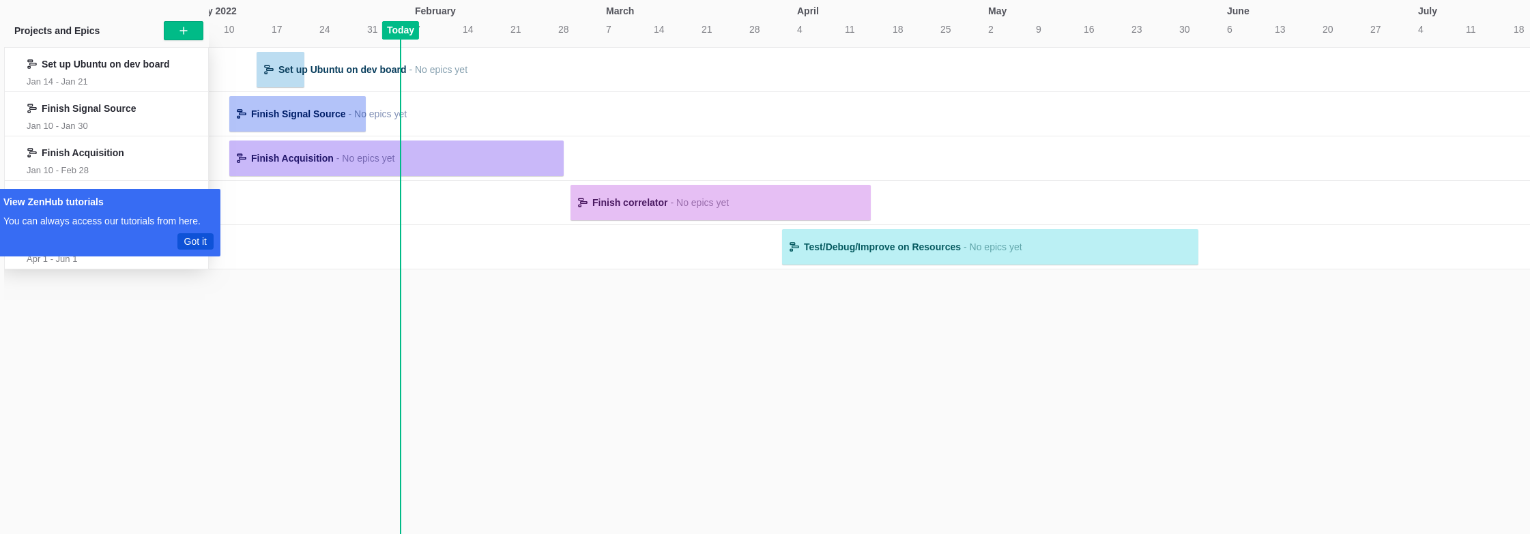
Roadmap

