Slide 1
PREDICTION ON BANK LOANS
Sarat Chandra Vanam
Sairam Vinjamoori
Noel Sam Routhu

Slide 2
ABSTRACT
This presentation focuses on the development of a predictive model for assessing loan default risks, utilizing personal, professional, and financial data alongside loan specifications. Through exploratory data analysis (EDA) and advanced machine learning techniques, the project aims to empower lenders with a tool to make informed decisions, streamline risk management, and enhance the overall customer experience. The key components include thorough EDA, feature engineering, application of machine learning algorithms, and rigorous model evaluation. The outcomes promise efficient risk mitigation and a data-driven approach to credit risk assessment, contributing to a more stable and informed lending ecosystem.

Slide 3
INTRODUCTION
BACKGROUND:
Traditional methods of assessing credit risk often fall short in capturing the nuanced dynamics of an individual's financial This project takes a holistic approach, incorporating Exploratory Data Analysis (EDA) techniques to unveil underlying patterns, outliers, and crucial variables that significantly impact loan default probabilities. profile.
OBJECTIVES:
Develop a predictive model that leverages a diverse range of data points to assess the likelihood of loan default.
Empower lenders with a tool that facilitates efficient and informed decision-making in the loan approval process.
Proactively identify and manage potential risks through a comprehensive understanding of creditworthiness factors.
BENEFITS:
The outcomes of this project extend beyond risk mitigation. By integrating data-driven insights into the lending process, financial institutions can enhance customer experiences, streamline approval processes for creditworthy borrowers, and fortify the overall stability of the lending ecosystem.
As we embark on this exploration of predictive modeling for loan default risk assessment, the goal is not just to predict outcomes but to empower lenders with tools that shape a more resilient and efficient financial landscape.

Slide 4
DATASET & SOURCE
COMPONENTS:
Loan ID
Age
Income
LoanAmount
CreditScore
MonthsEmployed
NumCreditLines
InterestRate
LoanTerm
DTIRatio
Education
EmploymentType
MaritalStatus
HasMortgage
HasDependents
LoanPurpose
HasCoSigner
Default

Slide 5
DATASET & SOURCE
SOURCE:
https://www.kaggle.com/code/uditkishoregagnani/loan-default-eda-forecasting

Slide 6
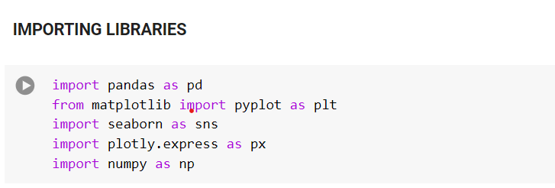
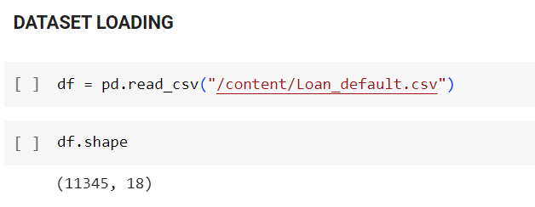
EXPLORATORY DATA ANALYSIS

Slide 7
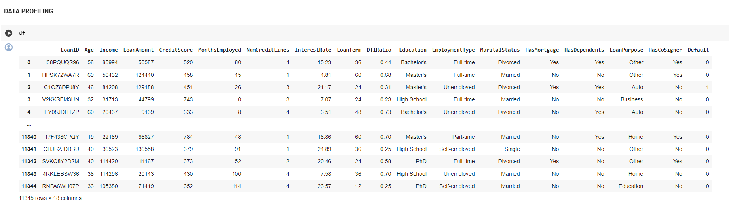
EXPLORATORY DATA ANALYSIS

Slide 8
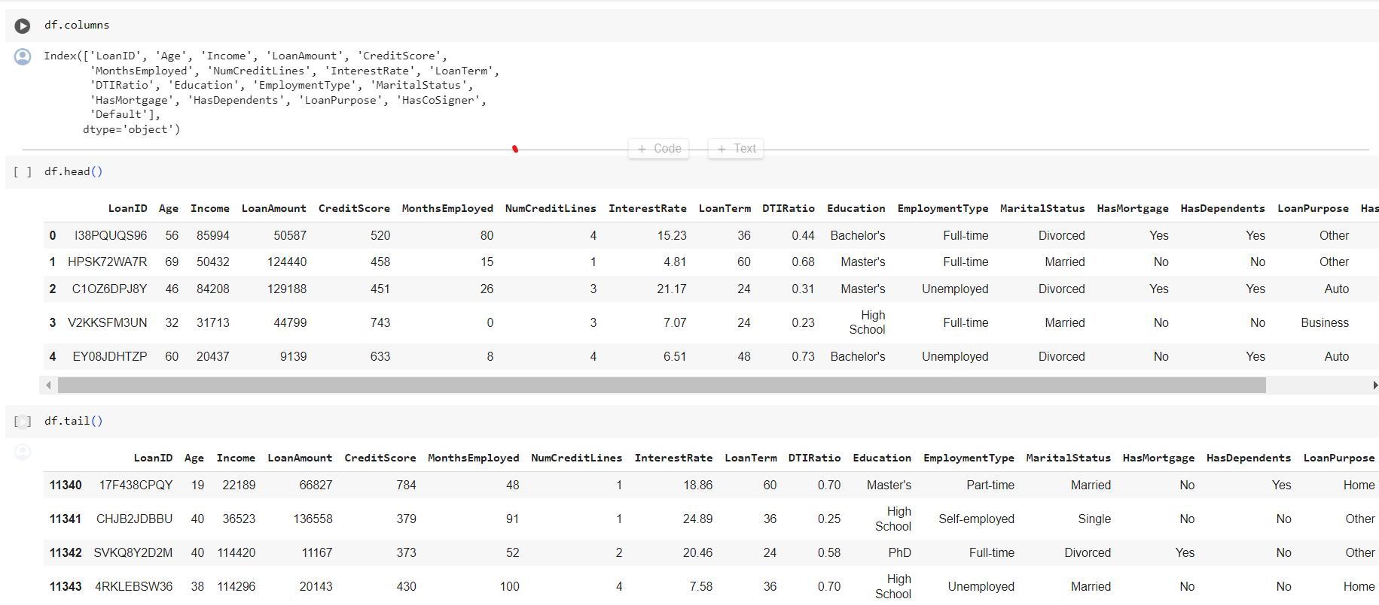
EXPLORATORY DATA ANALYSIS

Slide 9
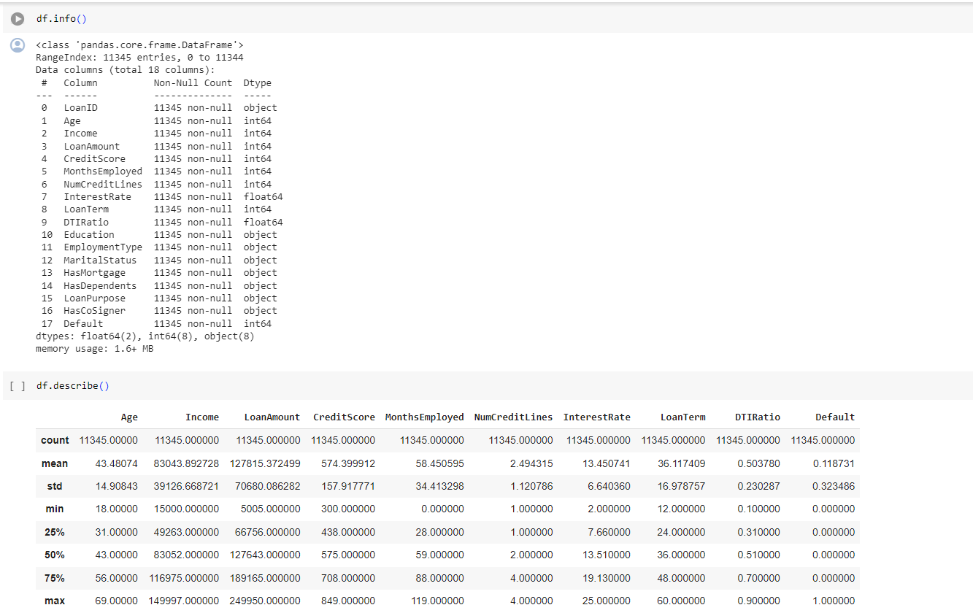
EXPLORATORY DATA ANALYSIS

Slide 10
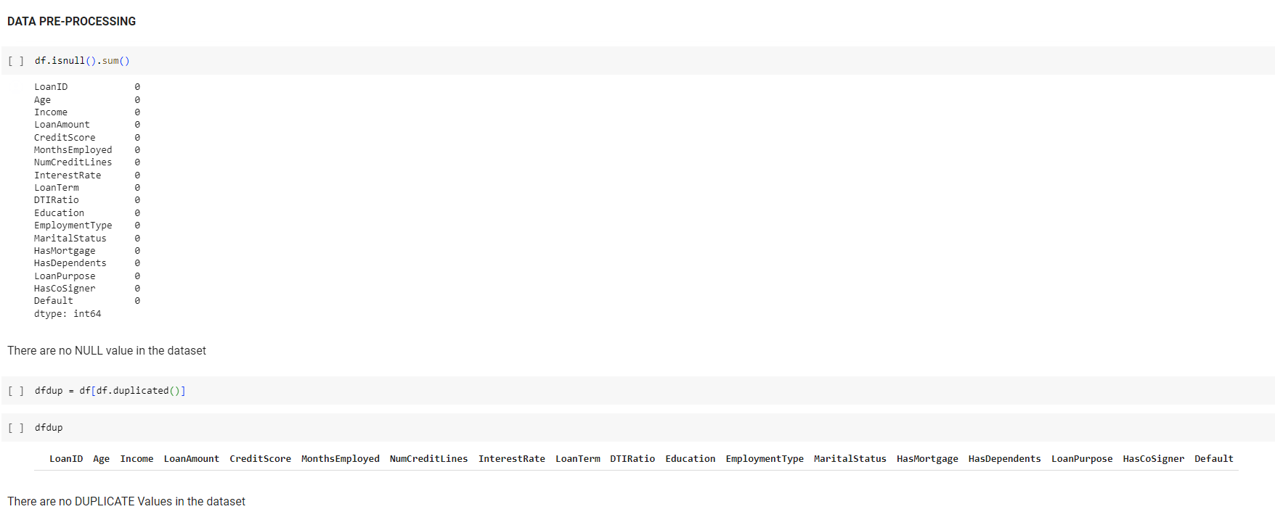
EXPLORATORY DATA ANALYSIS

Slide 11
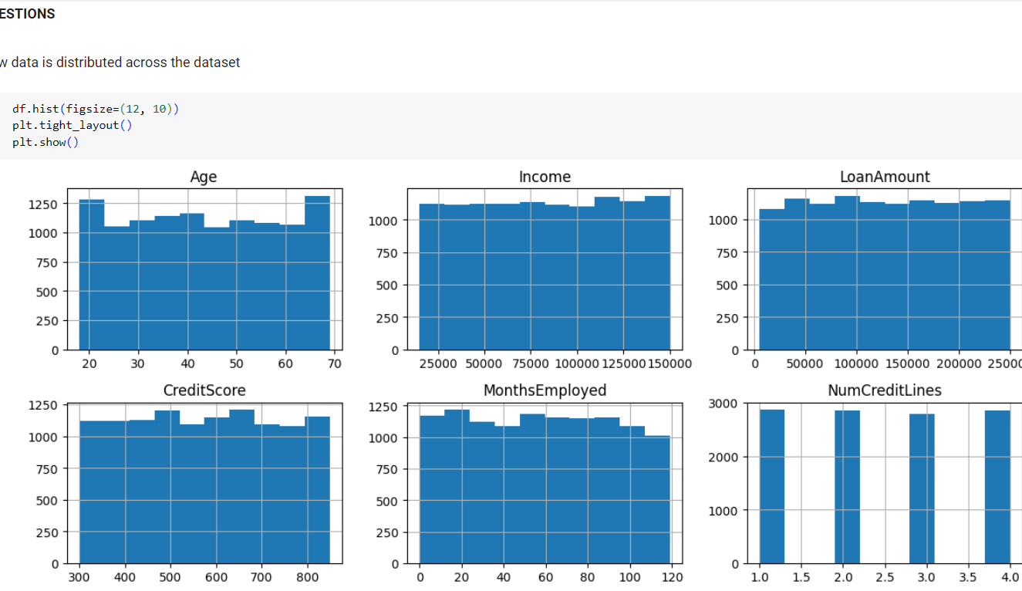
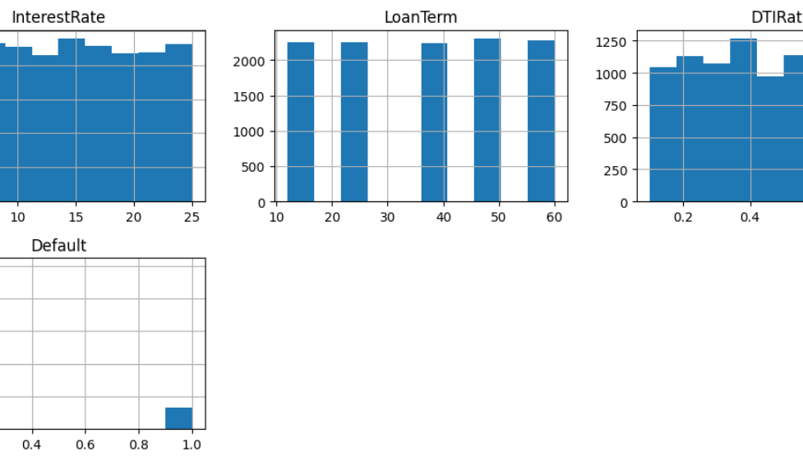
DATA DISTRIBUTION ACROSS THE DATASET

Slide 12
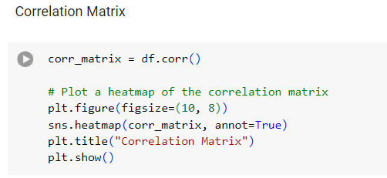
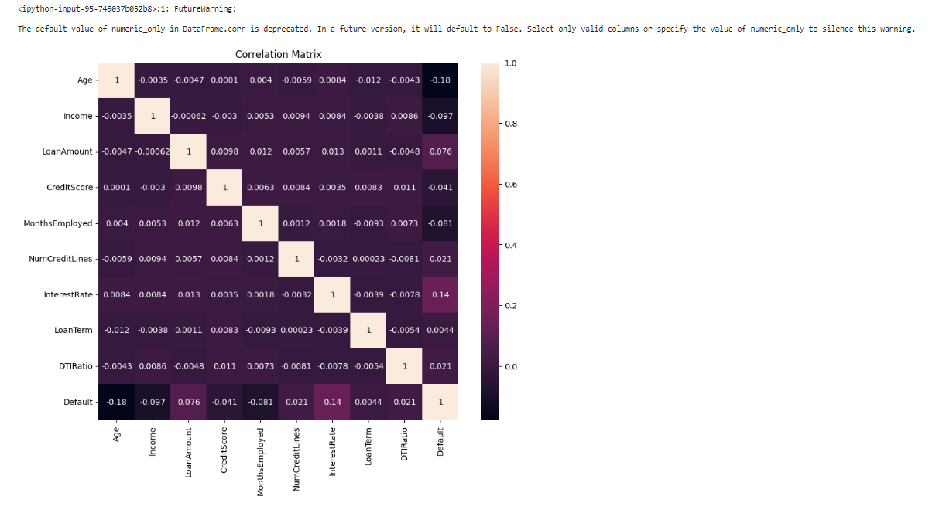
EXPLORATORY DATA ANALYSIS

Slide 13
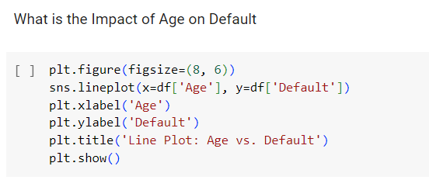
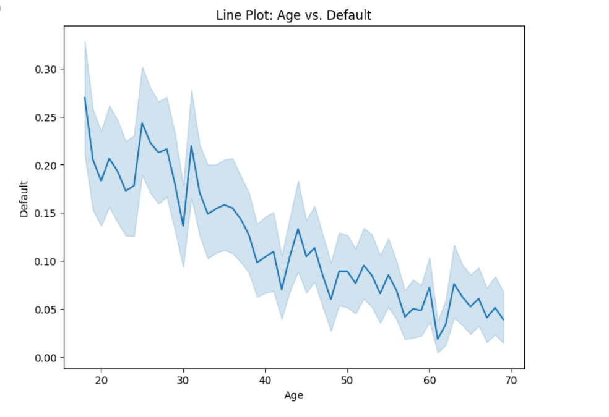
EXPLORATORY DATA ANALYSIS

Slide 14
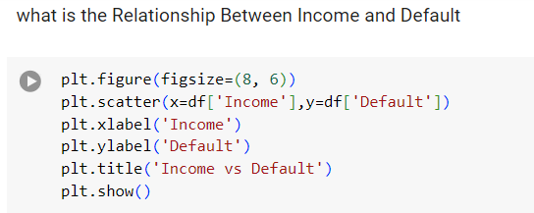
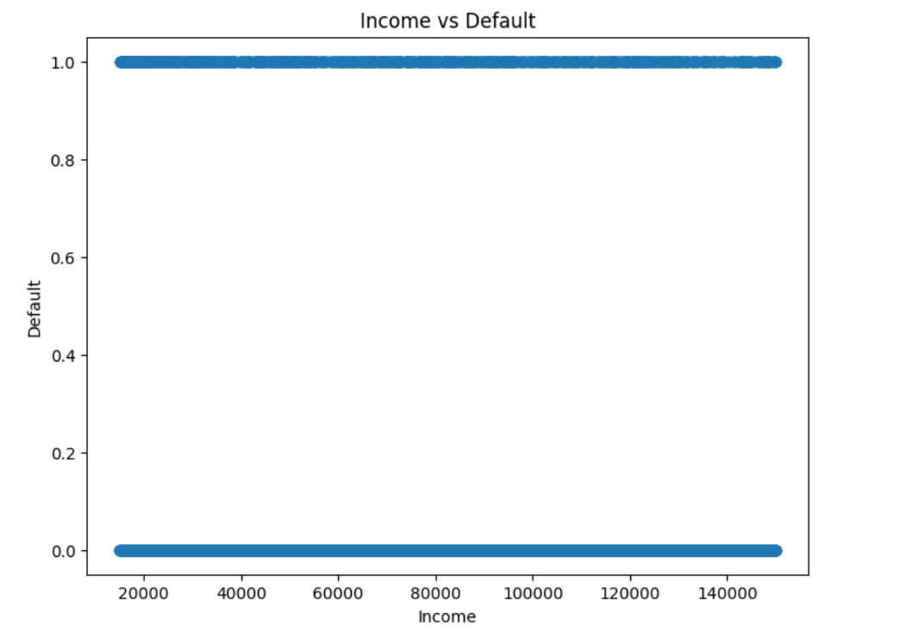
EXPLORATORY DATA ANALYSIS

Slide 15
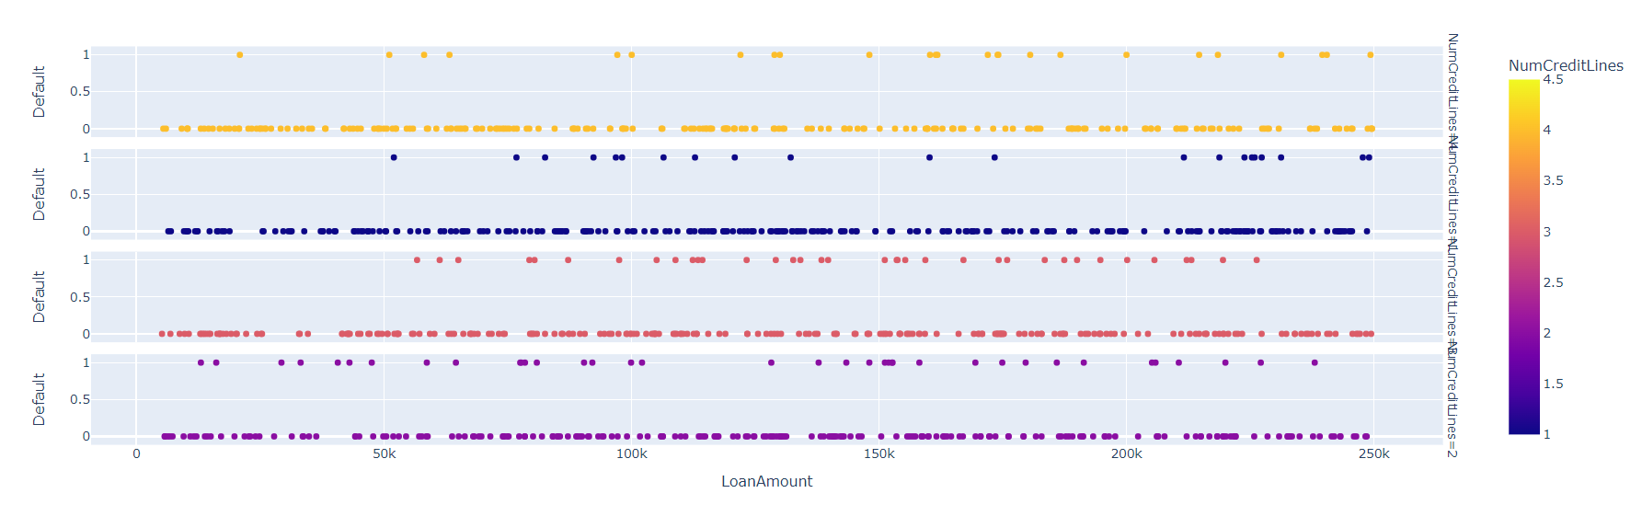
EXPLORATORY DATA ANALYSIS

Slide 16
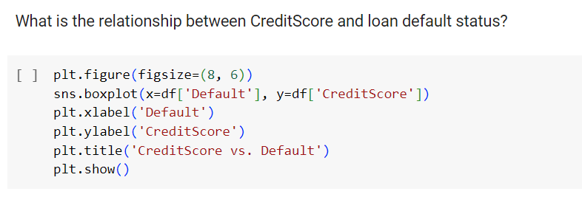
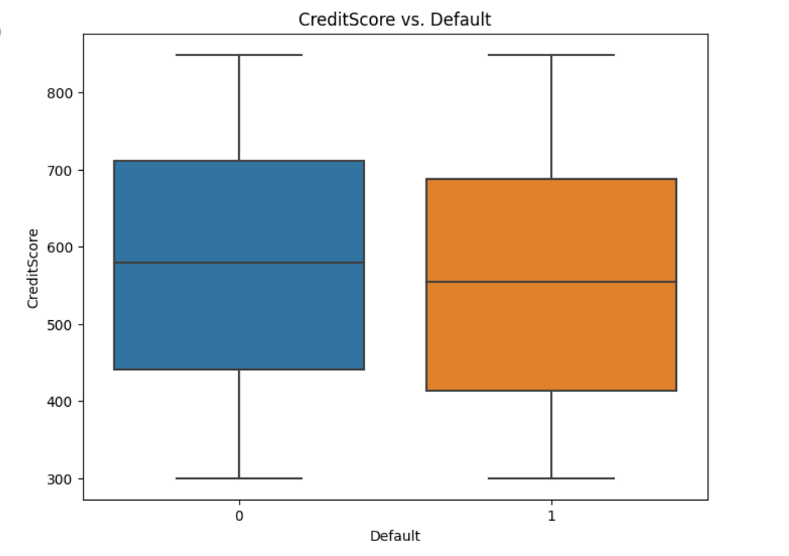
EXPLORATORY DATA ANALYSIS

Slide 17
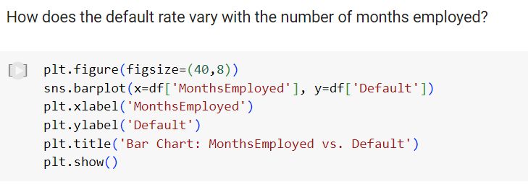
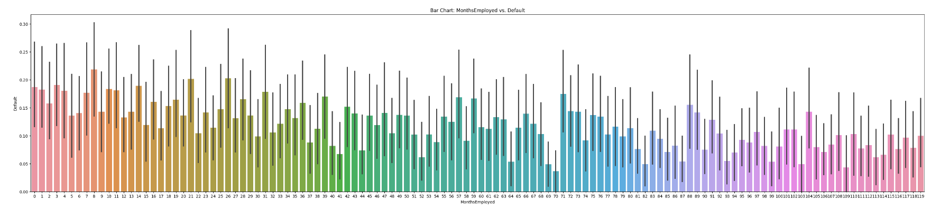
EXPLORATORY DATA ANALYSIS

Slide 18
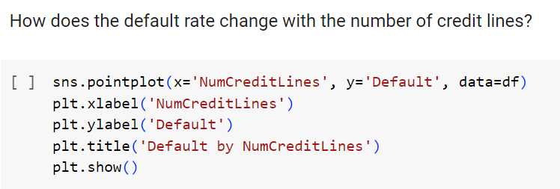
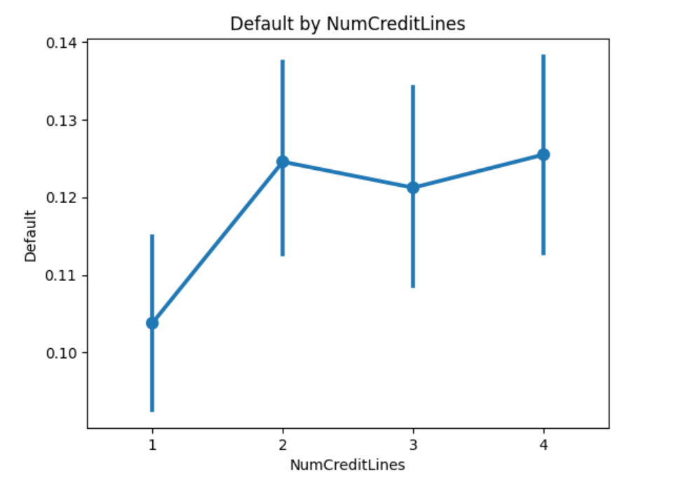
EXPLORATORY DATA ANALYSIS

Slide 19
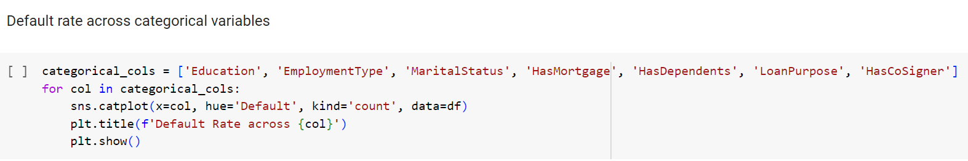
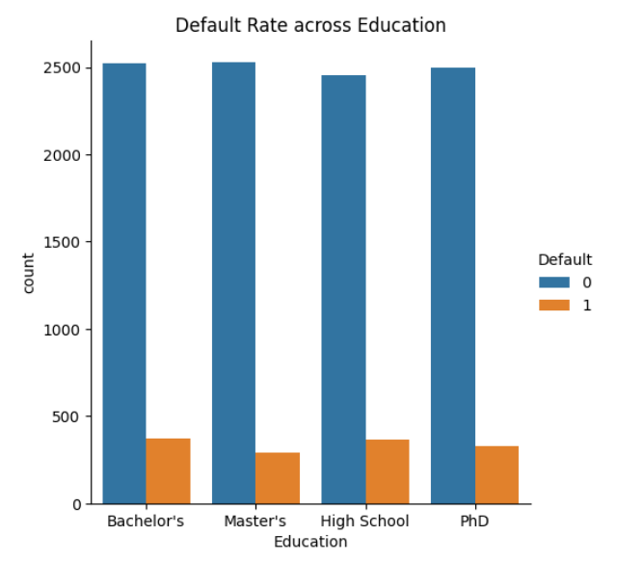
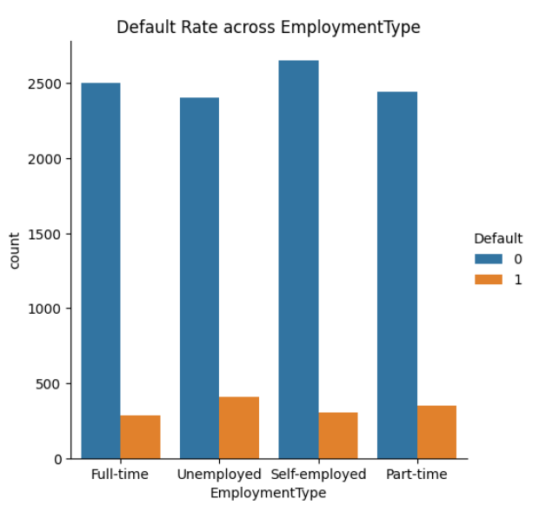
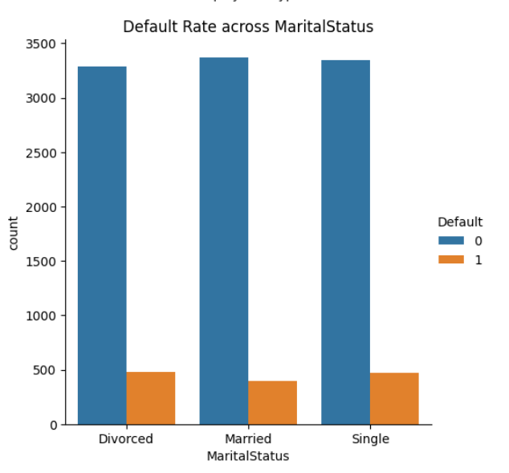
EXPLORATORY DATA ANALYSIS

Slide 20
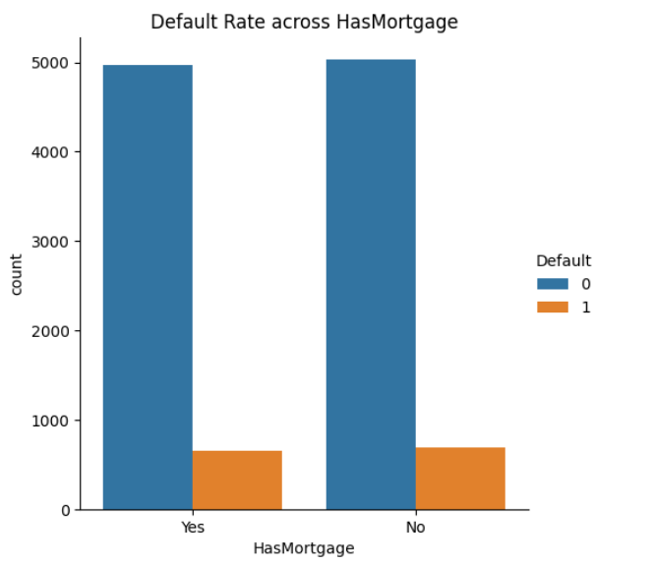
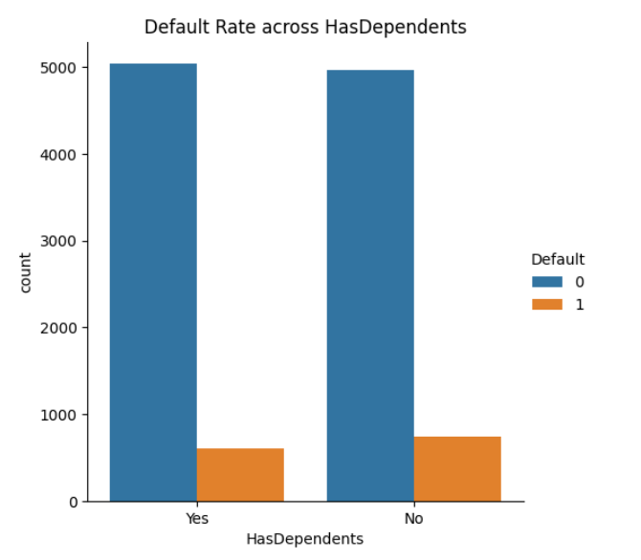
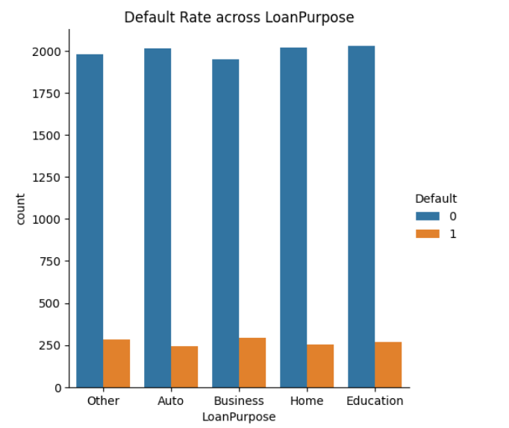
EXPLORATORY DATA ANALYSIS

Slide 21
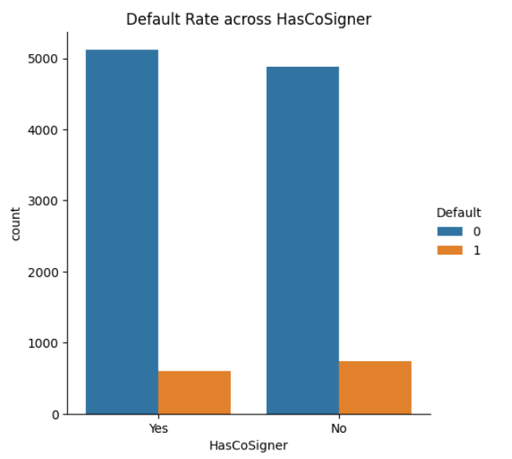
EXPLORATORY DATA ANALYSIS

Slide 22
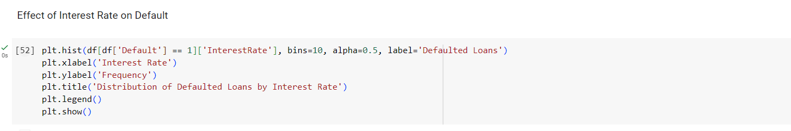
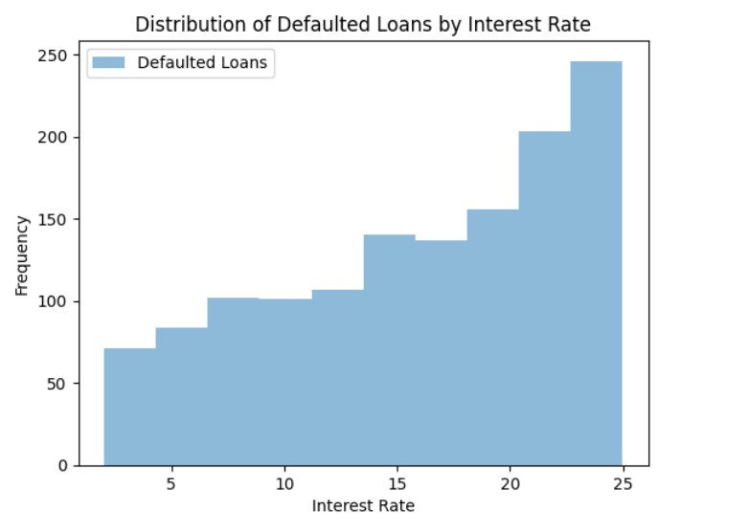
EXPLORATORY DATA ANALYSIS

Slide 23
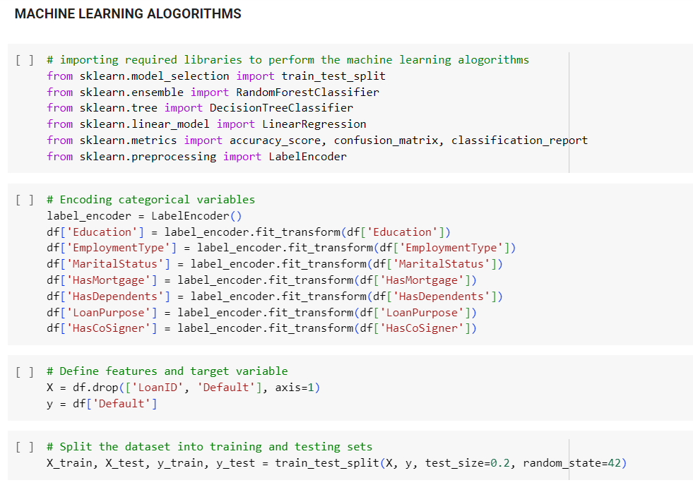
PREDICTIONS USING ML ALGORITHMS

Slide 24
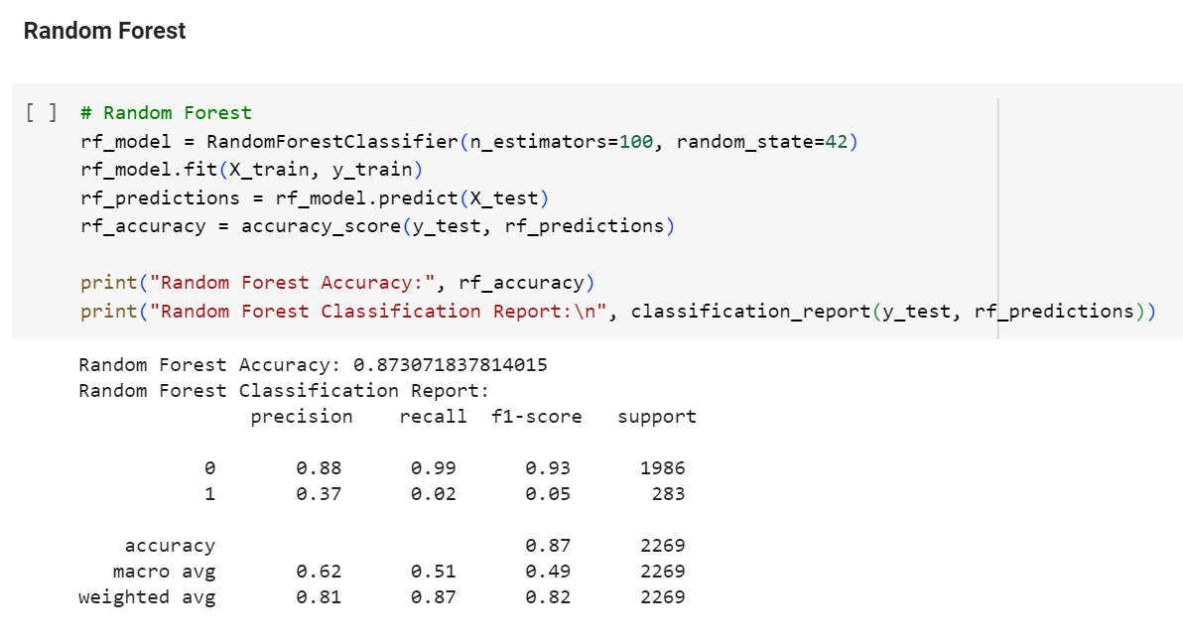
PREDICTIONS USING ML ALGORITHMS

Slide 25
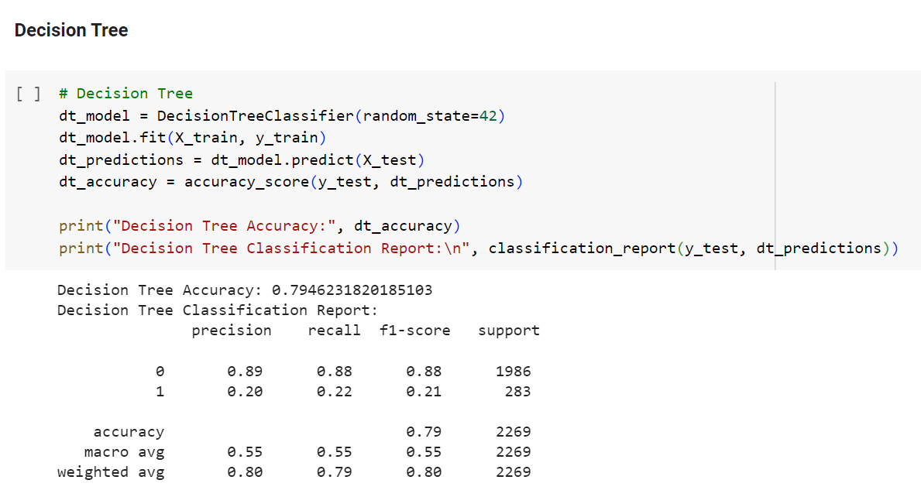
PREDICTIONS USING ML ALGORITHMS

Slide 26
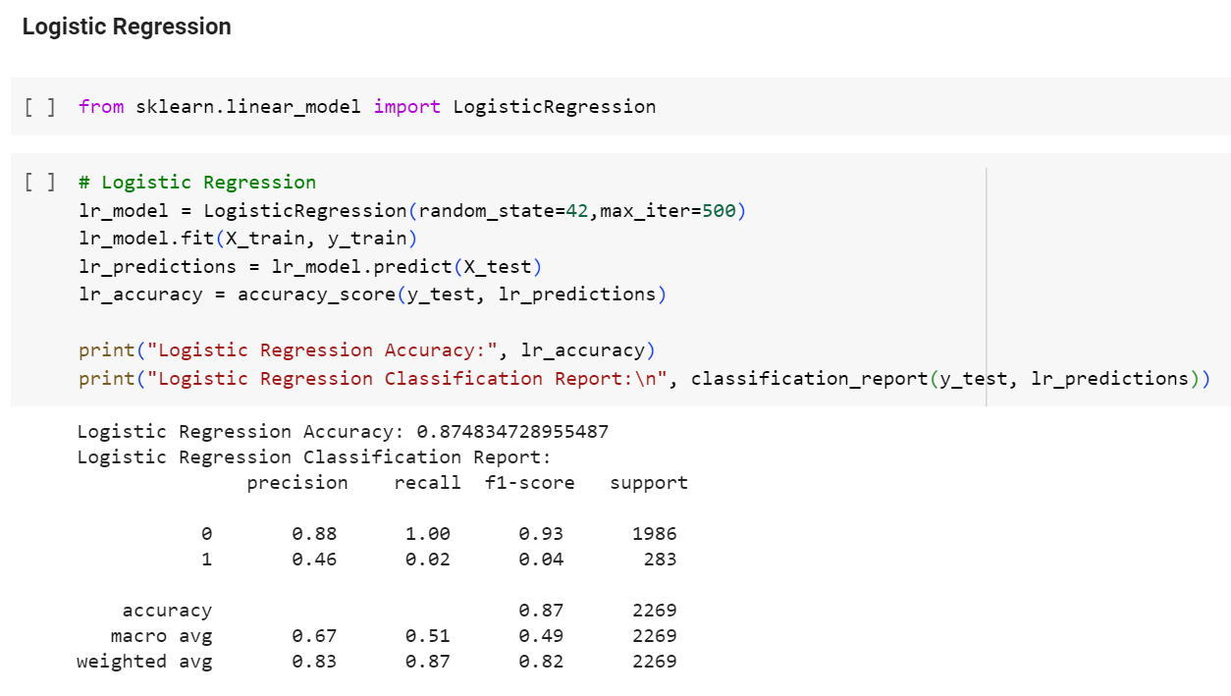
PREDICTIONS USING ML ALGORITHMS

Slide 27
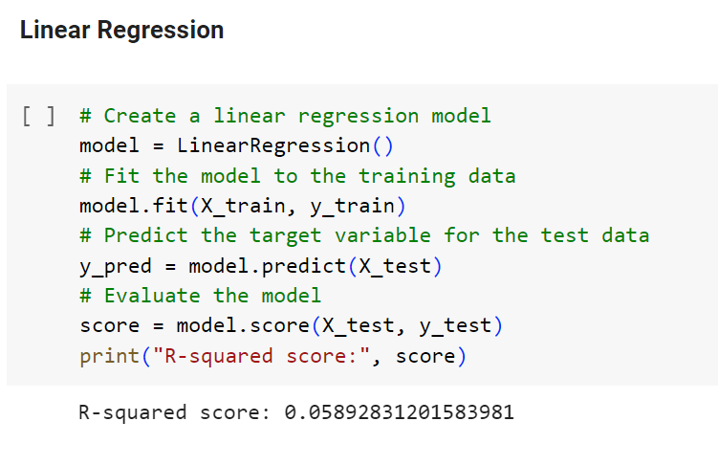
PREDICTIONS USING ML ALGORITHMS

Slide 28
CONCLUSION
Based on the exploratory data analysis (EDA) of the Loan_default.csv dataset, the following conclusions can be drawn regarding the impact of different variables on loan default:
Age and Months Employed: The variables "Age" and "Months Employed" show a negative impact on loan default. This suggests that as the age of the borrower increases or the duration of employment increases, the likelihood of default decreases.
Loan Amount and Interest Rate: The variables "Loan Amount" and "Interest Rate" have the highest positive impact on loan default. This implies that higher loan amounts and higher interest rates are associated with an increased likelihood of default.
Other Variables: The impact of the remaining variables on loan default is not as significant as Age, Months Employed, Loan Amount, and Interest Rate. These variables may still have some influence on default, but their impact is relatively smaller compared to the aforementioned variables.

Slide 29
GITHUB LINK:
https://github.com/noelsamrouthu/BankLoanPrediction

Slide 30
THANK YOU
Sarat Chandra Vanam
Sairam Vinjamoori
Noel Sam Routhu

