Slide 1

Exploratory data analysis
Python Midterm Project - 72541

Slide 2
Exploratory data analysis
Group 3
NOEL SAM ROUTHU
TALHA MOHAMMED
ARJUN REDDY
MANEESHA NARAHARI
Python Midterm Project - 72541

Slide 3
Exploratory data analysis
SUBJECT
VIDEO GAMES SALES
Python Midterm Project - 72541

Slide 4
Exploratory data analysis
CONTENTS
DESCRIPTION
DATA COLLECTION & UNDERSTANDING
CLEANING THE DATASET
Questions & visualizations
CONCLUSION
Python Midterm Project - 72541

Slide 5
Exploratory data analysis ON
DESCRIPTION
The dataset which we used to perform EDA on, is Video Game Sales. We have a huge dataset with sales dating from 1980 to 2020. The expected results should give us the understanding on number of sales, percentages, statistics of the companies etc., Video games played an important role in increasing the economic growth of many countries. Consumers of all ages between 10-50 involve in purchase of video games. They serve the purpose of fulfilling entertainment.
VIDEO GAMES SALES

Slide 6
Exploratory data analysis ON
DATA COLLECTION & UNDERSTANDING
Data collection and data understanding are fundamental steps in the data analysis process, especially in the context of data science and business intelligence. These steps involve gathering and comprehending the data you will be working with to derive valuable insights and make informed decisions.
In Data Collection, the following steps are achieved:
Mounted Drive (since we used Google Drive as the
required files are present in Drive)
Imported all the packages used for manipulation and visualization of data
Imported the Dataset from the drive location
Displaying the Dataset
VIDEO GAMES SALES

Slide 7
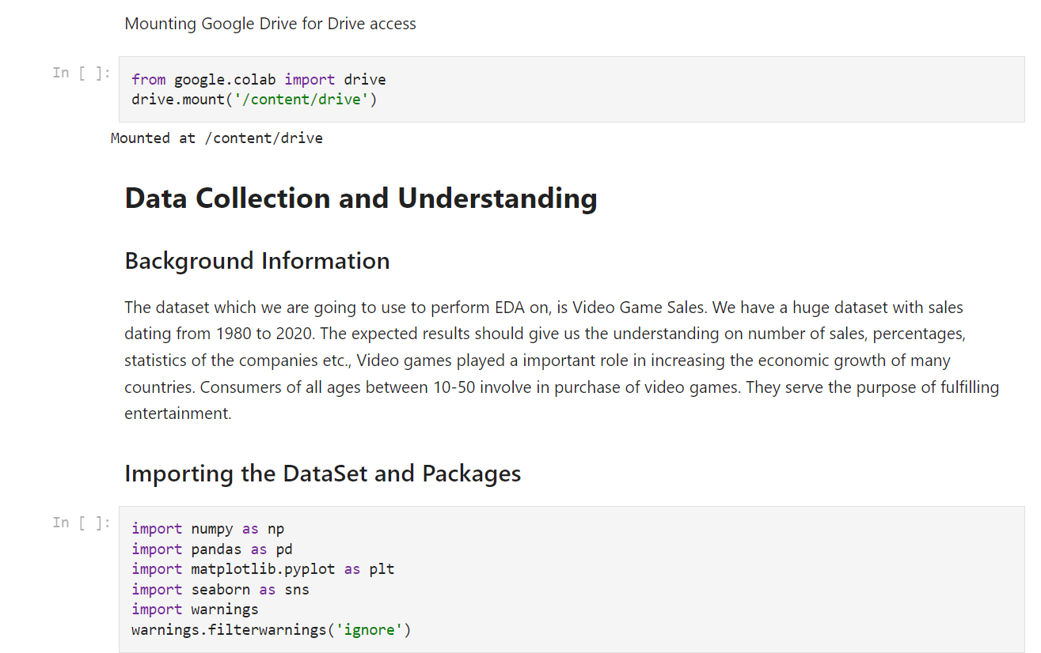
Exploratory data analysis ON
DATA COLLECTION & UNDERSTANDING
Data collection and data understanding are fundamental steps in the data analysis process, especially in the context of data science and business intelligence. These steps involve gathering and comprehending the data you will be working with to derive valuable insights and make informed decisions.
In Data Collection, the following steps are achieved:
Mounted Drive (since we used Google Drive as the
required files are present in Drive)
Imported all the packages used for manipulation and visualization of data
Imported the Dataset from the drive location
Displaying the Dataset
VIDEO GAMES SALES

Slide 8
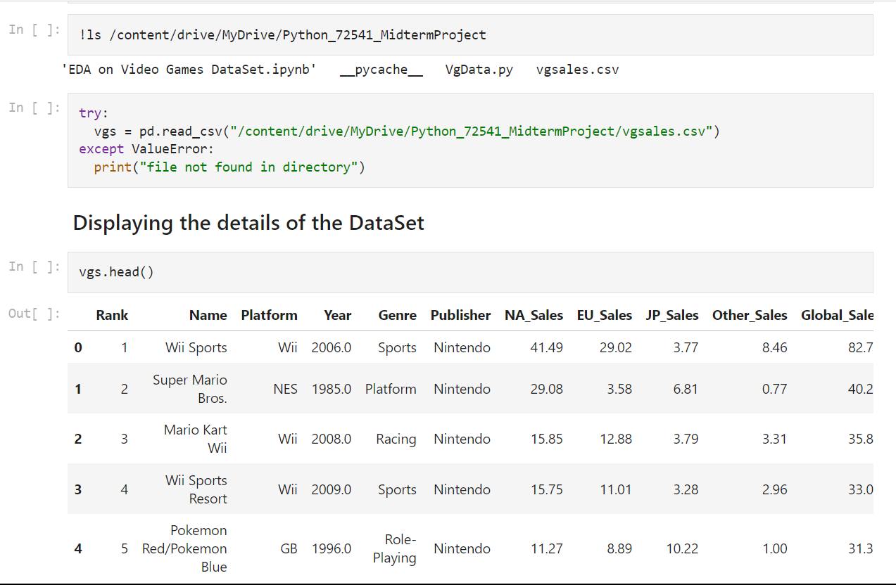
Exploratory data analysis ON
DATA COLLECTION & UNDERSTANDING
Data collection and data understanding are fundamental steps in the data analysis process, especially in the context of data science and business intelligence. These steps involve gathering and comprehending the data you will be working with to derive valuable insights and make informed decisions.
In Data Collection, the following steps are achieved:
Mounted Drive (since we used Google Drive as the
required files are present in Drive)
Imported all the packages used for manipulation and visualization of data
Imported the Dataset from the drive location
Displaying the Dataset
VIDEO GAMES SALES

Slide 9
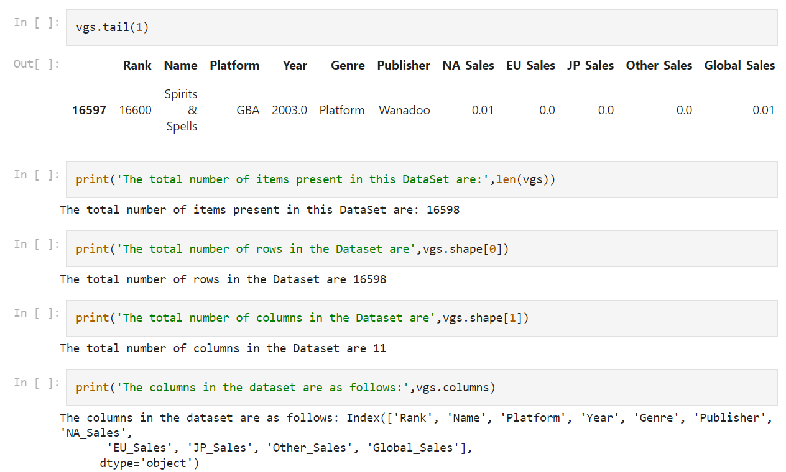
Exploratory data analysis ON
DATA COLLECTION & UNDERSTANDING
Data collection and data understanding are fundamental steps in the data analysis process, especially in the context of data science and business intelligence. These steps involve gathering and comprehending the data you will be working with to derive valuable insights and make informed decisions.
In Data Collection, the following steps are achieved:
Mounted Drive (since we used Google Drive as the
required files are present in Drive)
Imported all the packages used for manipulation and visualization of data
Imported the Dataset from the drive location
Displaying the Dataset
VIDEO GAMES SALES

Slide 10
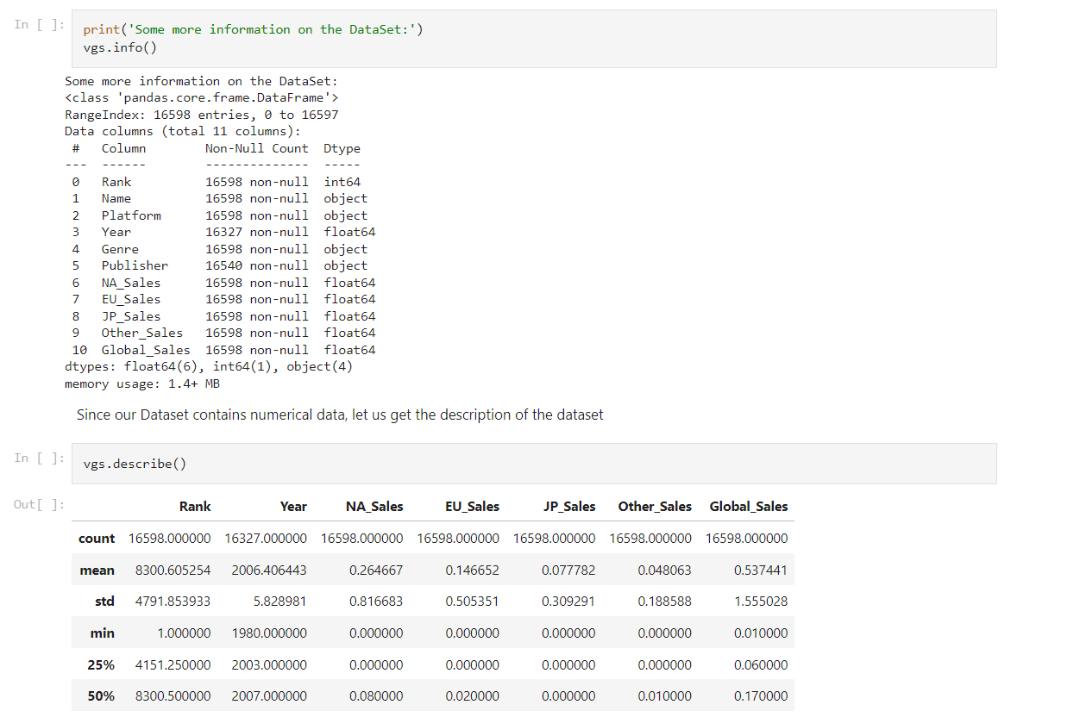
Exploratory data analysis ON
DATA COLLECTION & UNDERSTANDING
Data collection and data understanding are fundamental steps in the data analysis process, especially in the context of data science and business intelligence. These steps involve gathering and comprehending the data you will be working with to derive valuable insights and make informed decisions.
In Data Collection, the following steps are achieved:
Mounted Drive (since we used Google Drive as the
required files are present in Drive)
Imported all the packages used for manipulation and visualization of data
Imported the Dataset from the drive location
Displaying the Dataset
VIDEO GAMES SALES

Slide 11
Exploratory data analysis ON
Cleaning the dataset
Cleaning the dataset, often referred to as data cleaning or data preprocessing, is a crucial step in the data analysis process. It involves identifying and rectifying errors, inconsistencies, and inaccuracies in the data to ensure that it is accurate, complete, and ready for analysis.
While cleaning the dataset, the following steps are achieved:
Handling Missing values
Removing Duplicates
Replacing values with correct data
Data Validation and Verification
VIDEO GAMES SALES

Slide 12
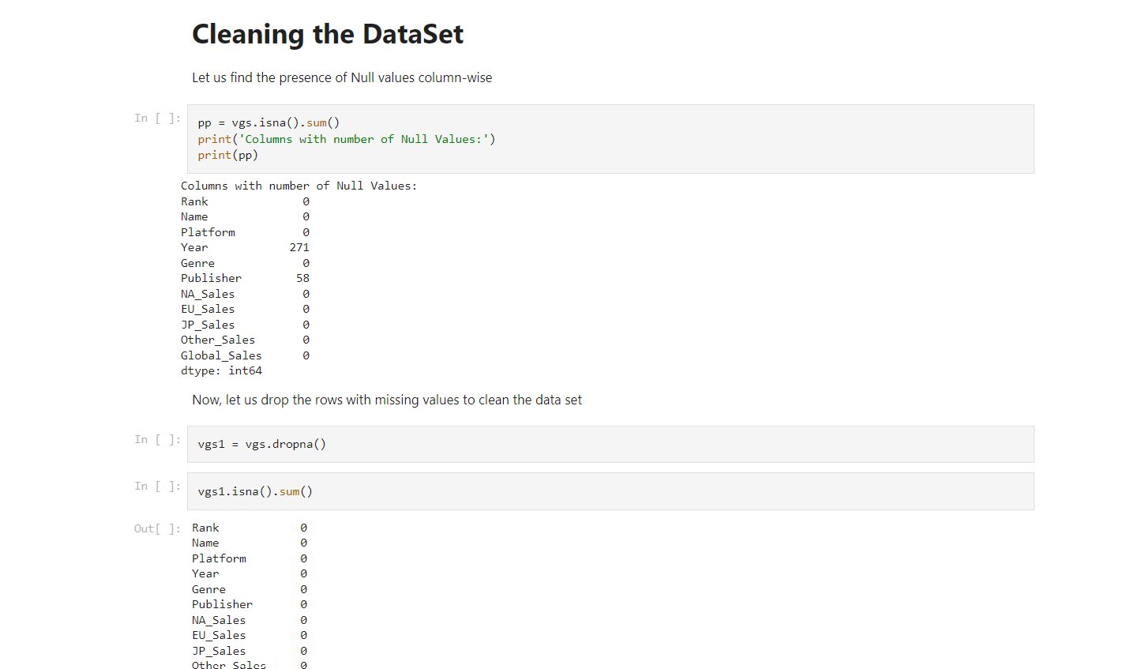
Exploratory data analysis ON
Cleaning the dataset
Cleaning the dataset, often referred to as data cleaning or data preprocessing, is a crucial step in the data analysis process. It involves identifying and rectifying errors, inconsistencies, and inaccuracies in the data to ensure that it is accurate, complete, and ready for analysis.
While cleaning the dataset, the following steps are achieved:
Handling Missing values
Removing Duplicates
Replacing values with correct data
Data Validation and Verification
VIDEO GAMES SALES

Slide 13
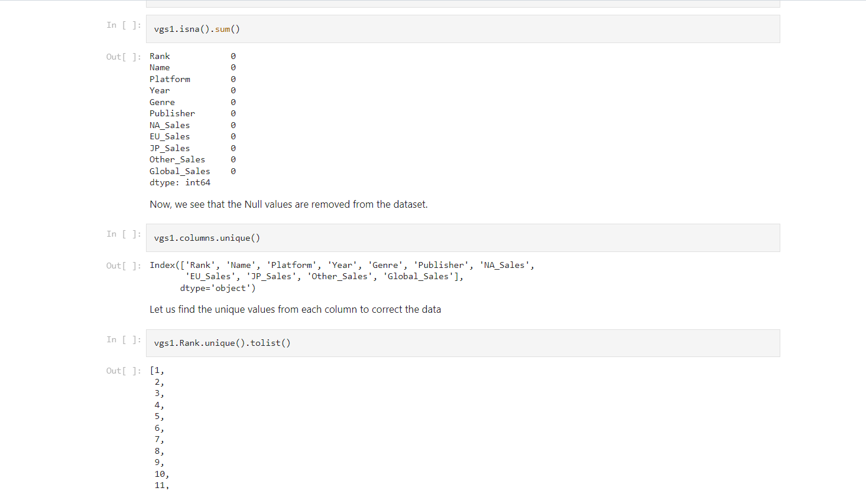
Exploratory data analysis ON
Cleaning the dataset
Cleaning the dataset, often referred to as data cleaning or data preprocessing, is a crucial step in the data analysis process. It involves identifying and rectifying errors, inconsistencies, and inaccuracies in the data to ensure that it is accurate, complete, and ready for analysis.
While cleaning the dataset, the following steps are achieved:
Handling Missing values
Removing Duplicates
Replacing values with correct data
Data Validation and Verification
VIDEO GAMES SALES

Slide 14
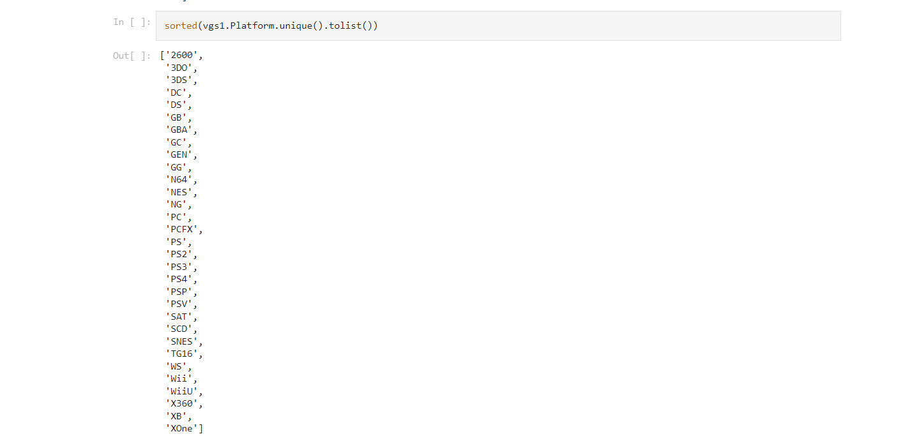
Exploratory data analysis ON
Cleaning the dataset
Cleaning the dataset, often referred to as data cleaning or data preprocessing, is a crucial step in the data analysis process. It involves identifying and rectifying errors, inconsistencies, and inaccuracies in the data to ensure that it is accurate, complete, and ready for analysis.
While cleaning the dataset, the following steps are achieved:
Handling Missing values
Removing Duplicates
Replacing values with correct data
Data Validation and Verification
VIDEO GAMES SALES

Slide 15

Exploratory data analysis ON
Cleaning the dataset
Cleaning the dataset, often referred to as data cleaning or data preprocessing, is a crucial step in the data analysis process. It involves identifying and rectifying errors, inconsistencies, and inaccuracies in the data to ensure that it is accurate, complete, and ready for analysis.
While cleaning the dataset, the following steps are achieved:
Handling Missing values
Removing Duplicates
Replacing values with correct data
Data Validation and Verification
VIDEO GAMES SALES

Slide 16
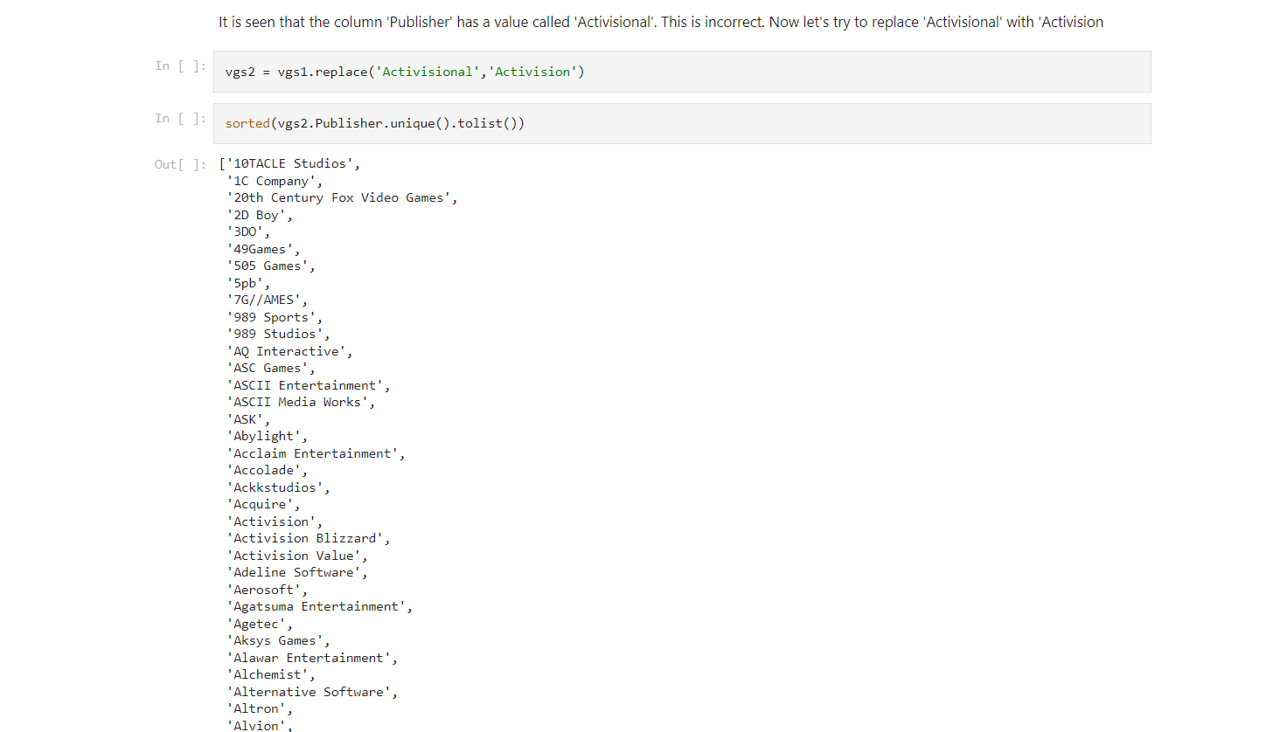
Exploratory data analysis ON
Cleaning the dataset
Cleaning the dataset, often referred to as data cleaning or data preprocessing, is a crucial step in the data analysis process. It involves identifying and rectifying errors, inconsistencies, and inaccuracies in the data to ensure that it is accurate, complete, and ready for analysis.
While cleaning the dataset, the following steps are achieved:
Handling Missing values
Removing Duplicates
Replacing values with correct data
Data Validation and Verification
VIDEO GAMES SALES

Slide 17
Exploratory data analysis ON
QUESTIONS & vISUALIZATION
Data visualization is the graphical representation of data to help people understand the patterns, trends, and insights contained within the data. It involves creating visual elements such as charts, graphs, maps, and dashboards to make data more accessible and understandable. Data visualization plays a crucial role in data analysis, decision-making, and communication of information.
To achieve visualization, the following aspects are necessary:
Questionnaire
Graphical Representation
VIDEO GAMES SALES

Slide 18
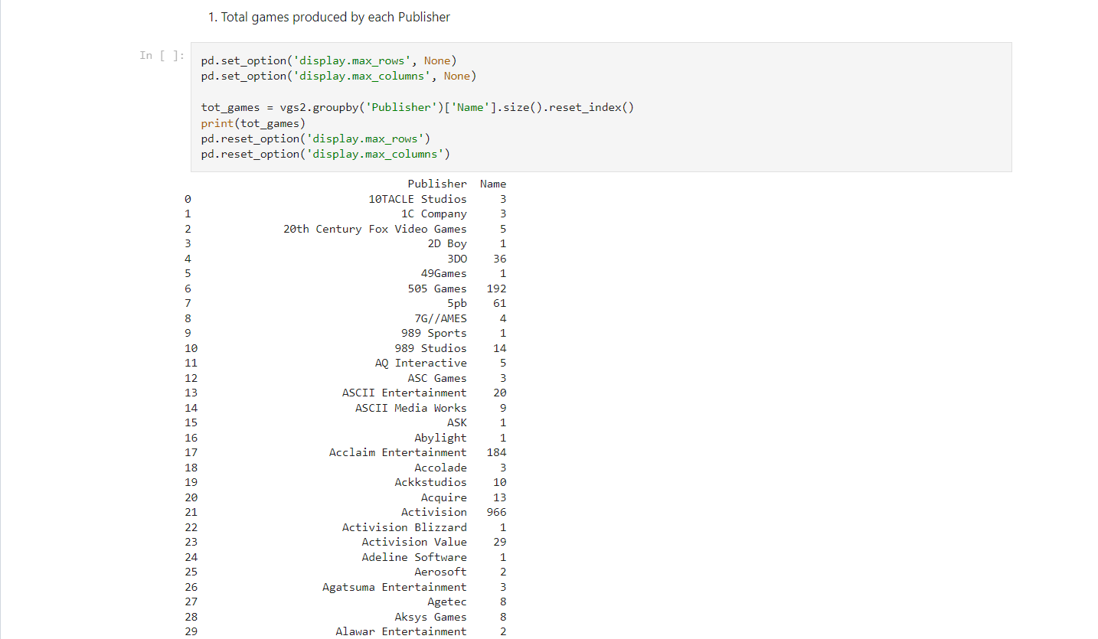
Exploratory data analysis ON
QUESTIONS & vISUALIZATION
Data visualization is the graphical representation of data to help people understand the patterns, trends, and insights contained within the data. It involves creating visual elements such as charts, graphs, maps, and dashboards to make data more accessible and understandable. Data visualization plays a crucial role in data analysis, decision-making, and communication of information.
To achieve visualization, the following aspects are necessary:
Questionnaire
Graphical Representation
VIDEO GAMES SALES

Slide 19
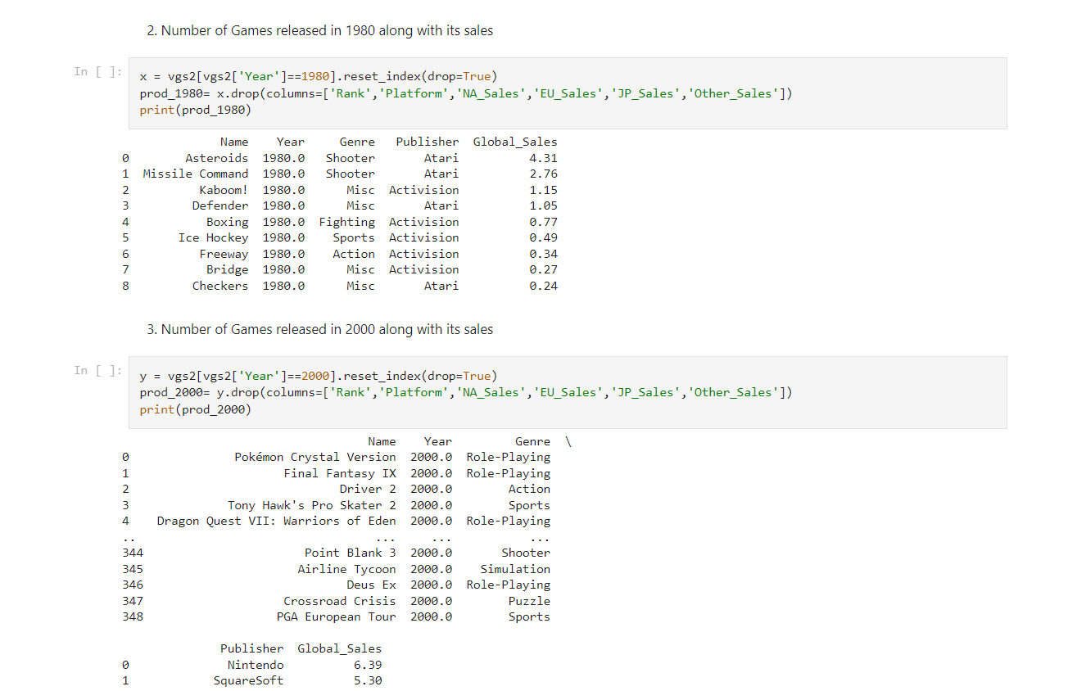
Exploratory data analysis ON
QUESTIONS & vISUALIZATION
Data visualization is the graphical representation of data to help people understand the patterns, trends, and insights contained within the data. It involves creating visual elements such as charts, graphs, maps, and dashboards to make data more accessible and understandable. Data visualization plays a crucial role in data analysis, decision-making, and communication of information.
To achieve visualization, the following aspects are necessary:
Questionnaire
Graphical Representation
VIDEO GAMES SALES

Slide 20
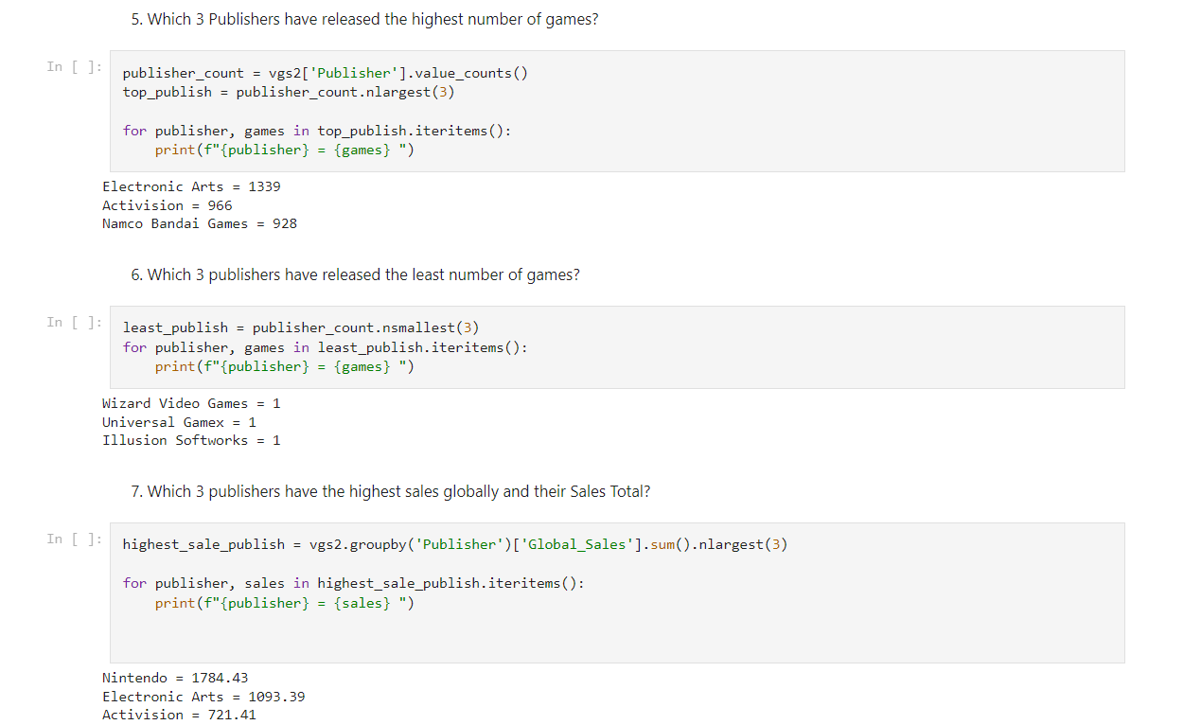
Exploratory data analysis ON
QUESTIONS & vISUALIZATION
Data visualization is the graphical representation of data to help people understand the patterns, trends, and insights contained within the data. It involves creating visual elements such as charts, graphs, maps, and dashboards to make data more accessible and understandable. Data visualization plays a crucial role in data analysis, decision-making, and communication of information.
To achieve visualization, the following aspects are necessary:
Questionnaire
Graphical Representation
VIDEO GAMES SALES

Slide 21
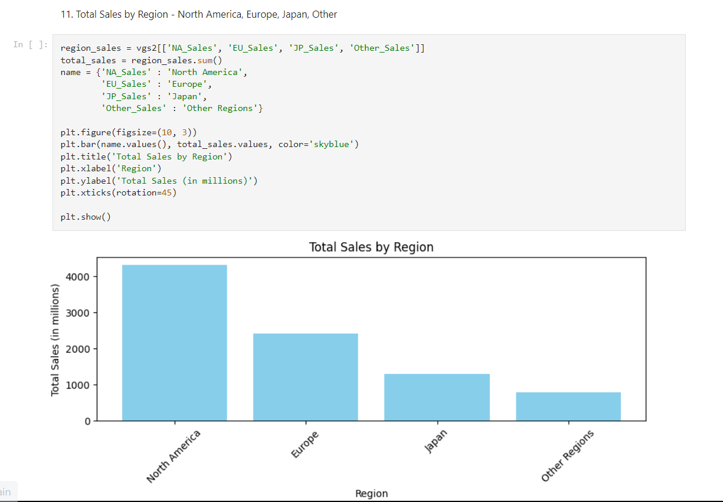
Exploratory data analysis ON
QUESTIONS & vISUALIZATION
Data visualization is the graphical representation of data to help people understand the patterns, trends, and insights contained within the data. It involves creating visual elements such as charts, graphs, maps, and dashboards to make data more accessible and understandable. Data visualization plays a crucial role in data analysis, decision-making, and communication of information.
To achieve visualization, the following aspects are necessary:
Questionnaire
Graphical Representation
VIDEO GAMES SALES

Slide 22
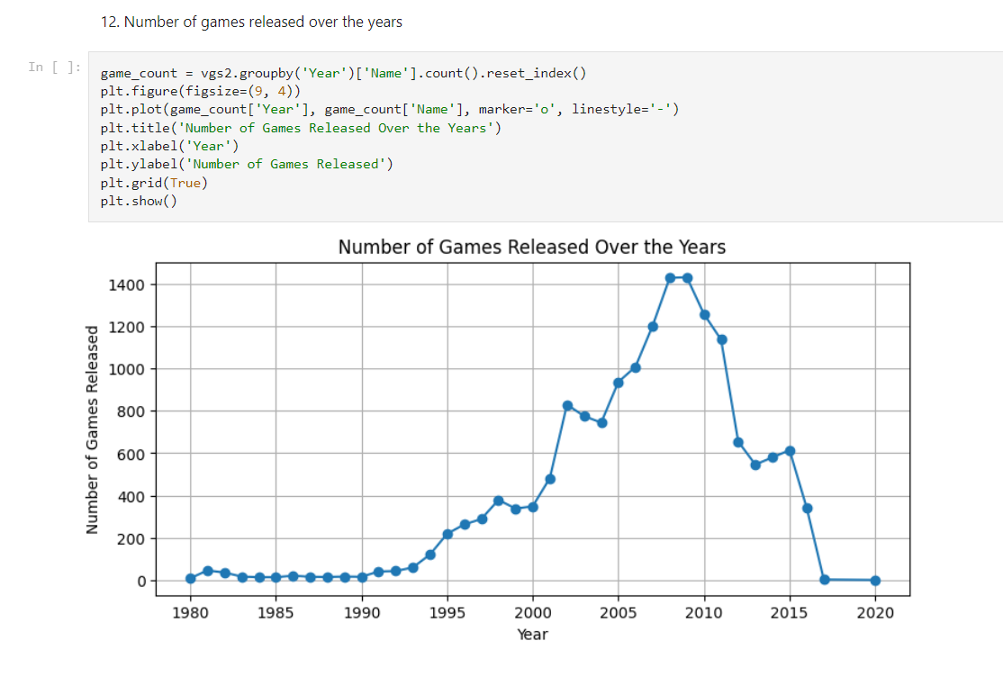
Exploratory data analysis ON
QUESTIONS & vISUALIZATION
Data visualization is the graphical representation of data to help people understand the patterns, trends, and insights contained within the data. It involves creating visual elements such as charts, graphs, maps, and dashboards to make data more accessible and understandable. Data visualization plays a crucial role in data analysis, decision-making, and communication of information.
To achieve visualization, the following aspects are necessary:
Questionnaire
Graphical Representation
VIDEO GAMES SALES

Slide 23
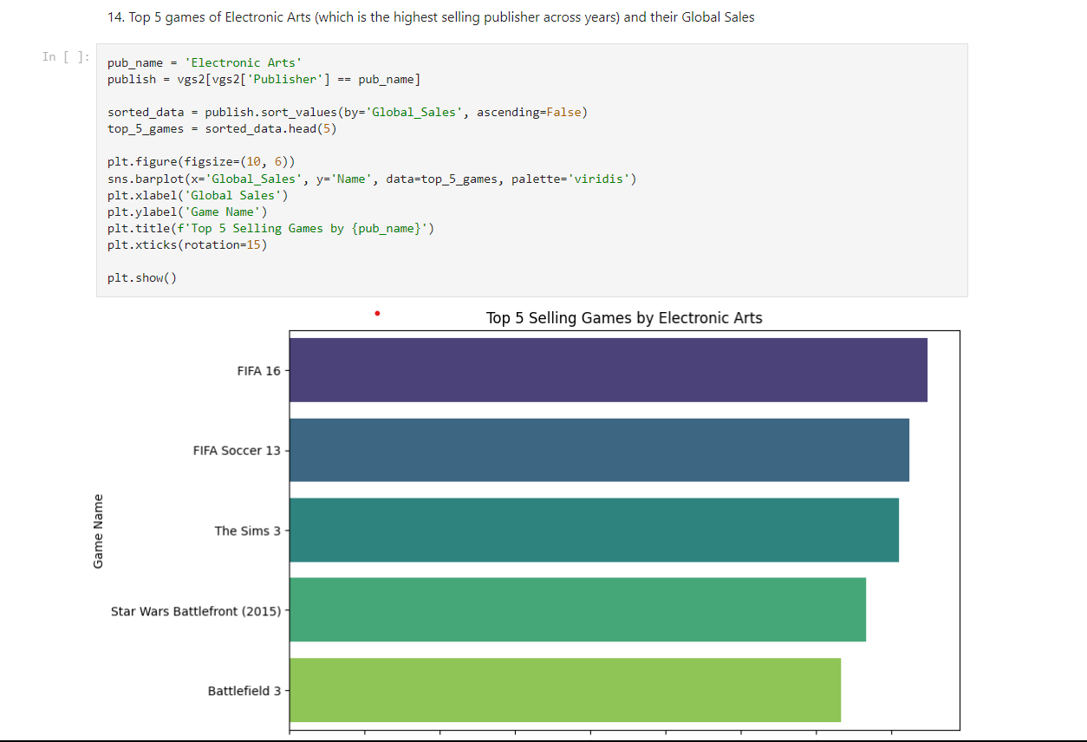
Exploratory data analysis ON
QUESTIONS & vISUALIZATION
Data visualization is the graphical representation of data to help people understand the patterns, trends, and insights contained within the data. It involves creating visual elements such as charts, graphs, maps, and dashboards to make data more accessible and understandable. Data visualization plays a crucial role in data analysis, decision-making, and communication of information.
To achieve visualization, the following aspects are necessary:
Questionnaire
Graphical Representation
VIDEO GAMES SALES

Slide 24
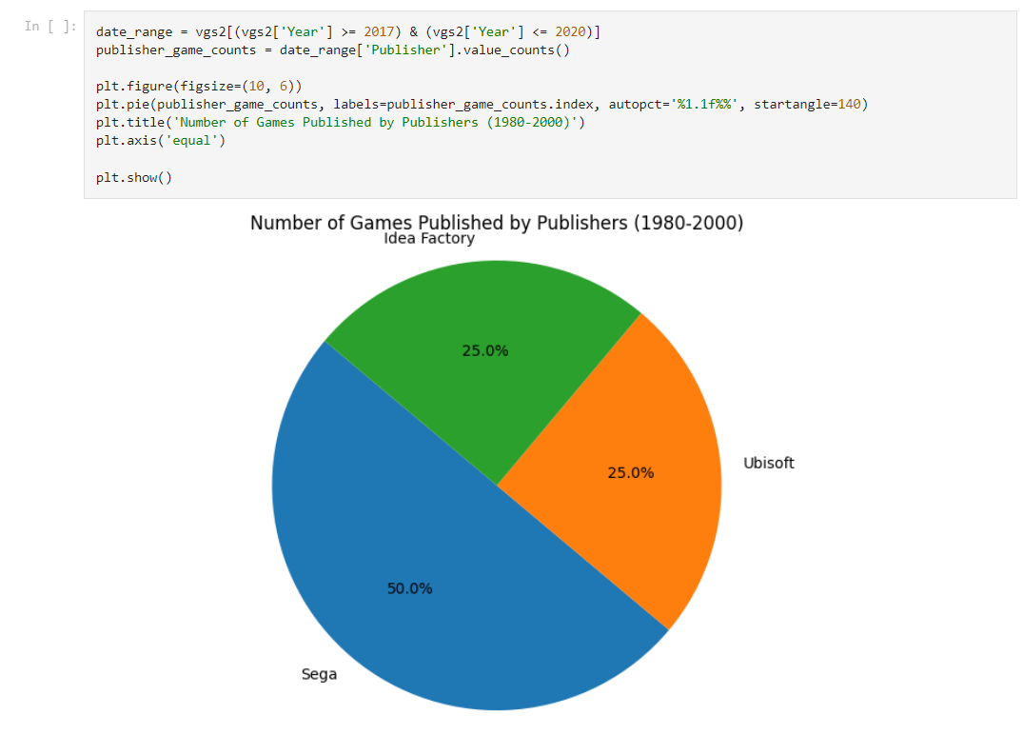
Exploratory data analysis ON
QUESTIONS & vISUALIZATION
Data visualization is the graphical representation of data to help people understand the patterns, trends, and insights contained within the data. It involves creating visual elements such as charts, graphs, maps, and dashboards to make data more accessible and understandable. Data visualization plays a crucial role in data analysis, decision-making, and communication of information.
To achieve visualization, the following aspects are necessary:
Questionnaire
Graphical Representation
VIDEO GAMES SALES

Slide 25
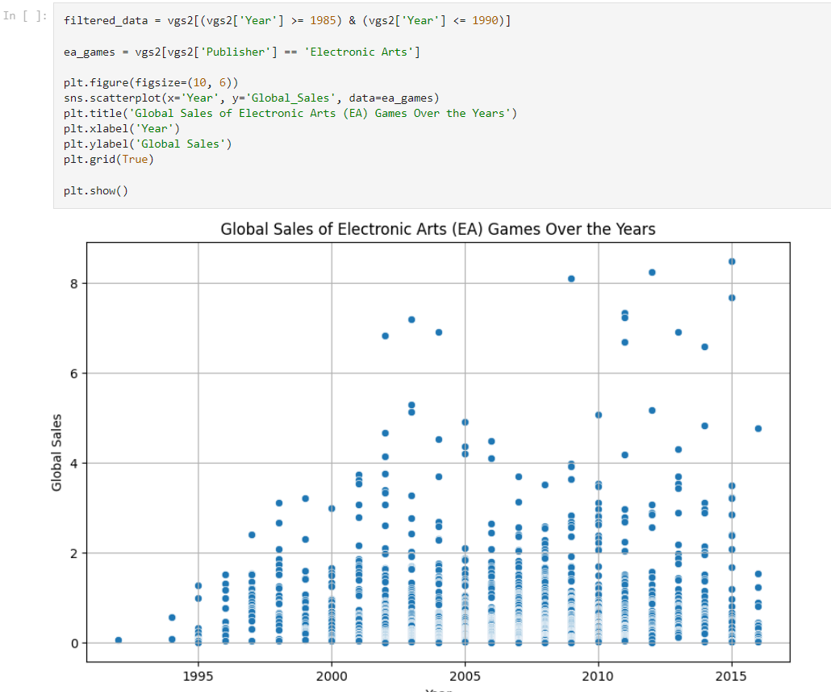
Exploratory data analysis ON
QUESTIONS & vISUALIZATION
Data visualization is the graphical representation of data to help people understand the patterns, trends, and insights contained within the data. It involves creating visual elements such as charts, graphs, maps, and dashboards to make data more accessible and understandable. Data visualization plays a crucial role in data analysis, decision-making, and communication of information.
To achieve visualization, the following aspects are necessary:
Questionnaire
Graphical Representation
VIDEO GAMES SALES

Slide 26
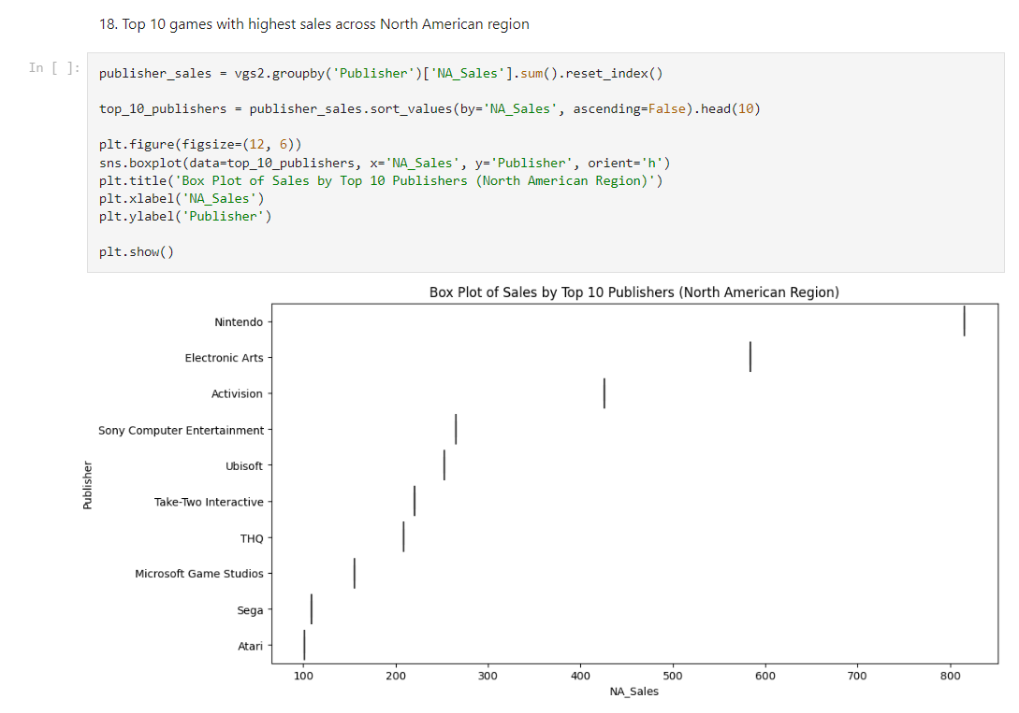
Exploratory data analysis ON
QUESTIONS & vISUALIZATION
Data visualization is the graphical representation of data to help people understand the patterns, trends, and insights contained within the data. It involves creating visual elements such as charts, graphs, maps, and dashboards to make data more accessible and understandable. Data visualization plays a crucial role in data analysis, decision-making, and communication of information.
To achieve visualization, the following aspects are necessary:
Questionnaire
Graphical Representation
VIDEO GAMES SALES

Slide 27
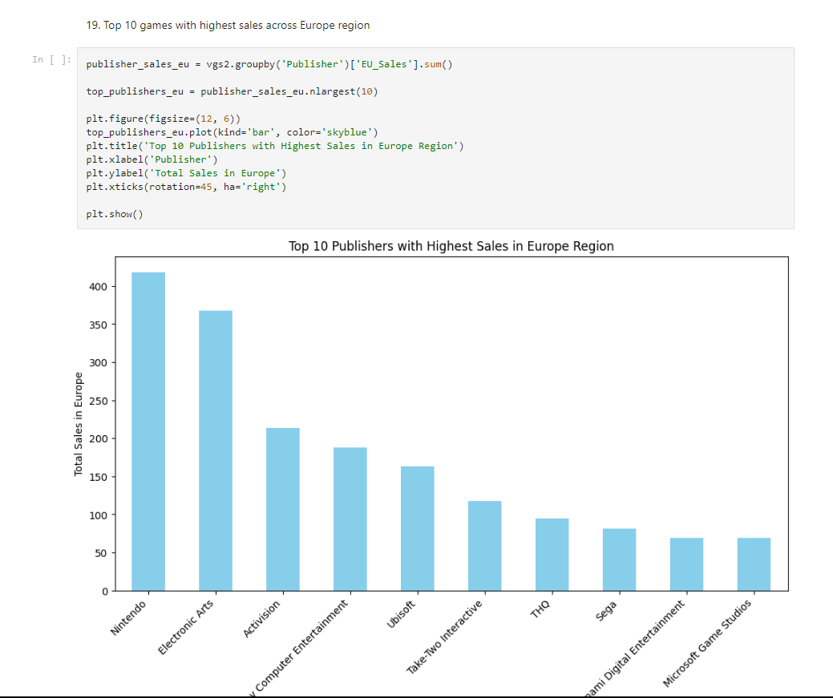
Exploratory data analysis ON
QUESTIONS & vISUALIZATION
Data visualization is the graphical representation of data to help people understand the patterns, trends, and insights contained within the data. It involves creating visual elements such as charts, graphs, maps, and dashboards to make data more accessible and understandable. Data visualization plays a crucial role in data analysis, decision-making, and communication of information.
To achieve visualization, the following aspects are necessary:
Questionnaire
Graphical Representation
VIDEO GAMES SALES

Slide 28
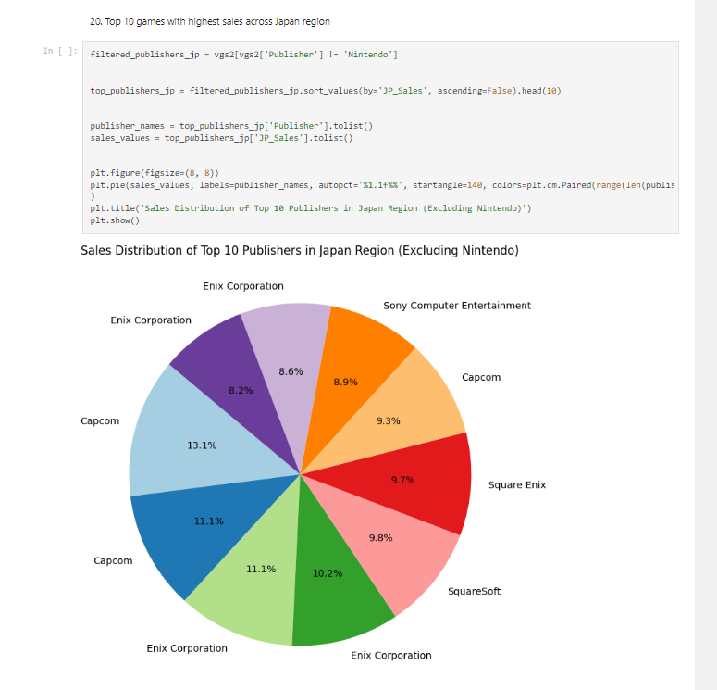
Exploratory data analysis ON
QUESTIONS & vISUALIZATION
Data visualization is the graphical representation of data to help people understand the patterns, trends, and insights contained within the data. It involves creating visual elements such as charts, graphs, maps, and dashboards to make data more accessible and understandable. Data visualization plays a crucial role in data analysis, decision-making, and communication of information.
To achieve visualization, the following aspects are necessary:
Questionnaire
Graphical Representation
VIDEO GAMES SALES

Slide 29
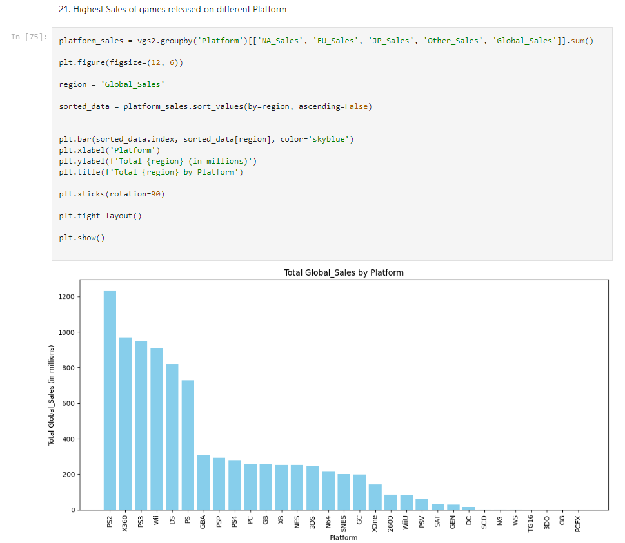
Exploratory data analysis ON
QUESTIONS & vISUALIZATION
Data visualization is the graphical representation of data to help people understand the patterns, trends, and insights contained within the data. It involves creating visual elements such as charts, graphs, maps, and dashboards to make data more accessible and understandable. Data visualization plays a crucial role in data analysis, decision-making, and communication of information.
To achieve visualization, the following aspects are necessary:
Questionnaire
Graphical Representation
VIDEO GAMES SALES

Slide 30
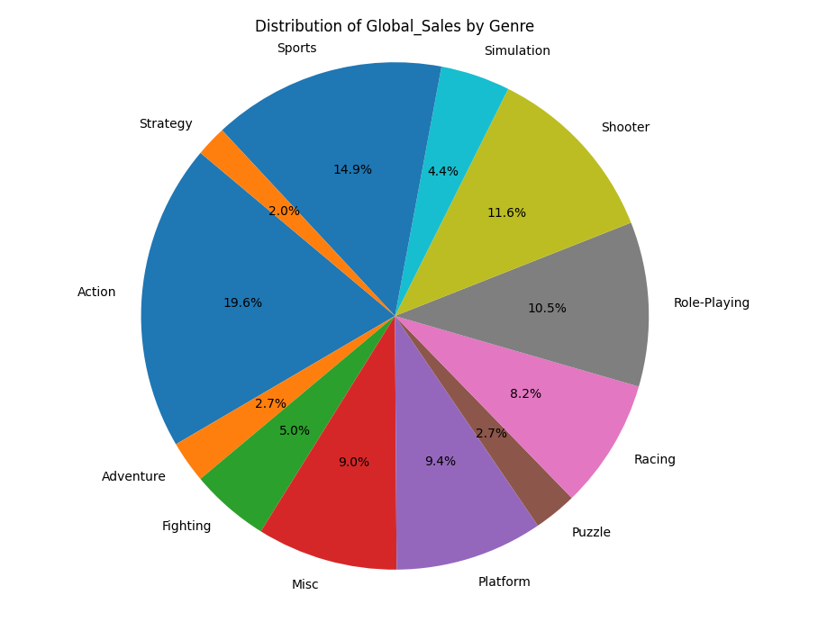
Exploratory data analysis ON
QUESTIONS & vISUALIZATION
Data visualization is the graphical representation of data to help people understand the patterns, trends, and insights contained within the data. It involves creating visual elements such as charts, graphs, maps, and dashboards to make data more accessible and understandable. Data visualization plays a crucial role in data analysis, decision-making, and communication of information.
To achieve visualization, the following aspects are necessary:
Questionnaire
Graphical Representation
VIDEO GAMES SALES

Slide 31
Exploratory data analysis ON
conclusion
VIDEO GAMES SALES

Slide 32
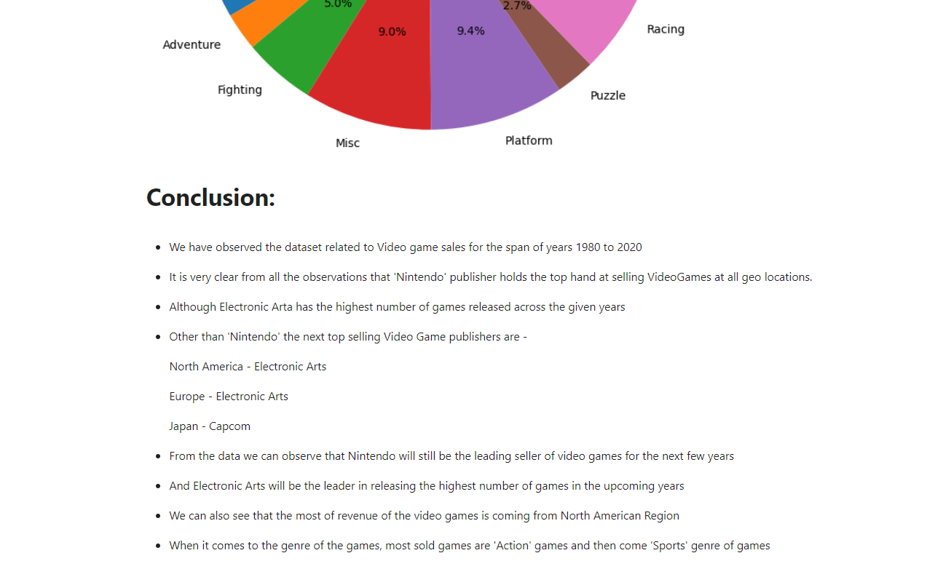
Exploratory data analysis ON
QUESTIONS & vISUALIZATION
Data visualization is the graphical representation of data to help people understand the patterns, trends, and insights contained within the data. It involves creating visual elements such as charts, graphs, maps, and dashboards to make data more accessible and understandable. Data visualization plays a crucial role in data analysis, decision-making, and communication of information.
To achieve visualization, the following aspects are necessary:
Questionnaire
Graphical Representation
VIDEO GAMES SALES

Slide 33
Exploratory data analysis ON
SOURCES
https://www.kaggle.com/datasets/gregorut/videogamesales/
Github link
https://github.com/noelsamrouthu/EDA-on-VideoGame-Sales
VIDEO GAMES SALES

