Slide 1
Global Drifter Data Program Data Analysis
Philip Boone
Noel Weichbrodt

Slide 2
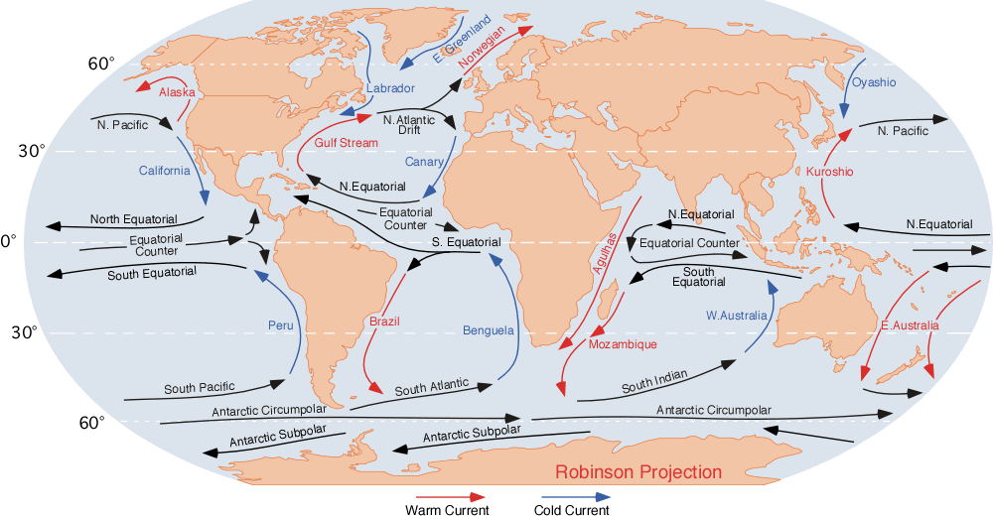
Currents
Notes:
Currents
Important in dispersal of ocean-dwelling life forms
Study of marine debris
Effect on temperature: currents bring warm water up the north Atlantic

Slide 3
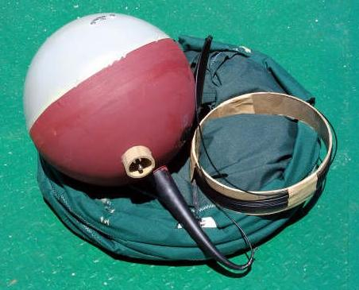
Drifters

Slide 4

Gaussian Kernel Smoother
A = 1
σ_{x} = σ_{y} = 1

Slide 5
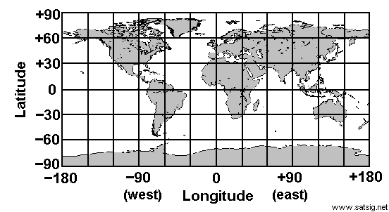
Latitude and Longitude Divisions

Slide 6
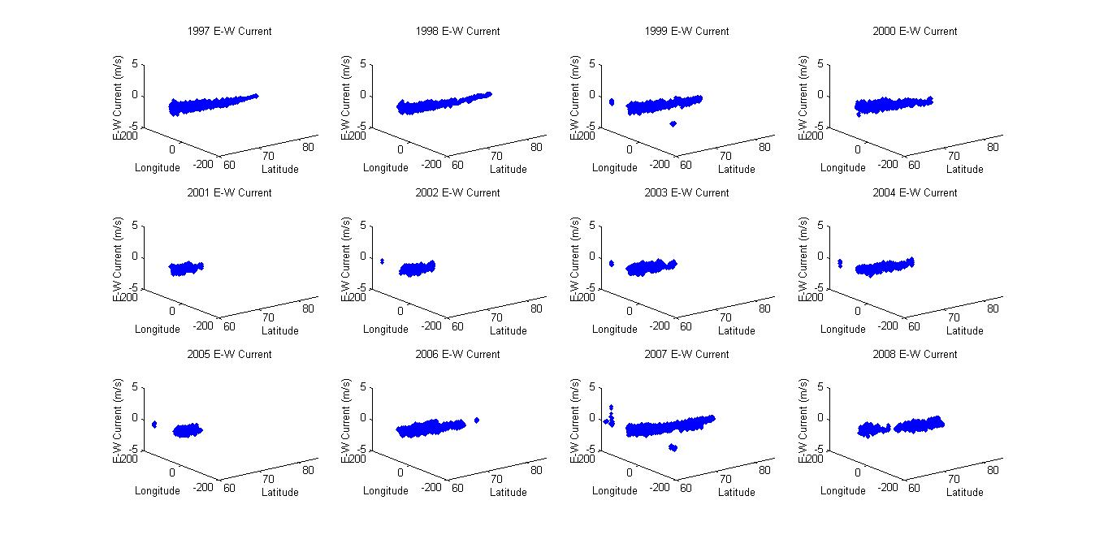
1997-2008 Arctic Raw East-West Current

Slide 7
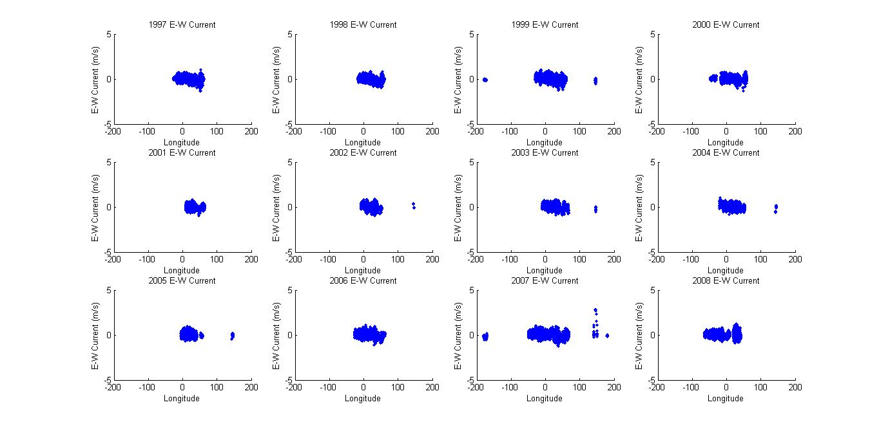
1997-2008 Raw East-West Current vs. Longitude

Slide 8
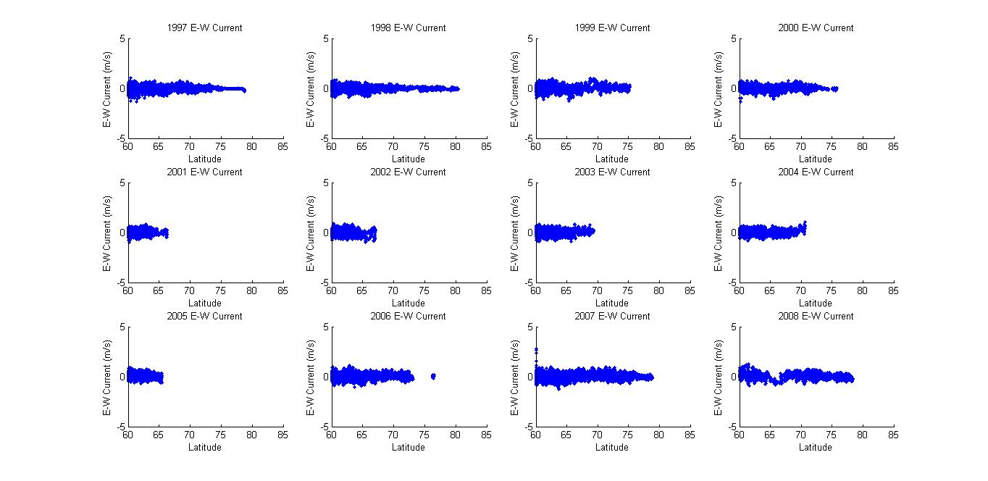
1997-2008 Raw East-West Current vs. Latitude

Slide 9
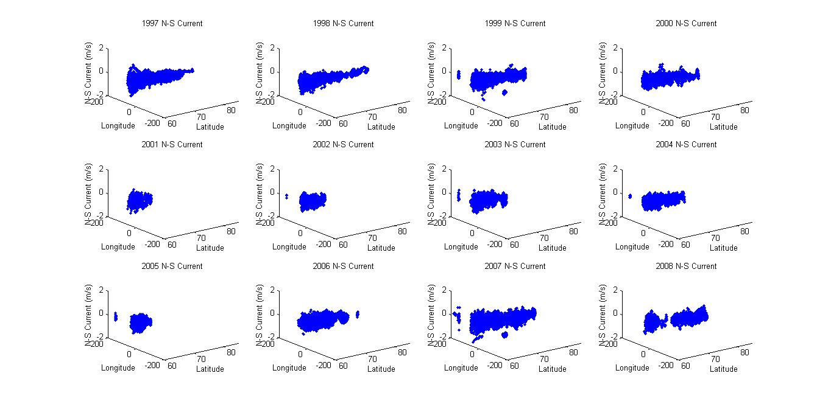
1997-2008 Arctic Raw North-South Current

Slide 10
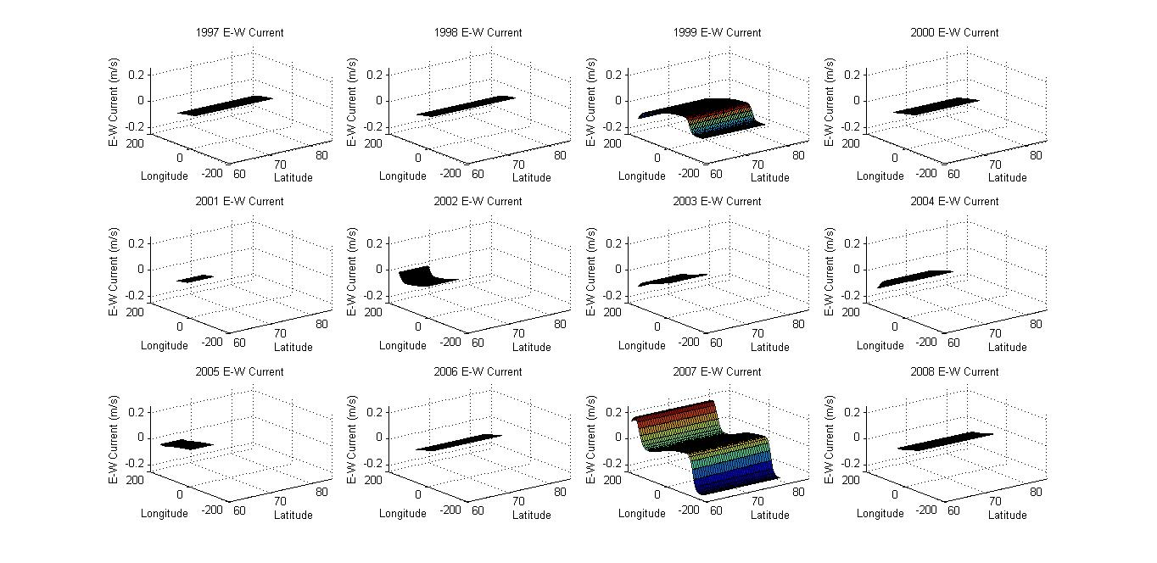
1997-2008 Arctic East-West Current Smoothed

Slide 11
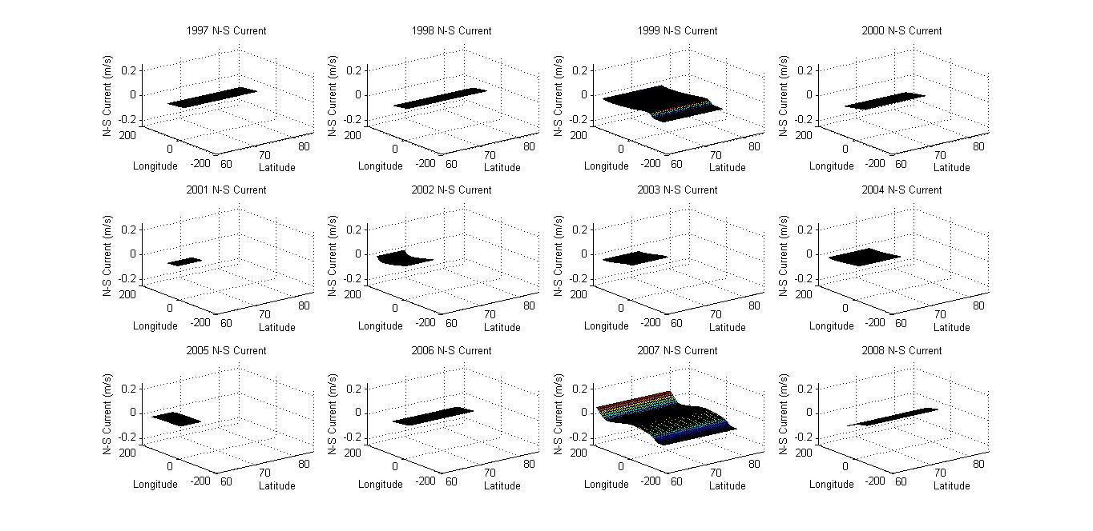
1997-2008 Arctic North-South Current Smoothed

Slide 12
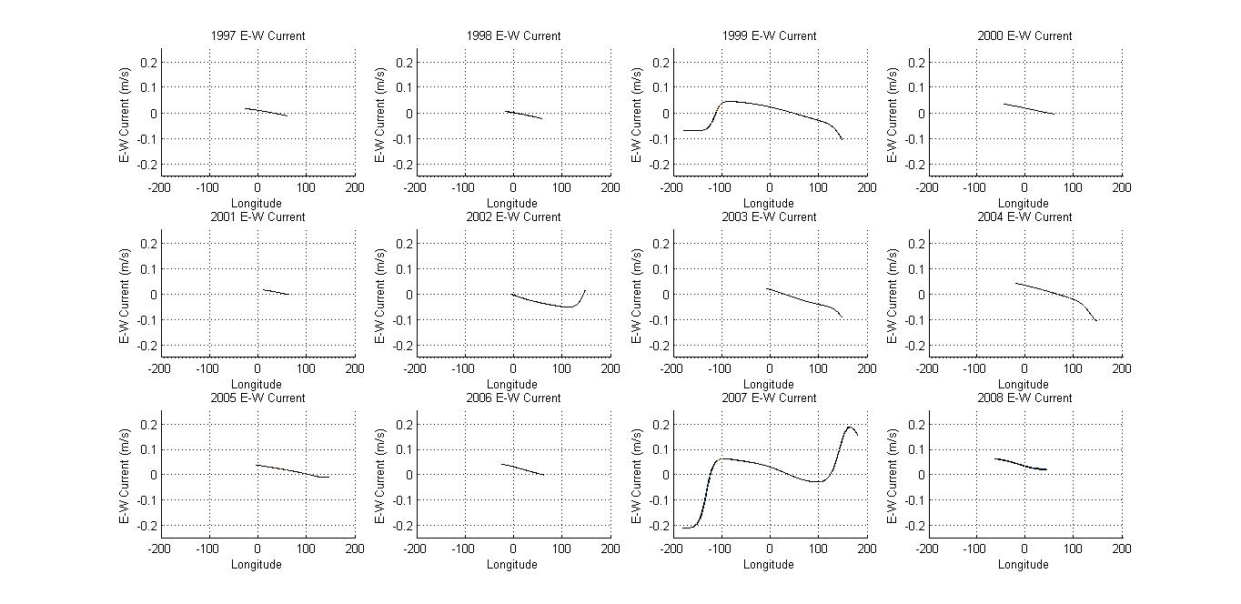
1997-2008 Arctic East-West Current Smoothed vs. Longitude

Slide 13
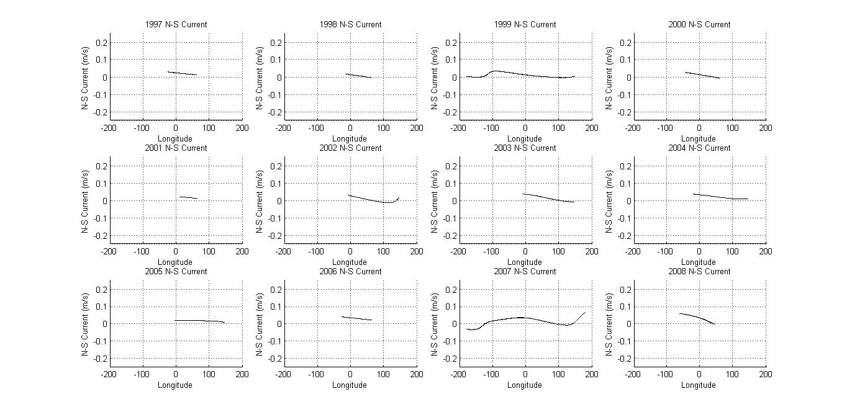
1997-2008 Arctic North-South Current Smoothed vs. Longitude

Slide 14
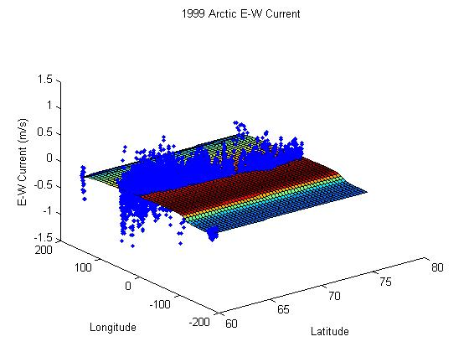
1999 Arctic East-West Current

Slide 15
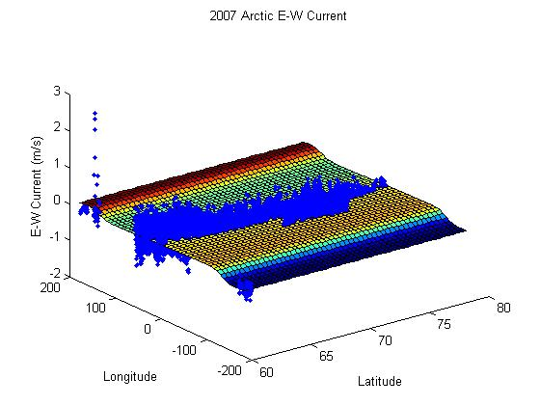
2007 Arctic East-West Current

Slide 16
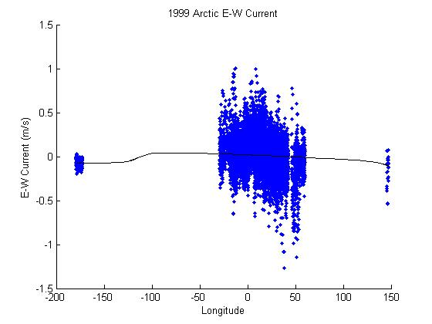
1999 Arctic East-West Current vs. Longitude

Slide 17
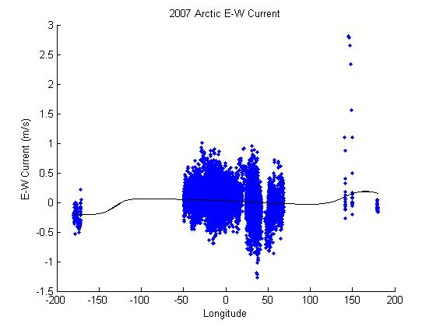
2007 Arctic East-West Current vs. Longitude

Slide 18
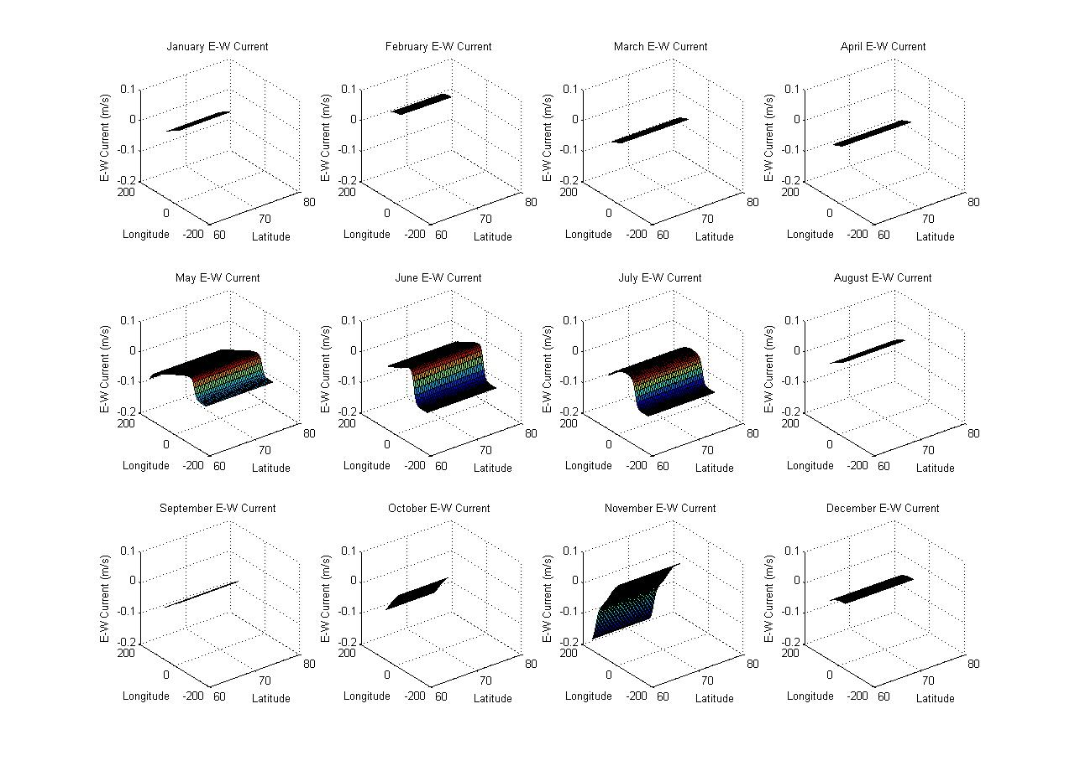
1999 Arctic Monthly East-West Current

Slide 19
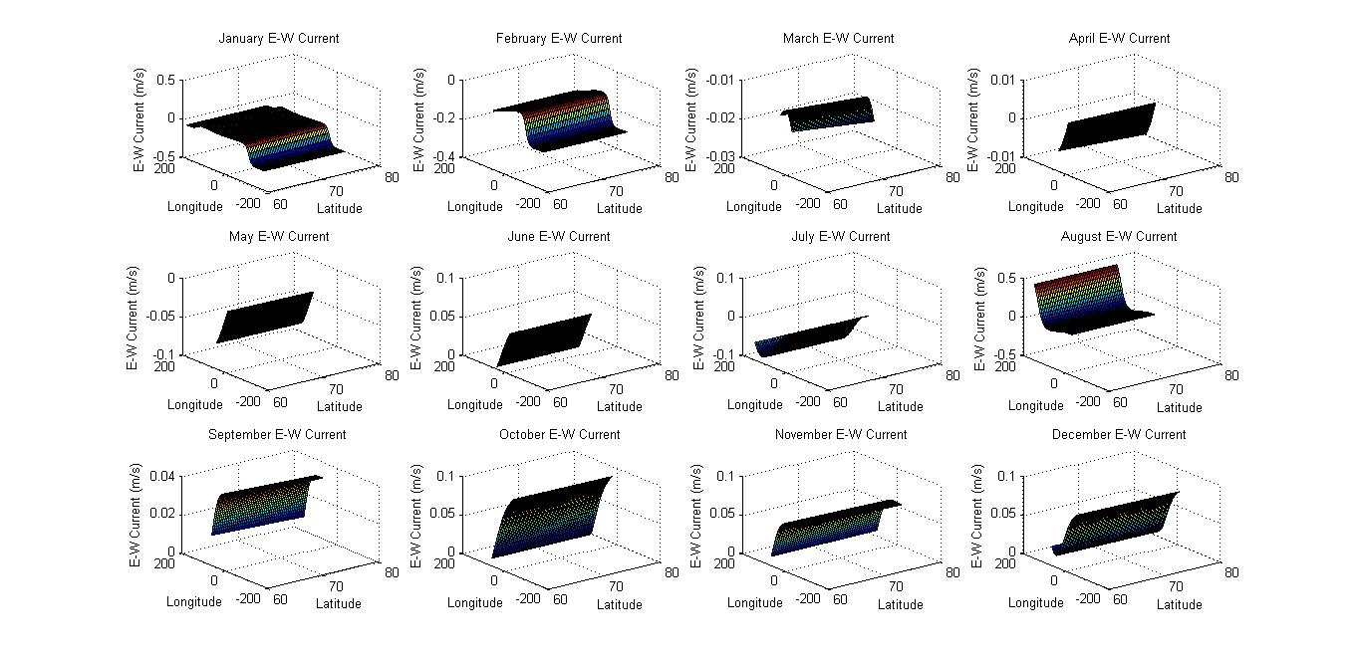
2007 Arctic Monthly East-West Current

Slide 20
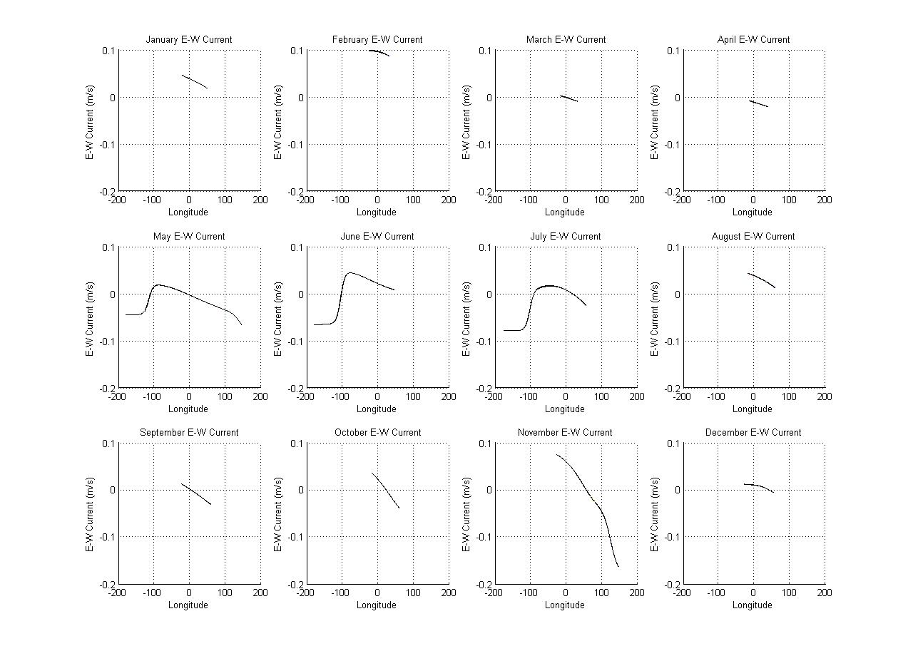
1999 Arctic Monthly East-West Current vs. Longitude

Slide 21
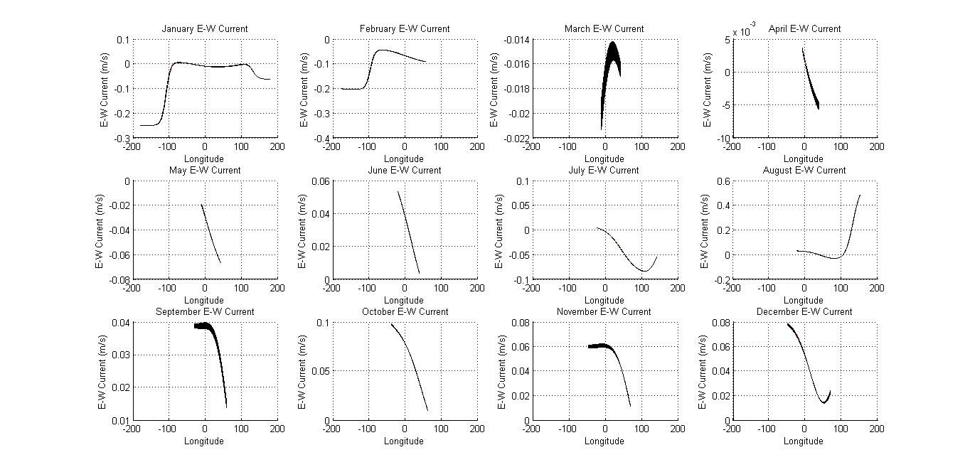
2007 Arctic Monthly East-West Current vs. Longitude

Slide 22
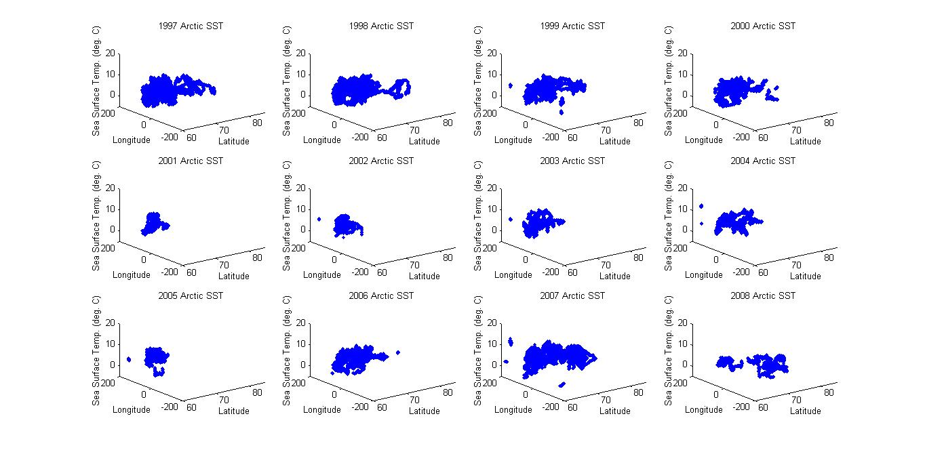
12 Year Arctic Raw Sea Surface Temp.

Slide 23
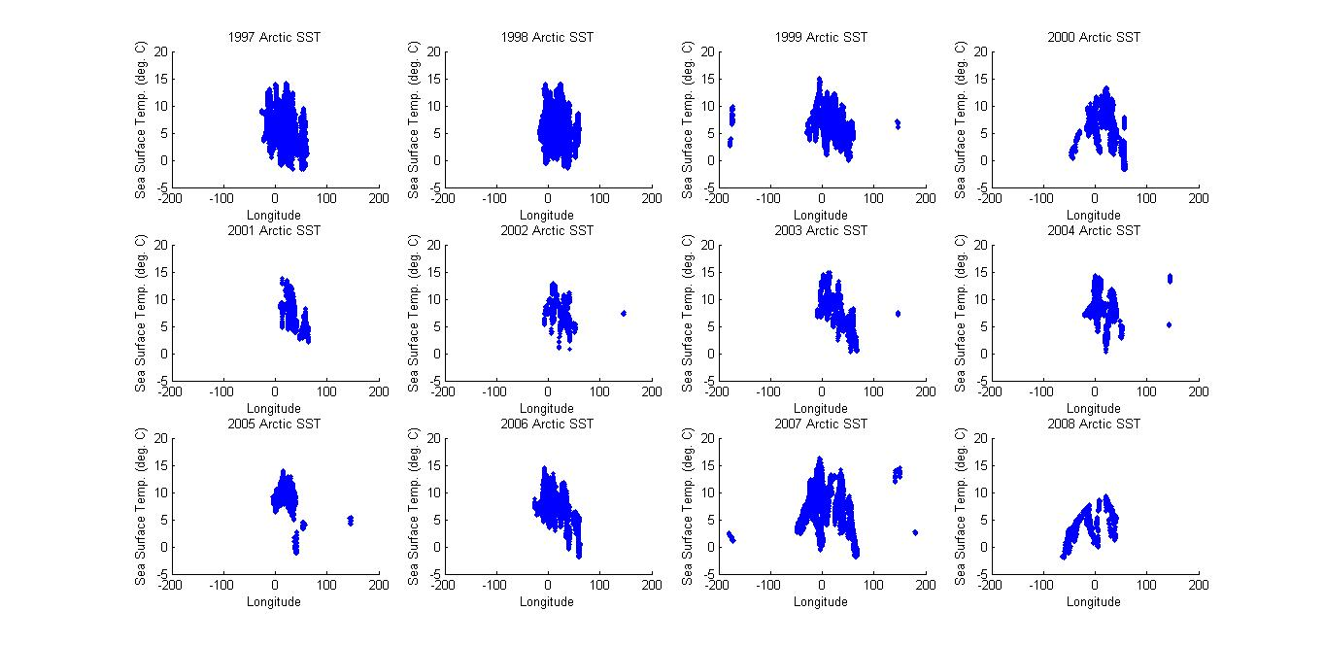
12 Year Arctic Raw Sea Surface Temp. vs. Longitude

Slide 24
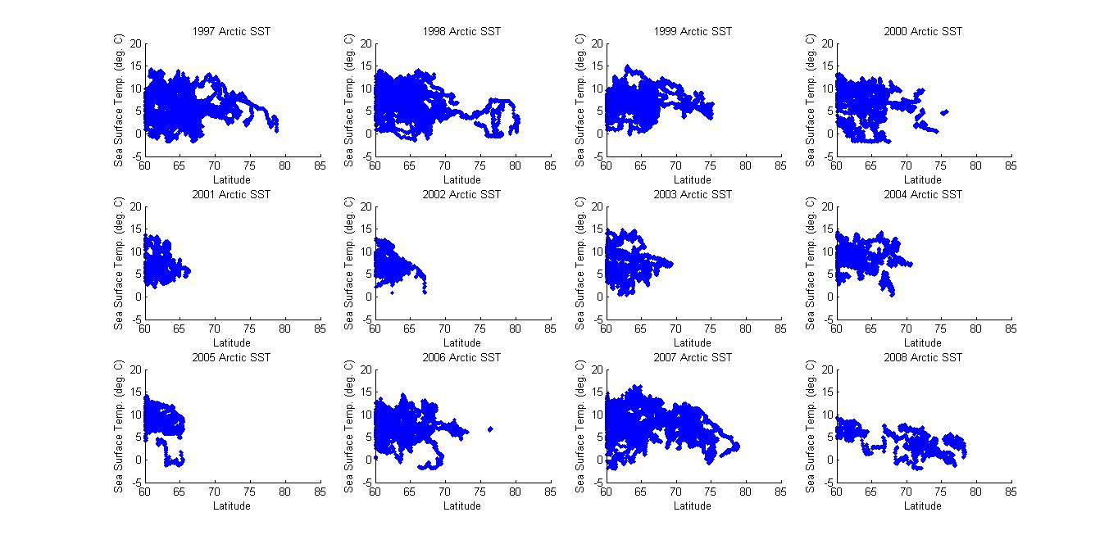
12 Year Arctic Raw Sea Surface Temp. vs. Latitude

Slide 25
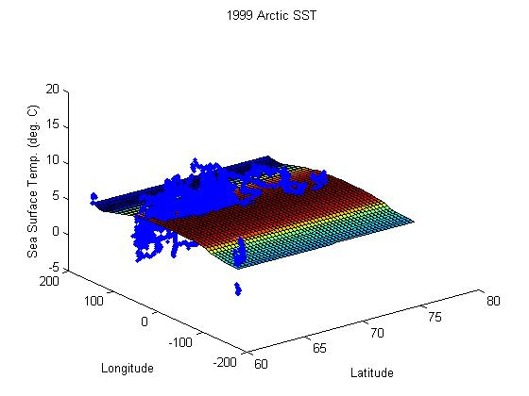
1999 Arctic Sea Surface Temp. Smoothed

Slide 26
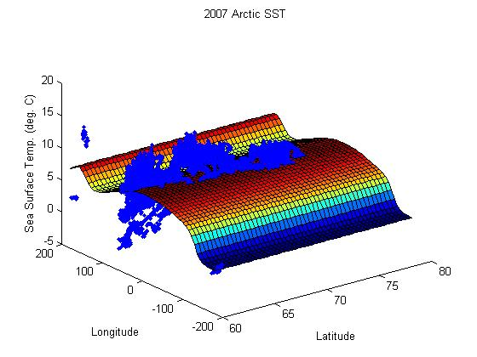
2007 Arctic Sea Surface Temp. Smoothed

Slide 27
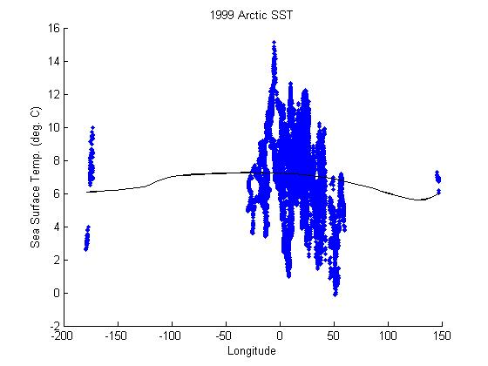
1999 Arctic Sea Surface Temp. Smoothed vs. Longitude

Slide 28
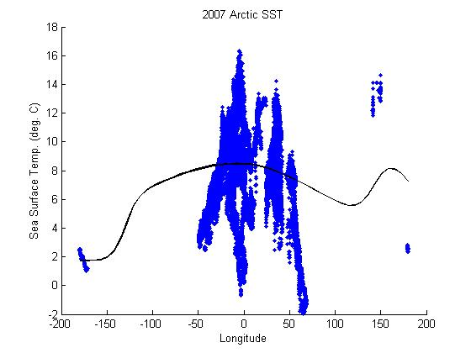
1999 Arctic Sea Surface Temp. Smoothed vs. Longitude

Slide 29
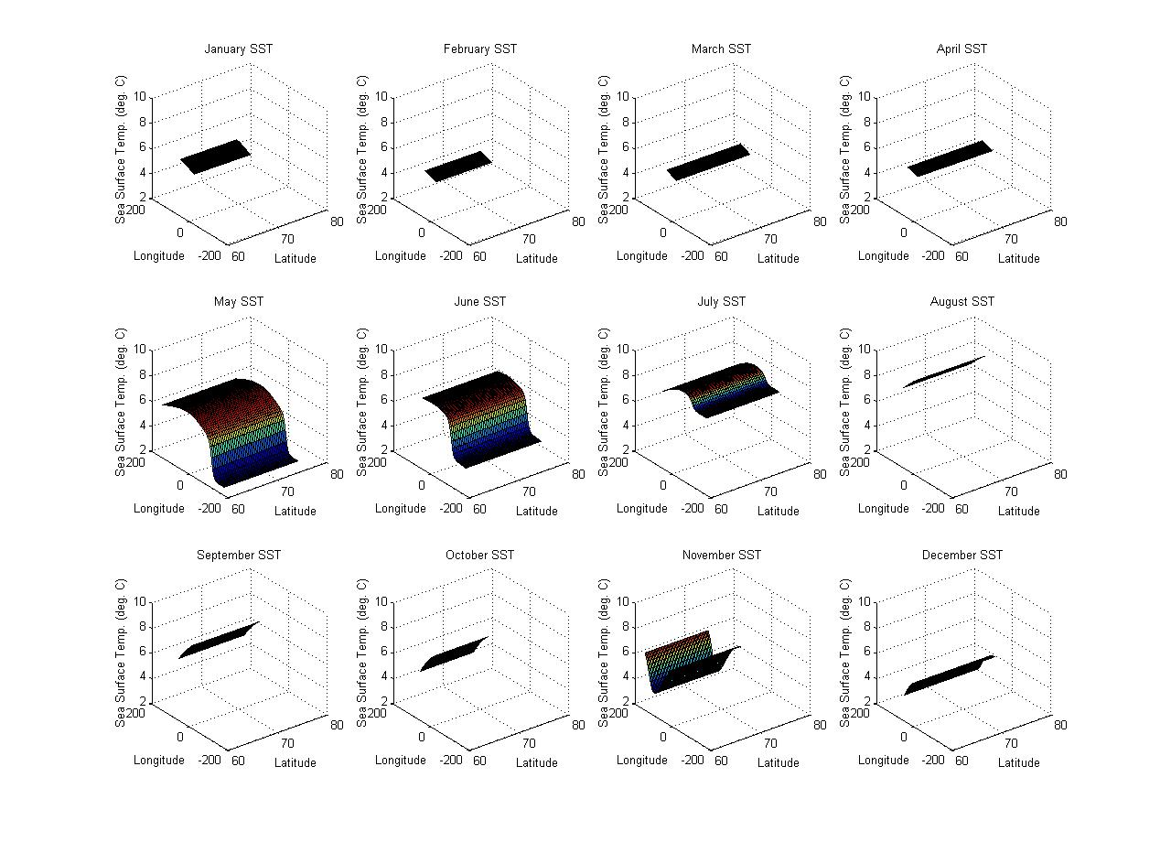
1999 Arctic Monthly Sea Surface Temp.

Slide 30
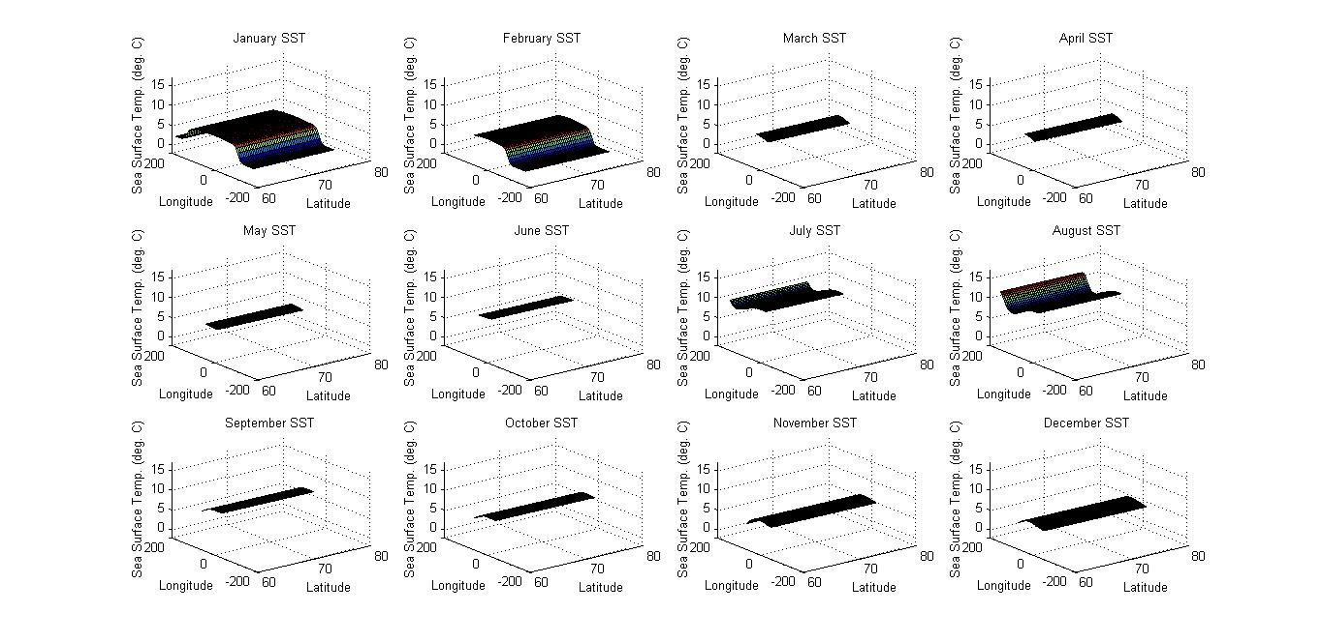
2007 Arctic Monthly Sea Surface Temp.

Slide 31
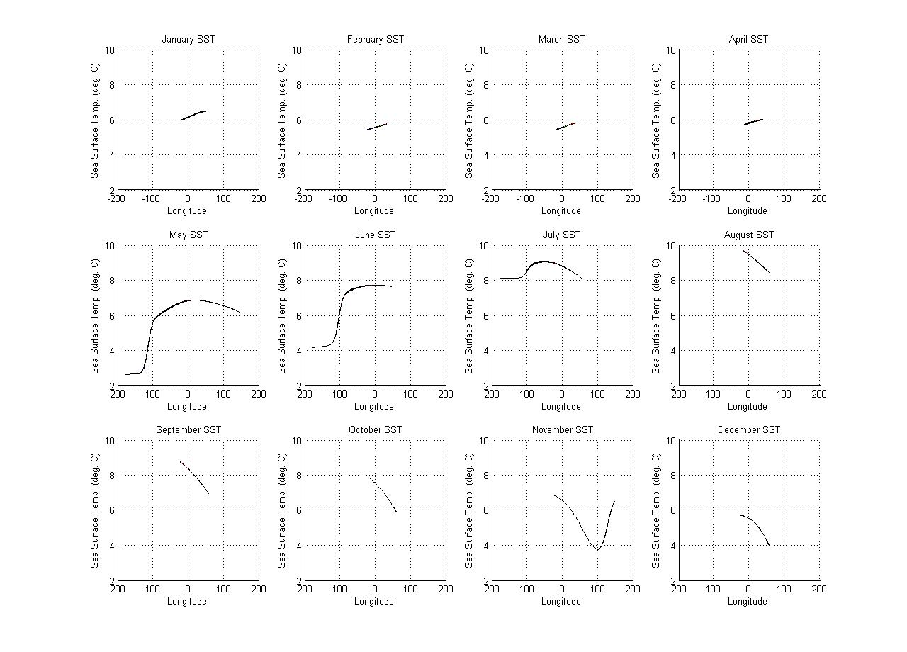
1999 Arctic Monthly Sea Surface Temp. vs. Longitude

Slide 32
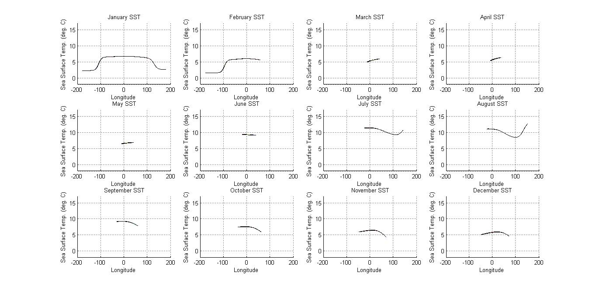
2007 Arctic Monthly Sea Surface Temp. vs. Longitude

