Slide 1
Responsible Conduct in Research

Slide 2

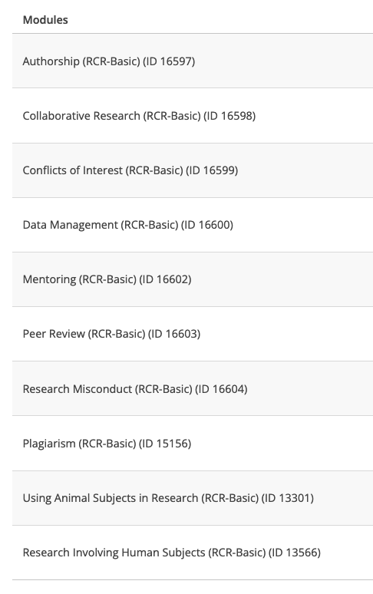
All faculty, students, post-docs need to do this training
Send me completed notification that you did the CITI training and I’ll give you 10 extra credit points

Slide 3
Authorship
Universally accepted rules for authorship do not exist across disciplines
A person that has a ”significant intellectual contribution” should be considered an author
Plant Pathology – First author did most or all of the work, second author did some stuff … last author is corresponding author, usually the PI.
First and corresponding author should be contacted regarding data, methods, and code availability
Reproducibility?

Slide 4
Collaboration
Mutually agreed upon goals and duties
Including data sharing and data management
Data management plans and memorandum of understanding documents can be useful to spell out collaborative agreements
Reproducibility?

Slide 5
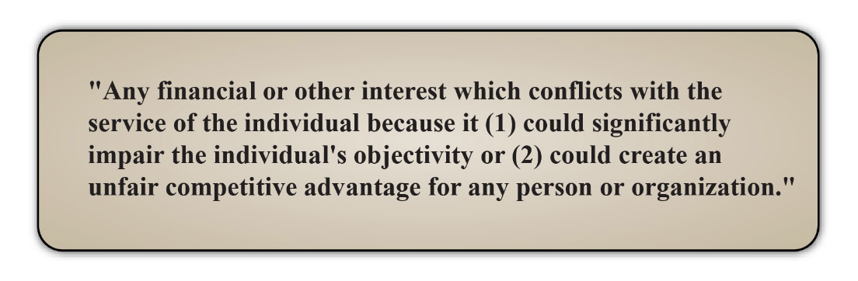
Conflicts of interest
personal, commitment
Reproducibility?
https://www.citiprogram.org/members/index.cfm?pageID=665&ce=1#view

Slide 6
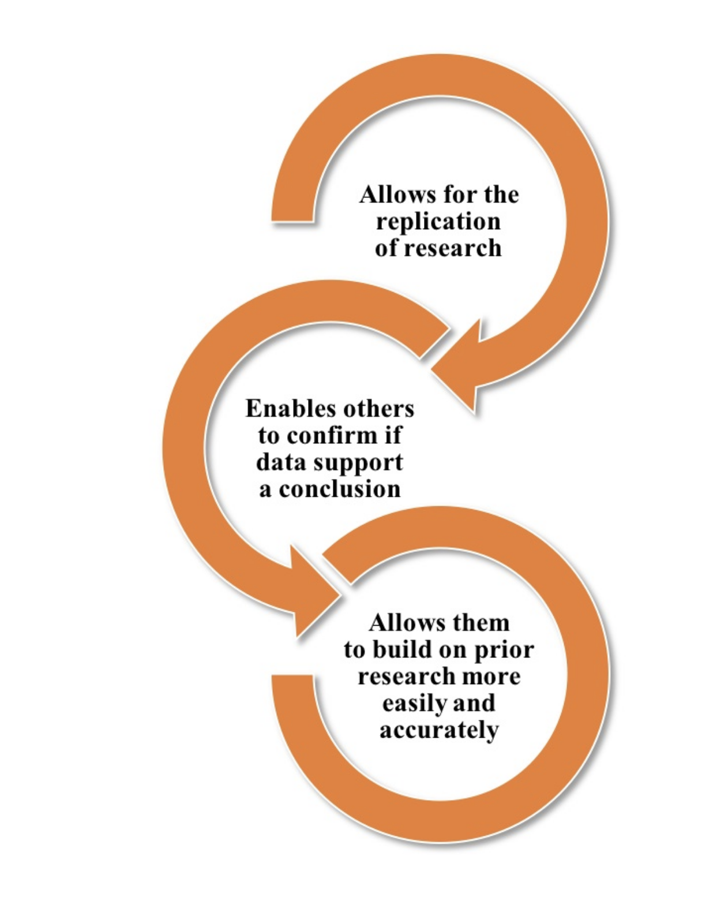
Data management
Systematic plans to eliminate confusion, bias, and errors
reliability and validity
data stewardship
Reproducibility?

Slide 7
Mentorship
Responsibilities of mentor
Honest and fair
Clarifying expectations
Balance personal and professional goals
Responsibilities of trainee
Identify goals
Find a good mentor for you
Actively participate to communicate needs
Reproducibility?

Slide 8
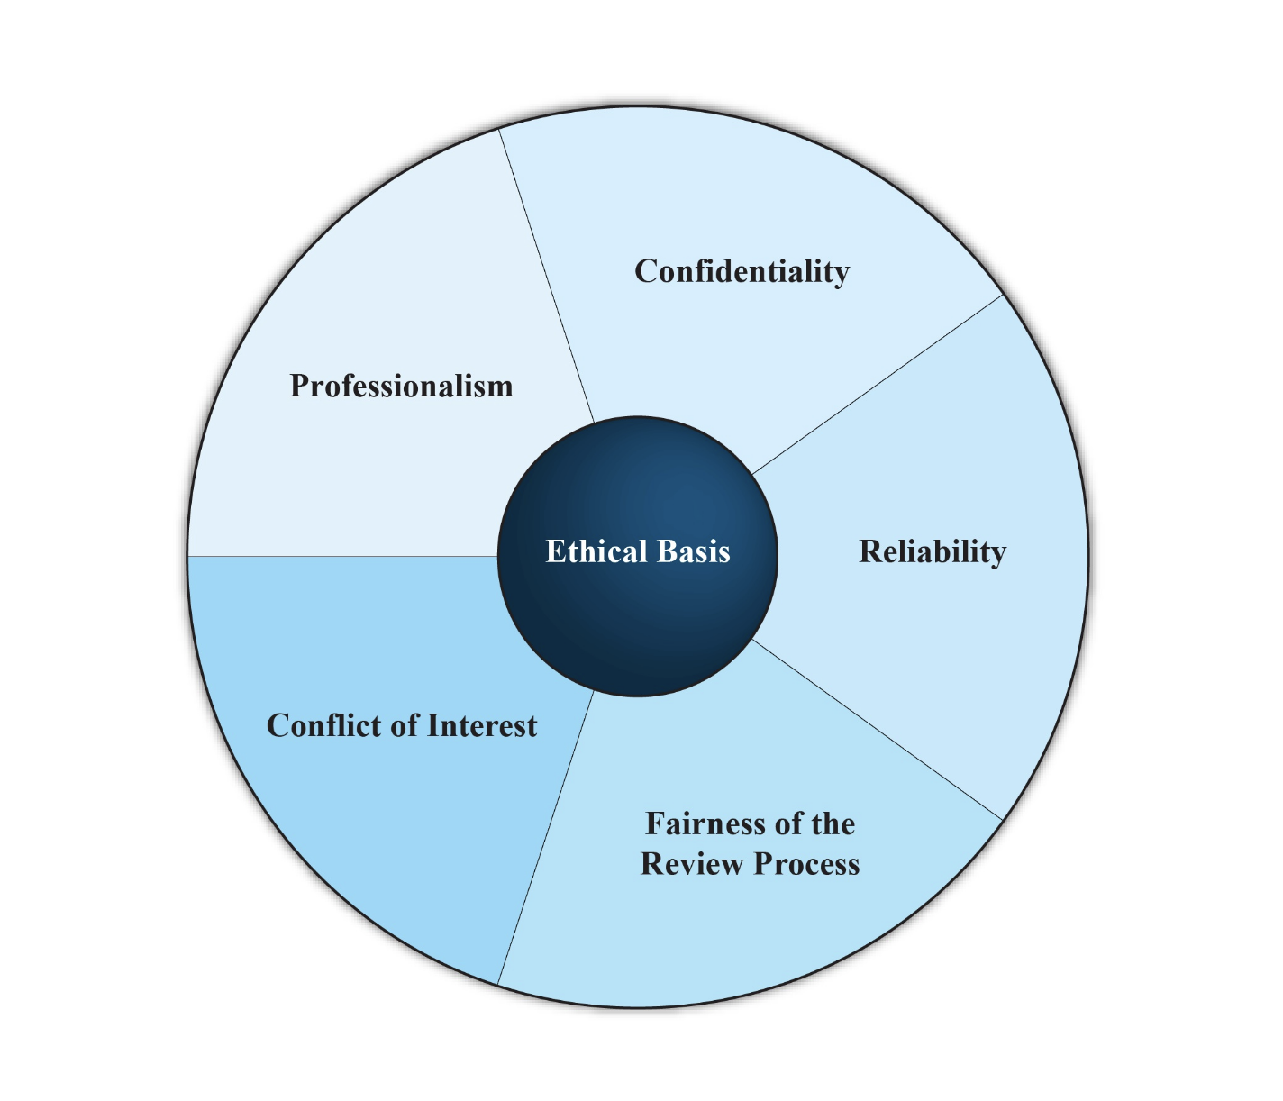
Peer review
Reproducibility?
https://www.citiprogram.org

Slide 9
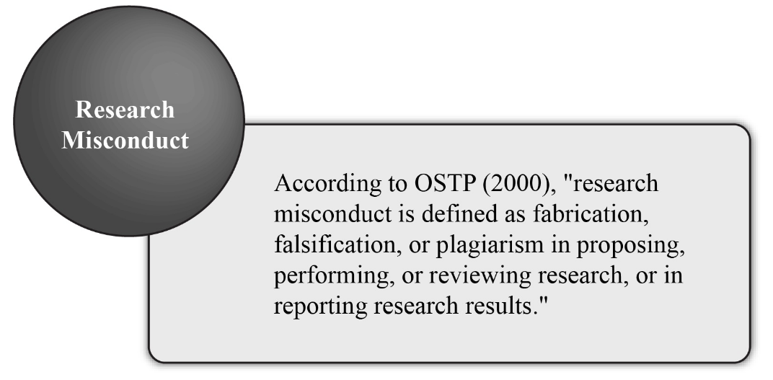
Research misconduct
Fabrication – make up data
Falsification – changing or omitting data
Plagiarism – taking someone else's words or ideas as your own
Reproducibility?
https://www.citiprogram.org

Slide 10

Choose your own adventure!!
Split into four groups
Work together through the videos.
Maybe choose different adventures
Group discussion at the end
https://ori.hhs.gov/TheLab/TheLab.shtml

