Slide 1
Data Management Plans
Partially prepared from DataONE Education Modules https://www.dataone.org/
and https://www.nal.usda.gov/data/data-management-plan-guidance

Slide 2
Outline
What is a data management plan?
Purpose of a data management plan
data management plan components
Example DMPs – Critique my DMP!!

Slide 3
What is a data management plan?
A document for the plan of what you will do with the data you collect
Plan not necessarily reproducibility of analysis
plans for data accessibility in a public repository
DMPs are living documents!

Slide 4
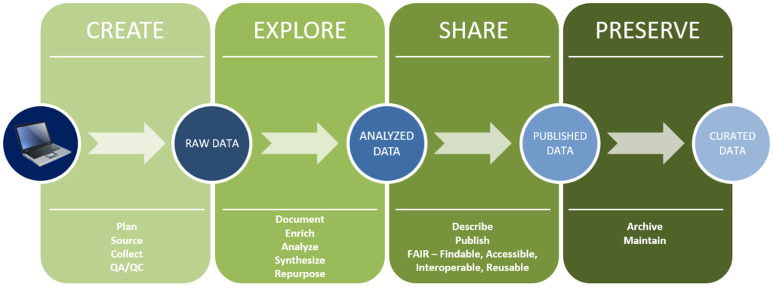
Data management plans
https://rto.asu.edu/research-data-management/data-management-planning/

Slide 5
Purpose of a data management plan
Increases research efficiency and organization
Improves communication between research team
Ensures others will be able to use data
Funding requirement
Reproducibility standards
Findable
Accessible
Interpretable
Reusable

Slide 6
DMP components
Expected data types
Data formats and standards
Data storage and preservation
Data sharing, protection, and public access
Roles and responsibilities
Budget

Slide 7
Expected Data Types
Describe the types of data you will produce
environmental data
sensors
images
video and audio recordings
digital transcriptions
field notebooks from crop management experiments
sequence data for whole genomes or metagenomics
Custom computer code or scripts
metadata
How and when it will be acquired

Slide 8

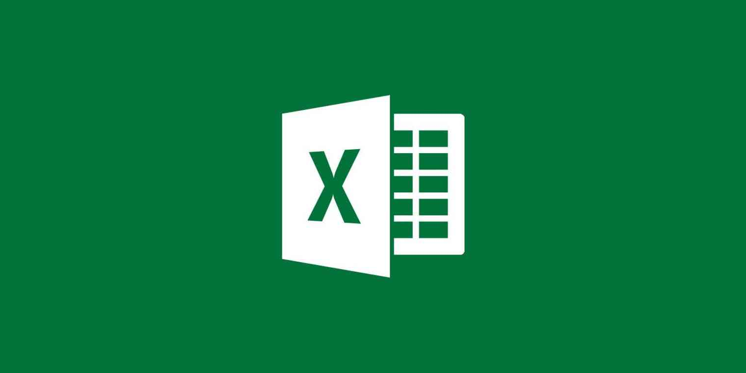
Data Formats and Standards
Data formats
excel, text, csv, fasta
Justification of file formats
Data standards
Naming conventions
How data will be processed into other forms for different software

Slide 9
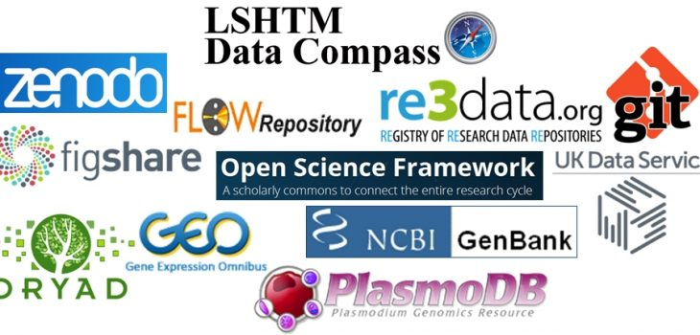
Data Storage and Preservation of Access
Describe where the data will be deposited in a trusted archiving environment for the life of the project
Short and long term
Short term may be locally and non-public
own computer
HPC
External drive
FigShare
GitHub
BitBucket

Slide 10
Data Sharing and Public Access
Describe your data access and sharing procedures
plans for publication or public release
Name specific repositories, databases, and catalogs as appropriate. Many repositories for storage and preservation also offer public access functionality (e.g. the Ag Data Commons).
USDA strongly discourages limiting distribution of data to project or personal websites only. Similarly,
In most cases it is insufficient to make data available only on request
Long term storage must exist in some repository
Two repositories and a local copy are good
GitHub and SRA or Genebank
Harvard Dataverse
AUrora (Auburn Library)
Ag Data Commons (USDA repository)

Slide 11

Roles and Responsibilities
Note who will primarily ensure DMP implementation.
Define key roles of the DMP team.
Provide a contingency plan in case key personnel leave the project.
Describe what resources are needed to carry out the DMP.
Funding for salary data manager
Funding for data repository submission

Slide 12
Critique my DMP!!

Slide 13
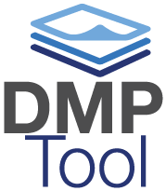
Make your own DMP
https://dmptool.org

