Slide 1
Naming things – Organizing for yourself and for others
Prepared in part by Jenny Bryan – Reproducible Science Workshop

Slide 2
Overview
Naming files
Naming things within files
File organization

Slide 3
Overview
Naming files
Naming things within files
File organization

Slide 4
Three principles for naming files
Machine readable
Human readable
Computer organizes for you

Slide 5
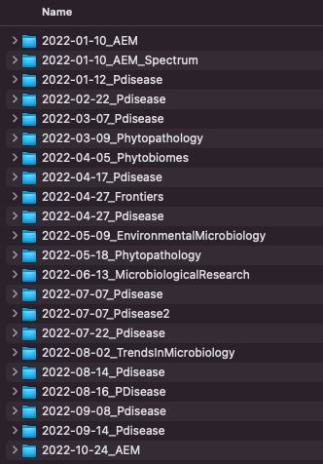
Machine readable
Regular expression and searching friendly
do not use spaces, punctuation, accented characters, case sensitive
Easy to search
deliberate and consistent use of delimiters
_ helps separate the journal reviewed

Slide 6
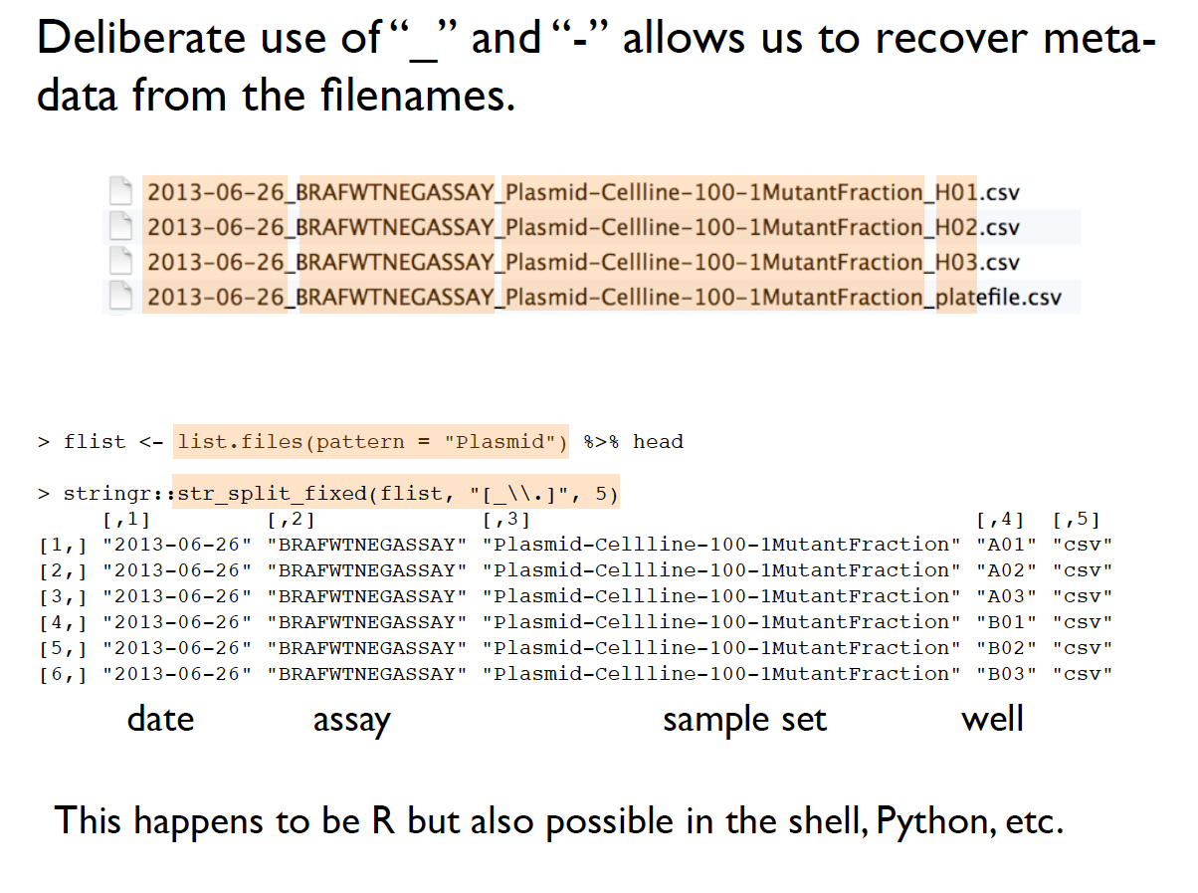
Machine readable
Jenny Bryan – Reproducible Science Workshop

Slide 7
Machine readable
Easy to search for files later
Easy to narrow file lists based on names
Easy to extract info from files – metadata
Avoid the following:
Spaces in file names
punctuation
accented characters

Slide 8
Human readable
Name contains content
Sample info
time
date
well number
etc…
Should be obvious what it is just by looking at it

Slide 9
Computer organizes things for you
Use ISO 8601 standard for dates
YYYY-MM-DD

Slide 10
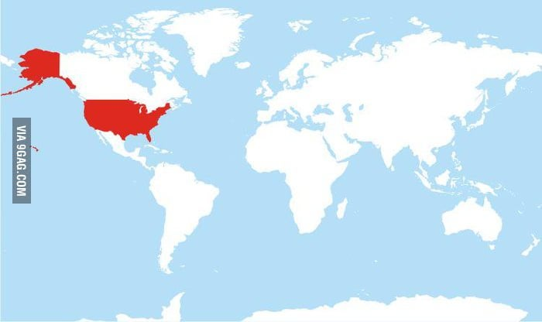
Countries using MM-DD-YYYY format
https://www.reddit.com/r/funny/comments/4jtat7/comprehensive_map_of_all_countries_that_use_the/

Slide 11
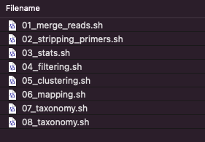
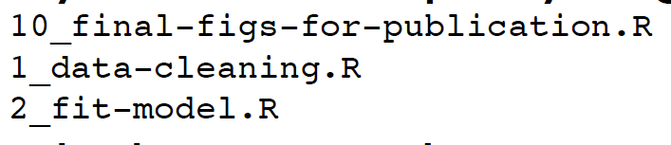
Computer organizes things for you
Numeric first
left pad numbers with zeros
Not left padded

Slide 12
Three principles for naming files
Machine readable
Human readable
Computer organizes for you
Something easy to do that will pay you back so much in the long run
May have to do this multiple times

Slide 13
Overview
Naming files
Naming things within files
File organization

Slide 14
Naming things within files
Machine readable
Human readable
Computer organizes for you

Slide 15
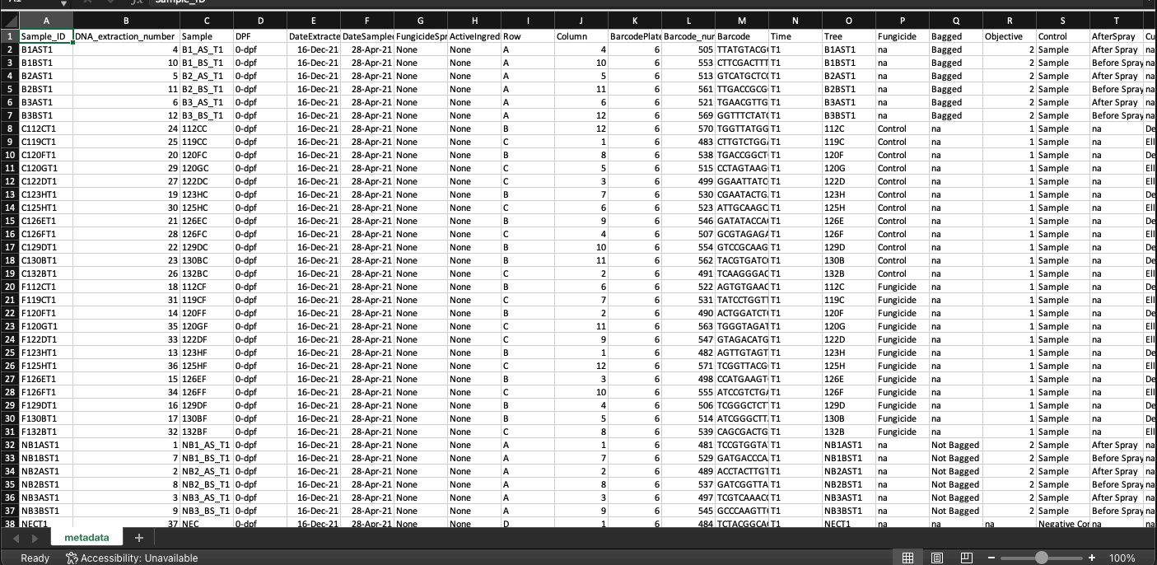
Column headers no spaces, delimiters, units written in words, sample names mean something

Slide 16
Overview
Naming files
Naming things within files
File organization

Slide 17
Data formatting
Garbage In, Garbage out
Excel and other spreadsheet programs are great until you have to reproduce anything
https://datacarpentry.org/2015-03-09-ISI-CODATA/lessons/excel/ecology-examples/00-intro.html

Slide 18
Data formatting
Can use them for
organizing data
data entry
subsetting data
sorting data
stats
plots
Tables
https://datacarpentry.org/2015-03-09-ISI-CODATA/lessons/excel/ecology-examples/00-intro.html

Slide 19
Data formatting
Can use them for
organizing data
data entry
subsetting data
sorting data
stats
plots
Tables
BUT SHOULD WE?
Difficult to reproduce or track what we are doing
https://datacarpentry.org/2015-03-09-ISI-CODATA/lessons/excel/ecology-examples/00-intro.html

Slide 20
Data formatting Rules
All variables in one column
One observation per row
Once entered – do not touch it!
Export to a text based format
Never merge cells
Coded treatments, within experiment replicates, experimental replication, response

Slide 21

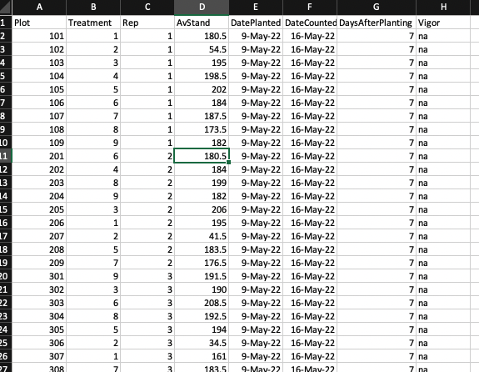
Good
Long data
one row = one datum point with separate columns for treatments

Slide 22

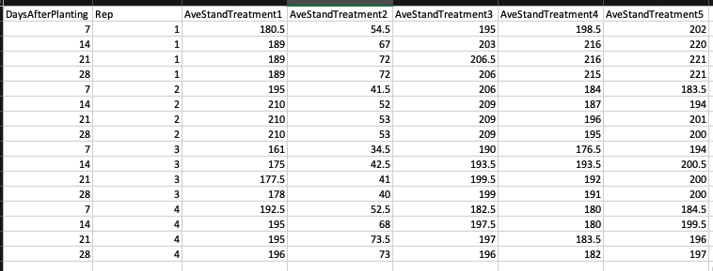
OK
Wide data
one row = all data for one treatment rep combination

Slide 23

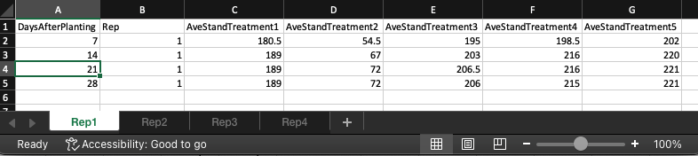
The bad

Slide 24

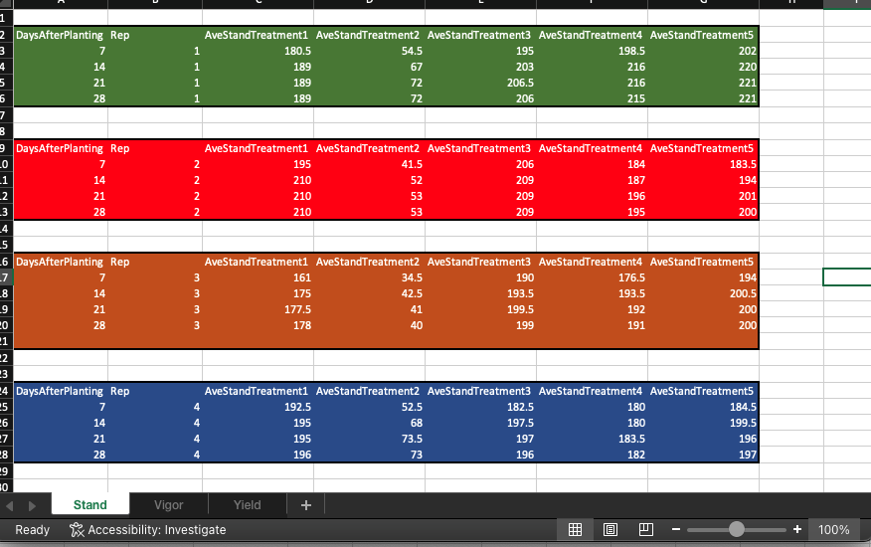
The ugly

Slide 25
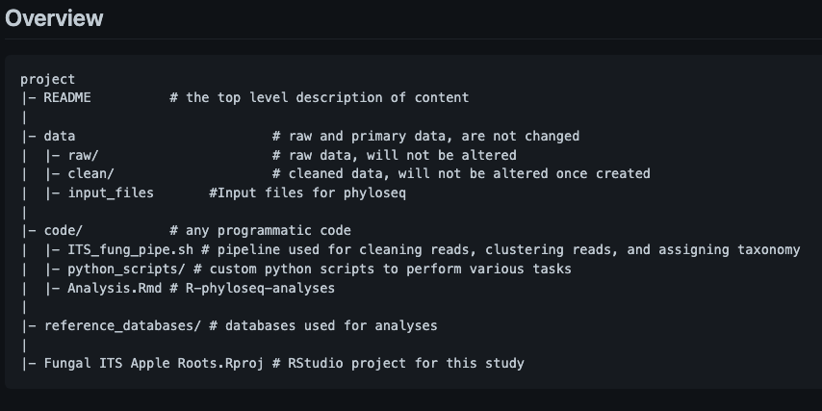
File trees

Slide 26
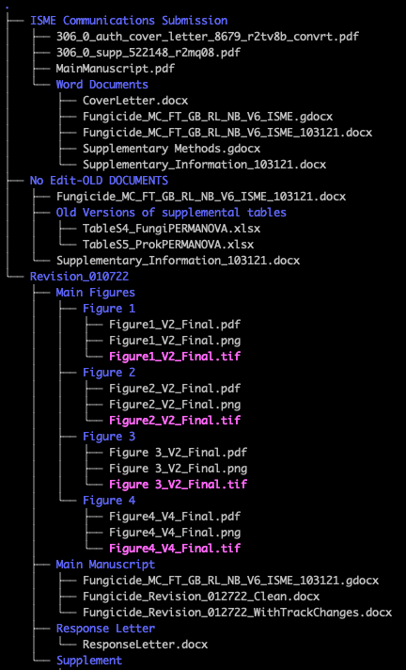
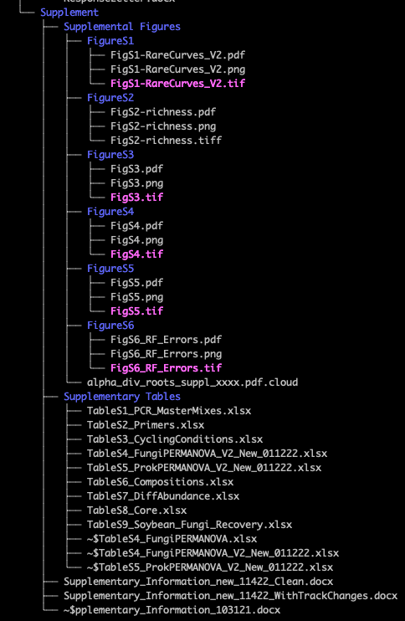
File tree for manuscript

Slide 27
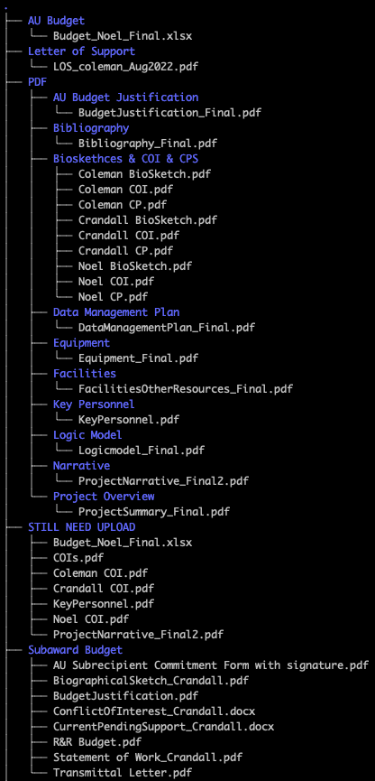
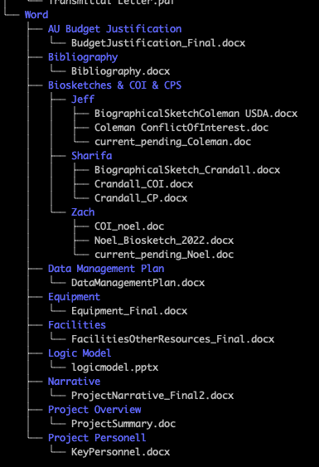
File tree for proposal

