Slide 1
Setting up a github repository and connecting it to RStudio

Slide 2
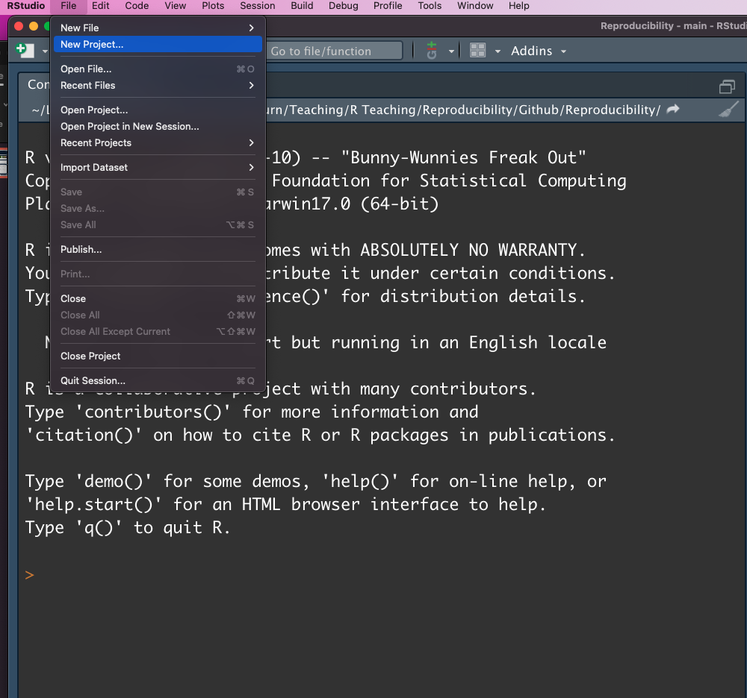
Open a new project from Rstudio

Slide 3
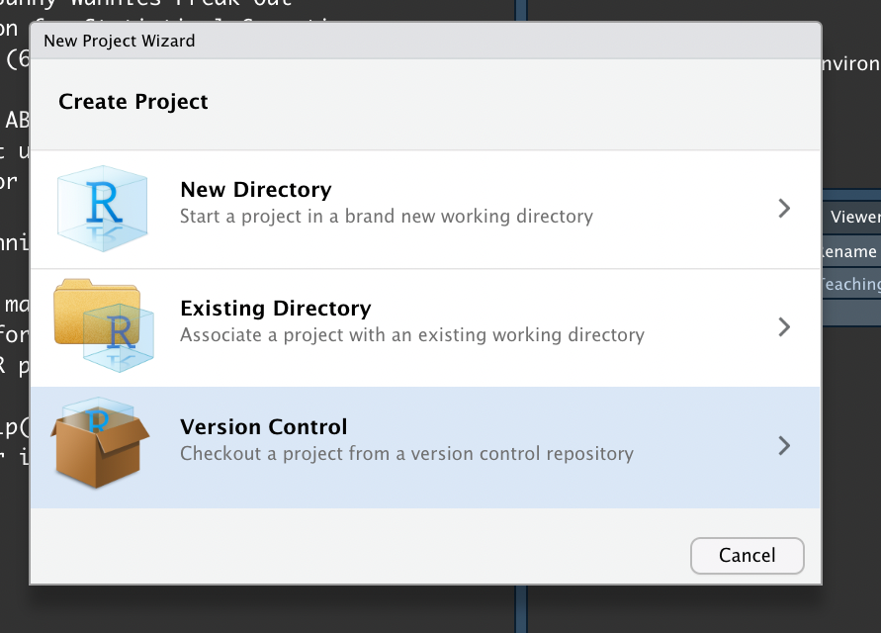
Start a new version control project

Slide 4
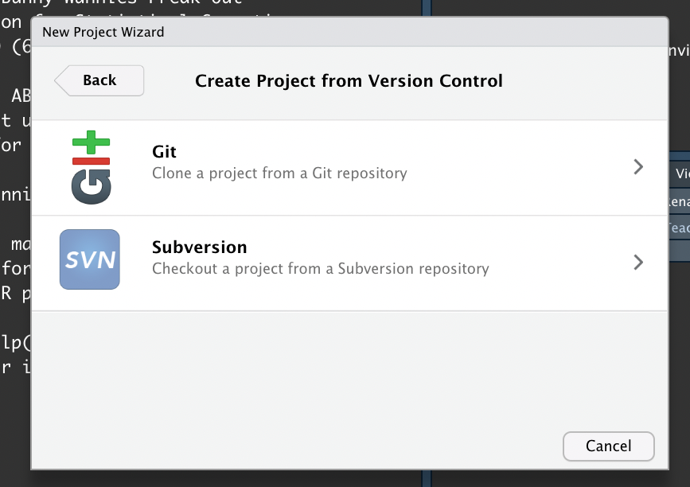
Click Git to initiate a git repository

Slide 5
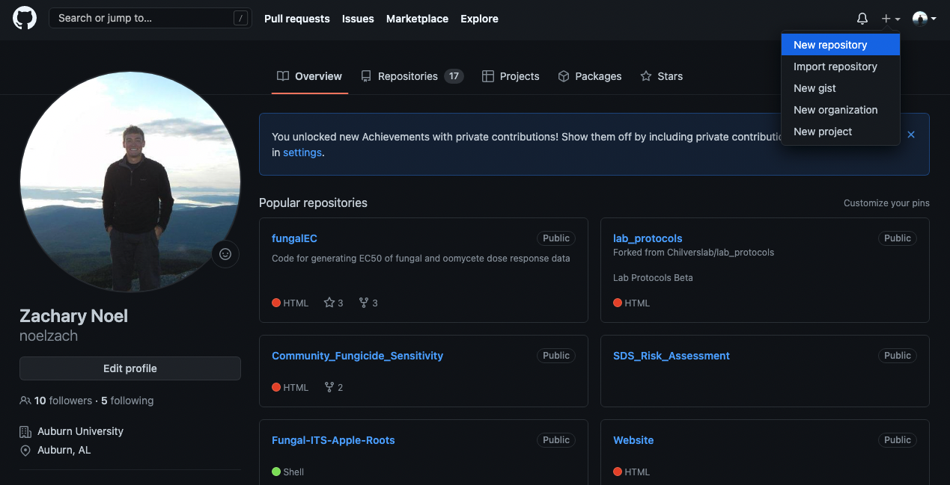
Now go to your github and create a new repository

Slide 6
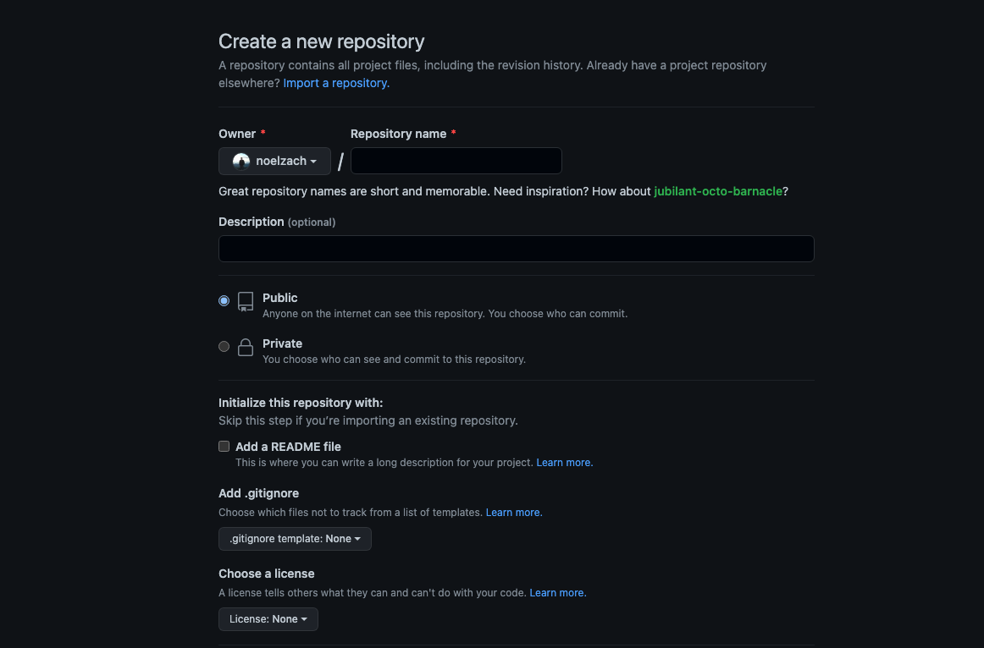
Now go to your github and create a new repository
Give a name
Add a readme
Give MIT license

Slide 7
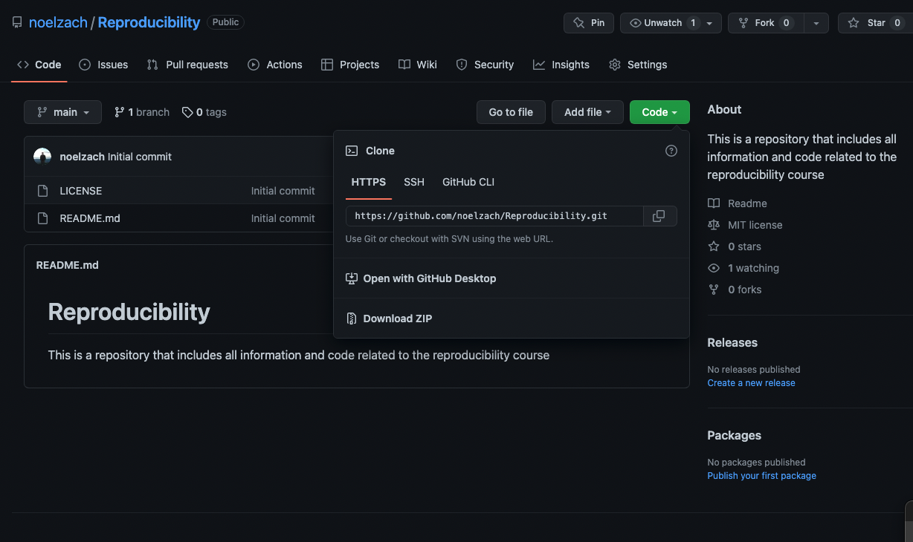
Click create, navigate to repository, and copy the link to the repository

Slide 8
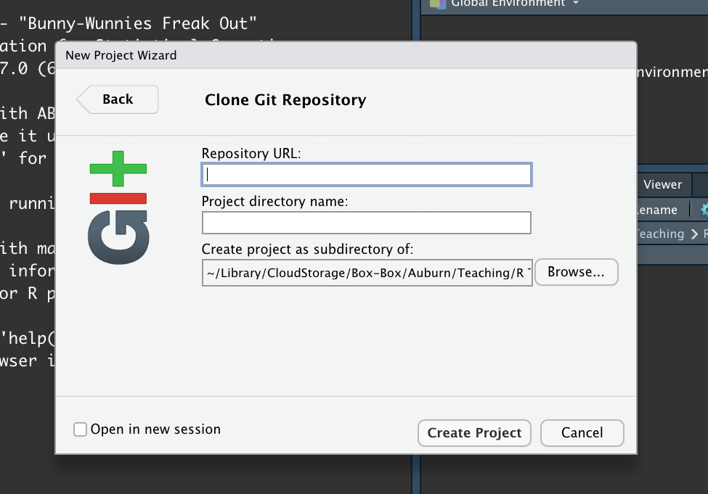
Paste repository URL here and tell your computer where you want to save your repository

Slide 9
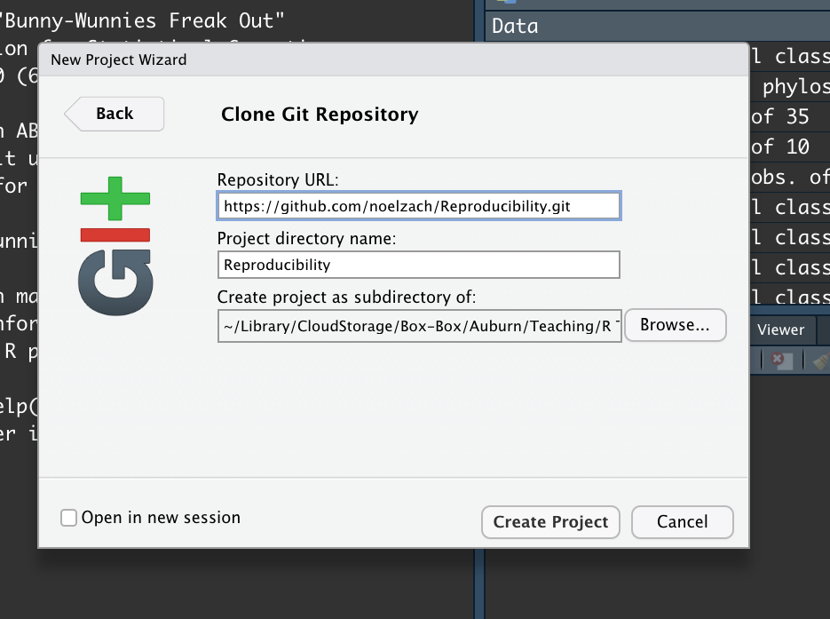

Slide 10
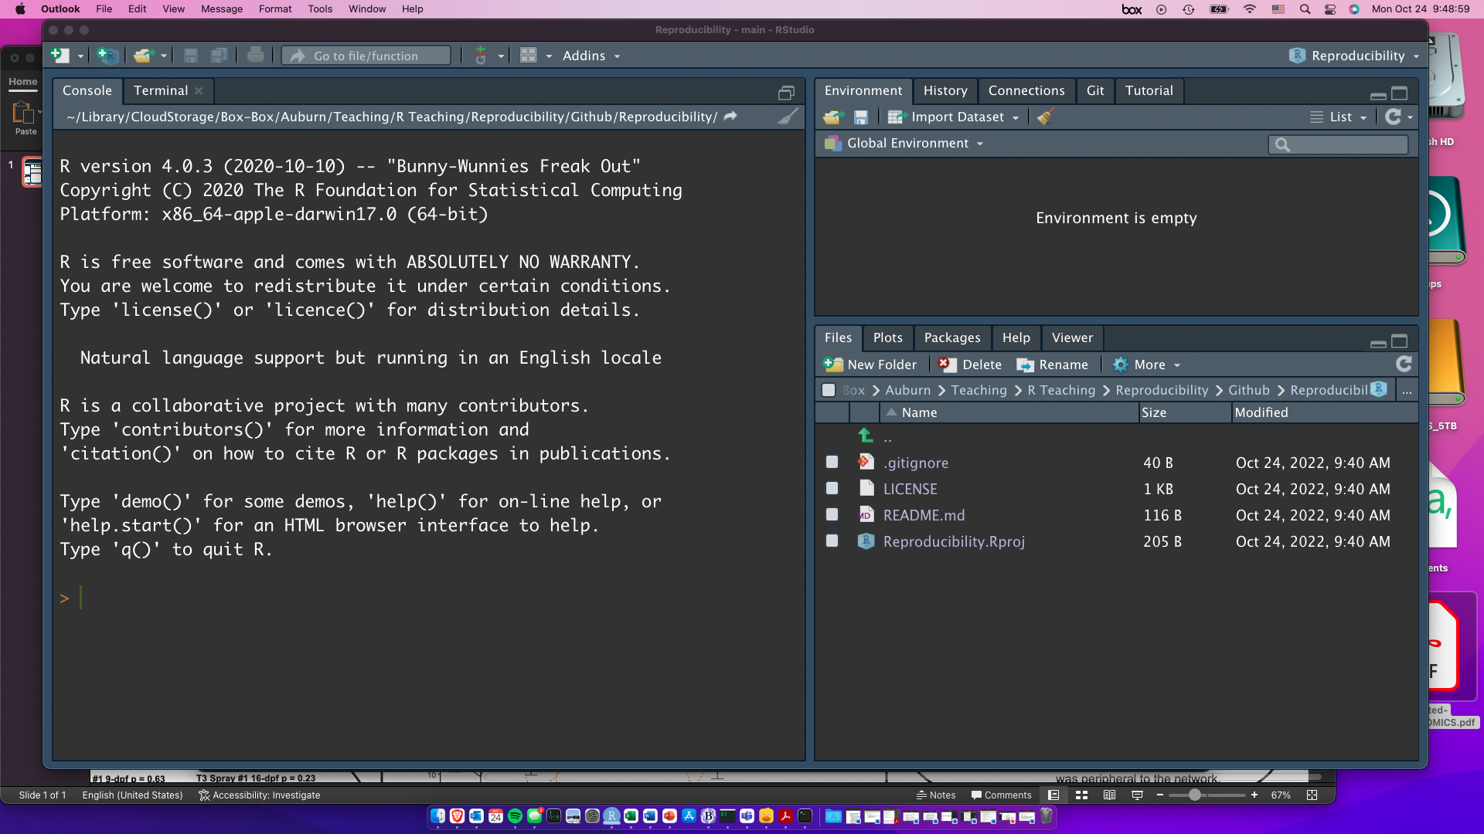
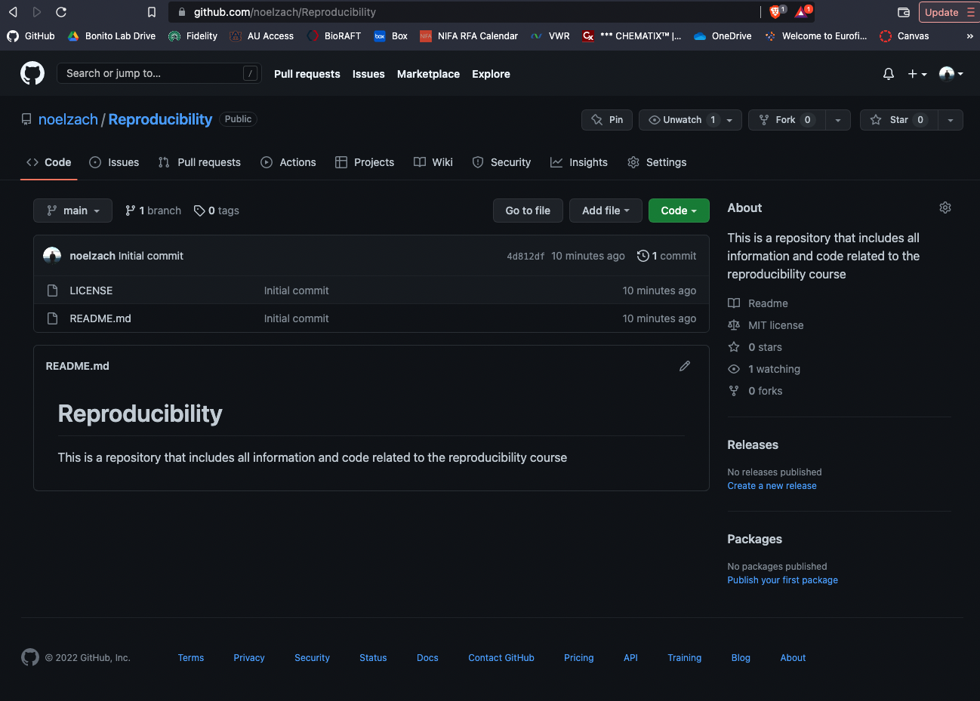
Your Rstudio file directory should now match the github version

Slide 11
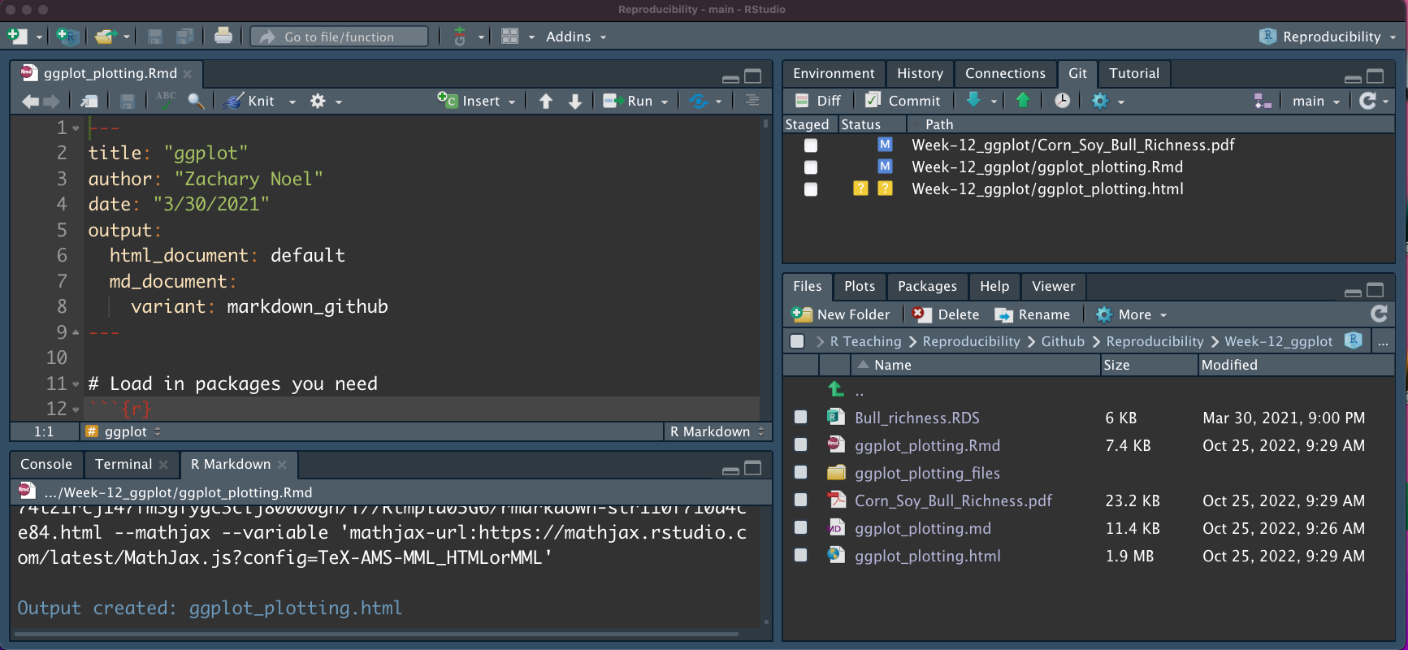
Committing, pushing, and pulling

Slide 12
Committing, pushing, and pulling
Check the boxes and click commit

Slide 13
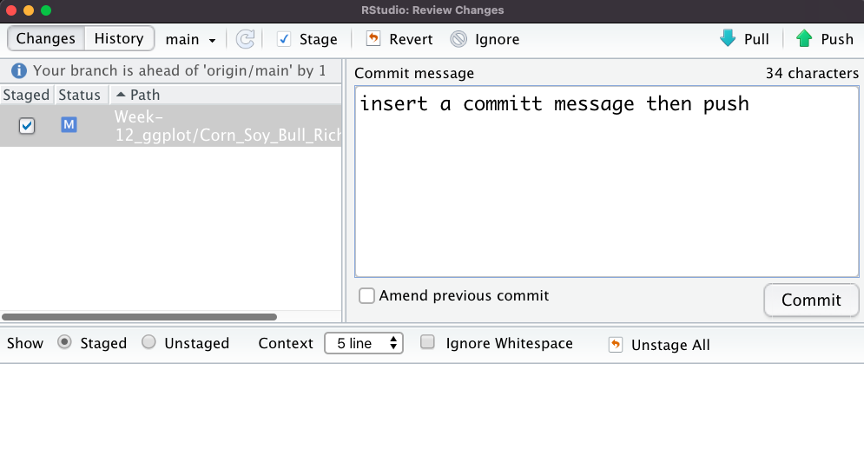
3. Push them to github
1. Type a commit message
2. Commit to changes

Slide 14
