Slide 1
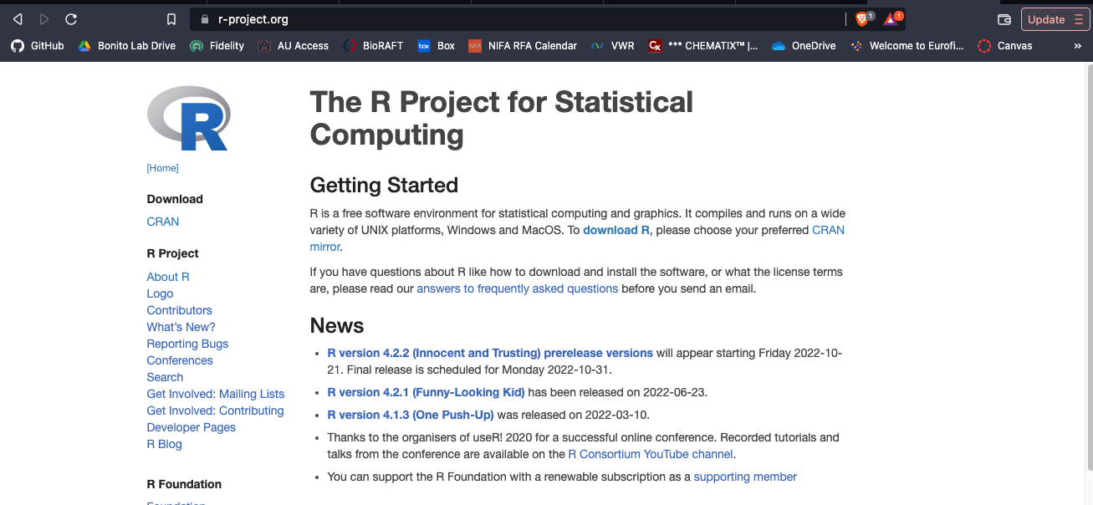
Installing R
Next page you will see a bunch of CRAN mirrors. CRAN = Comprehensive R Archive Network. These are just servers that host up-to date versions of R, and some developers work on these servers. Just choose the mirror/location closest to you.

Slide 2
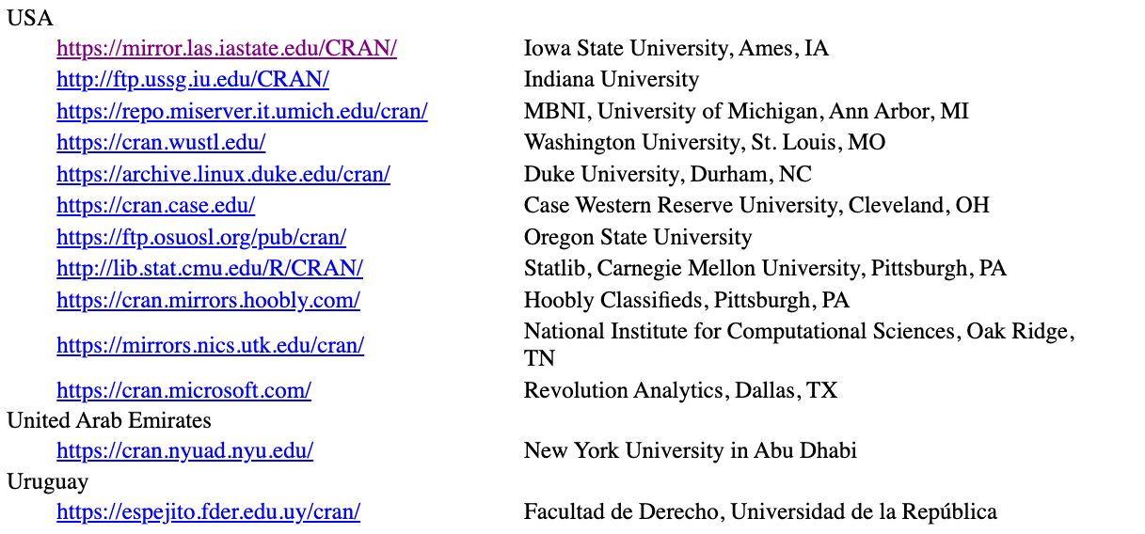
Installing R

Slide 3
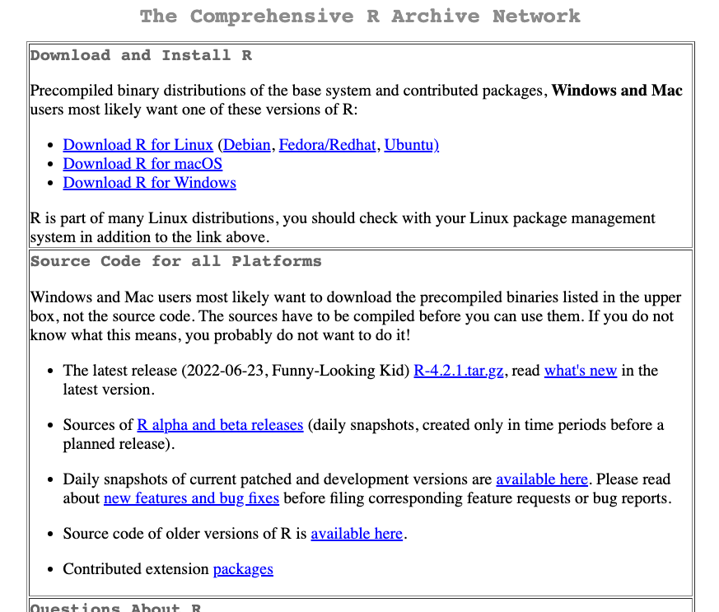
Installing R
Click to download R based on your operating system
The next page will have instructions for mac, linux, or windows. Just follow the prompts

Slide 4
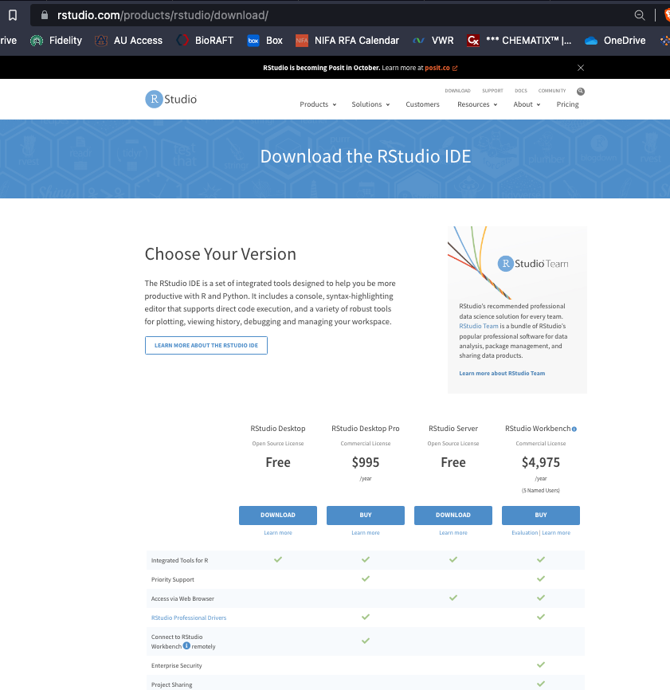
Installing RStudio
Easy way
google “install Rstudio”
Navigate to the URL listed in the image
Download the free version of Rstudio
Follow the prompts to install the correct version for your operating system

Slide 5
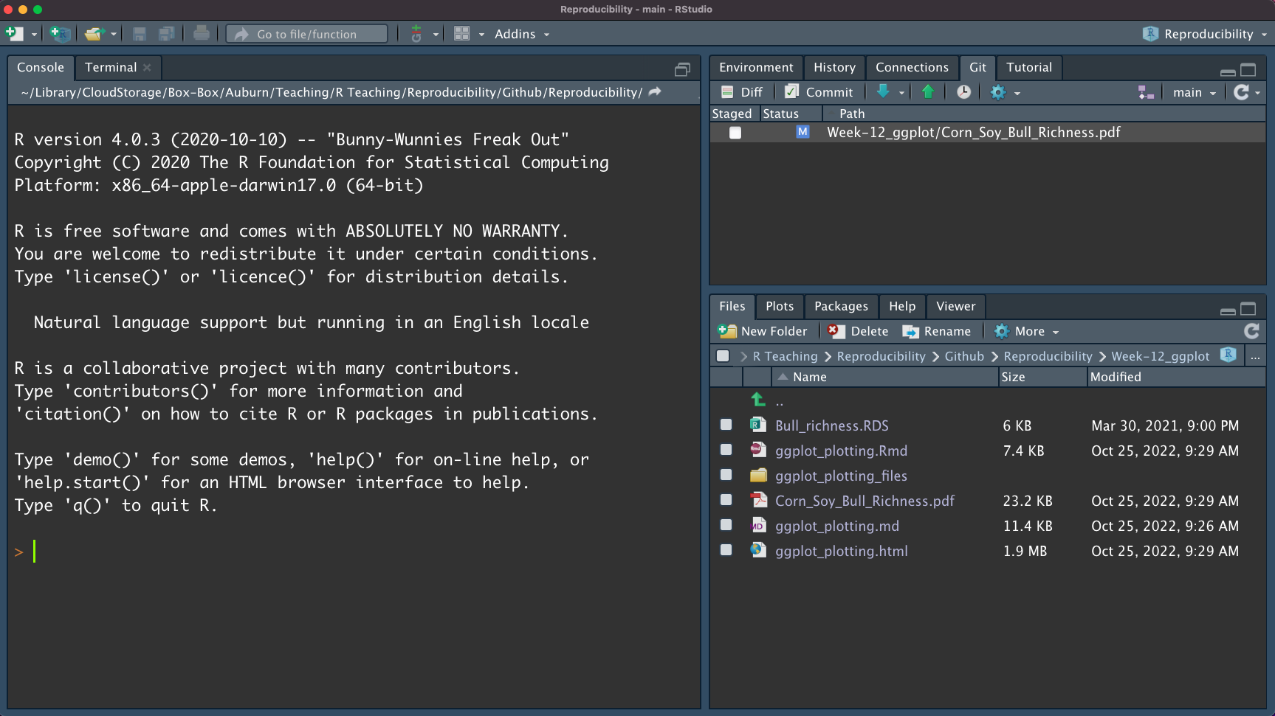
Open RStudio and make sure R is connecting
Should see something similar with the R version loaded into the console

Slide 6
RStudio tour

Slide 7
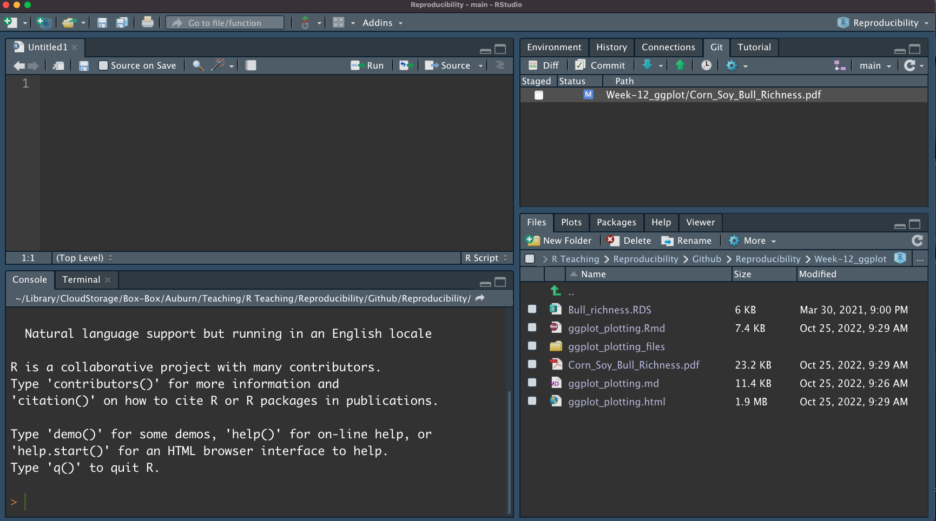
RStudio tour
Script – where you write code
Simply a text file…
Flex space - environment, history, git, other tutorials
Flex space - plots, files, packages, help
Console – where code is “compiled” – read and interpreted

Slide 8
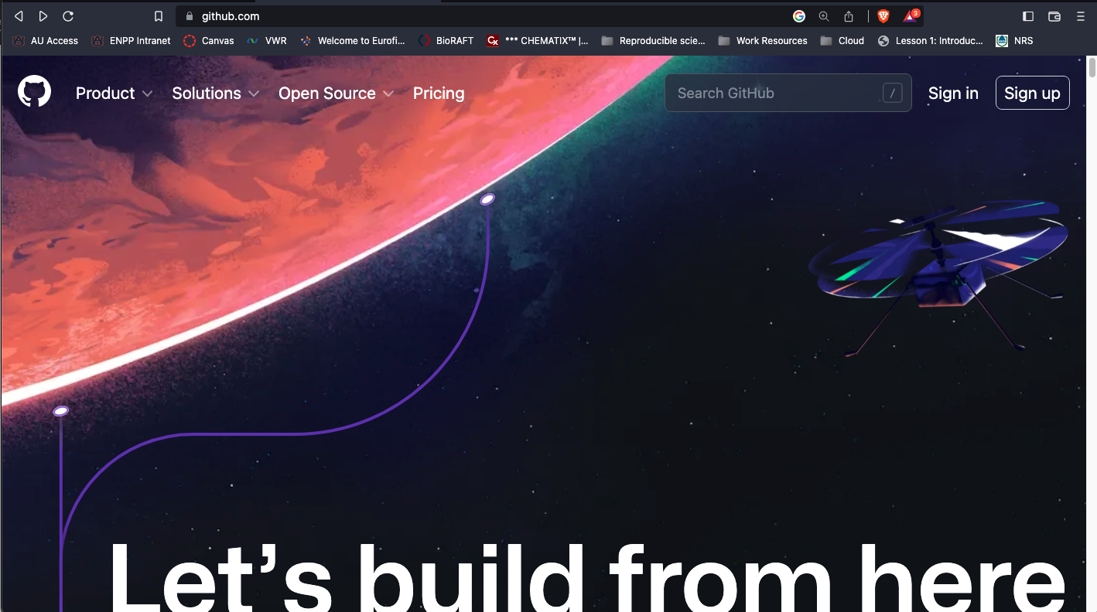
GitHub
navigate to github.com and follow the prompts to sign up

