Slide 1


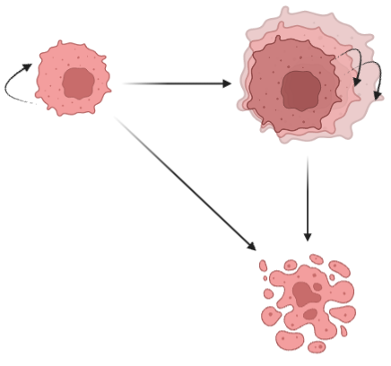
Cell proliferation
Cell death
P_{i-1} cells endoreplicate
(thus becoming P_{i})
P_{i} cells endoreplicate
Cycling state
Polyploid state
⍺
k(j,x)
k(i,x)
P_{i≤𝞲}
P_{j>𝞲}
a(i,x)
a(j,x)
A
Apoptotic state

