Slide 1
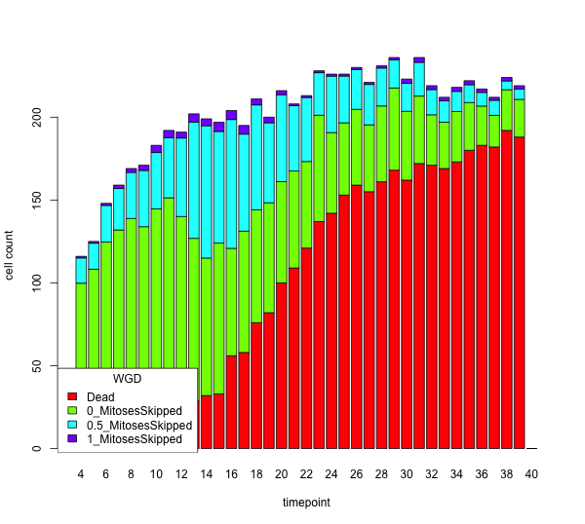
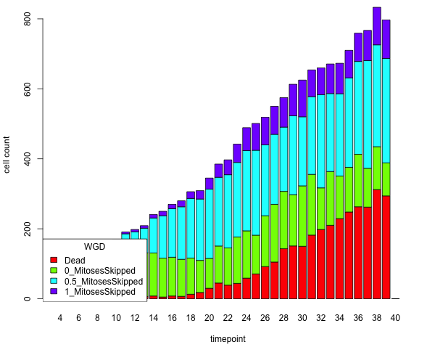
Classification of cell tracks to G1/S, G2/M and endoreplication
SUM-159 (2N)
SUM-159 (4N)
Gemcitabine (50 nM)
Dead
G1/S
G2/M
Endoreplication
Dead
G1/S
G2/M
Endoreplication

Slide 2
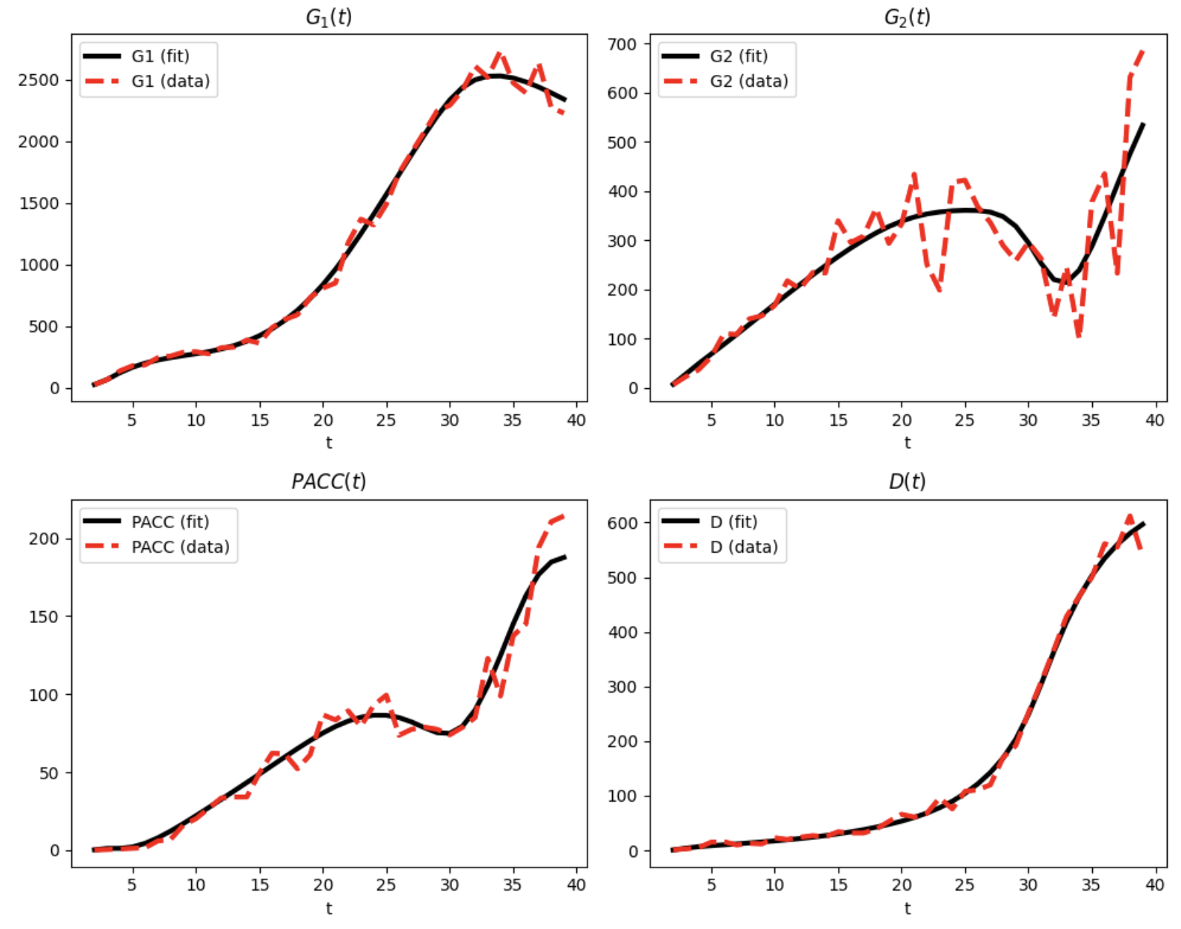
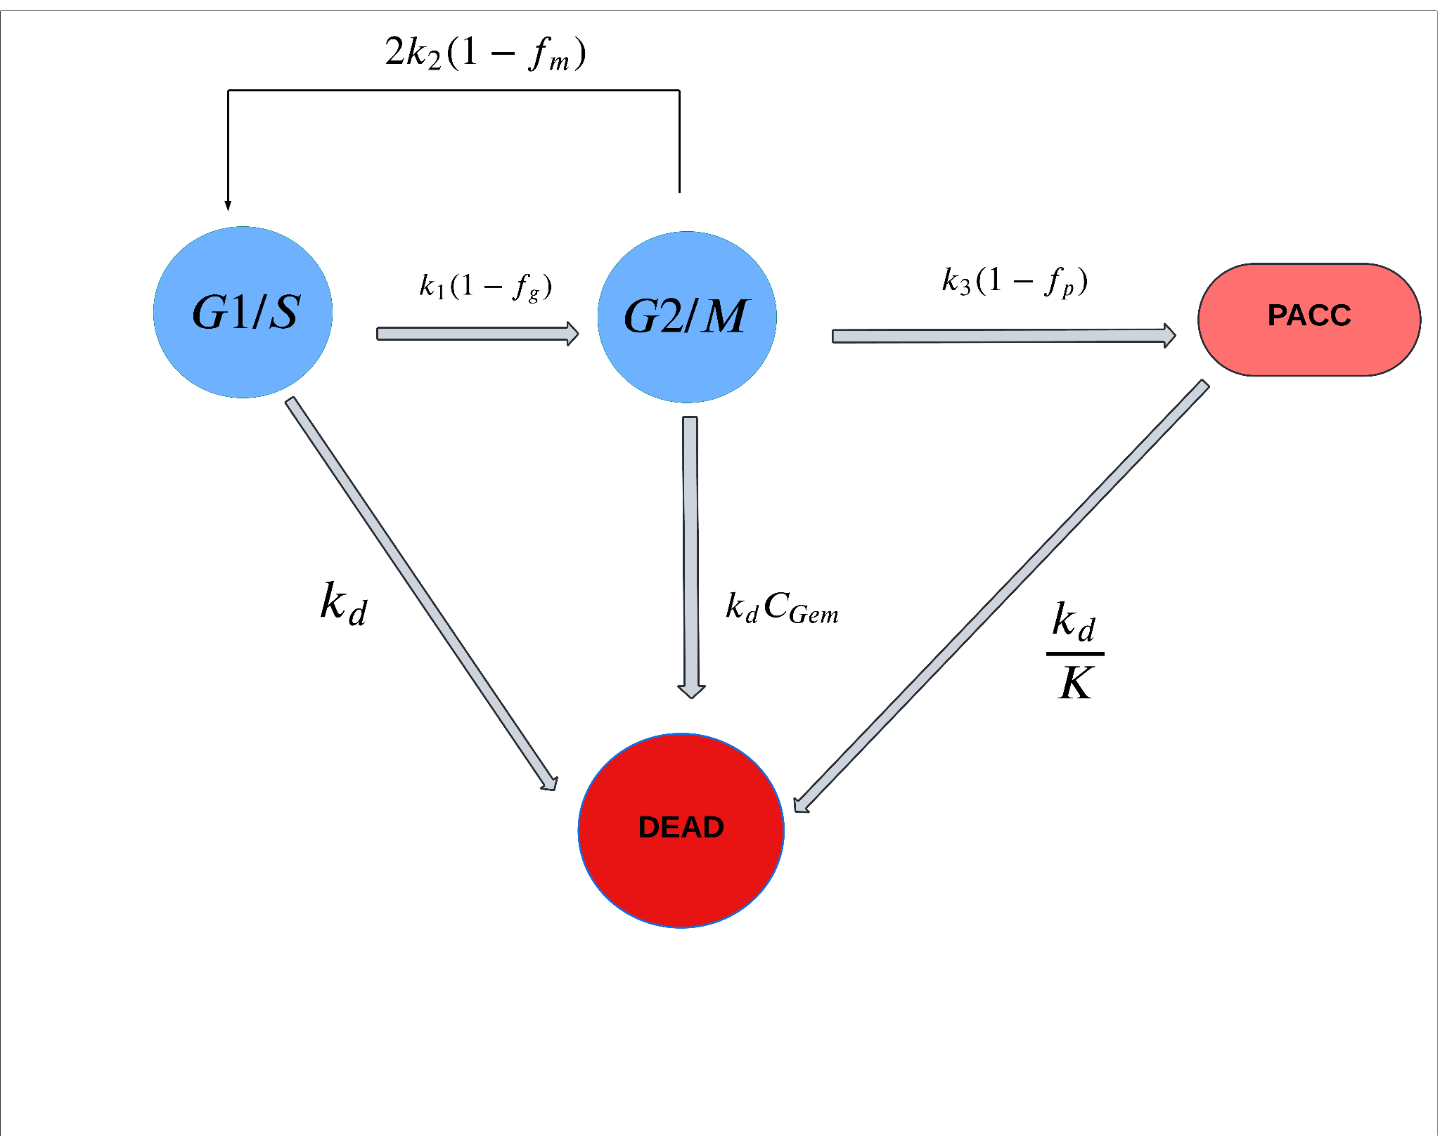
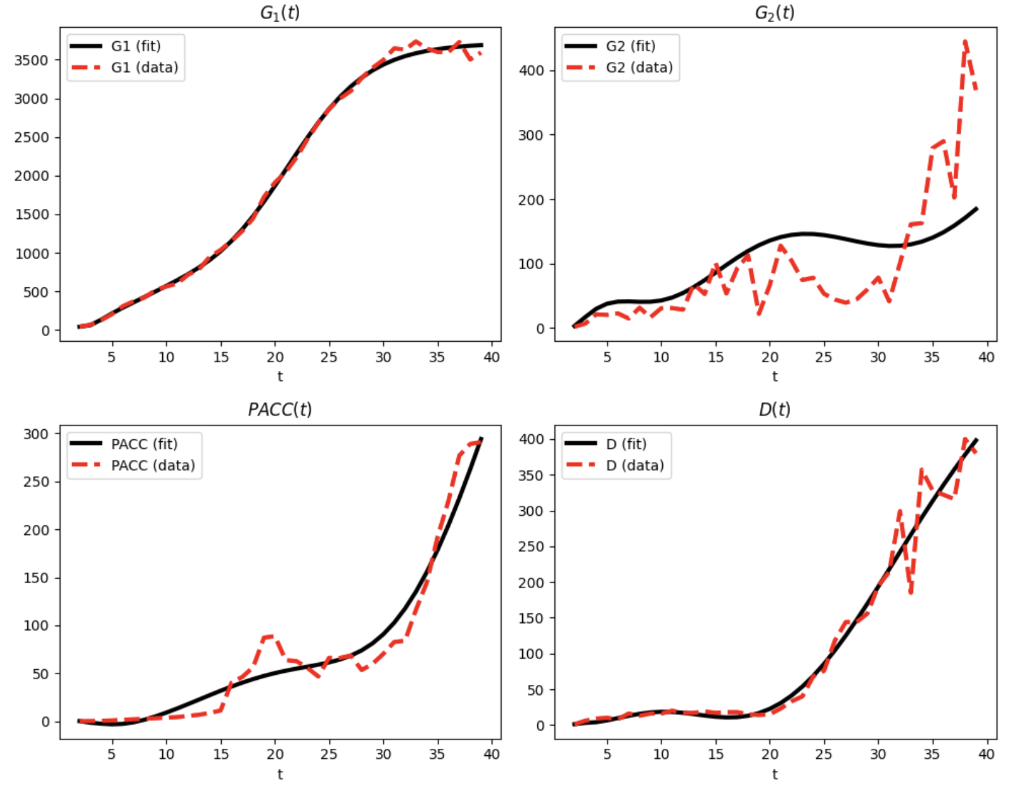
Gemcitabine sensitivity as a function of tumor ploidy
SUM-159 (2N)
SUM-159 (4N)

Slide 3
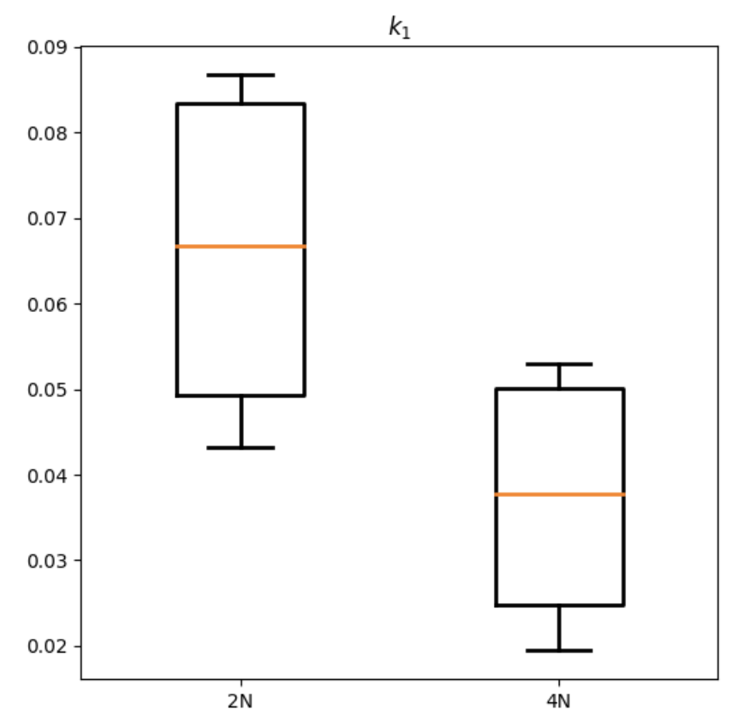
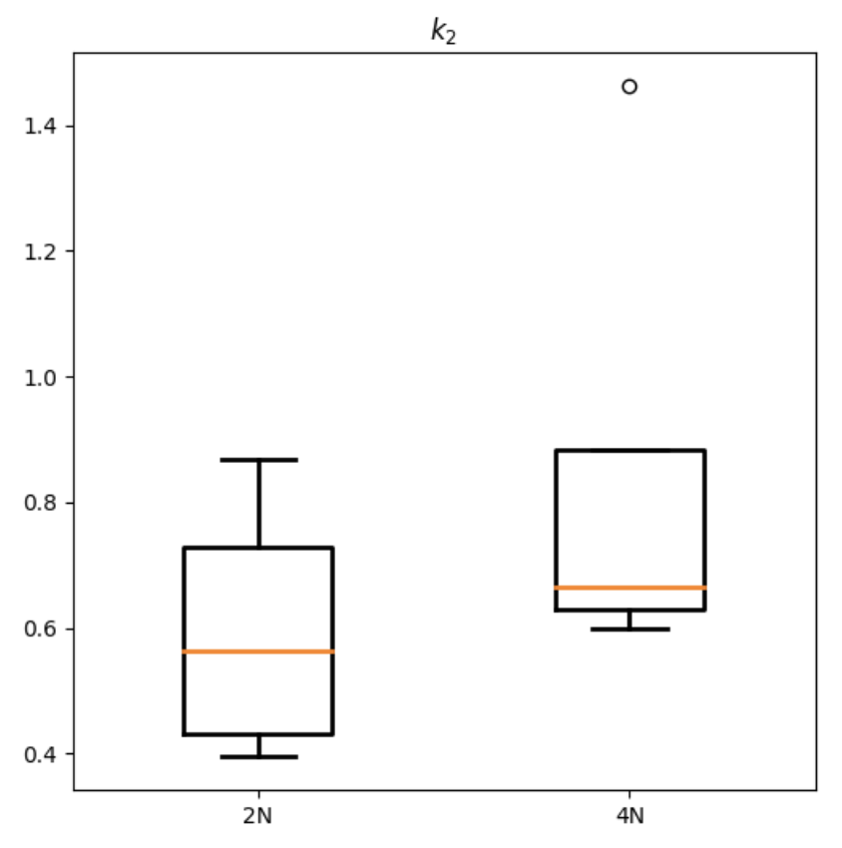
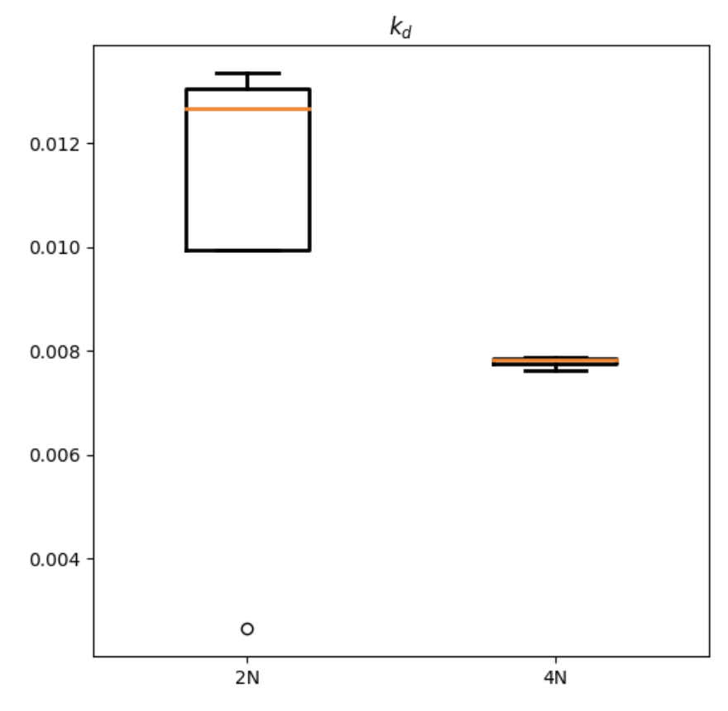
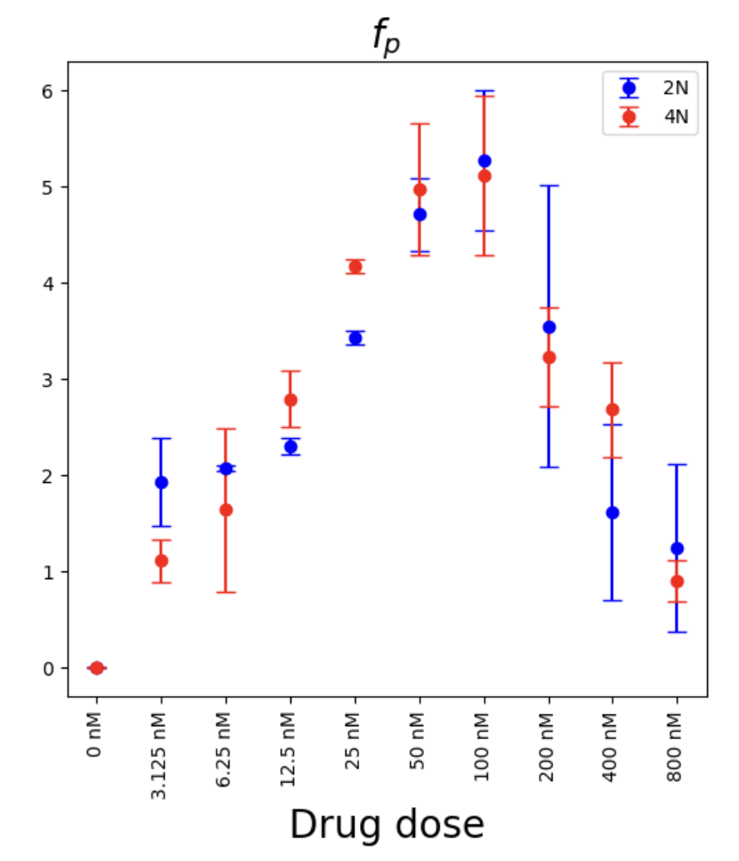
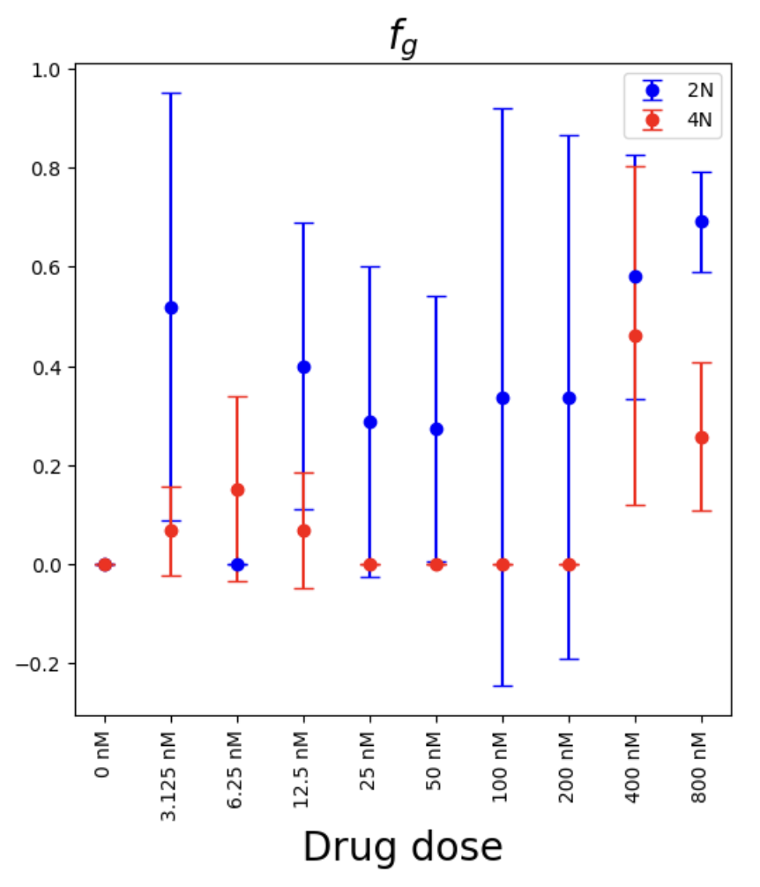
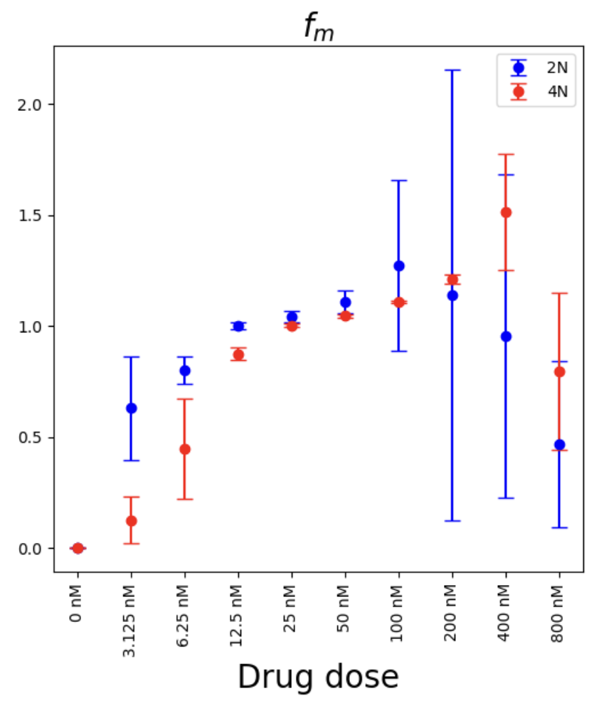
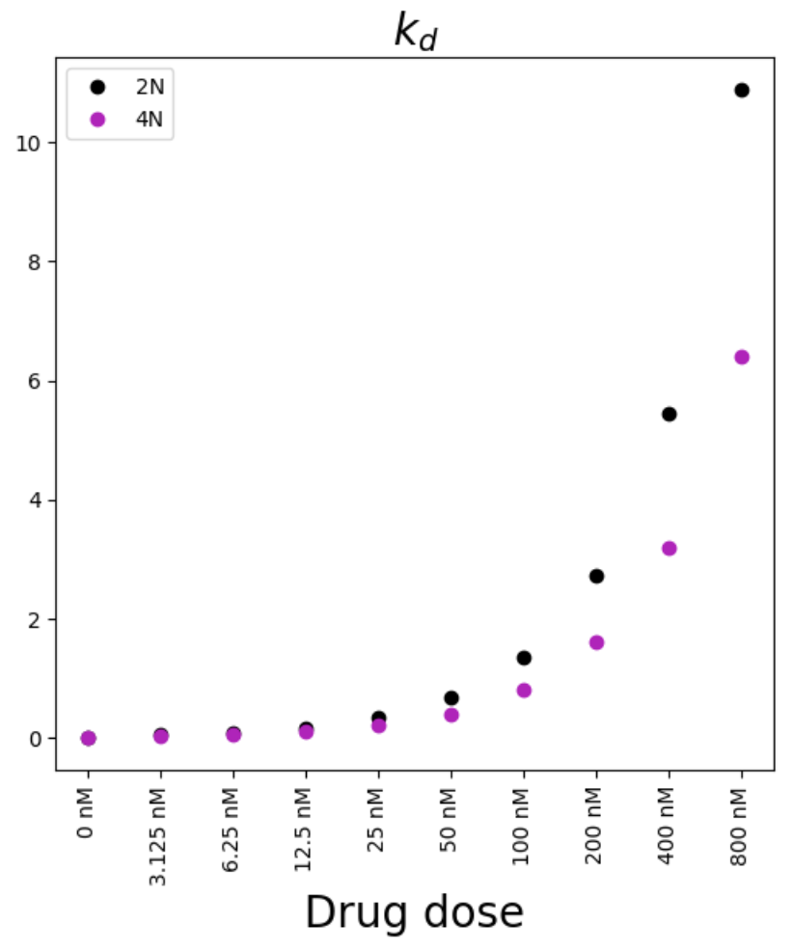
Parameterization of cell cycle dynamics in the absence and presence of gemcitabine
No treatment
A
B
Cell cycle dynamics
C
Cell death
Gemcitabine treatment
Cytostatic effects
Cytotoxic effects
D
E

Slide 4
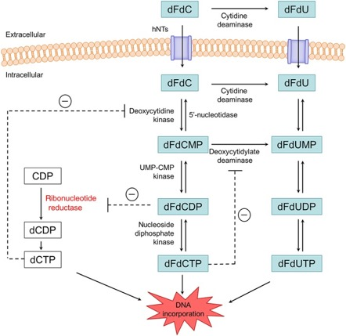
Gemcitabine (dFdC) metabolism differ in ploidy-dependent manner and cause alternative mode of actions (MoA) in 2N and 4N SUM-159 cells
2
Vmax (2N) = 8.597
Vmax (4N) = 33.10
1
With the PK/PD Core @Moffitt

Slide 5
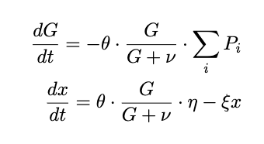
Expanding the mathematical model for gemcitabine sensitivity with the drug PK/PD values
Total gemcitabine
Active drug (dFdCTP)
Notes:
17

