Slide 1
Hypothesis
The higher the ploidy of a proliferating cell, the faster it can exit the cell cycle and enter the endoreplication? cycle (which confers resistance to several stressors, including Gemcitabine).
Notes:
These data suggests that Gemcitabine resistance is a function of how effectively tumor cells can enter the polyploid state in response to a given drug concentration. We hypothesize that…

Slide 2
Slide about how polyploid normal cells are terminally differentiated

Slide 3
Slide about how Andriy & Daria obtained 4N SUM-159 cells from 2N cells
In Contrast to normal polyploid cells, these cells do divide!

Slide 4

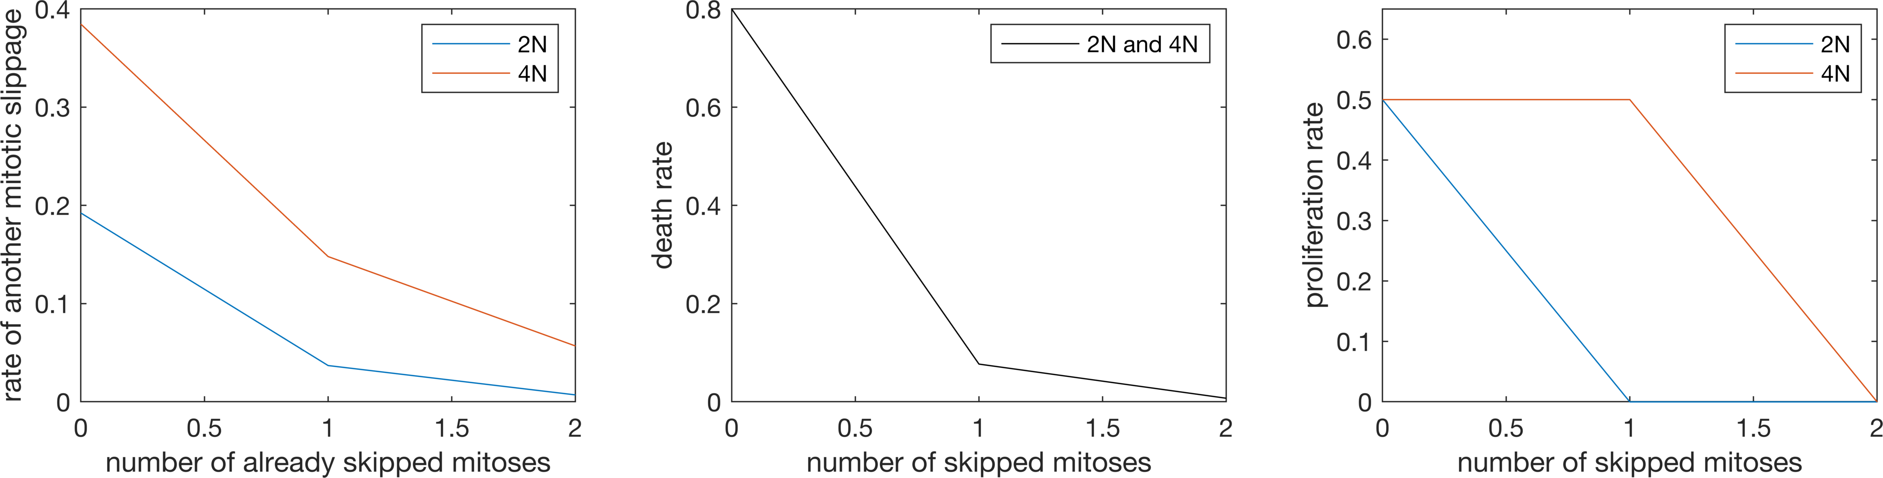



Modeling concentration of cells P_{i} that have skipped i rounds of mitosis
Cell death
Cell proliferation
P_{i-1} cells endoreplicate
(thus becoming P_{i})
P_{i} cells endoreplicate
Notes:
We model the change in the concentration of cell P_i that have skipped anywhere between 0 and 2 rounds of mitosis
First term are cells leaving the compartment i-1, thus ending up in compartment P_i
Second term are cells leaving the compartment i, thus ending up in compartment P_i+1
Third and last term we have cell death and proliferation
The rates at which cells endoreplicate, die and proliferate (k, d, and alpha respectively) are all functions of two parameters:
The number of mitosis these cells have already skipped (i) and
Drug concentration x
For a fixed drug concentration x, our initial guess for d looks as follows: the higher the number of skipped mitoses, the lower the cell death rate. We assume that the same relationship holds for both SUM-159 lineages (2N cells and 4N cells). Though note that none of the 4N cells will have 0 skipped mitoses. So even though the relationship is identical, their effective death rate will be different
For cell proliferation, we know that under normal circumstances, cells that have skipped one or more mitoses don’t proliferate. So proliferation will be positive if and only if i=0. At the same time we know that our 4N sum-159 cells do in fact proliferate happily. So for this cell type we allow proliferation to be positive if i<=1.
And finally endoreplication rate. Here our initial guess is that the more mitoses a cell has skipped, the less likely it is that yet another endoreplication will happen. And here we assume that this relationship differs between our 2N and 4N sum-159 cells
Again, shown here are examples of these function for a fixed drug concentration of 500. We will now show preliminary results of fitting this model to data to obtain estimates of a, w, v_2N and v_4N (which will tell us how these functions will shift along the y axes)

Slide 5

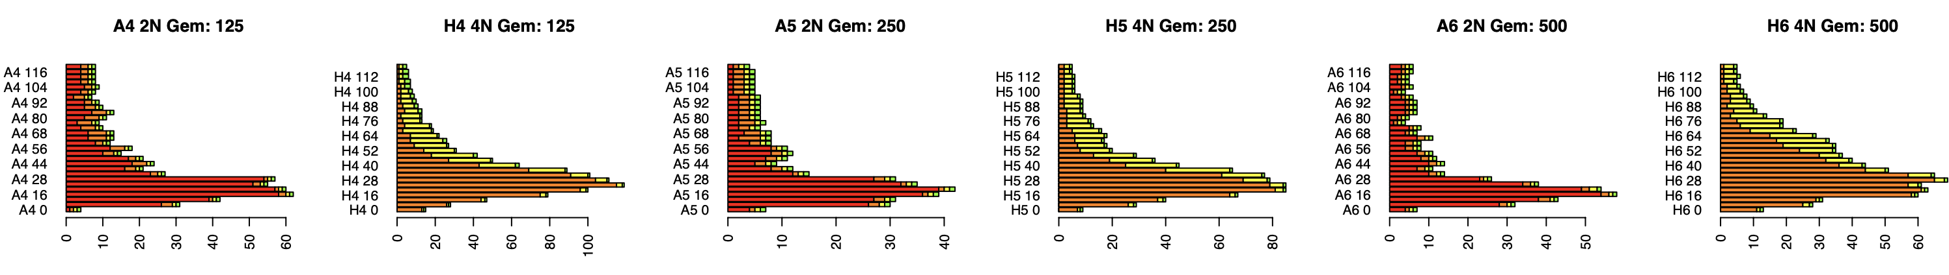
Some images
Notes:
Xx: describe data/measurments , perhaps show a few images from the Incucyte and the classification results from Mahmoud.
Data is fresh from the oven, preliminary segmentation results shown here are from late last week, we are still working on improving segmentation and classification, but we did attempt to fit model to the data from just these two wells

Slide 6
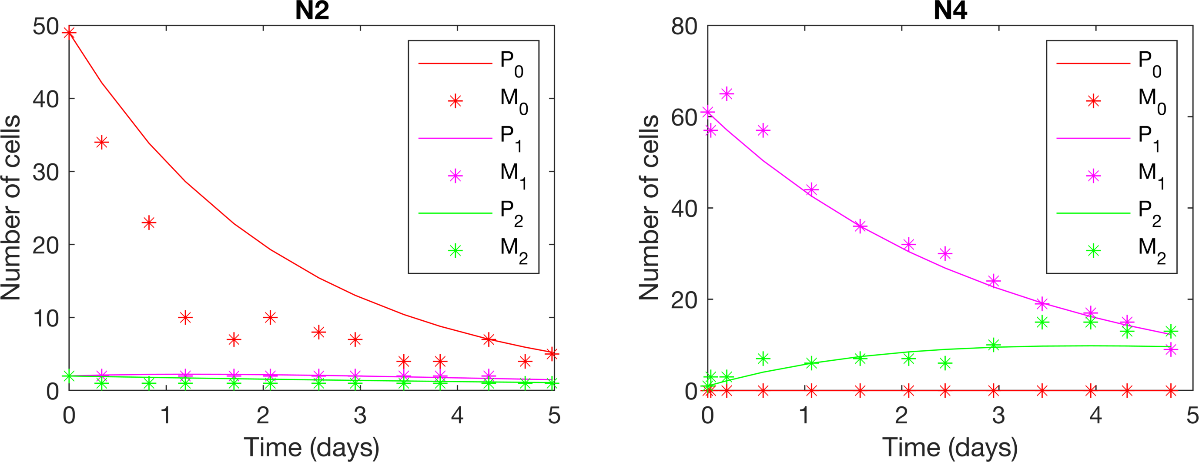
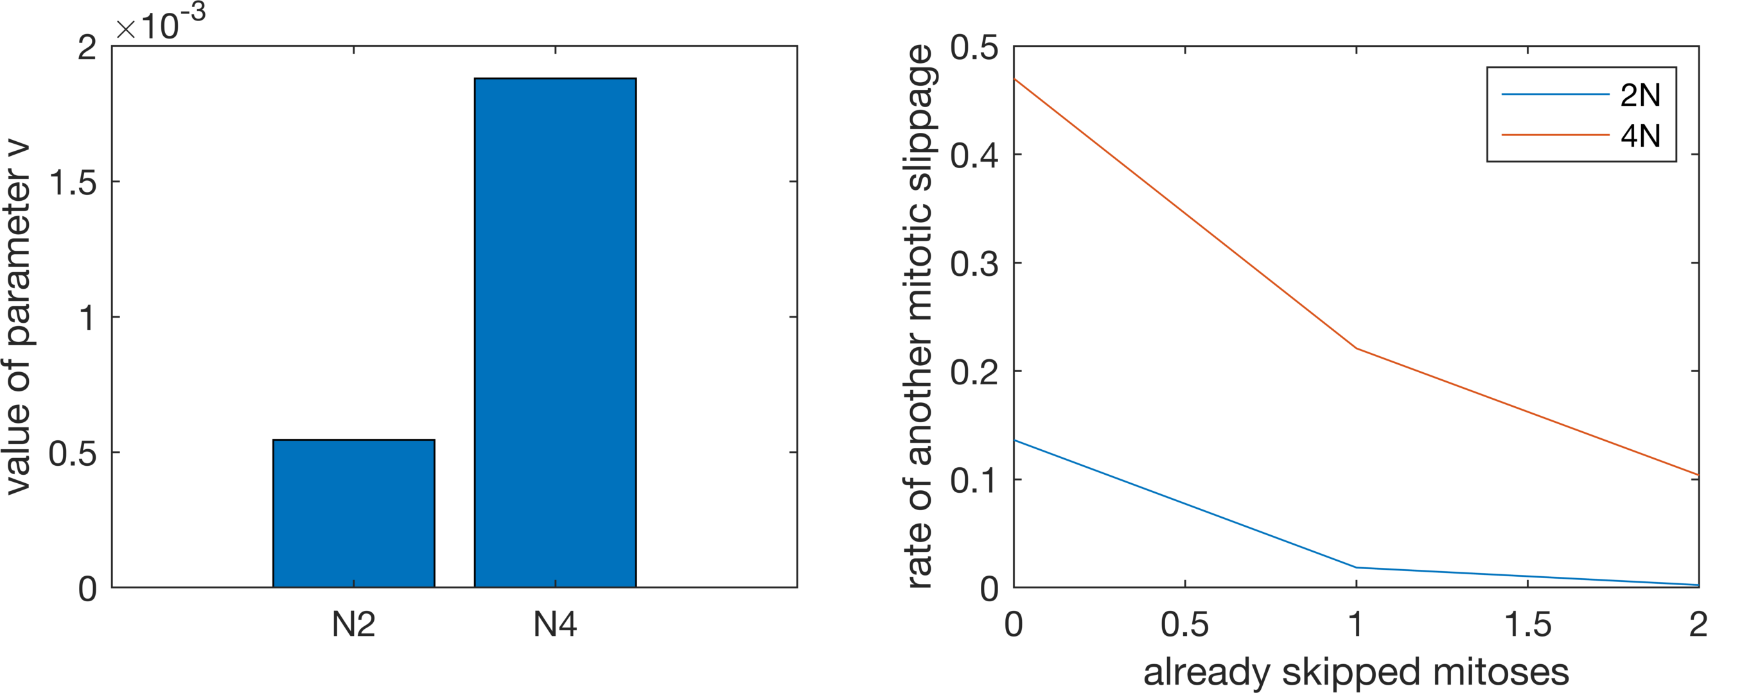
Fitting the mathematical model to data from Gemcitabine-exposed 2N and 4N SUM-159 cells
4N cells can access the polyploid state more efficiently:
Notes:
… and the model fit the data reasonably well, especially for 4N cells on the right
Curves are the different ploidy compartments P0, P1 and P2 with 0 1 and 2 skipped mitoses
Data points are the measurements M0 M1 M2, again for 0 1 and 2 skipped mitoses
A reminder: we assume that the same relationship between number of skipped mitosis and death rate holds for both 2N and 4N cells and that none of the two cell types can proliferate if they have skipped more than 1 mitosis. For 2N cells threshold is even lower, 0 mitoses
So the interesting behavior we were after was not the death and proliferation rate, but how these two cell types differ in the rate they endereplicate – which is determined by the parameter v. Inferred value for parameter v is almost 4 times as high for 4N cells than for 2N cells at this particular drug concentration. Which means the polyploid (resistant) state is more accessible to these 4N cells.
Plan is to test this model on multiple pairs of proliferating 4N and 2N cells -- If the value of parameter v turns out to be a function of cell type, then ploidy of a cancer could inform model parameter and enable predictive modeling of response to various drug concentrations

Slide 7
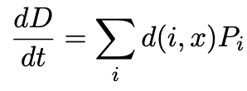
Next steps
Model and fit dead cells:
Model decay in drug concentration over time
Model delay in drug response (currently first 16 hours excluded from fitting)
Expand to all administered drug concentrations and replicates
Model de-polyploidization
Notes:
.. Other next steps include: …

