Slide 1
Main Figures

Slide 2
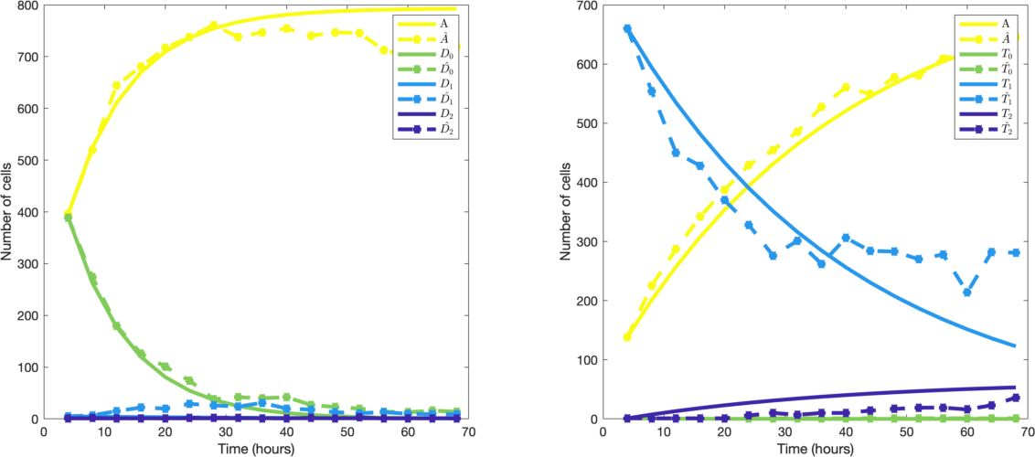
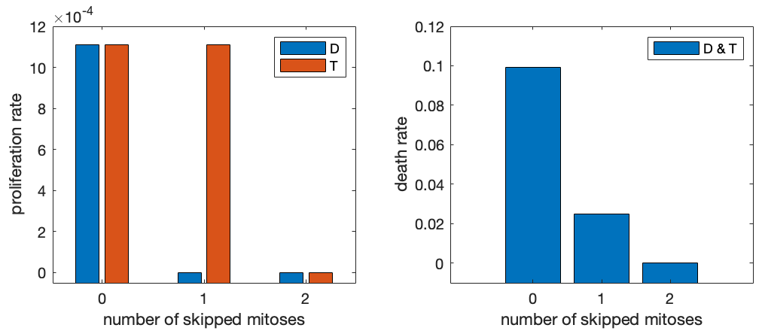
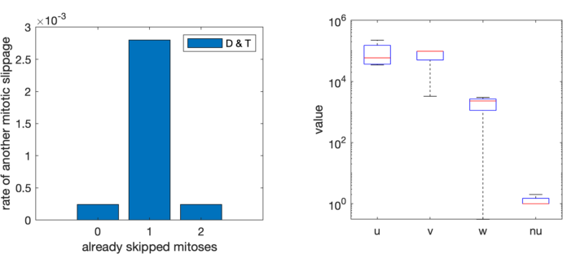
A
B
(A-B) ODE model of polyploidization (lines) recapitulates experimental observations (points) for 2N (A) and 4N SUM-159 lineages (B). (C-D) ODE model assumes fixed relationships between the number of skipped mitoses (x-axes) and proliferation (C), death (D) and endoreplication rate (E). With the exception of proliferation rate, these relations are assumed to be identical irrespective of lineage (2N vs. 4N). (F) Michaelis-constants of proliferation (a), endoreplication (v) and death (w) fitted across multiple replicates (n=4).
C
D
E
F
ODE_model

Slide 3
Supplementary Figures

Slide 4
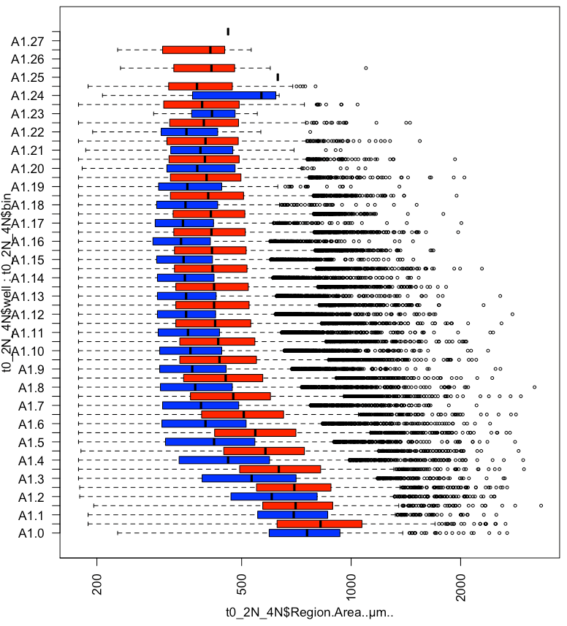

Cell Density bin
Nucleus area (um)
SI_Ploidy_Area_Density

Slide 5
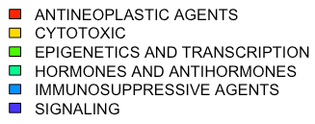
SI_GDSC_vs_ploidy

Slide 6
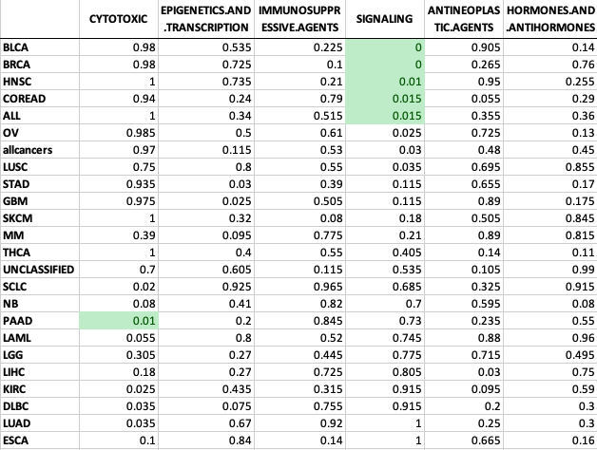
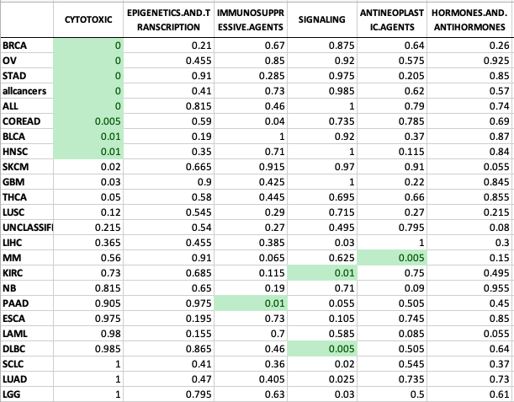
SI_GDSC_vs_ploidy_A
SI_GDSC_vs_ploidy_B

