Slide 1

Homework 3
Emanuele Nardone PhD Student

Slide 2
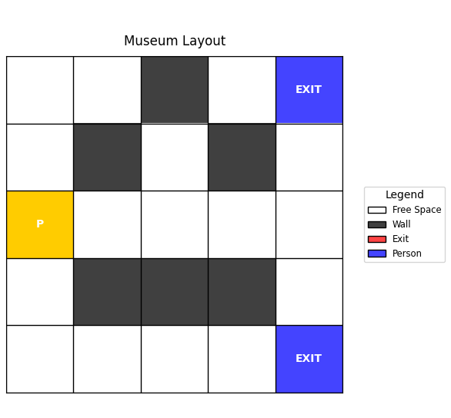
Homework 3
01
Exercise 1 – A*
Goal:
Design and implement an emergency evacuation system for a museum. The system must find the shortest safe path from any visitor's position to the nearest emergency exit, avoiding obstacles like walls and exhibits.
Input:
Museum Layout
Elements
Moves allowed

Slide 3
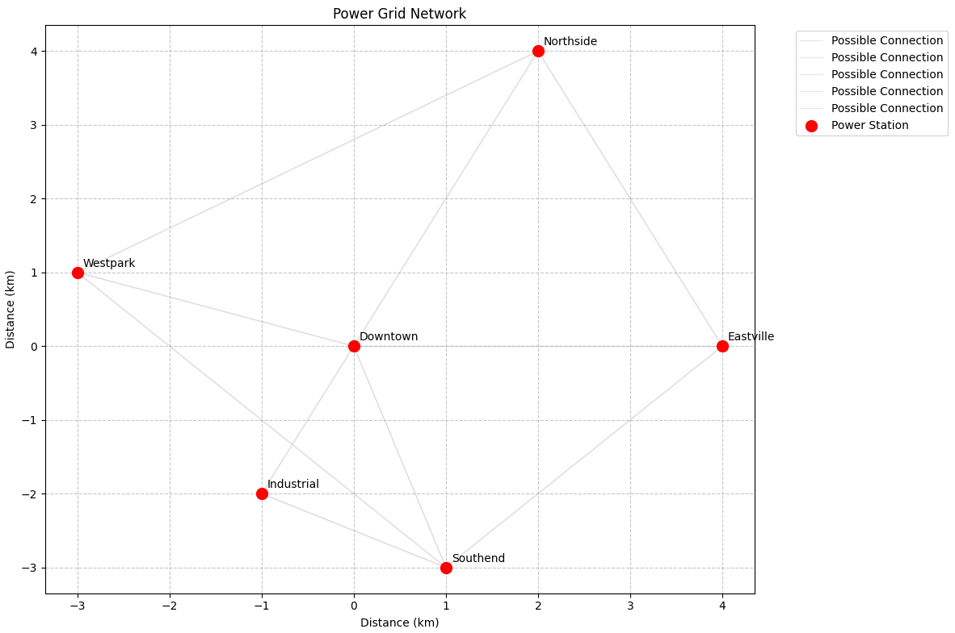
Homework 3
01
Exercise 2 – PRIM
Goal:
Optimize the power distribution network for a city by connecting all neighborhood transformer stations with minimum total cable cost. Each connection has a specific cost based on distance and terrain factors.
Input:
6 transformers stations
Connection costs

