Slide 1
Overview
Integration Services
Platform Invoke
Calling COM Objects from Managed Code
Calling .NET Objects from COM Objects

Slide 2
Integration Services
Introduction to Platform Invoke
Introduction to COM Interoperability
Interop Marshaling Overview

Slide 3
Introduction to Platform Invoke
Allows Managed Code to Call Unmanaged Functions That Are Implemented in a DLL
Provides the Mechanism for
  Finding and invoking unmanaged functions
  Marshaling managed arguments to and from unmanaged code

Slide 4
Introduction to COM Interoperability
COM and .NET Differences Include:
  Lifetime management - reference counting versus
  garbage collection
  Service discovery - QueryInterface versus Reflection
  Object memory – fixed versus movable
Runtime Callable Wrapper (RCW)
  Used by managed clients to call a method on a COM object
COM Callable Wrapper (CCW)
  Used by COM clients to call a method on a managed object

Slide 5
Interop Marshaling Overview
Interop marshaling governs how data is passed between managed and unmanaged memory during calls
  Is a run time activity performed by the common language runtime marshaling service
Blittable data types are common to managed and unmanaged memory and require no conversion – data types (C# keyword) :
  System.Byte (byte) System.SByte (sbyte)
  System.Int16 (short) System.UInt16 (ushort)
  System.Int32 (int) System.UInt32 (uint)
  System.Int64 (long) System.IntPtr System.UIntPtr

Slide 6
Interop Marshaling Overview (continued)
Non-blittable types have different or ambiguous representations in managed and unmanaged languages and may require conversion
  For example, managed strings are non-blittable types
The standard RCW or CCW usually provides adequate marshaling for calls that cross the boundary between COM and the .NET Framework
  Custom attributes can optionally adjust the way the runtime represents managed and unmanaged code

Slide 7
Platform Invoke
How Platform Invoke Works
Calling a Win32 API From Managed Code
Calling Unmanaged Functions
Pinning
Marshaling
Performance Considerations and Limitations of
Platform Invoke

Slide 8
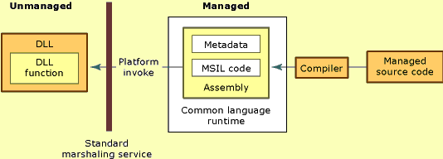
How Platform Invoke Works

Slide 9
Calling a Win32 API From Managed Code
Declare the Method with the static and extern
C# Keywords
Import the DLL That Implements the Unmanaged Function That You Wish to Call
Optionally, Specify Custom Marshaling Information to Override the .NET Framework Default Marshaling
[DllImport(<DLL name>, EntryPoint=<function name>,
CharSet=<type of characterset>]

Slide 10
Calling Unmanaged Functions
To Call a Function That Is Implemented in an Unmanaged DLL
  Add a using statement for System.Runtime.InteropServices
  Add a DllImport attribute to a method, specifying the name of the unmanaged DLL that exports the function to be called
  Declare with the static and extern C# keywords the method that is used to call unmanaged code without providing any implementation for the method
using System.Runtime.InteropServices;
…
[DllImport("msvcrt.dll", CharSet=CharSet.Ansi)]
public static extern int puts(String str);

Slide 11
Pinning
Data Is Temporarily Locked in Its Current Memory Location to Keep It from Being Relocated by the Common Language Runtime’s Garbage Collector
Pinning Is Performed When Data Has to Be Passed Between Managed and Unmanaged Code and
  Has a fixed layout and common data representation in both managed and unmanaged memory
    - or -
  Has a fixed layout but the data representation is different in managed and unmanaged memory and the class is marshaled by reference

Slide 12
Marshaling
Platform Invoke Marshals Simple Data Types Between Managed and Unmanaged Code
Custom Marshalling Can Be Specified by Using the MarshalAs Attribute
public static extern int MessageBoxW(
int h,
[MarshalAs(UnmanagedType.LPWStr)] string m,
…);

Slide 13
Performance Considerations and Limitations of Platform Invoke
Platform Invoke Supports Only Integer Arguments to Callback Functions
Platform Invoke Does Not Support All Data Types
Platform Invoke Supports Calling Only Global Functions Exported from the DLL
Array Arguments That Are Passed by Reference and Copied Back Are Resized to 1

Slide 14
Calling COM Objects from Managed Code
Runtime Callable Wrappers
Generating Runtime Callable Wrappers
Threading Models
Signature Translation and Error Handling
Marshaling
Performance and Security Issues
Best Practices

Slide 15
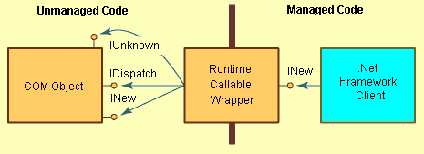
Runtime Callable Wrappers

Slide 16
Generating Runtime Callable Wrappers
Runtime Callable Wrappers Are Generated in One of Three Ways:
  Adding a reference to a COM component in a
  Visual Studio .NET project
  Employing the Type Library Importer
  Creating custom wrappers

Slide 17
Threading Models
COM Components Use Apartments to Synchronize Access to Managed Resources
Runtime Creates/Initializes Apartment When Calling a COM Object
To ensure that the main thread of an application is STA
using System.Threading;
using APTOBJLib;
…
Thread.CurrentThread.ApartmentState =
ApartmentState.STA;
AptSimple obj = new AptSimple ();
obj.Counter = 1;
…
[STAThread]
static void Main()
…

Slide 18
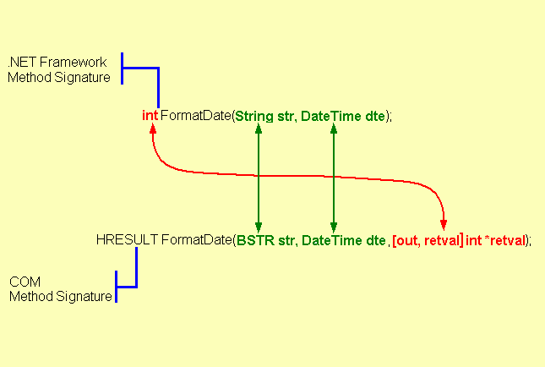
Signature Translation and Error Handling

Slide 19
Marshaling
Wrappers perform data marshaling
  Support for marshaling data to and from COM almost always provides the correct marshaling behavior
Table shows corresponding COM and C# types
MarshalAsAttribute to change the marshaling behavior
Two ways to customize the RCW to handle types
  Edit the interop assembly
  Create a wrapper manually
public void M1
([MarshalAs(UnmanagedType.LPWStr)]String msg);

Slide 20
Performance and Security Issues
Recognize that transitions that occur when managed code must interact with unmanaged code result in an overhead of 10 to 40 instructions per call.
  Limit the number of transitions that appear in your code
  Instead, use API calls that perform several actions
  at once
Eliminate the creation of the proxy and stub by setting the ApartmentState on the thread before creating a
COM object
For trusted code, suppress security checks that are performed when managed code calls unmanaged code

Slide 21
Best Practices
The MSIL Disassembler can be used on the generated assembly to determine the exact names of the namespace and classes that are generated
Any parameter passed by reference in C++ or
Visual Basic 6.0 will generate a parameter that needs
to be passed by using the ref keyword in C#

Slide 22
Calling .NET Objects from COM Objects
COM Callable Wrappers
The Export Process
Registering a .NET Framework Class with the System Registry
Using the ClassInterfaceAttribute
Using .NET Framework Types from COM
Managed and Unmanaged Events
Best Practices

Slide 23
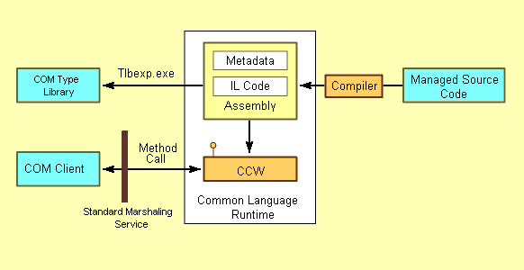
COM Callable Wrappers

Slide 24
The Export Process
Every public class in an assembly is converted to a coclass in a type library
Interfaces that are explicitly implemented are exported to the type library
Managed Code Type Library
public interface IShape
{
void Draw();
void Move(int x, int y);
}
class Circle : IShape
{
void Draw();
void Move(int x, int y);
void Enlarge(int x);
}
[ uuid(…), dual, odl, oleautomation ]
interface IShape : IDispatch {
HRESULT Draw();
HRESULT Move(int x, int y);
}
[ uuid(…) ]
coclass Circle {
interface IShape;
}
}

Slide 25
Registering a .NET Framework Class with the System Registry
To register a .NET Framework class with the system registry, use the Assembly Registration tool (Regasm.exe)
Registering a .NET Framework class creates the following entries in the system registry:
  The CLSID of the .NET Framework class under the Hkey_Classes_Root\CLSID registry key
  Two sub keys: Implemented Categories and InprocServer32 under the HKCR\CLSID\<class ID> key
The default value of the HKCR\CLSID\<class ID> key is set to the ProgID of the class
The default value of the InprocServer32 is set to the name of the DLL that contains the common language runtime (Mscoree.dll)

Slide 26
Using the ClassInterfaceAttribute
The class interface is an interface that exposes all public methods, properties, fields, and events that are explicitly exposed on the .NET Framework object
The [ClassInterface(ClassInterfaceType.None)] attribute prevents the class interface from being created
The [ClassInterface(ClassInterfaceType.AutoDispatch)] attribute creates a dispatch interface
The [ClassInterface(ClassInterfaceType.AutoDual)] attribute creates a dual interface

Slide 27
Using .NET Framework Types from COM
To Use a .NET Framework Class from Unmanaged Code
  Set a reference to the type library file that describes the interferences of the .NET Framework class
In Visual Basic 6.0, Use the References Dialog Box to Set the Reference
In Visual C++ 6.0, Use the #import Directive to Reference to the Type Library
Create and Use Objects of the Classes That Are Defined in the Type Library

Slide 28
Managed and Unmanaged Events
.NET event model differs from COM event model
  Managed events are based on delegates, whereas unmanaged events (in COM) are based on connection points.
See the .NET SDK for details on the topics:
  Handling Events Raised by a COM Source
  Raising Events Handled by a COM Sink

Slide 29
Best Practices
Define an Explicit Interface for COM Clients to Use Rather Than Generating the Class Interface
Avoid Caching Dispatch Identifiers
Restrict Using the Dual Interface Option for the Class Interface

Slide 30
Review
Integration Services
Platform Invoke
Calling COM Components from Managed Code
Calling .NET Objects from COM Objects

Slide 31
Overview
Overview of Attributes
Defining Custom Attributes
Retrieving Attribute Values

Slide 32
Overview of Attributes
Introduction to Attributes
Applying Attributes
Common Predefined Attributes
Using the Conditional Attribute
Using the DllImport Attribute
Using the Transaction Attribute

Slide 33
Introduction to Attributes
Attributes Are:
  Declarative tags that convey information to the runtime
  Stored with the metadata of the element
.NET Framework Provides Predefined Attributes
  The runtime contains code to examine values of attributes and act on them

Slide 34
Applying Attributes
Syntax: Use Square Brackets to Specify an Attribute
To Apply Multiple Attributes to an Element, You Can:
  Specify multiple attributes in separate square brackets
  Use a single square bracket and separate attributes with commas
  For some elements such as assemblies, specify the element name associated with the attribute explicitly
[attribute(positional_parameters,named_parameter=value, ...)]
element

Slide 35
Common Predefined Attributes
.NET Provides Many Predefined Attributes
  General attributes
  COM interoperability attributes
  Transaction handling attributes
  Visual designer component-building attributes

Slide 36
Using the Conditional Attribute
Serves As a Debugging Tool
  Causes conditional compilation of method calls, depending on the value of a programmer-defined symbol
  Does not cause conditional compilation of the method itself
Restrictions on Methods
  Must have return type of void
  Must not be declared as override
  Must not be from an inherited interface
class MyClass
{
[Conditional ("DEBUGGING")]
public static void MyMethod( )
{
...
}
}

Slide 37
Using the DllImport Attribute
With the DllImport Attribute, You Can:
  Invoke unmanaged code in DLLs from a C# environment
  Tag an external method to show that it resides in an unmanaged DLL
[DllImport("MyDLL.dll", EntryPoint=“MyFunction")]
public static extern int MyFunction(string param1);
public class MyClass( )
{
...
int result = MyFunction("Hello Unmanaged Code");
...
}

Slide 38
Using the Transaction Attribute
To Manage Transactions in COM+
  Specify that your component be included when a transaction commit is requested
  Use a Transaction attribute on the class that implements the component
using EnterpriseServices;
...
[Transaction(TransactionOption.Required)]
public class MyTransactionalComponent : ServicedComponent
{
...
}

Slide 39
Defining Custom Attributes
Defining Custom Attribute Scope
Defining an Attribute Class
Processing a Custom Attribute
Using Multiple Attributes

Slide 40
Defining Custom Attribute Scope
Use the AttributeUsage Tag to Define Scope
  Example
Use the Bitwise “or” Operator (|) to Specify
Multiple Elements
  Example
[AttributeUsage(AttributeTargets.Method)]
public class MyAttribute: System.Attribute
{ ... }
[AttributeUsage(AttributeTargets.Class | AttributeTargets.Struct)]
public class MyAttribute: System.Attribute
{ ... }

Slide 41
Defining an Attribute Class
Deriving an Attribute Class
  All attribute classes must derive from System.Attribute, directly or indirectly
  Suffix name of attribute class with “Attribute”
Components of an Attribute Class
  Define a public constructor for the attribute class whose arguments are the required positional parameters
  Use non-static public read-write properties for optional named parameters

Slide 42
Processing a Custom Attribute
The Compilation Process
1. Searches for the Attribute Class
2. Checks the Scope of the Attribute
3. Checks for a Constructor in the Attribute
4. Creates an Instance of the Object
5. Checks for a Named Parameter
6. Sets Field or Property to Named Parameter Value
7. Saves Current State of Attribute Class

Slide 43
Using Multiple Attributes
An Element Can Have More Than One Attribute
  Define both attributes separately
An Element Can Have More Than One Instance of The Same Attribute
  Use AllowMultiple = true

Slide 44
Retrieving Attribute Values
Examining Class Metadata
Querying for Attribute Information

Slide 45
Examining Class Metadata
To Query Class Metadata Information:
  Use the MemberInfo class in System.Reflection
  Populate a MemberInfo array by using the method System.Type.GetMembers
  Create a System.Type object by using the
  typeof operator
Example
System.Reflection.MemberInfo[ ] memberInfoArray;
memberInfoArray = typeof(MyClass).GetMembers( );

Slide 46
Querying for Attribute Information
To Retrieve Custom Attribute Information:
  Use GetCustomAttributes to retrieve all attribute information as an array
  Iterate through the array and examine the values of each element in the array
  Use the IsDefined method to determine whether a particular attribute has been defined for a class
System.Reflection.MemberInfo typeInfo;
typeInfo = typeof(MyClass);
object[ ] attrs = typeInfo.GetCustomAttributes(false);

Slide 47
Review
Overview of Attributes
Defining Custom Attributes
Retrieving Attribute Values

Slide 48

Assemblies
Managed Module
(MSIL and Metadata)
Managed Module
(MSIL and Metadata)
Assembly
Manifest
.html
Multiple Managed
Modules and
Resource Files
Are Compiled to
Produce an Assembly
.gif
Resource Files

