Slide 1

Hierarchical Search on DisCSPs
Michael Orlov and Amnon Meisels
Department of Computer Science
Ben-Gurion University

Slide 2


Overview
Motivation - why search hierarchically ?
Two parts
  Intelligent partition
  Descending Requirements Search (DesRS)
Experimental evaluation
Distributed partition…

Slide 3

Why hierarchically ?
Asynchronous search on DisCSPs comes in two forms
  Single search process – ABT
  Multiple search processes – ConcDB
How to enhance concurrency ?
Hierarchy can facilitate smart mechanisms for combining partial assignments (Pas)
Independency of hierarchy and search

Slide 4
HS - Algorithms Overview
Partition (forming a hierarchy)
  Agents select joining neighbors
  Formed components select a leader
  Leaders negotiate higher level joins
  Distributed formation of a binary tree
Descending Requirements Search (DesRS)
  Start search processes at leaves
  Send PAs through leaders to all agents
  Keep Nogoods for backjumping

Slide 5
Criteria for forming a partition
Join strongly constraining agents
Discarding small partial solutions
Use Constraint weight:
  probability that a pair of values is not in conflict
Higher level components - Virtual constraints
  Combination of constraints’ weights, approximated by multiplication

Slide 6
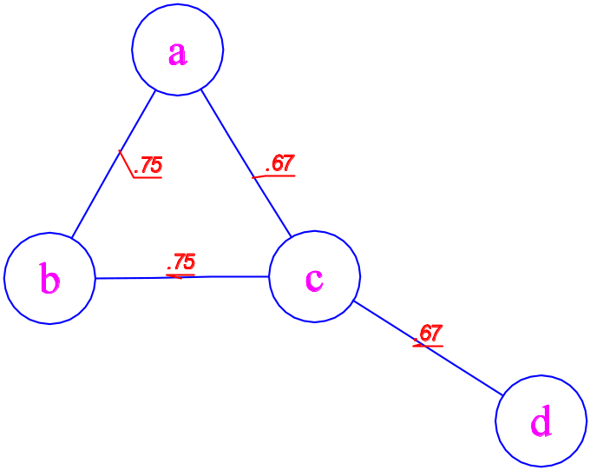
Example: Partition
Small graph-coloring problem
Domains of a, c and d are {1,2,3}
Domain of b is {1,2,3,4}

Slide 7
Partition – 1st level
Each agent sends Join to a minimal-weight neighbor
a → c, b → a, c → d, d → c
c and d join, send each other info about components – c is selected as leader
c sends Done to a, b

Slide 8
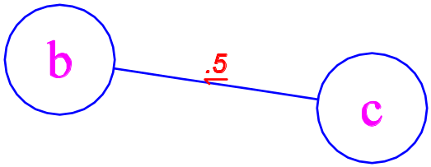
Partition – 2nd level
a and b remove c from list of neighbors
a and b join, and send Done to c
a, b, c, d send Leader messages to selected leaders, b is selected as leader of {a, b}
Leaders are activated at the next level (cannot be confused by previous levels messages)
b and c join, picking d as leader

Slide 9
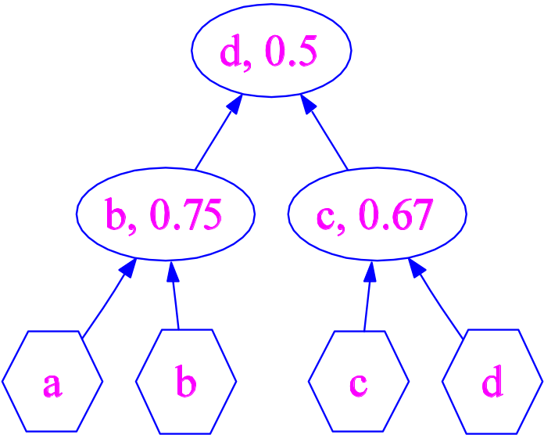
The resulting Partition
a hierarchy of agents
d sends Search message to all agents in order to initiate the search process

Slide 10
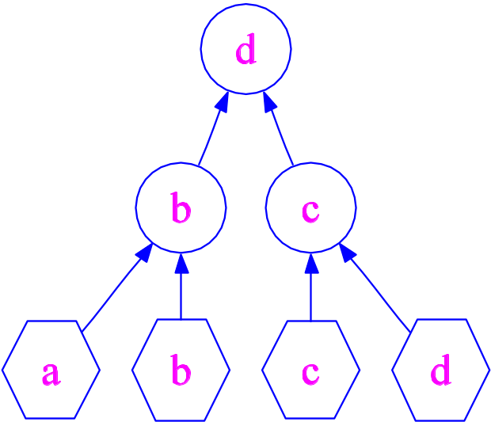
Example: DesRS
Each agent initiates a backtracking process
Processes are independent
Consider one originating at a
Note: numbers of processes and agents are independent

Slide 11
DesRS – search example
a to leader b: <a = 1>
Leader b forwards to leaf b → sends
<a = 1,b = 2> up
Leader b forwards to leaf d via leaders d, c
Leaf d to leader c: <a = 1,b = 2,d = 1>

Slide 12
DesRS – completing the search
Leaf c sends to leader c a complete solution
<a = 1,b = 2,d = 1,c = 3>
Leader c forwards it to USER via leader d
No backtracking! But backtracking works as expected (Nogoods)

Slide 13
Algorithm: Partition
Agents try to join neighbors with minimal weight: Join and NoJoin messages
Joining agents exchange component information with Components messages
Removing joined neighbors and environment for next level: Done messages
Leader activation: Leader messages
Agents can be self-leaders

Slide 14
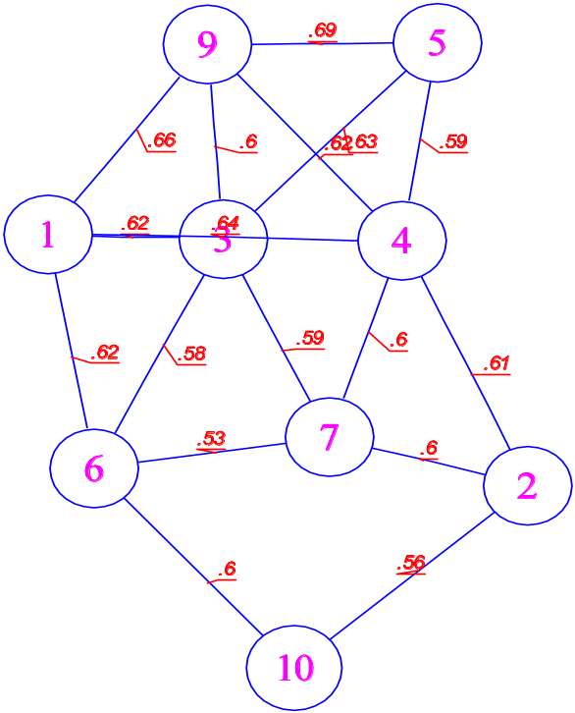
Partition (large example I )
Randomly generated CSP, p₁ = p₂ = 0.4

Slide 15
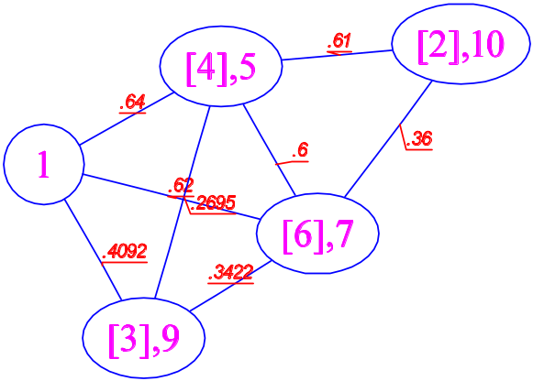
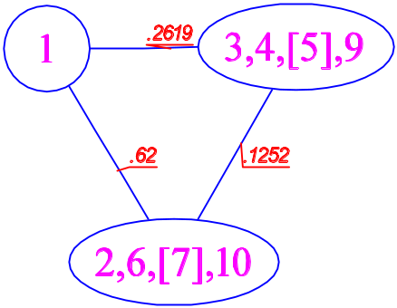
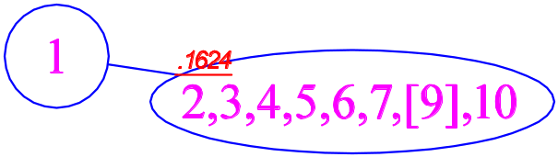
Partition (large example II)
Subsequent levels during partitioning

Slide 16
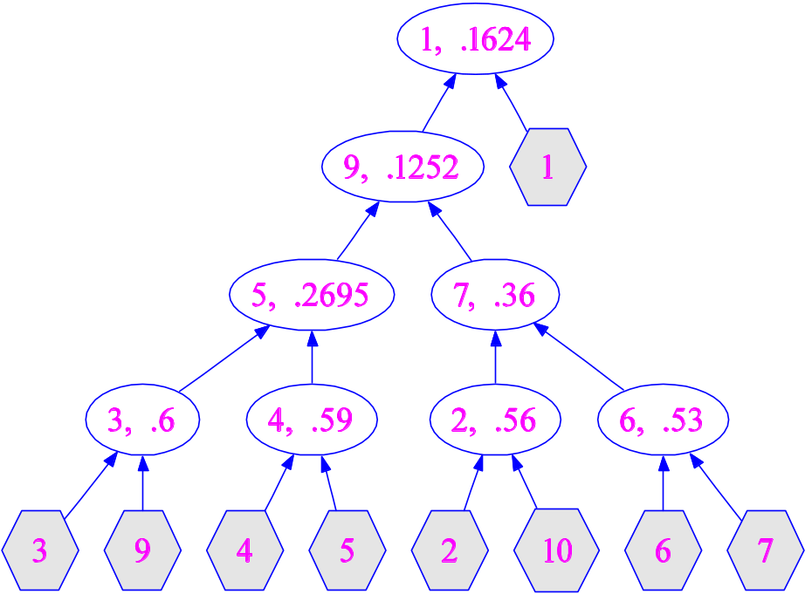

Partition (large example III)
Resulting hierarchy

Slide 17
Algorithm: DesRS
Agents initiate a backtracking search
Representative agents serve as routers
Search processes are independent
Run concurrently
Assignment and Nogood messages
Hierarchy serves as de-facto ordering

Slide 18
Algorithm Outline
Input : agent s, partition output, domain D, child agents
c_{0,1}, primitive child indicators prim_{0,1}
Output : a global solution is sent to USER
Locals : Id-Map[]

Slide 19
Algorithm Outline
Upon Search message: each primitive agent sends empty Assignment message to itself, with unique ID
Upon Assignment message to primitive agent: initialize ID to (PA,Domain,United-Explanation) mapping
Upon Assignment message to representative agent: route message up or down

Slide 20
Algorithm Outline
Upon Nogood message: expand United-Explanations in the corresponding mapping
Additionally, upon Assignment message to primitive agent or Nogood: find new non-conflicting value v in domain (expanding United-Explanations)
If such v exists, send extended Assignment message up, otherwise send Nogood with United-Explanations to the “culprit”

Slide 21
Experimental Results
DesRS vs. ABT & ConcDB

Slide 22
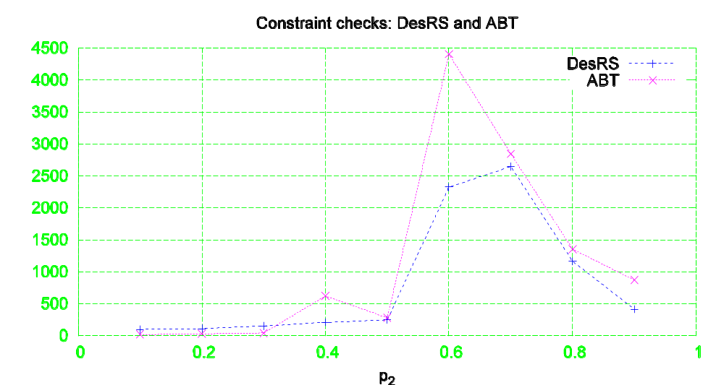
Runtime (NCCCs)
DesRS, ABT on random problems with 10 agents, domain size of 10, and p₁ = 0.5

Slide 23
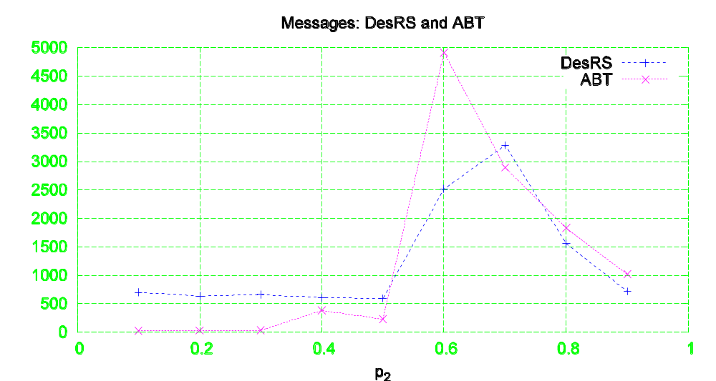
Total number of messages
DesRS, ABT on random problems with 10 agents, domain size of 10, and p₁ = 0.5

Slide 24
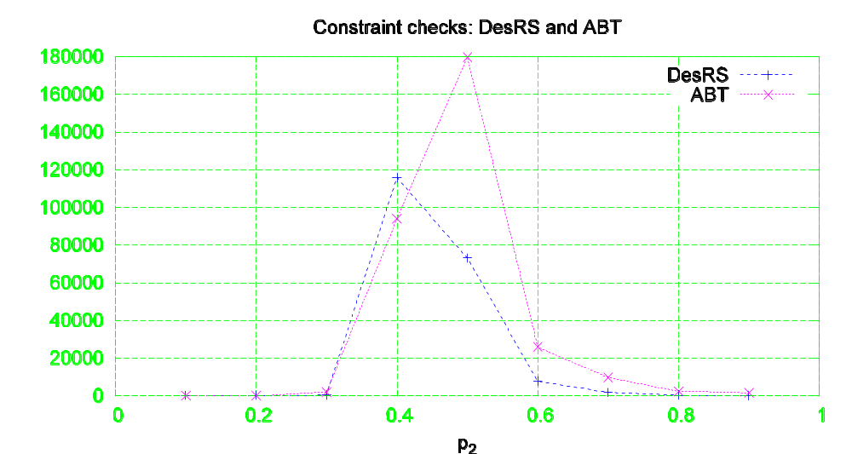
Larger problems
20 agents, domain size of 10, and p₁ = 0.4

Slide 25
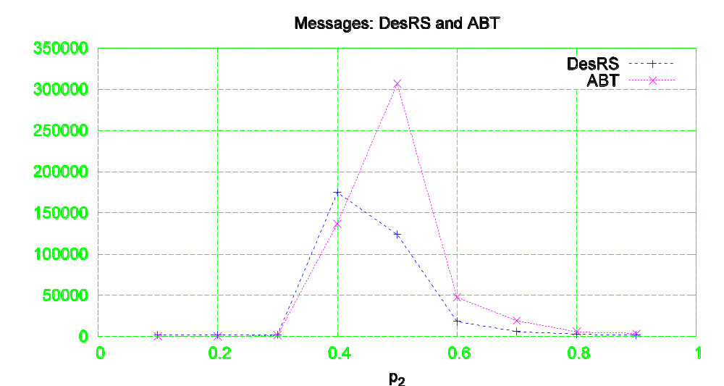
Larger problems - messages
20 agents, domain size of 10, and p₁ = 0.4

Slide 26
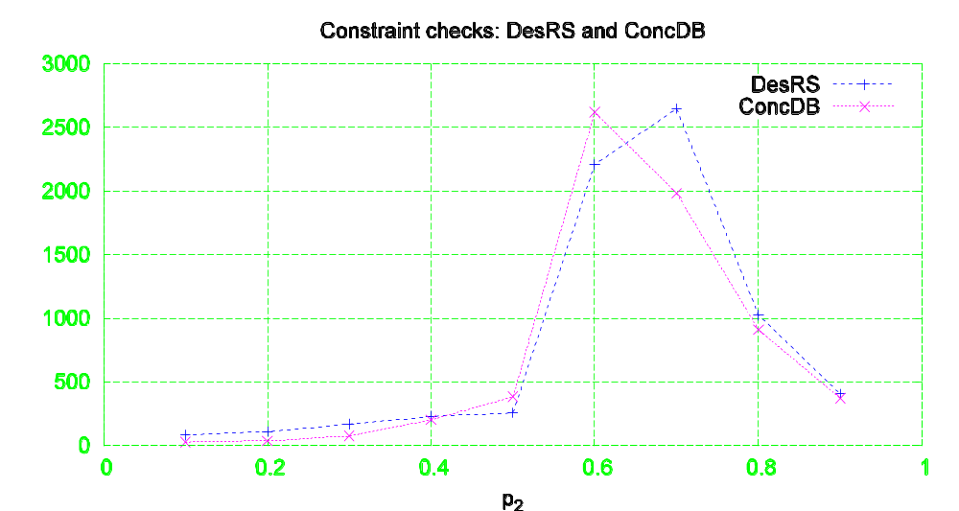
Concurrent search
DesRS vs. ConcDB [Zivan and Meisels, 2006] random problems with 10 agents

Slide 27
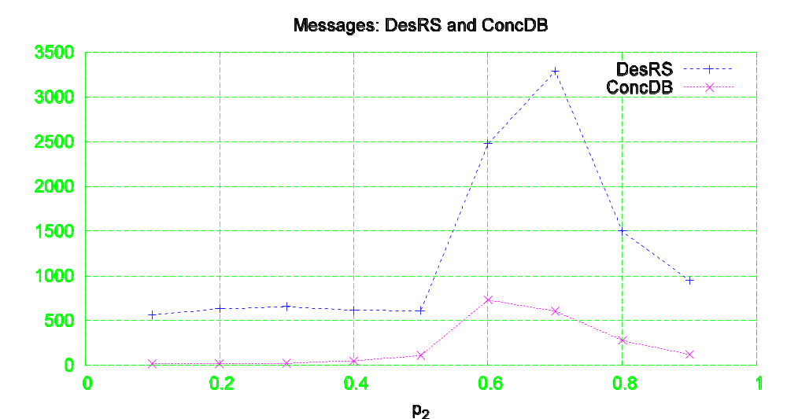
Concurrent search - messages
DesRS vs. ConcDB [Zivan and Meisels, 2006] random problems with 10 agents

Slide 28
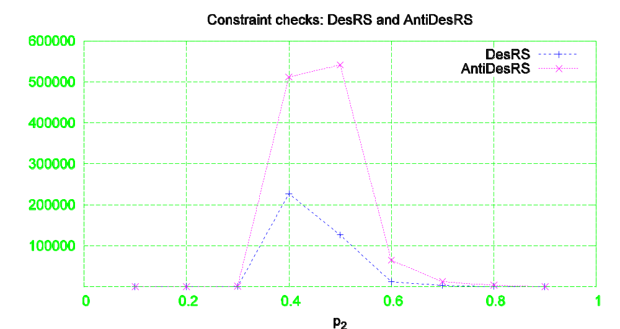
Importance of Partition
What if we change the order of neighbors during partition (20 agents, 10 values, p₁ = 0.4) ?

Slide 29
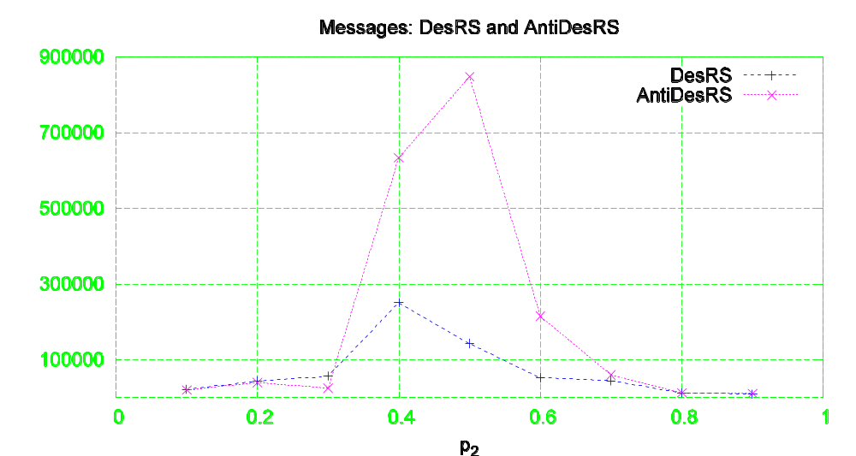
Opposite order - messages
Minimally constrained first (20 agents, 10 values, p₁ = 0.4)

Slide 30
Beyond Search

Slide 31
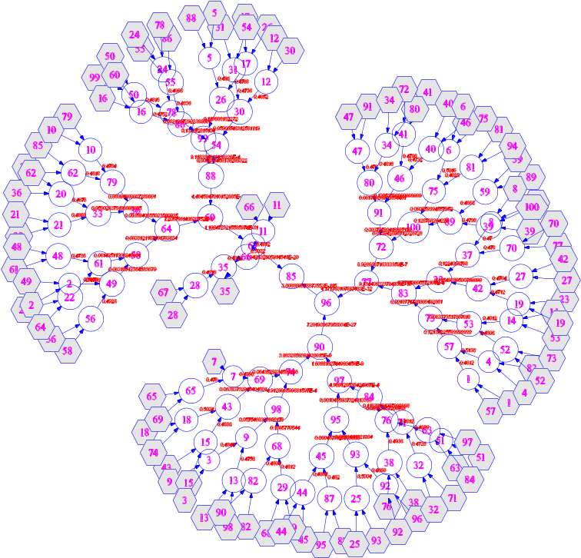
Partition: Additional applications
Social networks
P2P communication load balancing
Partition is fast!

Slide 32
Conclusions
Hierarchical search produces concurrent computation
Better than asynchronous backtracking in both run-time and communication load
Comparable run-time to concurrent search
More than one form of search that uses a hierarchy – many possible improvements
Partition into a hierarchy is useful for multiple goals

