Slide 1

Dead of Winter
a crossroads game
12.04.2016
Sofia
Kiril Petrov
Alexander Zorov

Slide 2
We present you a boardgame of life and death:
You control unique survivors
You can use different types of items and player abilities
You fight hordes of zombies
You search trough the game map
You find more companions
- But mostly you endure all of the dangers ahead
and manage by any means to survive
And of course this is not everything – you have a limited time to complete
the game and prove that you are a real Survivor !

Slide 3
What do we offer ?
Different game difficulty
Availability to choose starting survivors, main and secret objective
Different strategies
Dynamic map
Different situations and hardships
Lots and lots of fun and struggles

Slide 4
What made this happen ?
Java Core
Tomcat Server
Java Servlet Technology
MySQL DataBase
HTTP protocol for communication
Lots of JSP and JSTL
The few hours that we slept… that’s where the ideas came from :)

Slide 5
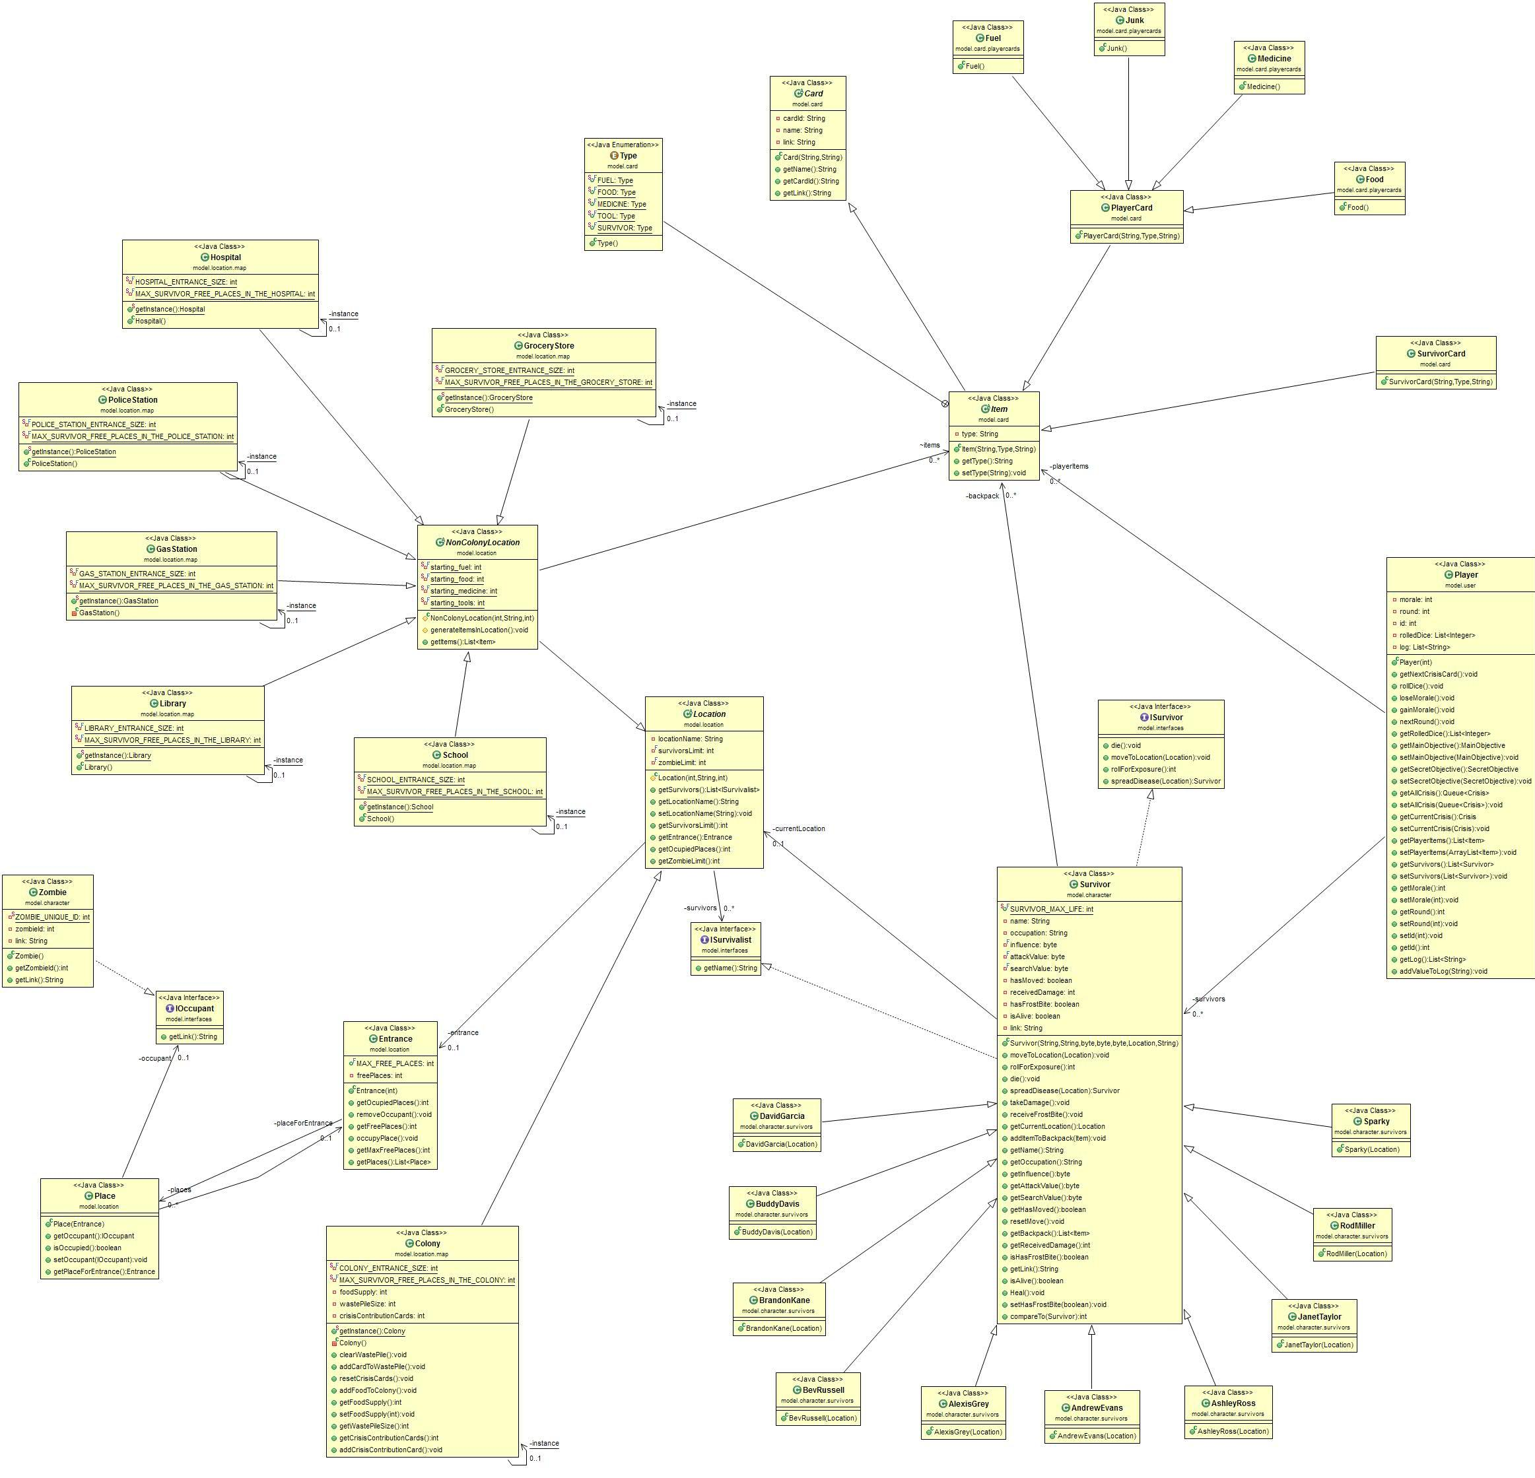

Slide 6
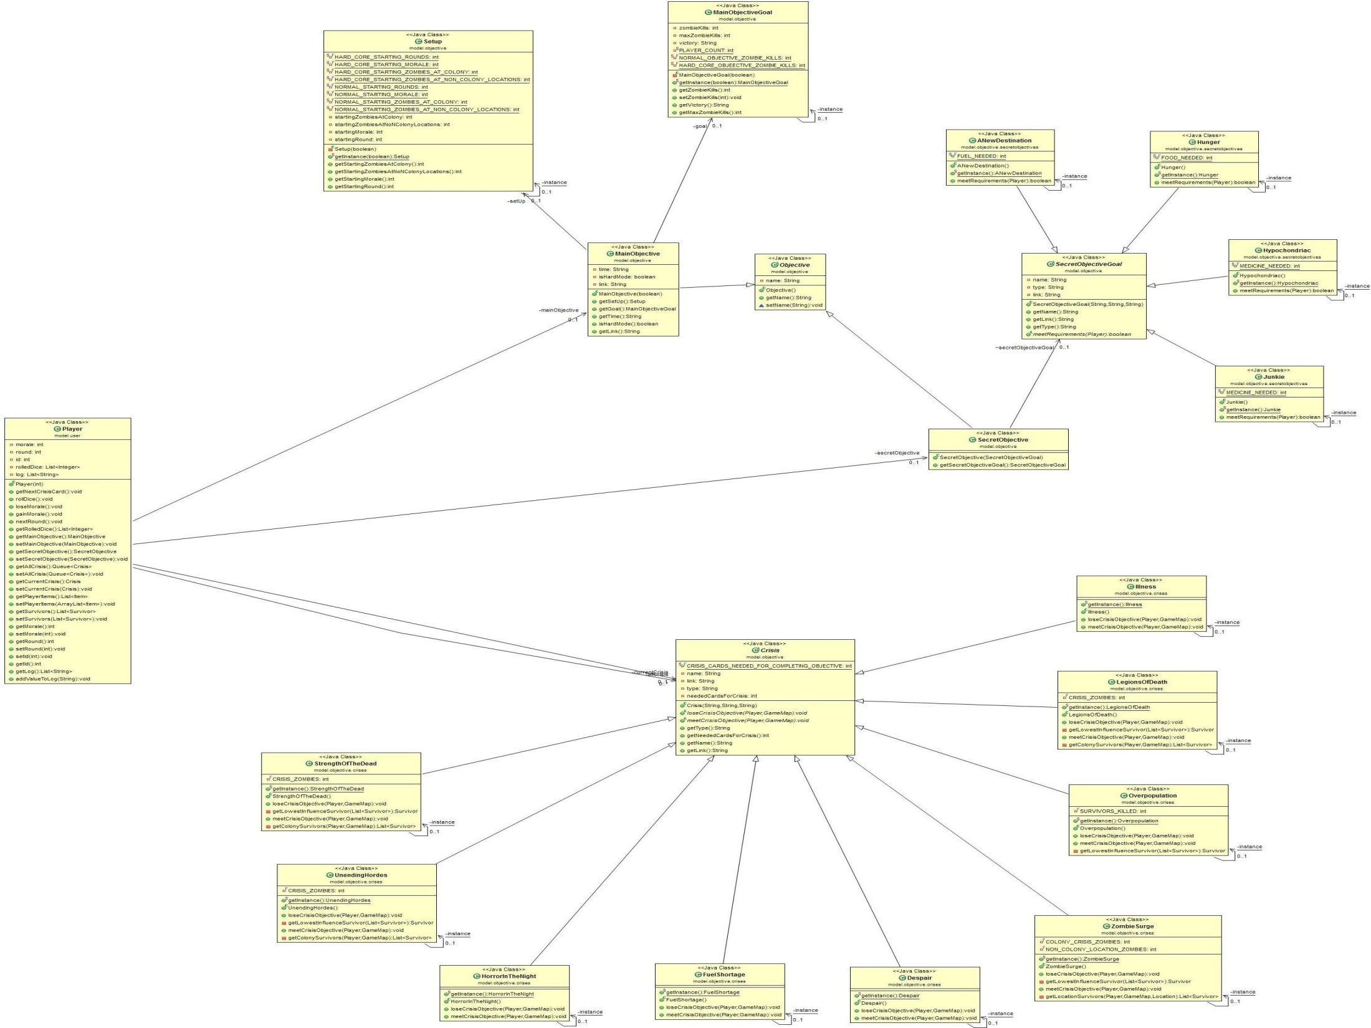
Tuk e class db diagramata

Slide 7
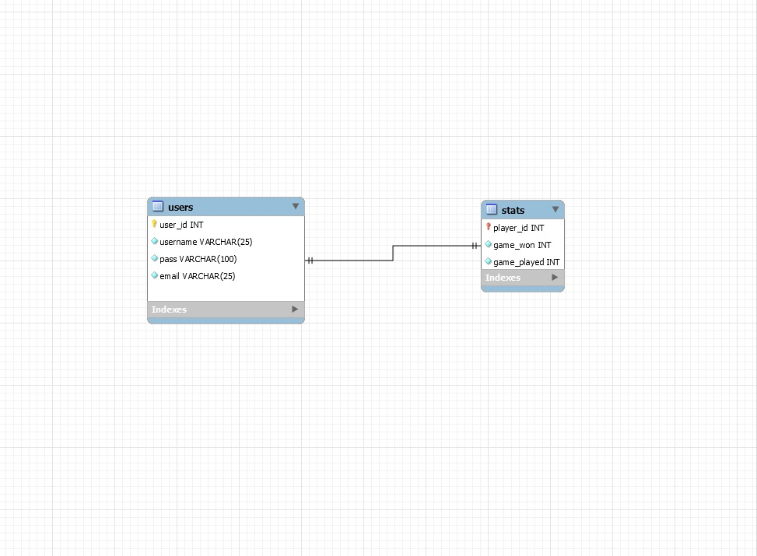
Tuk e class db diagramata

Slide 8
Some other Techs:
MVC for the game design
Design Patterns: Singleton, DAO for DB

Slide 9


Slide 10
Future Plans:
- Save Game Option
Multiplayer integration
New Heroes
New Items
Adding Survivor, Item and Player abilities
Adding chat for multiplayer

Slide 11
Thank You!
Q / A ?

