Slide 1

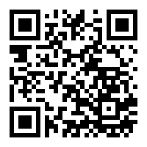
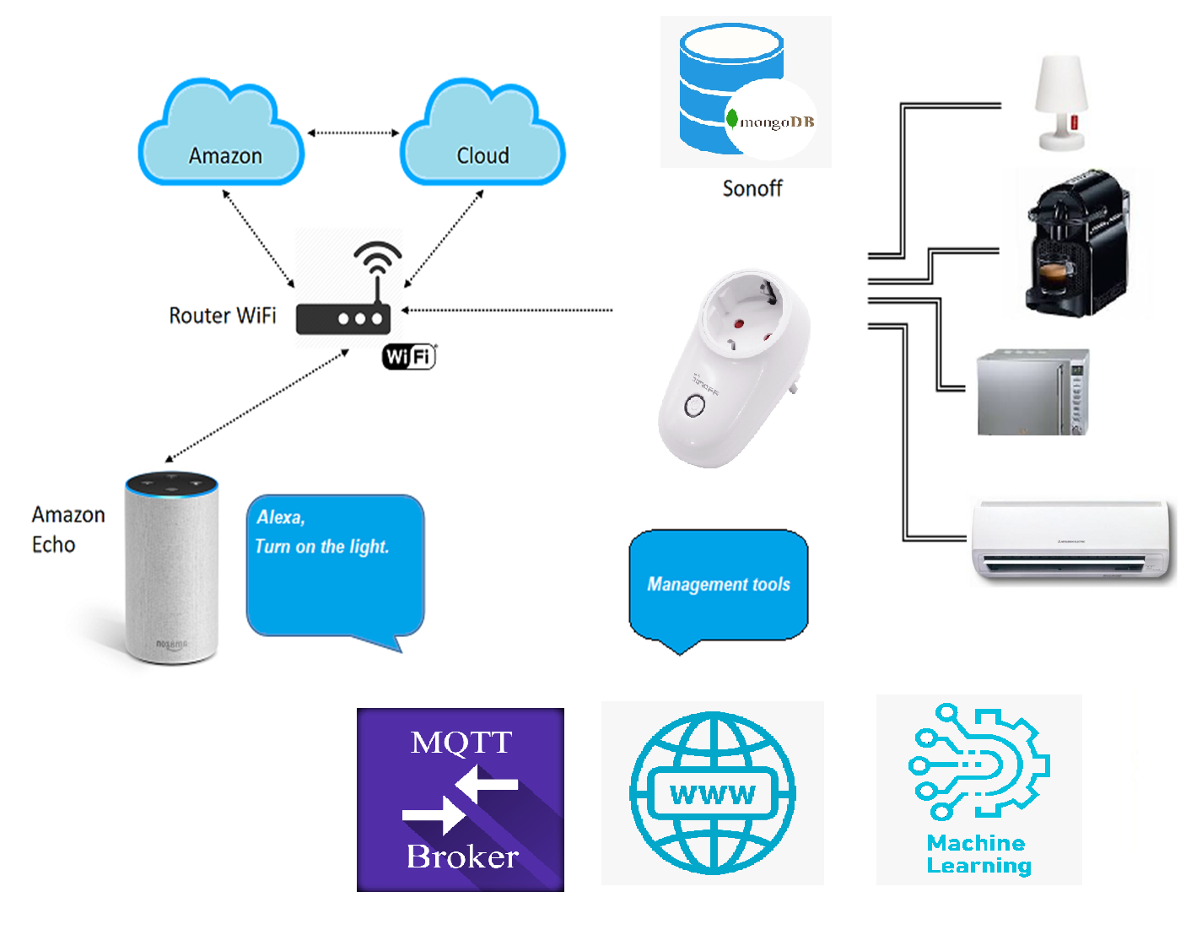

Ambient assisted living using voice assistant
_{Instructor : Yossi Zaguri}
_{Nof Hasson 308499557}
_{Orel Levi 308051358}
_{Matan Dahari 203910765}
We decided to do a project to help visually impaired people manage their basic lifestyles in the home environment by voice commands in such a way that they would be accessible to them independently.
Our project focuses on making the home environment accessible to users with disabilities by using a kit of smart power plugs and Alexa voice assistant as well and also mechanism that learns usage patterns and helps in safer use.
- SONOFF S26 WIFI plug with
Tasmota firmware.
- EXPRESS server communication
between the plug and home
appliances and the ALEXA
- Mosco MQTT BROKER
- MongoDB to save usage data +
Machine Learning of unsupervised
learning by using clustering.
The main features of the system will be support and lifestyle assistance through remote control and voice commands, monitoring and learning usage patterns to help improve both safety and electricity consumption.

