Slide 1

Web base Ordering & Manufacturing Management System

Slide 2
Agenda
Introduction
Problems
Solution
Similar system review
Technology review
System Architecture
Limitation
Quality Assurance
Development Model
Schedule and Milestones

Slide 3







Where the Idea from ?
Order
Order
Order
Order
Order
Order

Slide 4

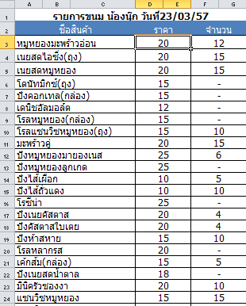


Slide 5
Problems
Mistake order

Slide 6
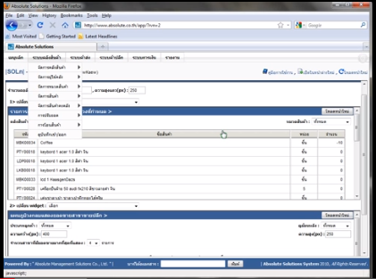
Similar system review
Absolute |Solution| website

Slide 7
Pros & Cons
Pros
All data is security from virus on machine.
The user can save investment.
Support using this web site with every operation system.
Support alert message with SMS and email.

Slide 8
Cons
Pros & Cons
Support only internet access areas.
No estimate the ingredients from ordering information.
No summary report system.

Slide 9
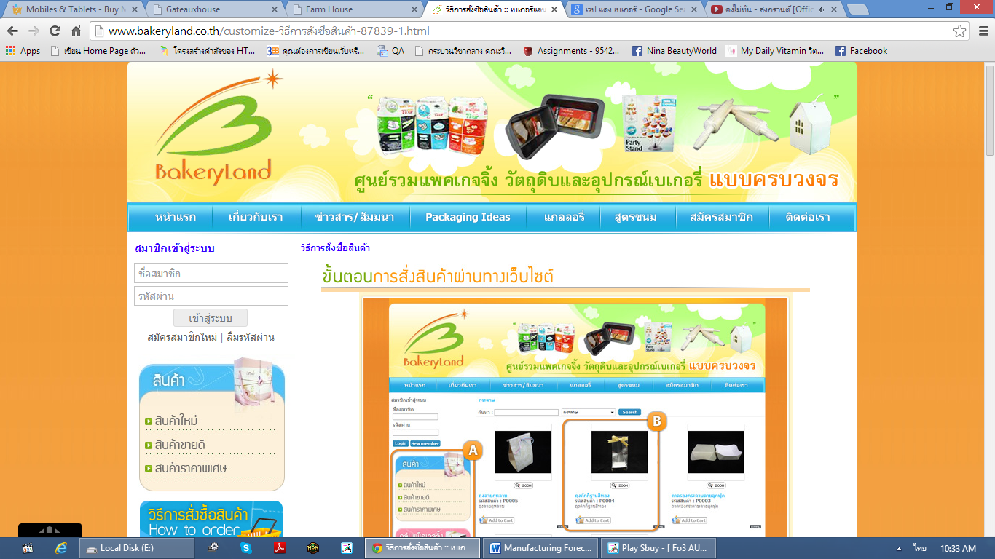
Similar system review
Bakery land website

Slide 10
Pros & Cons
Pros
The user can order the product through the website.
Have tutorial description for ordering.
Good category management.

Slide 11
Cons
Pros & Cons
Support only internet access areas.
No estimate the ingredients from ordering information.
No summary report system.

Slide 12
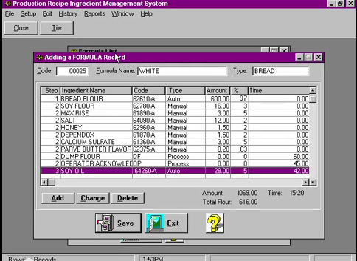
Similar system review
PRIMS Software

Slide 13
Pros & Cons
Pros
Easy to use for no user experience to operation.
Flexible technology to control over manual operation.
Record each step in the process.
Fast and accuracy.

Slide 14
Cons
Pros & Cons
No membership and login support.
No online interactive.
No coverage report type function.

Slide 15



Technology review

Slide 16



Technology & Development tools

Slide 17
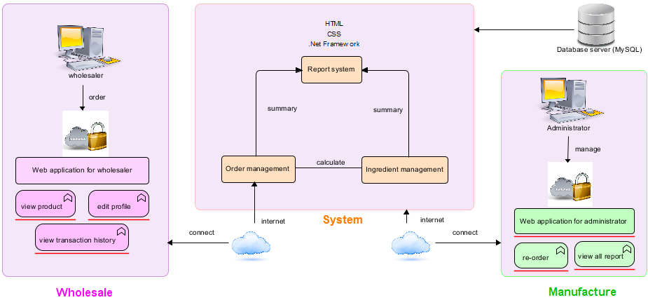
System Architecture

Slide 18
Limitation
This application required Internet connection to execute.
This application supports only Phungnoi bakery manufacturer as a sample for developing and testing the system.
This application cannot support stock and billing system.
This application cannot integrate directly with existing software.
This application require web browser.
This application require database server.

Slide 19
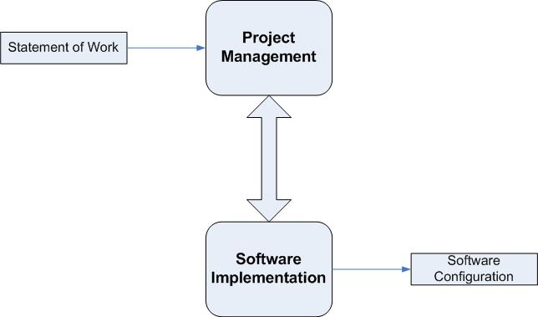
Quality & Assurance
ISO29110 for Very Small Entity (VSE)

Slide 20
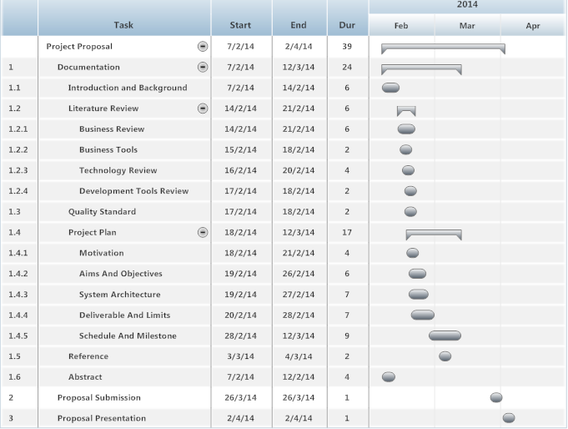
Schedule and Milestones
Proposal

Slide 21
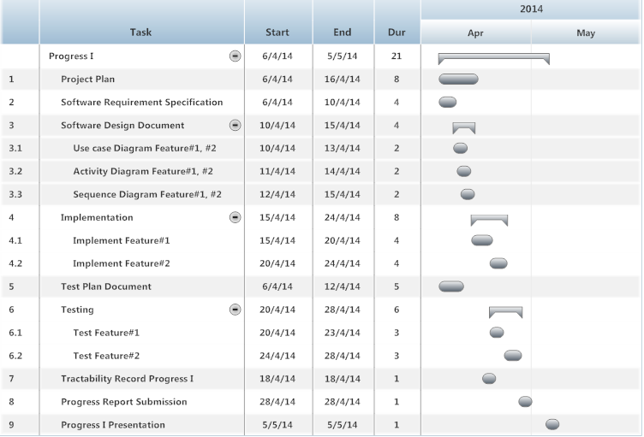
Schedule and Milestones
Progress I

Slide 22
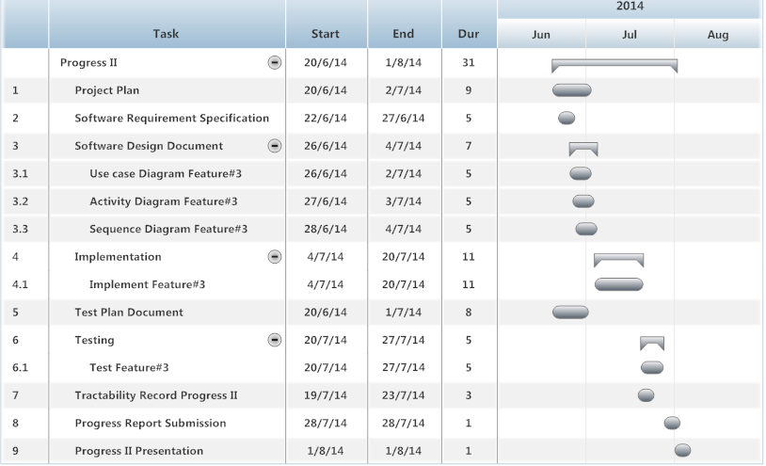
Schedule and Milestones
Progress II

Slide 23
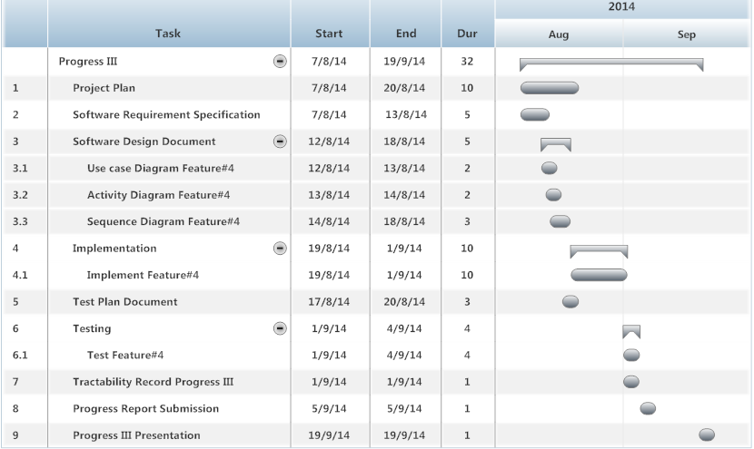
Schedule and Milestones
Progress III

Slide 24
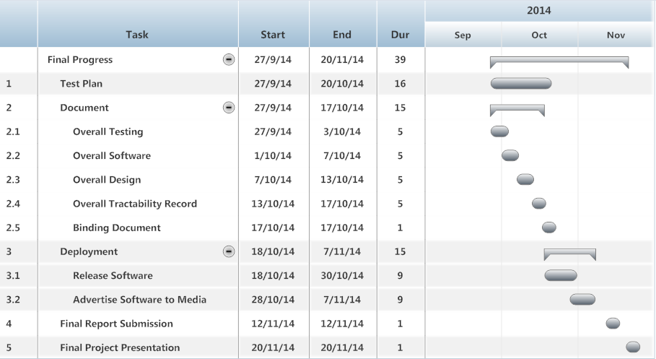
Schedule and Milestones
Final Progress

Slide 25

Q & A

