Slide 1

Web base Ordering & Manufacturing Management System

Slide 2
Agenda
Introduction
Problems
Solution
Similar system review
Technology review
System Architecture
Limitation
Quality Assurance
Development Model
Schedule and Milestones

Slide 3







Where the Idea from ?
Order
Order
Order
Order
Order
Order

Slide 4

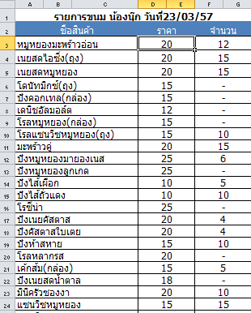
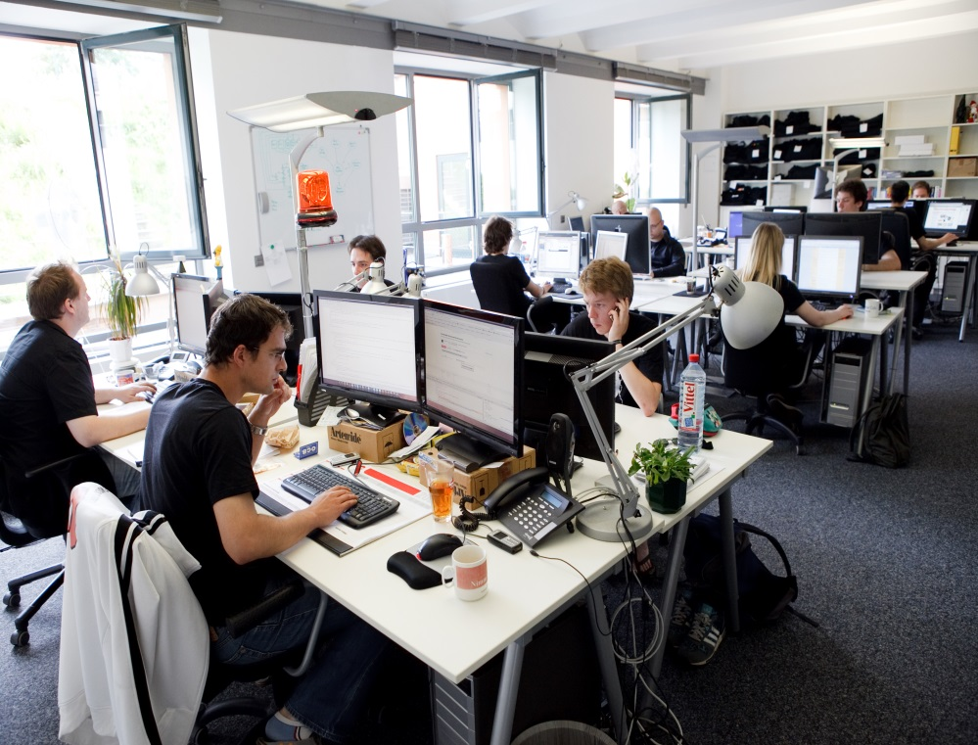
What are problems ?
Ordering

Slide 5
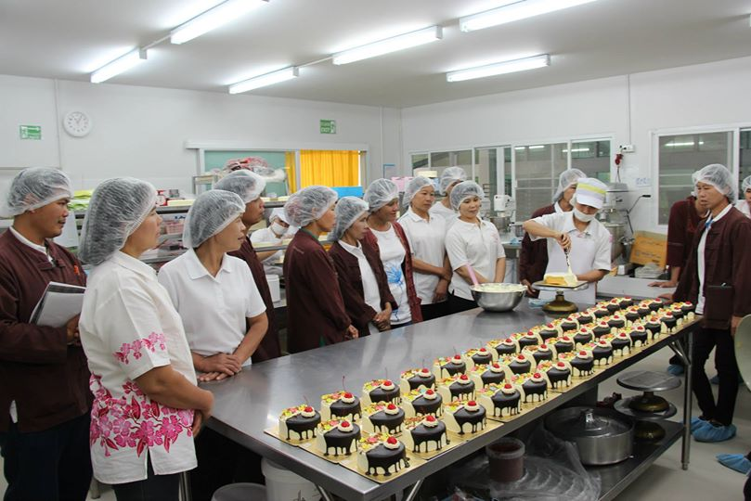
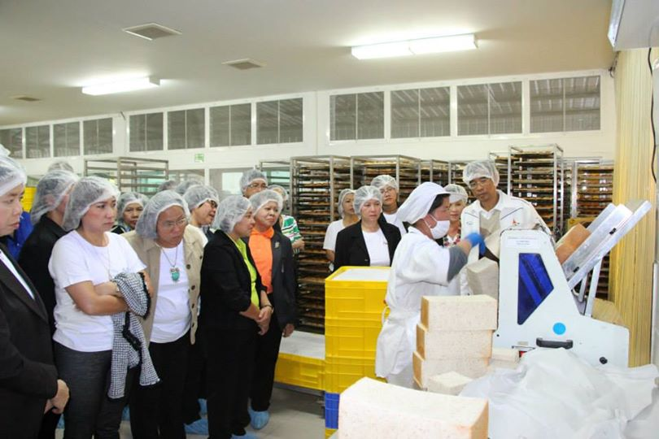
What are problems ?
Manufacturing

Slide 6
Solution
Reduce process in ordering system of company
Determine the usage of ingredients

Slide 7
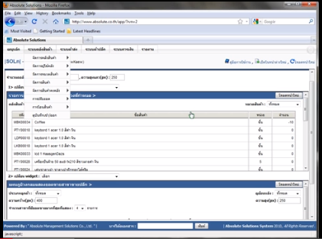
Similar system review
Absolute |Solution| website

Slide 8
Pros & Cons
Pros
All data is security from virus on machine.
The user can save investment.
Support using this web site with every operation system.
Support alert message with SMS and email.

Slide 9
Cons
Pros & Cons
Support only internet access areas.
No estimate the ingredients from ordering information.
No summary report system.

Slide 10
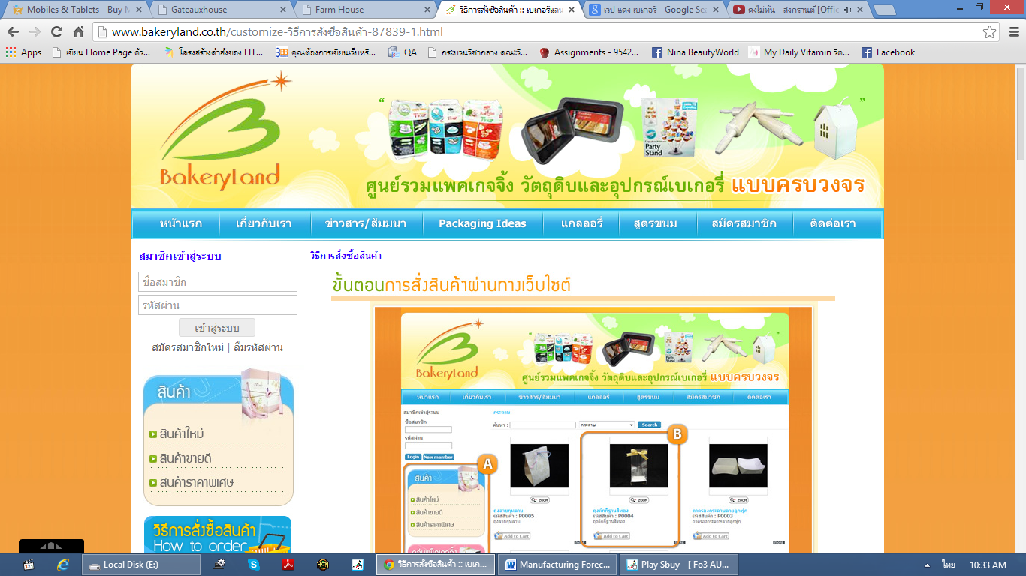
Similar system review
Bakery land website

Slide 11
Pros & Cons
Pros
The user can order the product through the website.
Have tutorial description for ordering.
Good category management.

Slide 12
Cons
Pros & Cons
Support only internet access areas.
No estimate the ingredients from ordering information.
No summary report system.

Slide 13
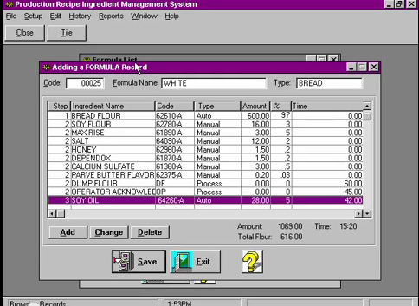
Similar system review
PRIMS Software

Slide 14
Pros & Cons
Pros
Easy to use for no user experience to operation.
Flexible technology to control over manual operation.
Record each step in the process.
Fast and accuracy.

Slide 15
Cons
Pros & Cons
No membership and login support.
No online interactive.
No coverage report type function.

Slide 16



Technology review

Slide 17



Technology & Development tools

Slide 18
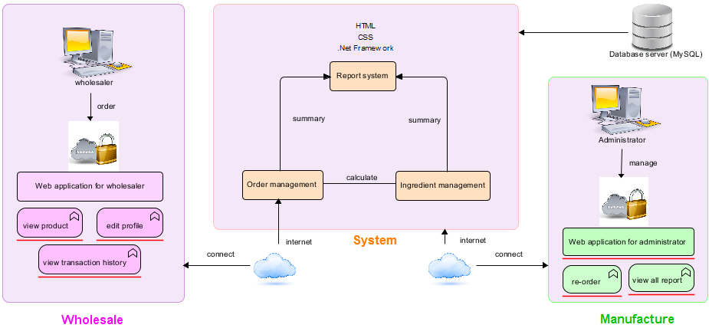
System Architecture

Slide 19
Limitation
This application required Internet connection to execute.
This application supports only Phungnoi bakery manufacturer as a sample for developing and testing the system.
This application cannot support stock and billing system.
This application cannot integrate directly with existing software.
This application require web browser.
This application require database server.

Slide 20
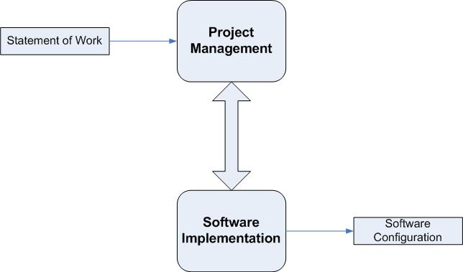
Quality & Assurance
ISO29110 for Very Small Entity (VSE)

Slide 21
Development Model
Notes:
Requirements of the complete system are clearly defined and understood.
When the project is big.
Major requirements must be defined; however, some details can evolve with time.

Slide 22
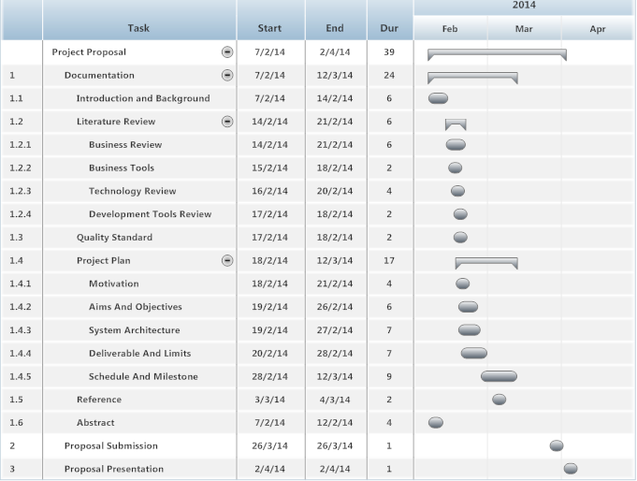
Schedule and Milestones
Proposal

Slide 23
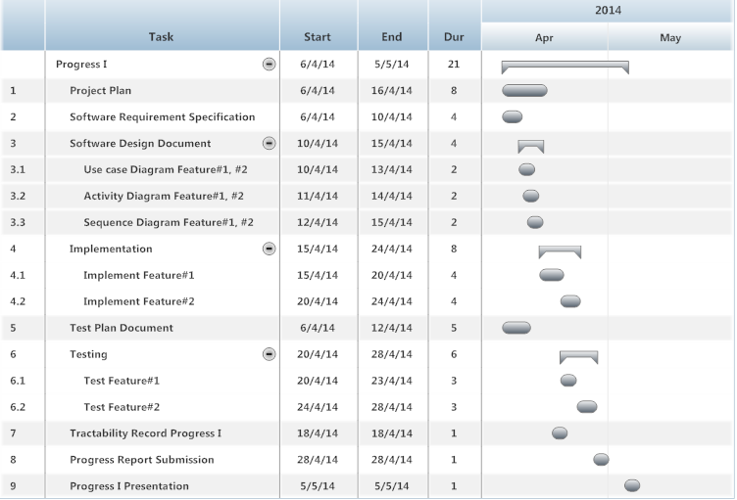
Schedule and Milestones
Progress I

Slide 24
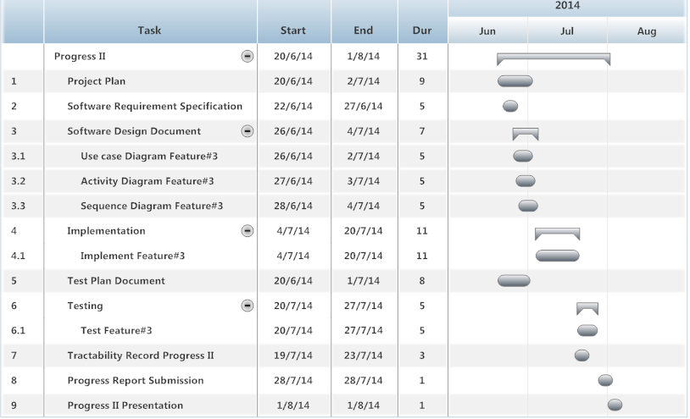
Schedule and Milestones
Progress II

Slide 25
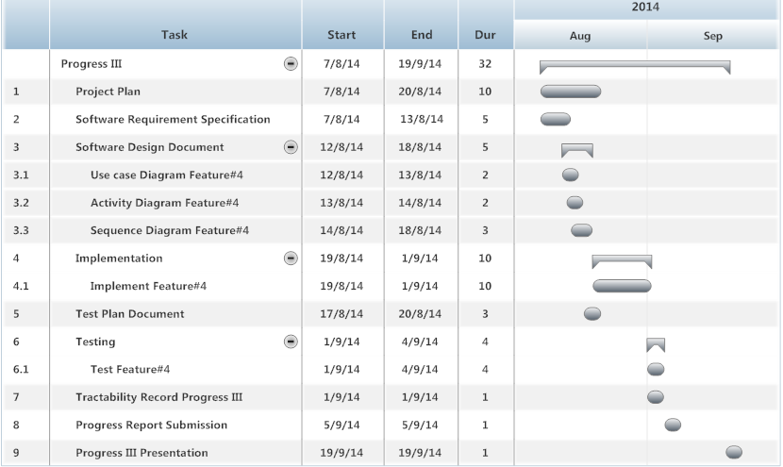
Schedule and Milestones
Progress III

Slide 26
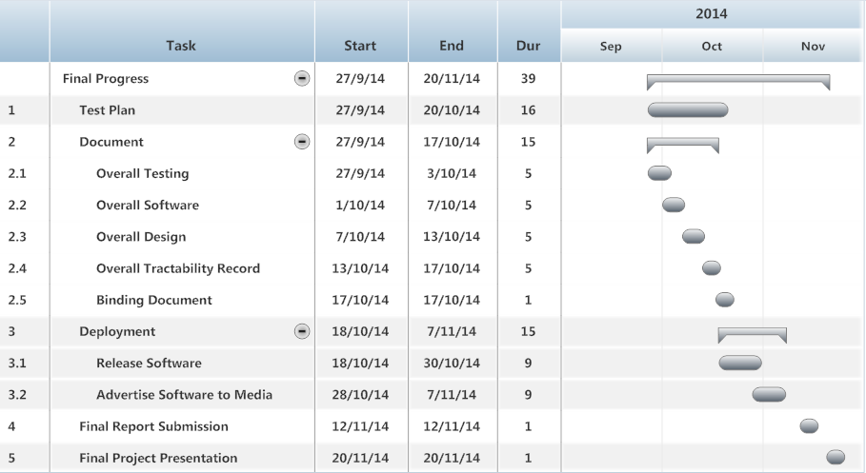
Schedule and Milestones
Final Progress

Slide 27

Q & A

