Slide 1
MedAlert
PREDICTING ED DECISIONS FROM EMS PRE-ARRIVAL REPORTS
Clean Text and Noisy ASR Robustness Evaluation
STUDENTS:
Nofar Refaeli ,Meital Gerasi

Slide 2
PROJECT REVIEW
PROBLEM DEFINITION
Task:
Predict ED decision labels from EMS pre-arrival report text.
input:
Synthetic EMS-to-ED handoff report
Outputs:
1. Arrival destination
2. Specialty consultation
Novelty:
Evaluate model performance on clean text and on noisy ASR transcripts created using TTS and ambulance-noise injection.
MOTIVATING USE CASE
EMS pre-arrival handoff reports provide the Emergency Department with early clinical information before the patient arrives.
This information may help the ED prepare the appropriate care area and specialty consultation.
However, these reports are often brief, incomplete, variable in wording, and may contain ASR transcription errors.

Slide 3
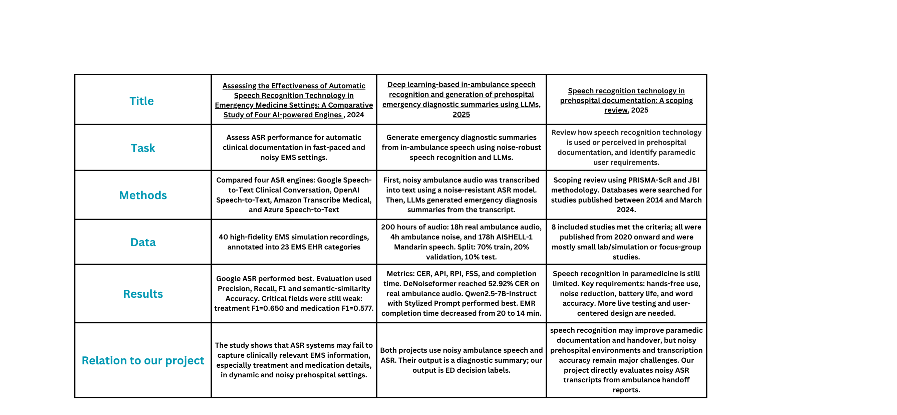
PREVIOUS WORK

Slide 4
DATASET PREPROCESSING
• Source: MIMIC-IV-Ext CDS task-specific files merged by stay_id.
• Files used: triage_level.csv, diagnosis.csv, and specialty_referral.csv.
• Working subset: 2,139 complete cases with HPI, initial vitals, triage, diagnosis, and specialty referral.
Cleaned noisy diagnosis/specialty fields:
specialties 591 → 63,
diagnoses 1,886 → 1,797
Parsed initial vitals from text into numeric variables and removed clinically implausible values.

Slide 5
Labeling
FIRST LABEL: ARRIVAL_DESTINATION
• Created using rule-based weak labeling.
• Input signals for labeling: clinical narrative, triage level, and parsed vital signs.
• Rules identify clinical instability, isolation risk, trauma/high-risk injury patterns, and low-acuity presentations.
• Used as target only; excluded from the text-generation prompt.
6 Final classes:
standard_ed_bed, monitored_bed, resuscitation_bay,
isolation_room, trauma_bay, triage_or_waiting_room

Slide 6
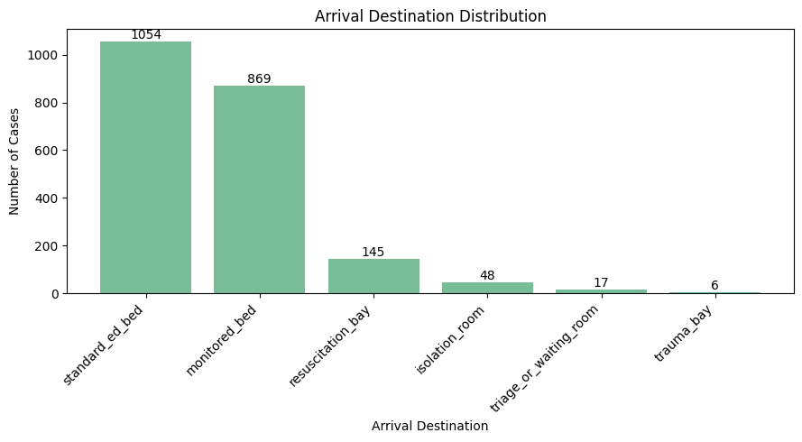
TARGET LABEL DISTRIBUTION AND CLASS IMBALANCE

Slide 7
Labeling
SECOND LABEL: SPECIALTY_CONSULT_LABEL
• Derived from the cleaned specialty field.
• Original specialties were grouped into broader clinical consult labels.
• 63 original specialties were reduced to 18 final consult classes.
• Generic labels such as medicine_or_ed_consult and other_consult were used only when no specific consult label was available.
• Used as target only; excluded from the text-generation prompt.
Examples:
orthopedics / hand surgery / podiatry → orthopedic_consult
ENT / ophthalmology / oral surgery / dentistry → ent_or_eye_oral_consult
*We intentionally prioritize ASR robustness over multi-label modeling in order to
keep the experimental question focused and interpretable.

Slide 8
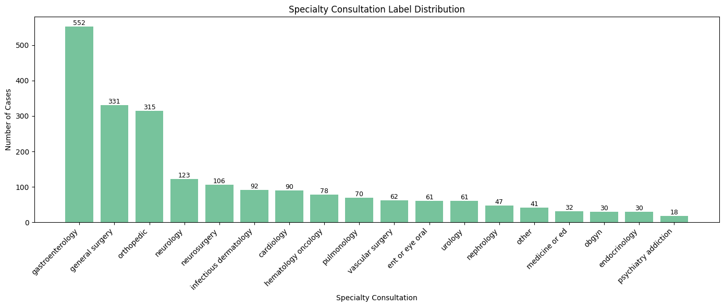
TARGET LABEL DISTRIBUTION AND CLASS IMBALANCE

Slide 9
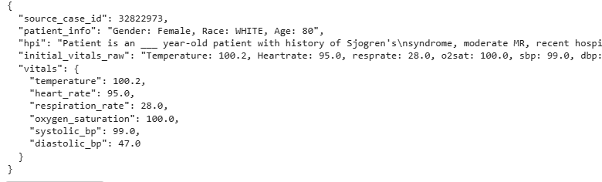
LEAKAGE-AWARE CASE SEED FOR REPORT GENERATION
Each case was converted into a structured seed containing HPI, patient information, and initial vital signs.
To reduce leakage, the seed excluded target labels, specialty fields, diagnosis fields, and triage, since these were related to the target-label creation.

Slide 10
SYNTHETIC EMS REPORT GENERATION
2,139 LABELED CLINICAL CASES
4 VARIANTS PER CASE:
↓
LEAKAGE-AWARE CASE SEEDS
professional_complete
brief_radio_missing_details
patient_reported_uncertain
distracted_or_disorganized_handoff
↓
GPT-4.1-MINI TEXT GENERATION
↓
4 EMS REPORT VARIANTS PER CASE
↓
8,556 SYNTHETIC EMS REPORTS

Slide 11
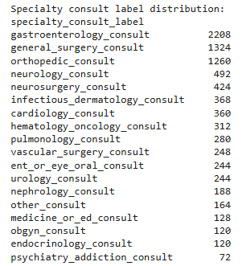
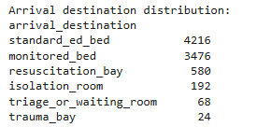
FINAL DATASET LABEL DISTRIBUTION
*The generated dataset preserves the original class imbalance, since each source case produced four report variants.

Slide 12
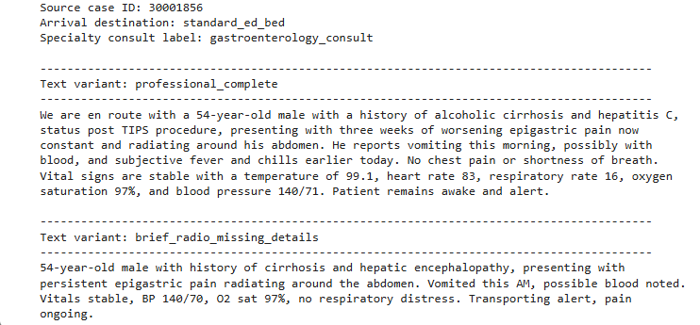
Example: Same Clinical Case, Different EMS Report Variants

Slide 13
POST-PROCESSING AND LEAKAGE REDUCTION
After generation, reports were scanned for hospital-based or leakage-prone wording.
• Imaging/lab results
• Specialist consult wording
• Hospital workflow phrases
Regex-based candidate detection → minimal LLM rewrite → second-pass check.
• Round 1 candidates: 461 reports (5.39%)
• Round 2 remaining candidates: 168 reports (1.96%)
DETECTED PATTERNS
METHOD
RESULTS

Slide 14
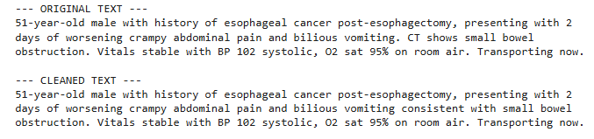
POST-PROCESSING AND LEAKAGE REDUCTION
The goal was to preserve clinical meaning while keeping the text EMS-style.

Slide 15
TRAIN / VALIDATION / TEST SPLIT
Split strategy:
• Group-based split by source_case_id: all 4 variants of the same clinical case were kept in the same split
• Class coverage check: all target classes are represented in train, validation, and test.
*This prevents leakage between train, validation, and test
Final split:
70% TRAIN:
5,988 reports (1,497 source cases)
15% VALIDATION:
1,284 reports (321 source cases)
15% TEST:
1,284 reports (321 source cases)

Slide 16
ASR ROBUSTNESS EVALUATION SETUP
Test reports
TTS conversion
(edge-tts, male voice, speed ×1.3)
GOAL
After selecting the best model for each target, evaluate its robustness on the same fixed test set:
Clean text reports
Noisy ASR transcripts after speech synthesis, ambulance noise, and Whisper transcription
Clean audio
Ambulance noise injection
(siren + white noise, medium level)
Noisy audio
Whisper transcription
Noisy ASR text
https://drive.google.com/file/d/12f6D7XoTyqm1V-QM2hh8oOpsJEE8EI6Z/view?usp=drive_link
Clean text test set vs Noisy ASR test set

Slide 17
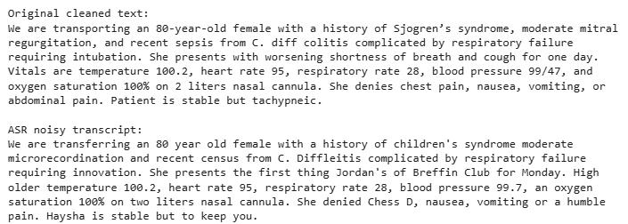
ASR Error Example: Clean Report vs Noisy Transcript
Mean WER: 0.474≈ 47%
WER measures the word-level difference between the clean EMS report and the ASR transcript.
In this example, about 31.6% of the words were changed, deleted, or inserted after noisy ASR transcription.

Slide 18
MODELS
TF-IDF + LOGISTIC REGRESSION BASELINE
TUNED HYPERPARAMETERS:
BASELINE APPROACH:
arrival_destination:
ngram_range = (1, 2)
min_df = 2
class_weight = balanced
• Text representation: TF-IDF
• Classifier: Logistic Regression
• Hyperparameter tuning was performed on the validation set
• Final evaluation was performed on the held-out test set
specialty_consult_label:
ngram_range = (1, 1)
min_df = 1
class_weight = balanced

Slide 19
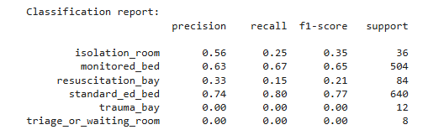
TF-IDF + LOGISTIC REGRESSION BASELINE: RESULTS
arrival_destination
Accuracy = 68.1%
Macro F1 = 0.330
Weighted F1 = 0.664

Slide 20
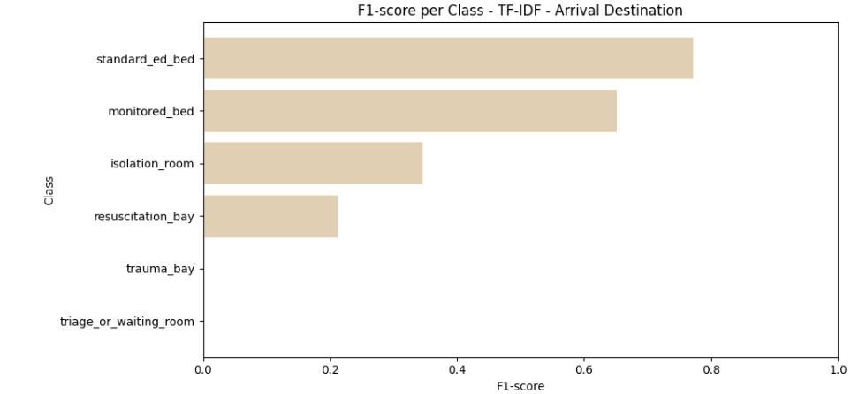
TF-IDF + LOGISTIC REGRESSION BASELINE: RESULTS
arrival_destination

Slide 21
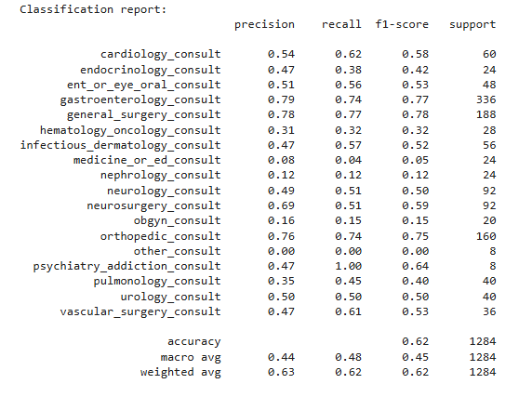
TF-IDF + LOGISTIC REGRESSION BASELINE: RESULTS
specialty_consult
Accuracy = 61.9%
Macro F1 = 0.452
Weighted F1 = 0.622

Slide 22
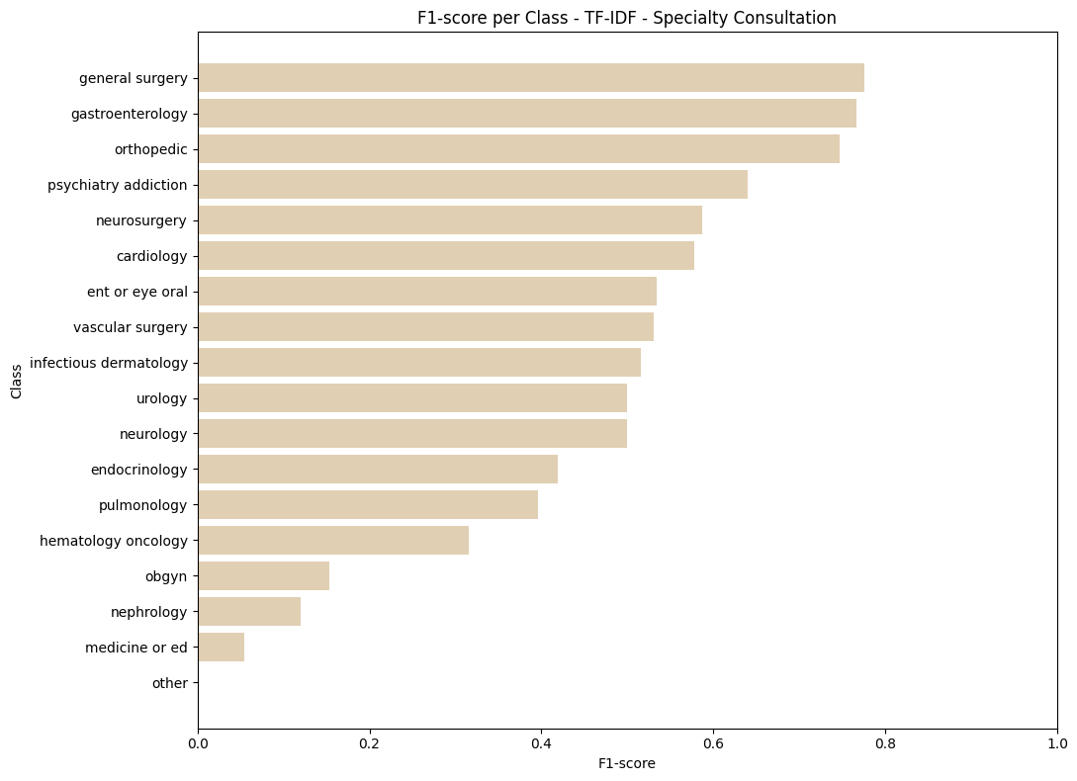
TF-IDF + LOGISTIC REGRESSION BASELINE: RESULTS
specialty_consult

Slide 23
Transformer Model Setup
BioClinicalBERT
• Tokenization with max_length = 128
• 3 epochs
• batch_size = 16
• learning_rate = 2e-5
• Best model selected by validation Macro F1
• Regular Trainer, without class weights
Input:
text_cleaned EMS report
Task:
Multi-class text classification

Slide 24
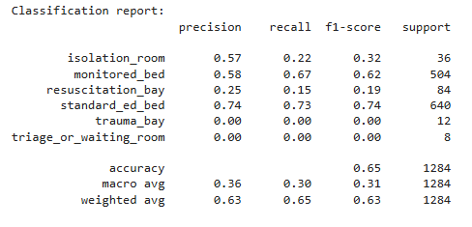
BioClinicalBERT Results: arrival_destination
Accuracy = 64.7%
Macro F1 = 0.312
Weighted F1 = 0.635

Slide 25
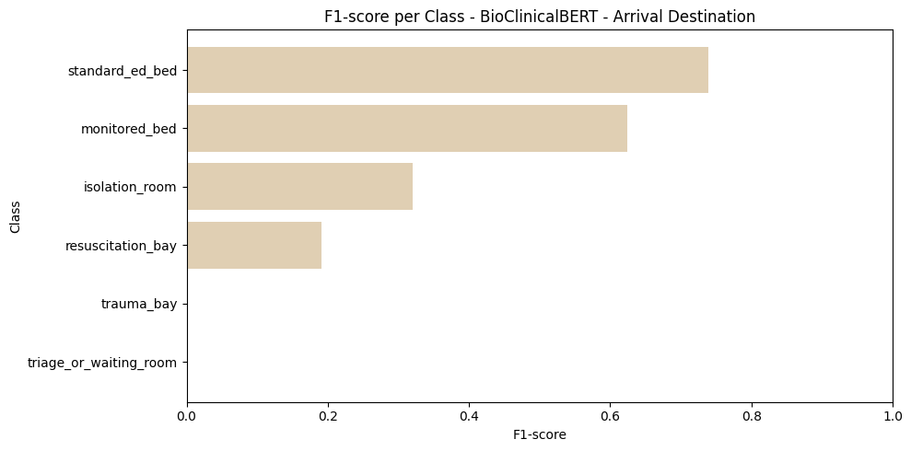
BioClinicalBERT Results: arrival_destination

Slide 26
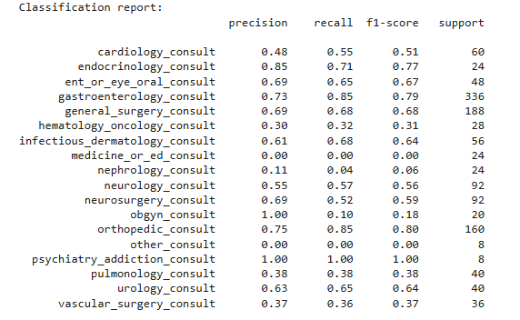
BioClinicalBERT Results: specialty_consult
Accuracy = 65.7%
Macro F1 = 0.497
Weighted F1 = 0.638

Slide 27
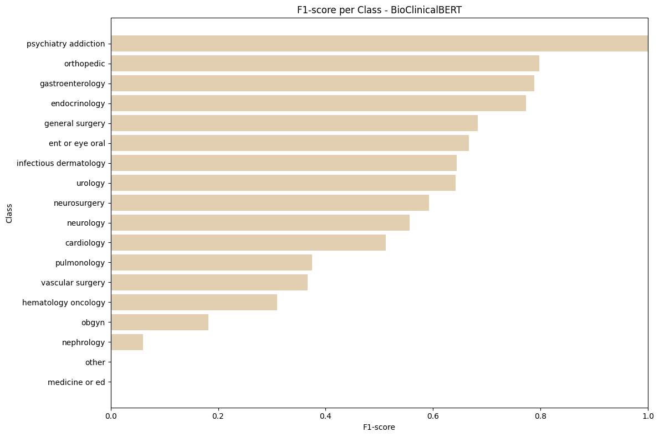
BioClinicalBERT Results: specialty_consult

Slide 28
Model | Target Label | Accuracy | Macro F1 | Weighted F1
TF-IDF + Logistic Regression | arrival_destination | 0.681 | 0.330 | 0.664
BioClinicalBERT | arrival_destination | 0.647 | 0.312 | 0.635
TF-IDF + Logistic Regression | specialty_consult | 0.619 | 0.452 | 0.622
BioClinicalBERT | specialty_consult | 0.657 | 0.497 | 0.638

Slide 29
PLAN TOWARD FINAL SUBMISSION
Clean vs ASR: Evaluate the best trained models on clean text and noisy ASR transcripts
Model tuning: Try more epochs, lower learning rate
Improve rare class performance:
using class weights.
Controlled oversampling / Text augmentation.
Perform error analysis using confusion matrices.

