Slide 1
MedAlert
ED DECISION CLASSIFICATION FROM LLM-GENERATED EMS VOICE REPORTS
Improving Robustness to ASR Noise with Clean and Noisy Training
STUDENTS:
Nofar Refaeli ,Meital Gerasi

Slide 2
PROJECT DEFINITION
PROBLEM DEFINITION
Task:
Predict ED preparation decisions from EMS pre-arrival handoff reports.
input:
Synthetic EMS pre-arrival handoff report
Outputs:
1. ED care area (arrival_destination)
2. Primary specialty consultation (specialty_consult_label)
Main research question:
How well can ED decisions be predicted from EMS reports, and does noisy ASR training improve performance?
Models:
DistilBERT and BioClinicalBERT
MOTIVATING USE CASE
EMS pre-arrival reports provide early clinical information that may help the ED prepare the appropriate care area and specialty consultation.
However, these reports are often brief, incomplete, and communicated verbally under noisy ambulance conditions.
To simulate this setting, we converted the reports to speech, added ambulance noise, and transcribed them using ASR.

Slide 3
NOVELTY
We generate synthetic noisy EMS training data
and train one Transformer model directly on the full report.
WE DO NOT USE A TRADITIONAL ASR → INFORMATION EXTRACTION →
RULE-BASED DECISION PIPELINE.
The model learns from both the clinical context and
recurring ASR errors.
We test whether noisy and clean+noisy training
improve downstream ED decision prediction.

Slide 4
DATASET PREPROCESSING
• Source: MIMIC-IV-Ext CDS task-specific files merged by stay_id.
• Files used: triage_level.csv, diagnosis.csv, and specialty_referral.csv.
• Working subset: 2,139 complete cases with HPI, initial vitals, triage, diagnosis, and specialty referral.
Cleaned noisy diagnosis/specialty fields:
specialties 591 → 63,
diagnoses 1,886 → 1,797
Parsed initial vitals from text into numeric variables and removed clinically implausible values.

Slide 5
Labeling
FIRST LABEL: ED CARE AREA
• Created using rule-based weak labeling.
• Input signals for labeling: clinical narrative, triage level, and parsed vital signs.
• Rules identify clinical instability, isolation risk, trauma/high-risk injury patterns, and low-acuity presentations.
• Used as target only; excluded from the text-generation prompt.
6 Final classes:
standard_ed_bed, monitored_bed, resuscitation_bay,
isolation_room, trauma_bay, triage_or_waiting_room

Slide 6
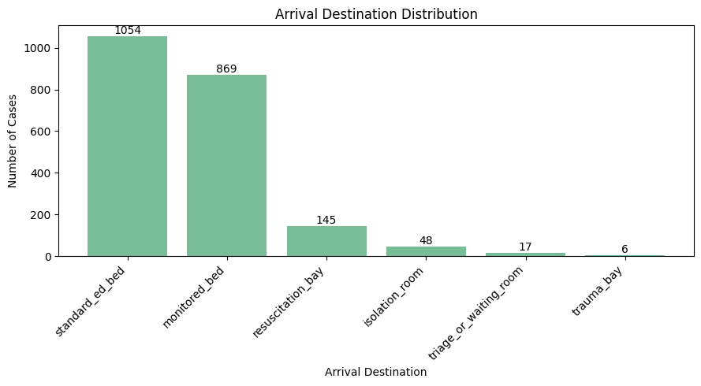
TARGET LABEL DISTRIBUTION AND CLASS IMBALANCE

Slide 7
Labeling
SECOND LABEL: PRIMARY SPECIALTY CONSULTATION
• Derived from the cleaned specialty field.
• Original specialties were grouped into broader clinical consult labels.
• 63 original specialties were reduced to 18 final consult classes.
• Generic labels such as medicine_or_ed_consult and other_consult were used only when no specific consult label was available.
• Used as target only; excluded from the text-generation prompt.
Examples:
orthopedics / hand surgery / podiatry → orthopedic_consult
ENT / ophthalmology / oral surgery / dentistry → ent_or_eye_oral_consult
*We intentionally prioritize ASR robustness over multi-label modeling in order to
keep the experimental question focused and interpretable.

Slide 8
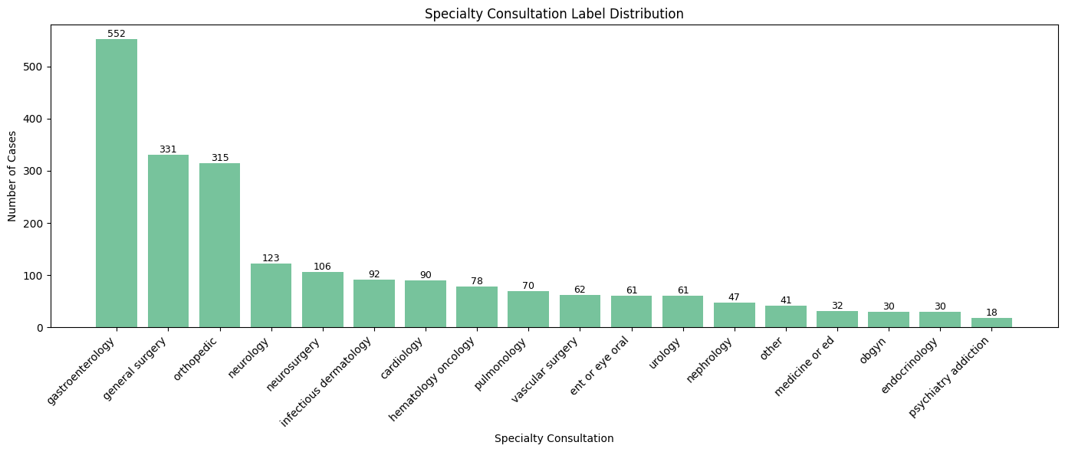
TARGET LABEL DISTRIBUTION AND CLASS IMBALANCE

Slide 9
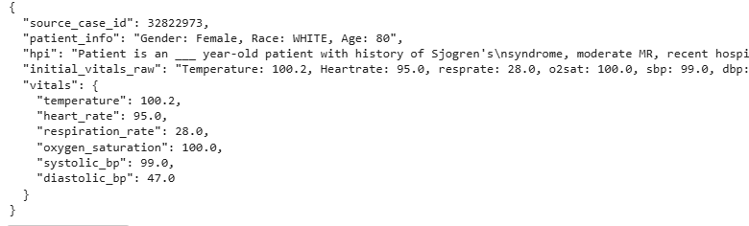
LEAKAGE-AWARE CASE SEED FOR REPORT GENERATION
Each case was converted into a structured seed containing HPI, patient information, and initial vital signs.
To reduce leakage, the seed excluded target labels, specialty fields, diagnosis fields, and triage, since these were related to the target-label creation.

Slide 10
SYNTHETIC EMS REPORT GENERATION
2,139 LABELED CLINICAL CASES
4 VARIANTS PER CASE:
↓
LEAKAGE-AWARE CASE SEEDS
professional_complete
brief_radio_missing_details
patient_reported_uncertain
distracted_or_disorganized_handoff
↓
GPT-4.1-MINI TEXT GENERATION
↓
4 EMS REPORT VARIANTS PER CASE
↓
8,556 SYNTHETIC EMS REPORTS

Slide 11
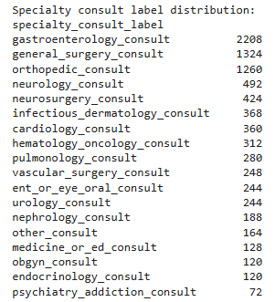
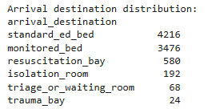
FINAL DATASET LABEL DISTRIBUTION
*The generated dataset preserves the original class imbalance, since each source case produced four report variants.

Slide 12
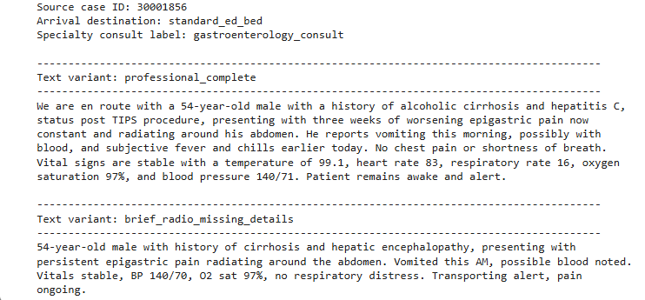
Example: Same Clinical Case, Different EMS Report Variants

Slide 13
POST-PROCESSING AND LEAKAGE REDUCTION
After generation, reports were scanned for hospital-based or leakage-prone wording.
• Imaging/lab results
• Specialist consult wording
• Hospital workflow phrases
Regex-based candidate detection → minimal LLM rewrite → second-pass check.
• Round 1 candidates: 461 reports (5.39%)
• Round 2 remaining candidates: 168 reports (1.96%)
DETECTED PATTERNS
METHOD
RESULTS

Slide 14
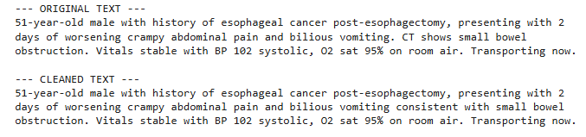
POST-PROCESSING AND LEAKAGE REDUCTION
The goal was to preserve clinical meaning while keeping the text EMS-style.

Slide 15
TRAIN / VALIDATION / TEST SPLIT
Split strategy:
• Group-based split by source_case_id: all 4 variants of the same clinical case were kept in the same split
• Class coverage check: all target classes are represented in train, validation, and test.
*This prevents leakage between train, validation, and test. The same group-based split was preserved after ASR generation.
Final split:
70% TRAIN:
5,988 reports (1,497 source cases)
15% VALIDATION:
1,284 reports (321 source cases)
15% TEST:
1,284 reports (321 source cases)

Slide 16
ASR ROBUSTNESS PIPELINE
Clean EMS reports
Example of audio after adding noise
GOAL
TTS conversion
(edge-TTS, male voice, speed ×1.3)
Test whether training with noisy ASR transcripts improves model robustness.
Training strategies:
Clean text only
Noisy ASR text only
Clean + noisy ASR text
Evaluation:
The original source-case split was preserved, and the same noisy test set was used for all comparisons.
Clean audio
Ambulance noise injection
(siren + white noise)
Noisy audio
Whisper ASR transcription
Noisy ASR transcripts
Training and evaluation datasets

Slide 17
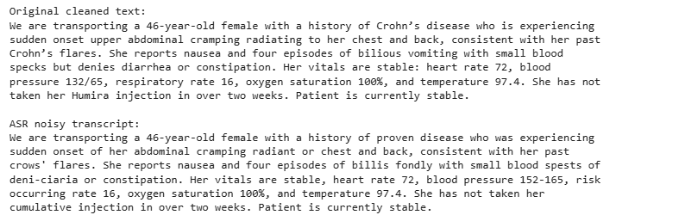
ASR Error Example: Clean Report vs Noisy Transcript
noise dataset:
Average WER:
Train: 44.3%
Validation: 43.9%
Test: 44.8%
Mean WER: 0.443 ≈ 44%
WER measures the word-level difference between the clean EMS report and the ASR transcript.

Slide 18
MODELS AND TRAINING STRATEGIES
EXPERIMENTAL STAGES
DistilBERT:
Stage 1 – Clean Baseline
General-purpose language model
Smaller and faster baseline
Included to test whether a general model
maybe less sensitive to ASR errors
Train on clean text
Test on clean text
Establish the best baseline model
for each target
BioClinicalBERT:
Stage 2 – ASR Robustness Evaluation
Train clean → Test noisy
Train noisy → Test noisy
• Pre-trained on biomedical and clinical text
• Better suited to medical terminology
• Used as the main domain-specific model
*Clean + noisy training → Noisy test
(BioClinicalBERT only)

Slide 19
BEST BASELINE MODELS ON CLEAN TEXT
Optimization experiments
DistilBERT vs. BioClinicalBERT | Full fine-tuning vs. partial freezing | Weighted vs. unweighted loss |
3 vs. 5 epochs | Learning rate: 2e-5 vs. 1e-5 | Max length: 128 vs. 192
1. ED Care Area
Best model: BioClinicalBERT
Partial fine-tuning: last 8 layers trainable
Max length: 128
3 epochs
Learning rate: 2e-5
No class weights
Clean test results
Accuracy: 67.1%
Macro F1: 0.319
Weighted F1: 0.652
2.Primary Specialty Consultation
Best model: BioClinicalBERT
Full fine-tuning
Max length: 192
3 epochs
Learning rate: 2e-5
No class weights
Clean test results
Accuracy: 65.7%
Macro F1: 0.506
Weighted F1: 0.640

Slide 20
BEST DISTILBERT BASELINE MODELS ON CLEAN TEXT
Selected configuration
Full fine-tuning | No class weights | 3 epochs | Learning rate: 2e-5 | Max length: 128
ED Care Area
Clean test results:
Accuracy: 66.5%
Macro F1: 28.0%
Weighted F1: 63.8%
Primary Specialty Consultation
Clean test results:
Accuracy: 60.7%
Macro F1: 34.4%
Weighted F1: 57.6%

Slide 21
CLEAN TRAINING → NOISY TEST
Model | Target | Clean Test Macro F1 | Noisy Test Macro F1 | Relative Change in Macro F1 (%)
DistilBERT | ED care area | 28.00% | 23.87% | −14.75%
BioClinicalBERT | ED care area | 31.86% | 22.55% | −29.22%
DistilBERT | Specialty consultation | 34.40% | 22.45% | −34.74%
BioClinicalBERT | Specialty consultation | 50.60% | 27.74% | −45.18%

Slide 22
CLEAN TRAINING → NOISY TEST
Model | Target | Clean Test Accuracy | Noisy Test Accuracy | Change
DistilBERT | ED care area | 66.50% | 55.90% | −10.6 pp
BioClinicalBERT | ED care area | 67.10% | 59.00% | −8.0 pp
DistilBERT | Specialty consultation | 60.70% | 40.80% | −19.9 pp
BioClinicalBERT | Specialty consultation | 65.70% | 39.30% | −26.4 pp

Slide 23
2.TRAIN NOISY ASR → TEST NOISY ASR
Model | Target | Clean → Noisy Macro F1 | Noisy → Noisy Macro F1 | Relative Change in Macro F1
BioClinicalBERT | ED care area | 22.55% | 27.64% | 22.57%+
DistilBERT | ED care area | 23.87% | 21.98% | -7.92%
BioClinicalBERT | Specialty consultation | 27.74% | 31.21% | 12.51%+
DistilBERT | Specialty consultation | 22.45% | 19.82% | -11.71%
Noisy training improved BioClinicalBERT in both targets, but did not improve DistilBERT according to Macro F1.

Slide 24
2.TRAIN NOISY ASR → TEST NOISY ASR
Model | Target | Clean → Noisy Accuracy | Noisy → Noisy Accuracy | Change
BioClinicalBERT | ED care area | 59.03% | 64.64% | +5.61 pp
DistilBERT | ED care area | 55.92% | 62.46% | +6.54 pp
BioClinicalBERT | Specialty consultation | 39.25% | 49.77% | +10.52 pp
DistilBERT | Specialty consultation | 40.81% | 45.09% | +4.28 pp

Slide 25
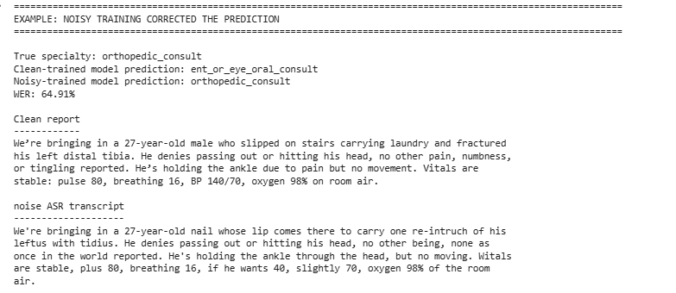
EXAMPLE: NOISY TRAINING IMPROVED ROBUSTNESS

Slide 26
3. CLEAN + NOISY TRAINING → NOISY TEST:
BioClinicalBERT
Target | Clean → Noisy Macro F1 | Noisy → Noisy Macro F1 | Clean + Noisy → Noisy Macro F1
ED care area | 22.55% | 27.64% | 29.16%
Specialty consultation | 27.74% | 31.21% | 38.33%
Target | Clean → Noisy Accuracy | Noisy → Noisy Accuracy | Clean + Noisy → Noisy: Accuracy
ED care area | 59.03% | 64.64% | 63.63%
Specialty consultation | 39.25% | 49.77% | 52.50%

Slide 27
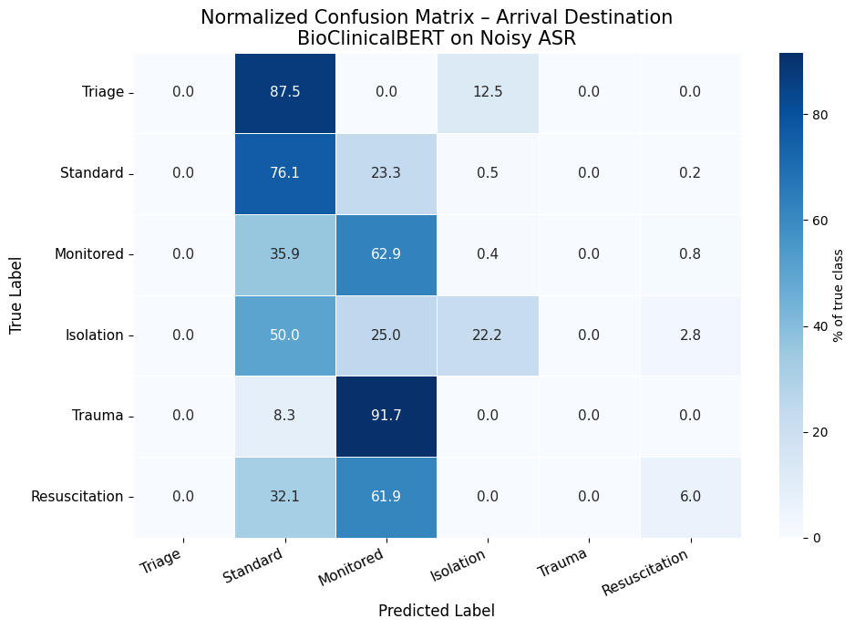
Error Analysis

Slide 28
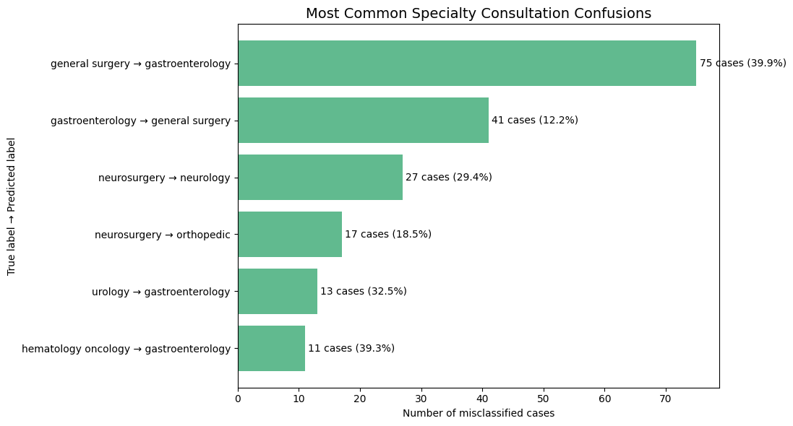
Error Analysis

Slide 29
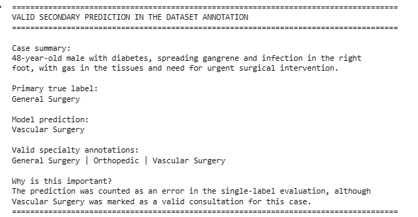
Error Analysis
11.48% of the apparent errors were valid secondary specialties

Slide 30
CONCLUSIONS AND FUTURE WORK
The solution improved robustness, but did not fully solve rare-class errors.
Performance was limited by ASR noise, class imbalance, label overlap, and partial multi-label ambiguity.
Oversampling and class-balanced training
Multi-label specialty classification
More rare-class data
Focus first on specialty consultation or ED care area, then extend to the second task.
Optimize the clean-to-noisy
training ratio.

