Slide 1
INTRODUCTORY SESSION
March-2026

Slide 2
Content
Intros
Admin
Tasks

Slide 3
INTRODUCTIONS

Slide 4
ADMIN

Slide 5
Admin
Record time in an excel sheet.
Not detailed. Just hours and a one-liner summary.
Share the excel sheet every week.
For questions, reach out to me via email fm_pro97@yahoo.com.
Small questions/doubts: First Google/ChatGPT/Claude then WhatsApp
Big questions: First Google/ChatGPT/Claude then Email
Share your bank account details for payments.
Payments will be made according to 400 Pkr/hr rate.
Payments will be made bi-weekly.

Slide 6
Classification of Categories

Slide 7
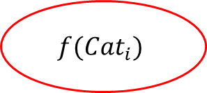
Problem Statement
Category 1 => Food
Category 2 => Personal Care
Category 3 => Food
Category 4 => Drinks
Category 5 => Home Care
Category 6 => Personal Care
.
.
Category N => Drinks
Category 1
Category 2
Category 3
Category 4
Category 5
Category 6
.
.
Category N
$$f(Cat_{i})$$
If a category cannot be classified in one of the four GROUPS, then it must be labeled as OTHER.

Slide 8
Sample Data
Nr | Category Name
1 | Bread (FOOD)
2 | Soap (PERSONAL CARE)
3 | Toilet Cleaner (HOME CARE)
4 | Bagels (FOOD)
5 | Liquid Detergent (HOME CARE)
6 | Chocolate Candies
7 | Carbonated Drink
8 | Lemon Juice
9 | Coffee Pods
10 | Milk

Slide 9
Definitions of Super Categories
Group Name | Definition
Food | Food is composed of all edible goods that are purchased and consumed by the household with the purpose of nourishing. It includes: cereals and cereal products; meat; fish and other seafood; milk, other dairy products and eggs; oils and fats; fruit and nuts; vegetables, tubers, plantains, cooking bananas and pulses; sugar, confectionery and desserts; salt, sauces and condiments, spices and culinary herbs and seeds.
Drinks | All kinds of beverages purchased by the household, regardless of where these are consumed. Includes both Alcoholic and Non-Alcoholic beverages.

Slide 10
Definitions of Super Categories
Group Name | Definition
Home Care | detergents, hand and machine dishwashing detergent, scouring powders, disinfectant bleaches, softeners, conditioners, stain remover; general purpose cleanser, window-cleaning products, unblocking agents, disinfectants; floor wax, polishes; polishes, creams and other shoe-cleaning articles (shoe brush); insecticides, pesticides, fungicides, distilled water; dustpans and dust brushes, dusters; cloths, floor cloths, chamois leathers; dish brush, household sponges, scourers, steel wool; filters, tablecloths and table napkins, kitchen paper, baking parchment roll, kitchen film, aluminium foil, doily; disposable plates, cups and cutlery; vacuum cleaner bags; candles, lamp wicks, methylated spirits, plastic bag, garbage bag; matches, clothes pegs, clothes hangers, pins, safety pins, sewing needles, knitting needles, thimbles, nails, screws, nuts and bolts, tacks, washers, glues and adhesive tapes for household use, string, twine and rubber gloves; pool cleaning chemicals and water treatment chemicals.

Slide 11
Definitions of Super Categories
Group Name | Definition
Home Care | insecticides, pesticides, fungicides, distilled water; filters, tablecloths and table napkins, kitchen paper, baking parchment roll, kitchen film, aluminium foil, doily; disposable plates, cups and cutlery; candles, lamp wicks, methylated spirits, plastic bags, garbage bags; matches, clothes pegs, clothes hangers, pins, safety pins, sewing needles, knitting needles, thimbles, nails, screws, nuts and bolts, tacks, washers, glues and adhesive tapes for household use, string, twine and rubber gloves, gardening gloves.

Slide 12
Definitions of Super Categories
Group Name | Definition
Personal Care | electric razors, hair trimmers and epilators, hand-held and hood hairdryers, straightening irons, curling tongs and styling combs, sunlamps, vibrators, electric toothbrushes and other electric appliances for dental hygiene, etc.; non-electric appliances: shavers, razors and hair trimmers and blades therefor, scissors, nail files, combs, shaving brushes, hairbrushes, toothbrushes, nail brushes, hairpins, curlers, personal weighing machines, scales, etc.; articles for personal hygiene: toilet soap, medicinal soap, cleansing oil and milk, shaving soap, shaving cream and foam, toothpaste, epilation wax, paper handkerchiefs, etc.; beauty products: lipstick, nail varnish, make-up and make-up removal products (including powder compacts, brushes and powder puffs), hair lacquers and lotions, pre-shave and after-shave products, sunbathing products and sunscreens, hair removers, perfumes and toilet waters, personal deodorants, bath products, etc.

Slide 13
Challenges
Manual assignment is not possible as we have thousands of categories.
No target labels are available (self-supervised learning).
Solution must have a high accuracy to minimize human efforts.

Slide 14
Opportunities
Decision boundaries are perfectly separable.
The four super categories are perfectly distinguishable.
LLMs can be leveraged to achieve exceptional accuracy.

Slide 15
Required Deliverable
1. Python script that takes categories file as input (in CSV/XLSX format) and generates an output file (in CSV/XLSX) with an additional column

Slide 16
Time Series – Anomaly Correction

Slide 17
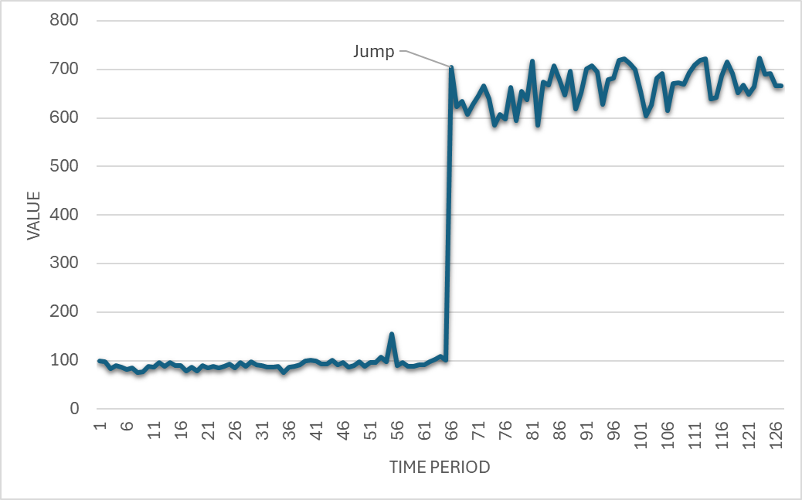
Example

Slide 18
To Dos
Develop a script that automatically detects such jumps.
There can either be a jump or no-jump.
Assume that at Max there is only one jump.
Develop a script that corrects for such jumps.
Assume that you know the jump point, now develop an algorithm that corrects the time series.

Slide 19
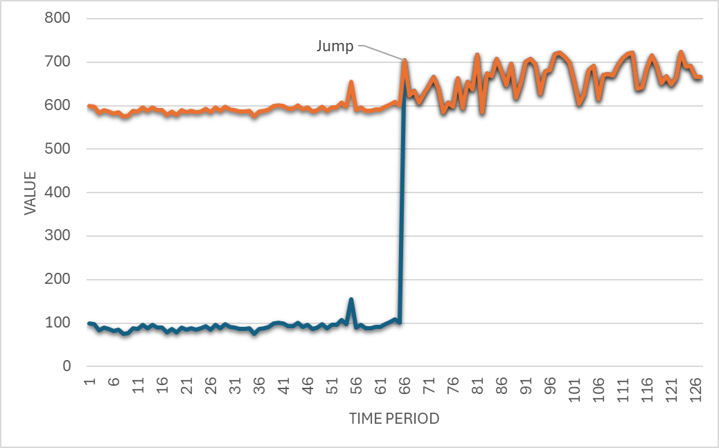
Corrected

