Slide 1

Quantum Machine Learning for Sentiment Analysis
Ashutosh Rai
Scholar No: 2422308
Under the Supervision of
Dr. Partha Pakray
Associate Professor, Dept of CSE
Department of Computer Science and Engineering
National Institute of Technology, Silchar

Slide 2
Table of contents
01
02
03
04
05
06
07
08
09
Introduction
Motivation
Literature Survey
Research Gap
Objectives
Proposed Methodology
Datasets
Timeline
Conclusion

Slide 3
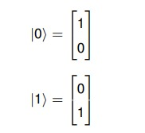
Introduction
Quantum Computing:
At its core, quantum computing [1] is a computing paradigm that leverages the unique rules of quantum physics, specifically concepts like superposition and entanglement to develop new forms of computer technology.
The basic unit of information in quantum computing is a quantum bit (qubit) analogous to a classical bit.
A qubit is represented by Dirac vector notation (|⟩).

Slide 4
Introduction
Superposition is a fundamental principle of quantum mechanics where a quantum system, such as a qubit, can exist in multiple states at the same time.
A qubit in superposition can be represented as ∣ψ⟩=α∣0⟩+β∣1⟩, where α and β are complex amplitudes.
And the probabilities of measuring the qubit in state ∣0⟩ or ∣1⟩ are given by |α| 2 and
|β| 2, respectively, with the normalization condition |α| 2 + |β| 2 = 1.
Quantum entanglement is a unique phenomenon where two or more qubits become fundamentally linked, acting as a single system.
This creates a deep connection between them, meaning the state of one qubit is directly correlated to the state of the other. As a result, if you measure one entangled qubit, you will instantly know the state of the partner qubit.

Slide 5
Introduction
Classical vs Quantum computing:
 | Classical Computing | Quantum Computing
Storage Unit | Classical Bits (0 or 1) | Quantum Bits (|0⟩, |1⟩)
Parallelism | Classical Bits are processed sequentially ex: 2-bit (00, 01, 10, 11) | Qubits are processed parallely ex: 2-qubits (|00⟩, |01⟩, |10⟩, |11⟩)
Processing Unit | Classical Gates ex: AND, OR, etc | Quantum Gates ex: Hadamard, CNOT, etc
Table 1: Difference between Classical and Quantum Computing

Slide 6
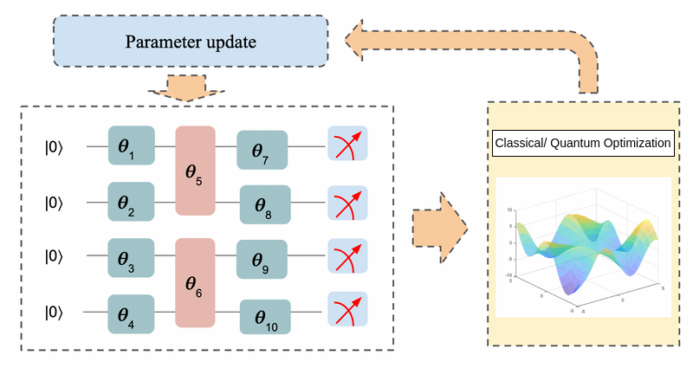
Introduction
Quantum Machine Learning:
Quantum Machine Learning [2] applies principles from quantum computing to machine learning tasks. It leverages quantum phenomena like superposition and entanglement for computation.
Figure 1: Overview of Quantum Machine Learning

Slide 7
Introduction
Sentiment Analysis:
The task of identifying the emotional tone in text and classifying it into polarities like Positive, Negative, or Neutral.
Consider a sample sentence: The movie was excellent.
The model needs to classify the sentiment polarity correctly.
Analyzed Sentence: The movie was excellent -> Positive Sentiment
Current State-of-The-Art techniques in Traditional Deep Learning:
Rely on Transformer models like BERT that use word embeddings (numerical vectors) to understand word meanings.
A core attention mechanism weighs the importance of each word to grasp the context.
However these models are computationally massive and data-hungry, creating a need for more efficient paradigms.

Slide 8
Introduction
QML for Sentiment Analysis:
The most common method is the Hybrid Quantum-Classical Model where classical pre-processing is passed to a quantum circuit. This quantum component is typically a Variational Quantum Classifier (VQC), which acts like a quantum neural network layer to learn and classify data patterns.
Our aim is to build and test a quantum-based recurrent architecture to perform sentiment analysis.

Slide 9
Motivation
Traditional deep learning models often fail to capture complex linguistic nuance and sarcasm.
State-of-the-art performance requires models with massive parameter counts, leading to extremely high computational costs.
QML offers the ability to process information in exponentially large, high-dimensional quantum spaces.
It has the potential to capture complex data correlations more naturally using entanglement.
Provides an opportunity to create powerful models with significantly fewer parameters.

Slide 10
Literature Survey
Title and Authors | Contributions | Inferences
Hybrid Quantum-Classical Machine Learning for Sentiment Analysis [3] Abu Kaisar Mohammad Masum et al (2023) | Proposed a hybrid QML model using QSVM and VQC with PCA and Haar Wavelet Transform for dimensionality reduction, achieving improved sentiment classification over classical models. | Shows that dimension reduction enhances quantum efficiency, and hybrid models outperform classical methods in sentiment analysis.
Quantum Self-Attention Neural Networks for Text Classification [4] Guangxi Li et al (2024) | Introduced QSANN using Gaussian Projected Quantum Self-Attention (GPQSA) for scalable quantum NLP, outperforming classical and syntax-based models. | Proves self-attention works efficiently on quantum circuits, enabling scalable, syntax-free QNLP for robust text understanding.

Slide 11
Literature Survey
Title and Authors | Contributions | Inferences
The Dawn of Quantum Natural Language Processing [5] Riccardo Di Sipio et al. (2022) | Proposed and trained hybrid QNLP models, such as a Quantum Transformer and a QLSTM, by replacing classical linear layers with Variational Quantum Circuits (VQCs). | The hybrid QLSTM matched classical performance with significantly fewer parameters, establishing the approach's feasibility despite potentially longer training times.
Quantum Long Short-Term Memory [6] Samuel Yen-Chi Chen et al. (2020) | Proposed a novel hybrid Quantum Long Short-Term Memory (QLSTM) model where the classical neural networks that form the gates of an LSTM cell are replaced by trainable Variational Quantum Circuits (VQCs). | Simulations showed the QLSTM can offer faster, more stable convergence and improved accuracy over classical LSTMs with a comparable number of parameters.

Slide 12
Literature Survey
Title and Authors | Contributions | Inferences
Learning temporal data with variational quantum recurrent neural network [7] Yuto Takaki et al. (2020) | Proposed a QRNN architecture using a circuit that separates "memory" qubits, which are never measured, from "working" qubits used for input/output at each step. | Demonstrated the model's ability to predict temporal data like waveforms and quantum dynamics, and found its accuracy depends on an optimal level of qubit interaction.
Quantum Recurrent Neural Networks for Sequential Learning [8] Yanan Li et al (2023) | Designed hardware-efficient QRNN using Quantum Recurrent Blocks and staggered stacking to reduce coherence time, achieving higher accuracy on sequential tasks. | Establishes a canonical, NISQ-feasible QRNN and validates its superiority for temporal data learning.

Slide 13
Literature Survey
Title and Authors | Contributions | Inferences
Application of Quantum Recurrent Neural Network in Low-Resource Language Text Classification [9] Wenbin Yu et al (2024) | Proposed BUQRNN and PN-BUQRNN combining mBERT embeddings with VQCs, improving Bengali text classification accuracy and reducing complexity. | Highlights quantum recurrence for sequential NLP and shows batch-upload encoding minimizes semantic loss under limited qubits.

Slide 14
Research Gap
An absence of rigorous benchmarking against state-of-the-art classical models, such as fine-tuned Transformers, impedes the validation of quantum advantage claims in NLP.
Comparative analysis between emergent quantum architectures, such as QRNNs and Quantum Self-Attention, is lacking, obscuring optimal model selection for specific NLP tasks.
A standardized, optimal strategy for encoding high-dimensional text data into quantum states is absent, creating a critical bottleneck evidenced by the varied approaches in literature.
The correlation between the claimed parameter efficiency of QML models and their task-specific performance remains poorly characterized and inconsistent across studies.

Slide 15
Research Gap
Existing QRNNs are largely general sequential processors, indicating a gap in designing recurrent quantum architectures specifically for complex linguistic features, such as long-range dependencies.

Slide 16
Objectives
To implement a hybrid Quantum Machine Learning (QML) model for sentiment analysis and evaluate its performance on real-world datasets.
To experiment with various quantum architectures and determine which yields optimal results for sentiment classification.
To explore various data encoding strategies within the QML model to potentially enhance model accuracy or efficiency.
To analyze the trade-offs between model performance, parameter efficiency, and the choice of the underlying quantum architecture.
To benchmark the performance of the developed QML model against an existing state-of-the-art classical model to determine its comparative advantages and shortcomings.

Slide 17
Proposed Methodology
Our proposed methodology is a hybrid quantum-classical model designed for sequential text analysis, leveraging a classical layer for data processing and a quantum circuit for the core recurrent computation.
The model's architecture is bifurcated into two primary stages:
Classical Processing Layer: The classical layers first processes each input token into a high-dimensional dense vector. This vector is then projected onto a lower-dimensional space to create a fixed-size input for the quantum layer. This dimensionality reduction is essential to accommodate the limited number of qubits available for stable computation.

Slide 18
Proposed Methodology
Quantum Recurrent Layer: The sequence of classical embedding vectors is then fed into the quantum layer. This layer functions as the recurrent core of the model, processing temporal dependencies within the data. The final classification probabilities are derived from measurements performed on this quantum circuit at the end of the sequence.
The quantum layer processes a single input vector at each timestep, mimicking the sequential nature of a classical Recurrent Neural Network. This workflow is composed of the following steps:
Input Encoding: At each timestep t, the classical feature vector xt is encoded into the initial state of the quantum register. This is accomplished via a parameterized unitary operation, U(xt), which maps the classical information onto the quantum state.

Slide 19
Proposed Methodology
Recurrent Quantum Cell: The encoded state is subsequently evolved by a trainable, parameterized quantum circuit, V(θ), which constitutes our Recurrent Quantum Cell. This unitary operation is designed to create entanglement among all qubits, allowing the model to learn complex correlations between the current input and the carried-over hidden state.
State Propagation via Partial Measurement: To facilitate recurrence, a partial measurement scheme is employed at the conclusion of each timestep. For a system with n qubits, the top n−3 "working qubits" are measured, collapsing their state to serve as a non-linear activation while effectively resetting them for the next input. Concurrently, the remaining 3 "memory qubits" are not measured, allowing their quantum state to be preserved and propagated forward, thus carrying the hidden state of the sequence.

Slide 20
Proposed Methodology
Final Classification Measurement: At the final timestep of the sequence, the three memory qubits are measured. This yields the classical probabilities corresponding to the three primary sentiment polarities (positive, negative, and neutral), from which the model's final prediction is determined.

Slide 21
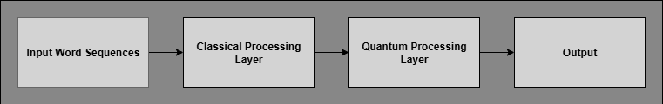
Proposed Methodology
Figure 2: High-Level Architecture of the Proposed Hybrid Quantum-Classical Model

Slide 22
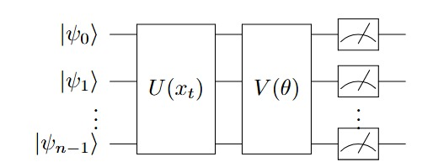
Proposed Methodology
Figure 3: High-level overview of the Quantum Recurrent Layer for n qubits. It consists of three primary stages: Input Encoding U (xt), the Recurrent Quantum Cell V (θ), and the final Measurement stage.

Slide 23
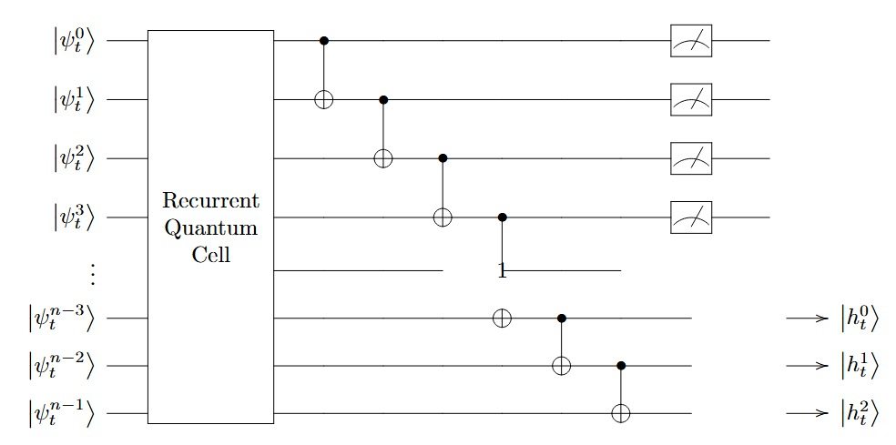
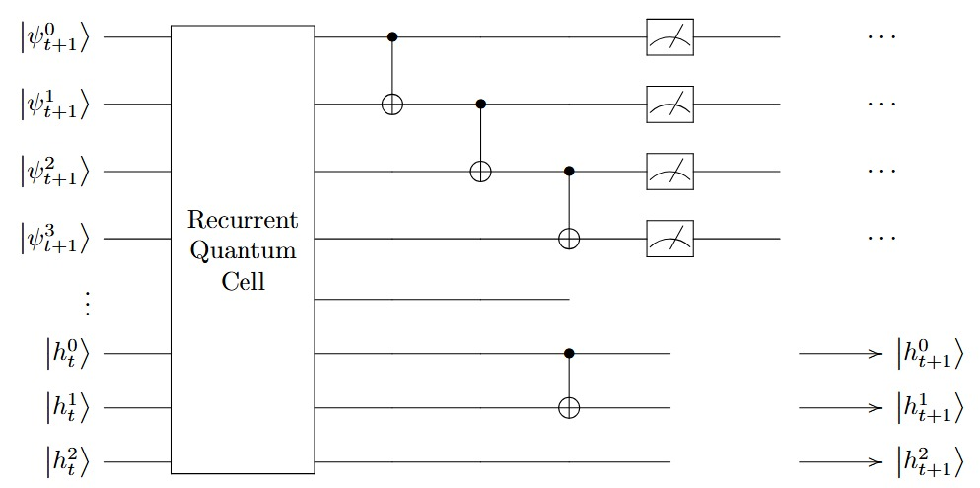
Proposed Methodology
Figure 4: The unrolled architecture of the proposed QRNN. State propagation between timesteps is achieved via partial measurement, where the bottom memory qubits carry the hidden state ∣ht⟩ forward

Slide 24
Datasets
This study will be benchmarked on three distinct, real-world sentiment analysis datasets. Sourced from the UCI Repository, this collection was originally introduced by Kotzias et al. (2015) [10] and allows us to test the model's ability to generalize across different text domains.
Dataset | Domain | Total Samples | Class Distribution (P/N)
IMDb Reviews | Movie Reviews | 748 | 386 / 362
Amazon Reviews | Product Reviews | 1000 | 500 / 500
Yelp Reviews | Restaurant Reviews | 1000 | 500 / 500

Slide 25
Timeline
Literature Survey
Implementing Classical Baseline
Model Optimization
Sep 2025
Jan 2026
Mar 2026
Aug 2025
Nov 2025
Feb 2026
Data Collection
Implementing Hybrid Model
Benchmarking and Final Analysis

Slide 26
Conclusion
A review of current literature indicates that emergent QNLP architectures, while promising, often lack rigorous benchmarking against state-of-the-art classical models, and a consensus on optimal architectural and encoding strategies is yet to be established.
This study addresses these gaps by proposing a novel, parameter-efficient Quantum Recurrent Neural Network (QRNN) architecture specifically designed for sentiment analysis.
Ultimately, this research will provide a critical empirical evaluation of the trade-off between on-task performance and parameter efficiency, contributing to a clearer understanding of the practical viability of quantum architectures for NLP.

Slide 27
References
[1] M. A. Nielsen and I. L. Chuang, Quantum computation and quantum information. Cambridge university press, 2010
[2] T. M. Khan and A. Robles-Kelly, “Machine learning: Quantum vs classical,” IEEE Access, vol. 8, pp. 219275–219294,
2020.
[3] A. K. M. Masum, A. Maurya, D. S. Murthy, and N. Mahmud, "Hybrid quantum-classical machine learning for sentiment
analysis," in 2023 International Conference on Machine Learning and Applications (ICMLA), 2023.
[4] G. Li, X. Zhao, and X. Wang, "Quantum self-attention neural networks for text classification," Science China
Information Sciences, vol. 67, no. 4, Art. no. 142501, 2024.
[5] R. Di Sipio, J.-H. Huang, S. Y.-C. Chen, S. Mangini, and M. Worring, “The dawn of quantum natural language
processing,” in ICASSP 2022-2022 IEEE International Conference on Acoustics, Speech and Signal Processing
(ICASSP), pp. 8612–8616, IEEE, 2022.
[6] S. Y.-C. Chen, S. Yoo, and Y.-L. L. Fang, “Quantum long short-term memory,” in ICASSP 2022-2022 IEEE
International Conference on Acoustics, Speech and Signal Processing (ICASSP), pp. 8622–8626, IEEE, 2022.

Slide 28
References
[7] Y. Takaki, K. Mitarai, M. Negoro, K. Fujii, and M. Kitagawa, “Learning temporal data with a variational quantum
recurrent neural network,” Physical Review A, vol. 103, no. 5, p. 052414, 2021.
[8] Y. Li, et al., "Quantum recurrent neural networks for sequential learning," Neural Networks, vol. 166, 2023.
[9] W. Yu, L. Yin, C. Zhang, Y. Chen, and A. X. Liu, "Application of quantum recurrent neural network in low-resource
language text classification," IEEE Transactions on Quantum Engineering, vol. 5, 2024.
[10] Kotzias D, Denil N, de Freitas N, et al. From group to individual labels using deep features. In: Proceedings of the
21th ACM SIGKDD International Conference on Knowledge Discovery and Data Mining, 2015. 597–606

