Slide 1
EEE485 - Term Project
Animal Classifier
Group 49: Nogay Evirgen

Slide 2
Dataset
Animals-10 dataset
Images do not have a fixed size.
Distribution of the classes are not equal.

Slide 3
Preprocessing
Preparing VGG-16
Resizing images to 224px x 224px
Data Standardization
Feature Extraction with VGG-16.
Dealing with the distribution of the classes.
Splitting data into train and test sets.

Slide 4
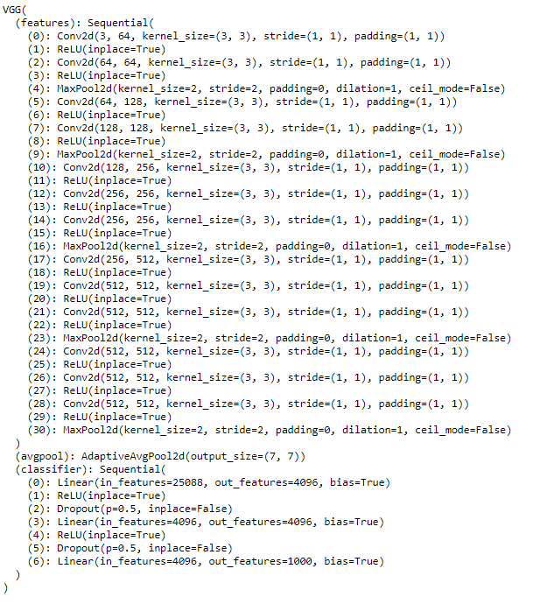
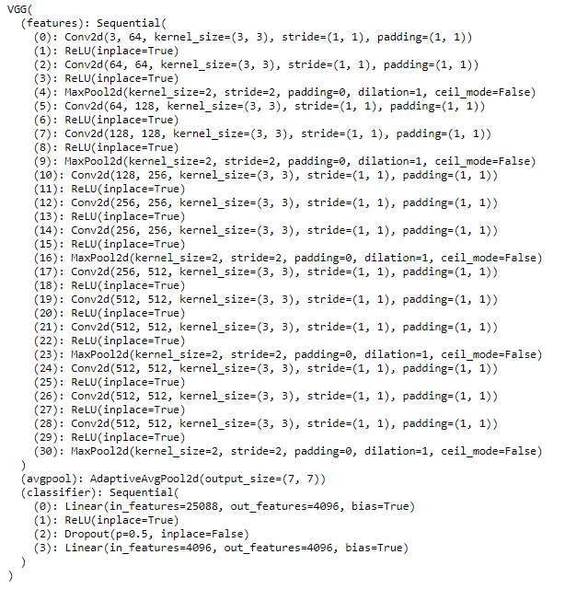

Slide 5
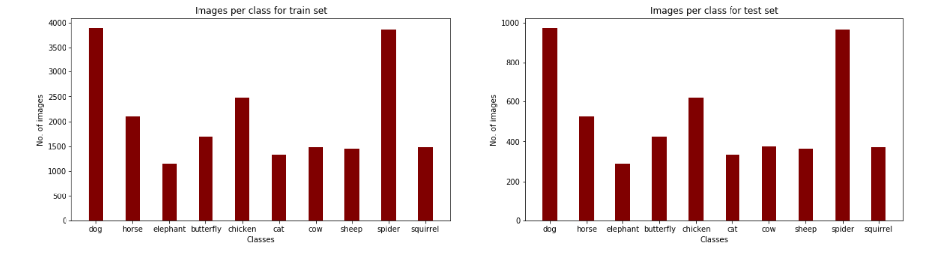
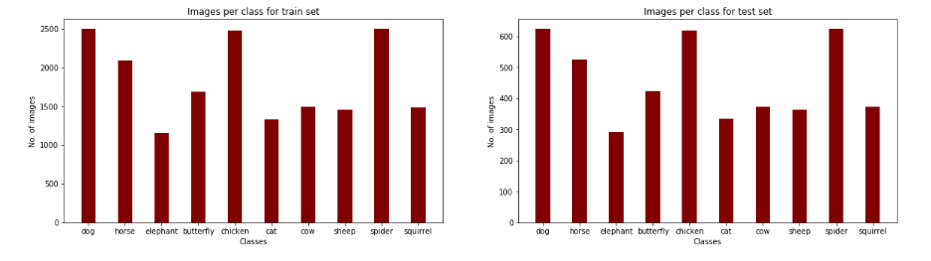

Slide 6
Logistic Regression
Softmax Classifier
Loss Function → Cross-Entropy
Learning rate = 0.001 , Epoch = 100

Slide 7
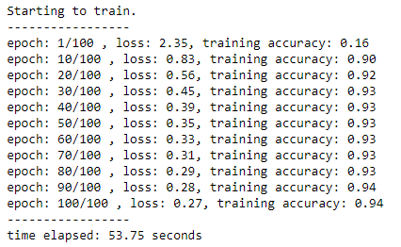
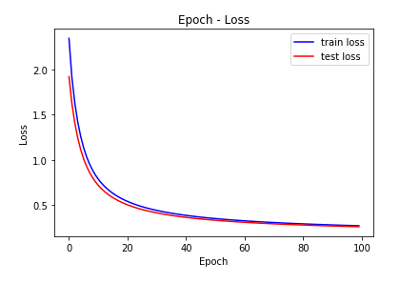
Logistic Regression

Slide 8
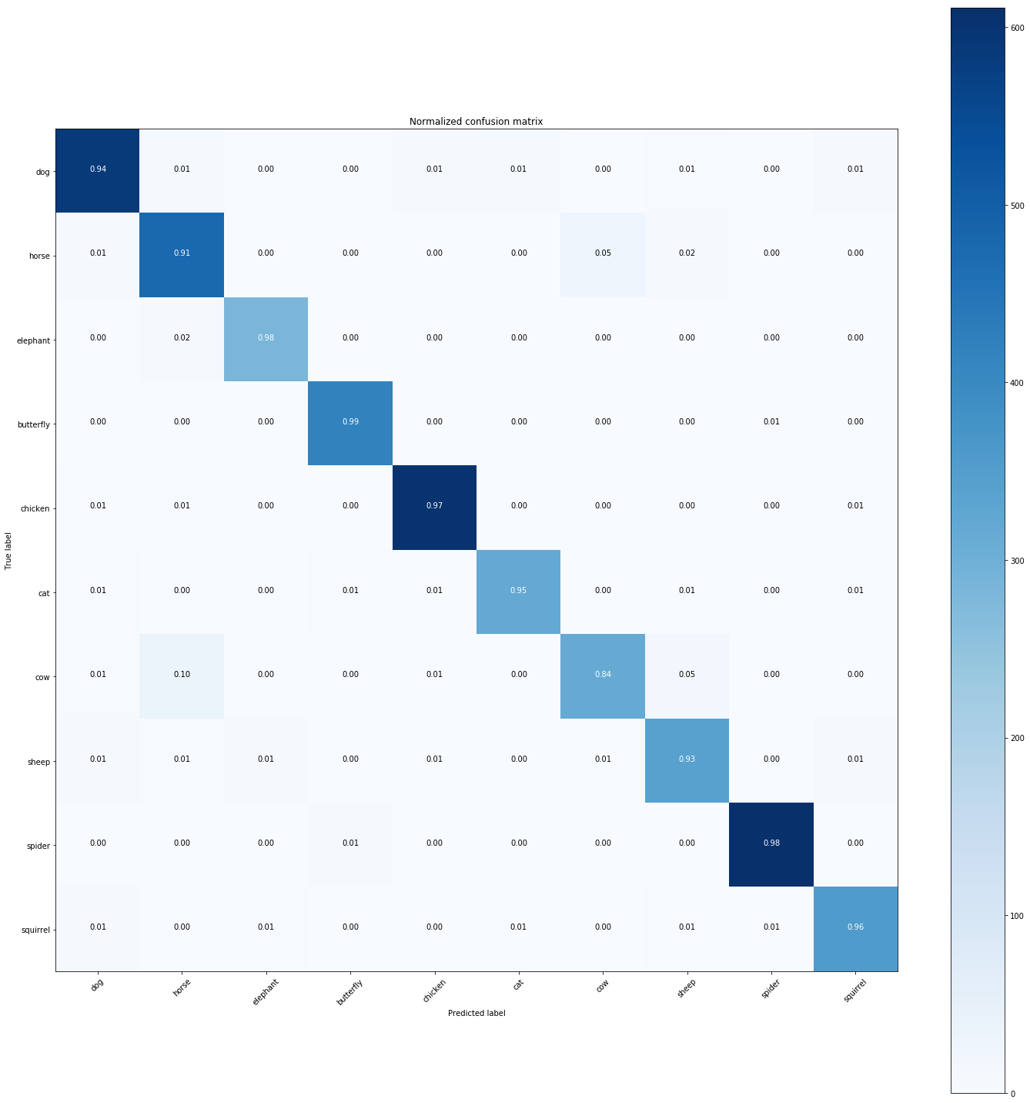
Logistic Regression
Overall accuracy = 93%
Overall precision = 93%
Overall recall = 93%

Slide 9
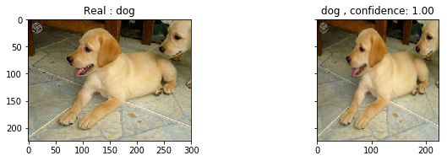
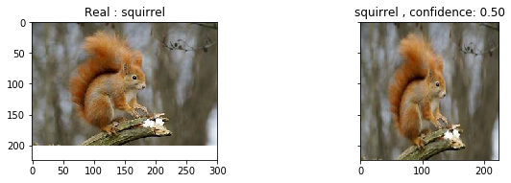
Logistic Regression

Slide 10

Linear SVM
Loss function → Hinge Loss with L2 Regularization
Learning rate = 0.001 , Epoch = 30
Regularization Coefficient = 0.00005
Loss Function

Slide 11
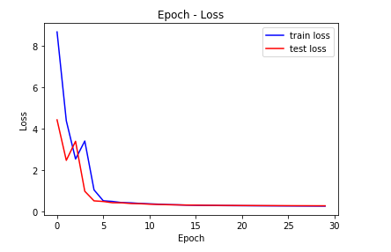
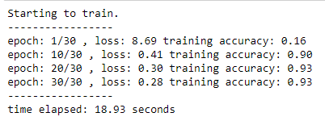
Linear SVM

Slide 12

Linear SVM
Overall accuracy = 94%
Overall precision = 93%
Overall recall = 93%

Slide 13


Linear SVM

Slide 14
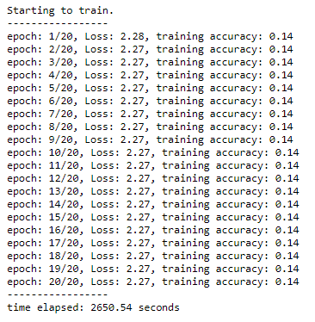
MLP
Input Layer: 4096 neurons
Output Layer: 10 neurons (Softmax Classifier)
Optimizer → SGD
Epoch = 20
Random Weight Initialization
Grid-search for hidden layers and learning rate values
None of those models converged.

Slide 15
MLP
Input Layer: 4096 neurons
Output Layer: 10 neurons (Softmax Classifier)
Optimizer → SGD
Epoch = 20
“He” Weight Initialization
Learning rate = 0.001
3 hidden layers with 128, 64 and 32 neurons.

Slide 16
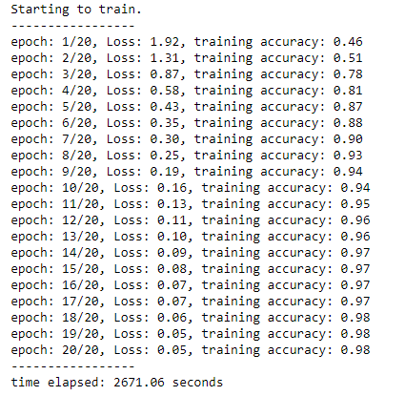
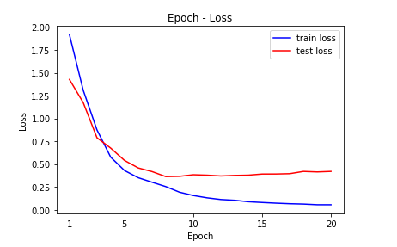
MLP

Slide 17

MLP
Overall accuracy = 93%
Overall precision = 93%
Overall recall = 93%

Slide 18
Conclusion
Results of these models are very similar.
It took very long time to train MLP.
Linear SVM converged the fastest.

