Slide 1
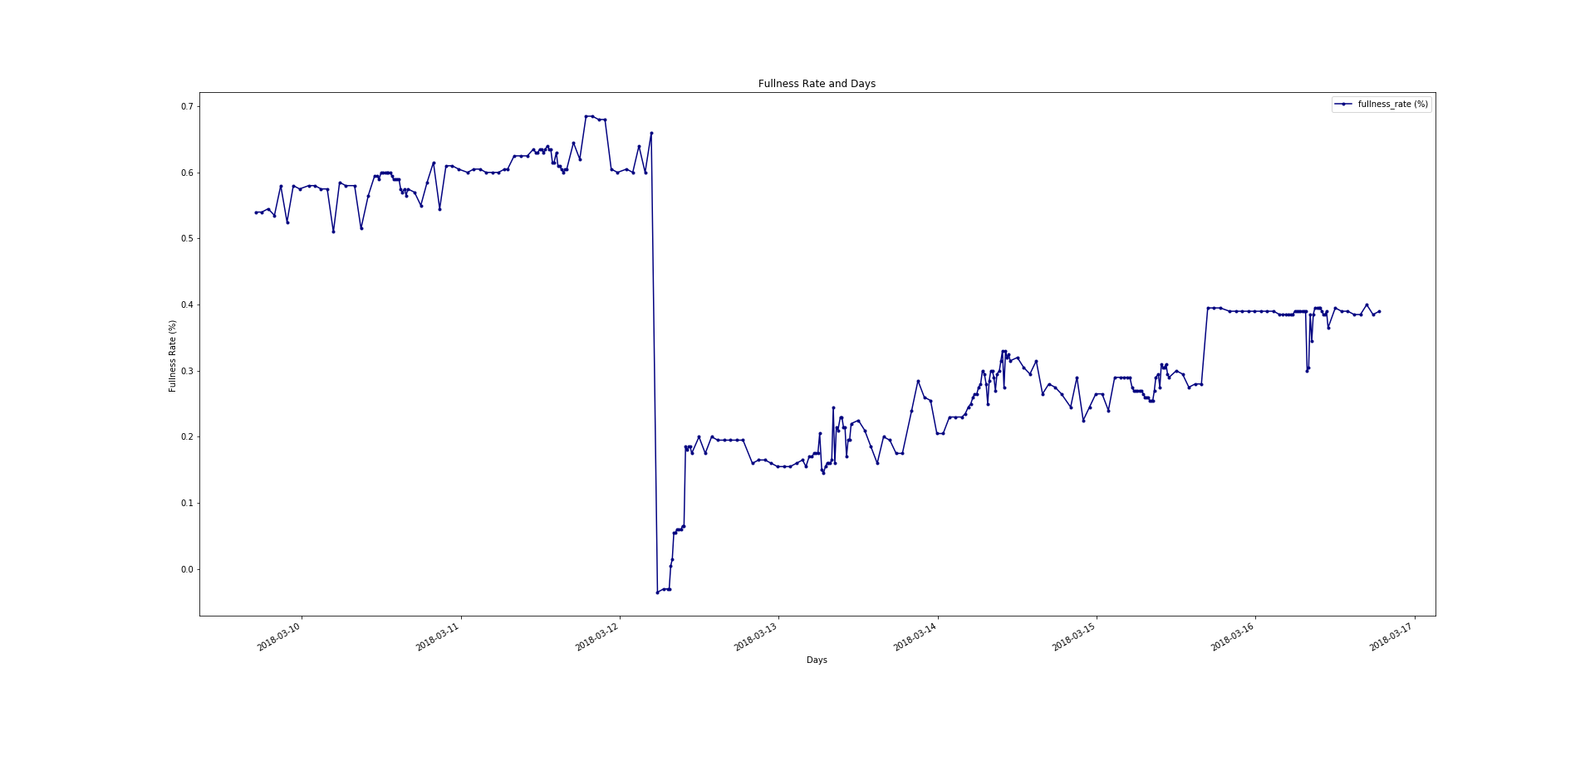
This is the graph.

Slide 2
In that graph, we can see that on 12 March around 4 a.m there is a massive drop which means garbage got collected from the container. Before analyzing anything, I fixed that. Since in this assignment, I am the one who decides when to collect garbabe.
To fix that, I added the amount of garbage got removed from the container. After that the Fullness Rate – Days graph changed to a more meaningful graph.

Slide 3
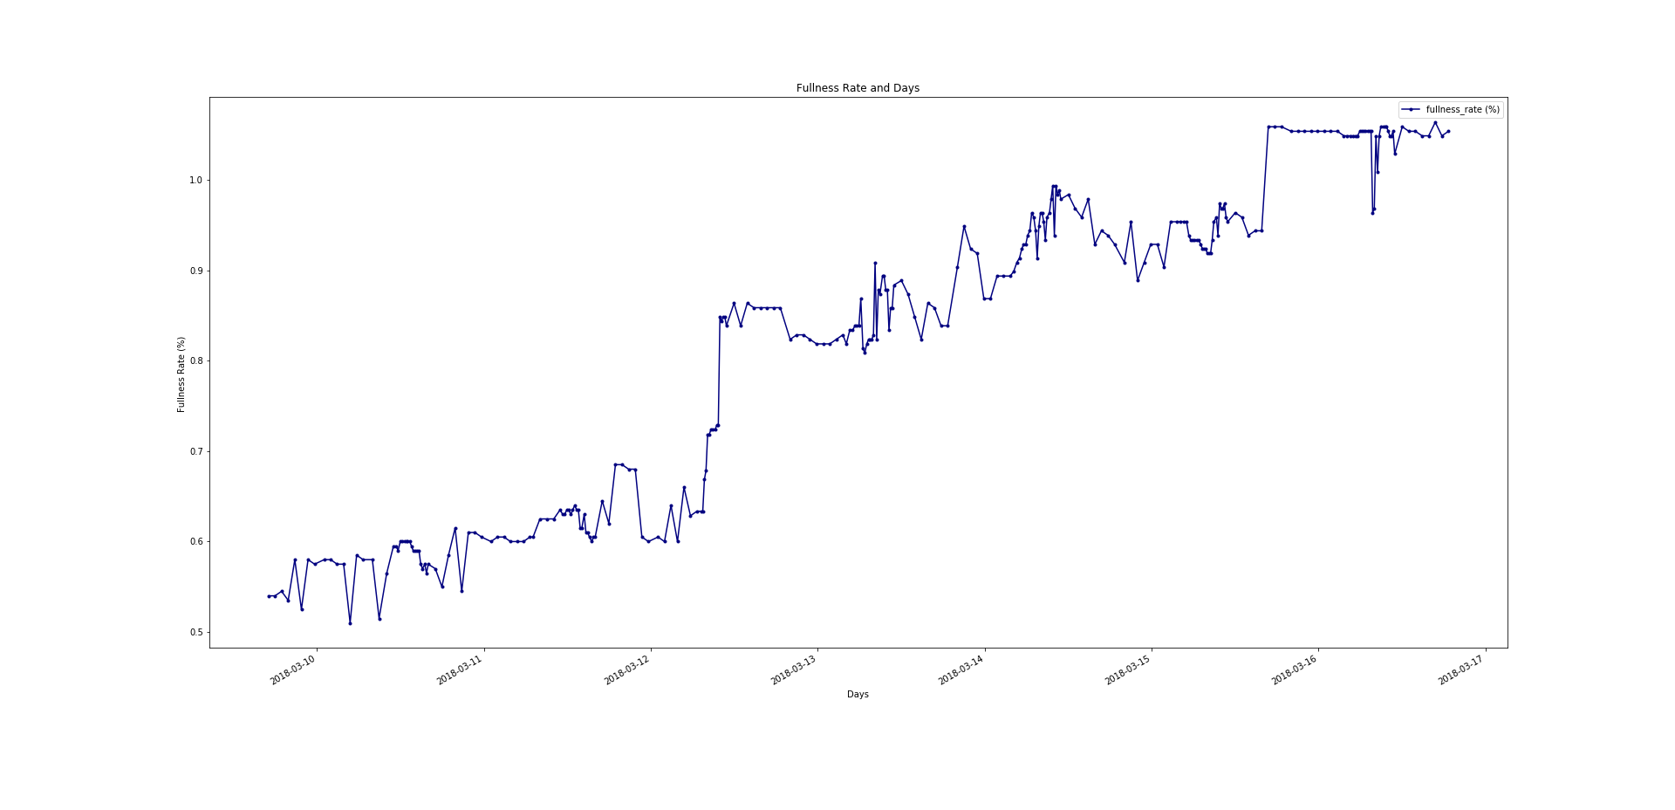
New version of Fullness Rate – Days graph

Slide 4
In the new version of this graph you can see that some of the data is above 1.0 (100%) and I’m totally ignoring that because, my objective is to understand the behavior of increaing garbage.
The time of when I would collect the garbage just before the Fullness Rate reaches 100%. This is kind of an obvious answer, the real trick is how to find it. Forecasting methods will be needed to achieve this.

Slide 5
There are some issues I’m aware but couldn’t decide what to do. The big massive drop is gone. However, there are still significant drops in the graph. There are two possibilities for that.
1) Sensors might giving deceiving data.
2) Garbabes are being collected from the containers.

Slide 6
Another issue is, In the «Dataset – 1» file, we can see that sensor generally returns information hourly. But, between some hours, it starts to return information every 20 minutes.
Changing the format of the label «Record Date» from Year-Month-Day Hour:Minute:Seconds+00:00 to Year-Month-Day Hour would definitely make the graph smoother.
To do that, we could look past and to the future for 30 minutes. For instance, every data between 17:30-18:30 would belong to 18:00 . We could add every data’s Fullness Rate then take the average.

Slide 7
AutoRegressive (AR) Model : «Predicts future behavior based on past behavior. It’s used for forecasting when there is some correlation between values in a time series and the values that precede and succeed them. The process is basically a linear regression of the data in the current series against one or more past values in the same series.»[2]
ARIMA Model : «An autoregressive integrated moving average, or ARIMA, is a statistical analysis model that uses time series data to either better understand the data set or to predict future trends. »[1]

Slide 8
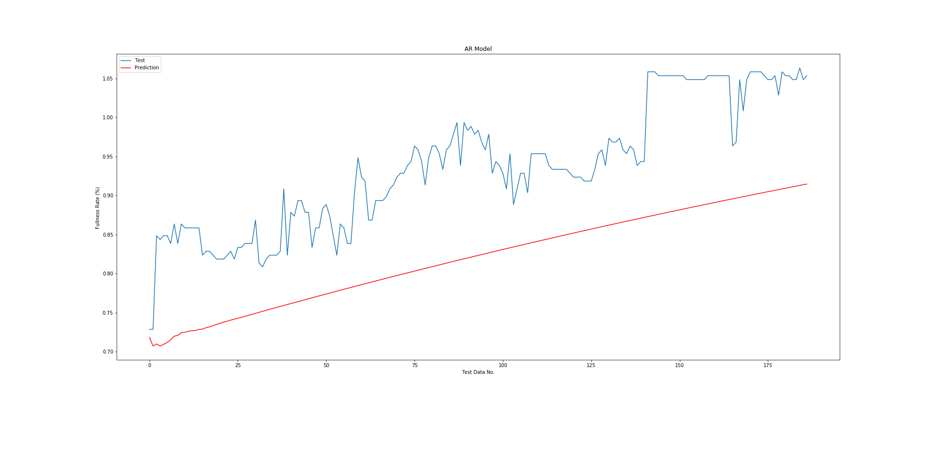
I trained 34.61% of my data with using AR model and tested it with the remaining. Since the graph is not stationary, I was aware that this might not be the best model. But, I wanted to check it anyway. The average percentage error was : 8.43% .

Slide 9
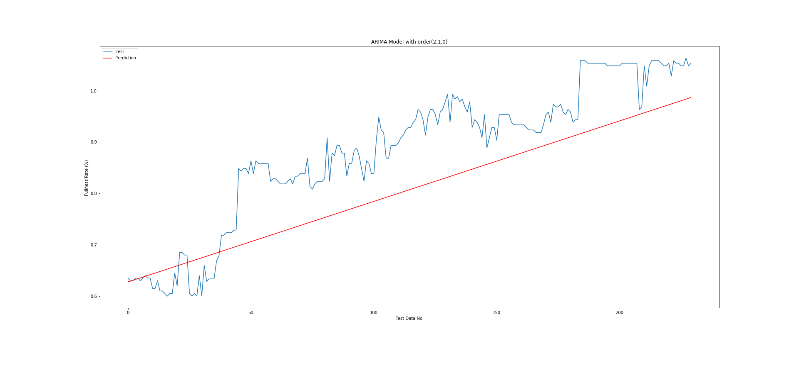
I trained 19.5% of my data with using ARIMA model of order (2,1,1) (these are just parameters) and tested it with the remaining 81.5% , the average percentage error was : 10.25% .

Slide 10
Since the AR model’s average error percentage was lower, I decided to use that model to predict 12/24 hours laters Fullness Rate.
Fullness Rate 12 hours later : 1.0672825822293917 %.
Fullness Rate 24 hours later :1.0773787652297635 %.
Obviously it’s over their capacity but like I said before I’m ignoring it. To get the real Fullness Rate all I need to do is, to subtract the value of Fullness Rate of the collection day from these two percentages.
Which the date I’d choose is the data no: 185 since it’s the last date before we reach 1.0 or over and it’s value is 0.9785%.
After the subtraction,
Fullness Rate 12 hours later : 0.08878258 %.
Fullness Rate 24 hours later : 0.09887877 %.

Slide 11
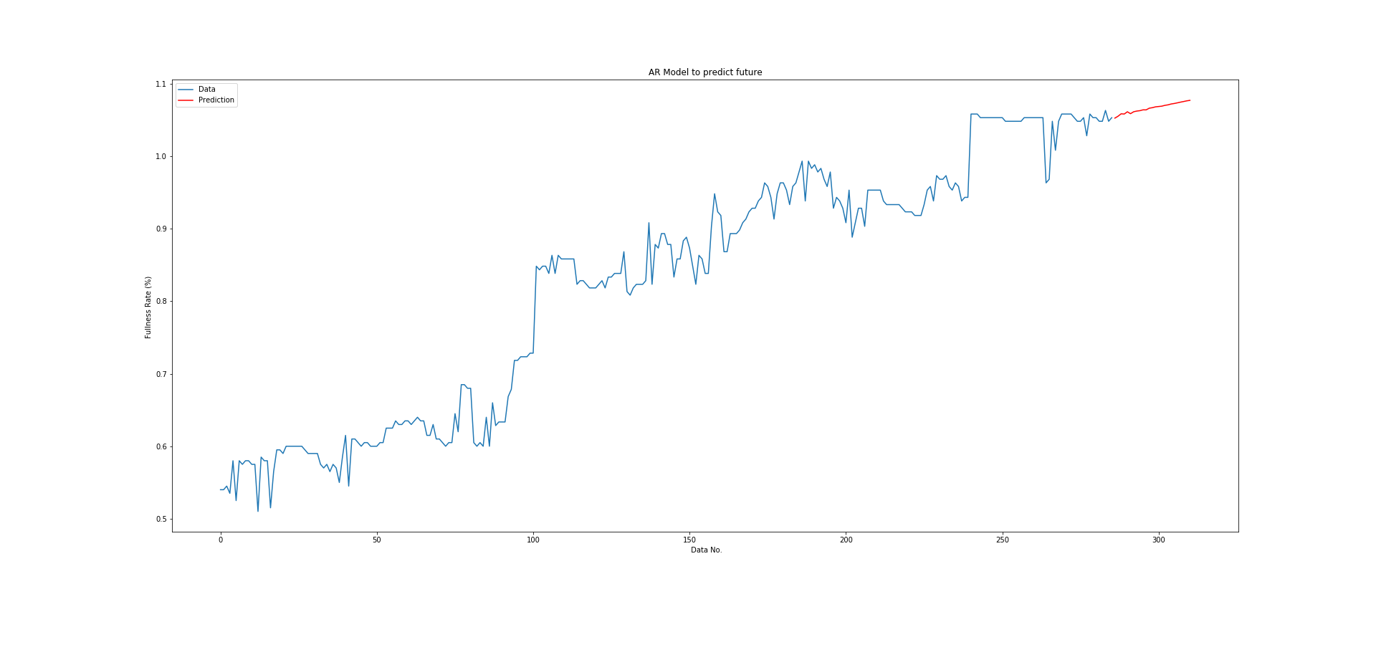
Prediction line with the data

Slide 12
Thank you for your time.
References
1)https://www.investopedia.com/terms/a/autoregressive-integrated-moving-average-arima.asp
2)https://www.statisticshowto.datasciencecentral.com/autoregressive-model/

