Slide 1
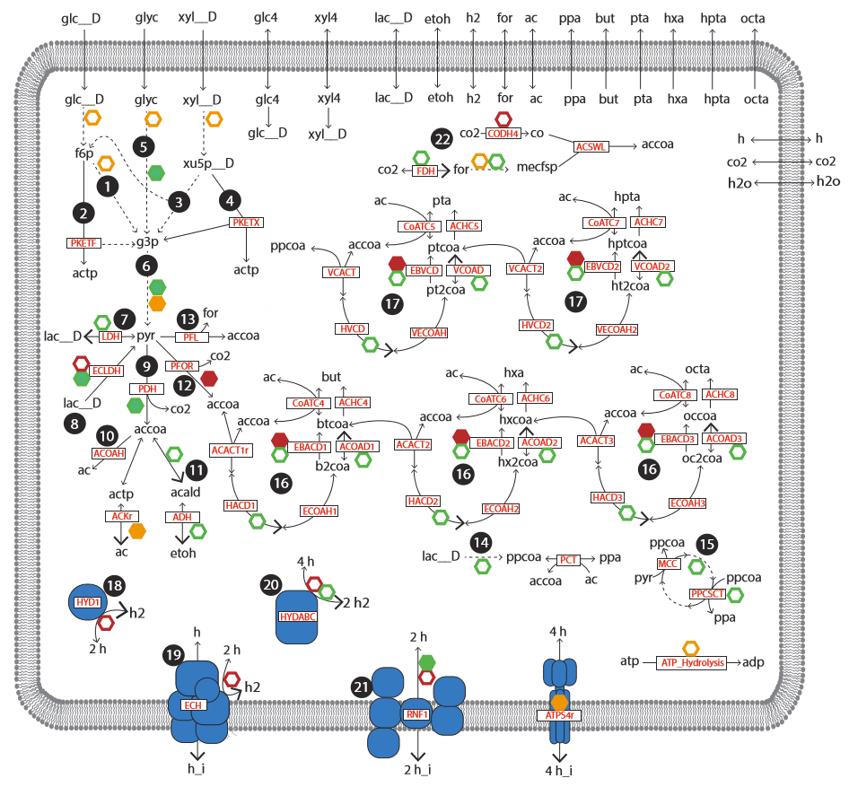
1.36
1.87
1.00
3pg
1.00
g6p
0.97
1.82
1.82
fdp
0.97
2pg
0.97
0.97
dhap
0.97
1.00
13dpg
1.87
1.82
icit
1.00
1.36
0.16
0.04
0.07
Pep
akg
0.73
0.07
0.11
succcoa
oaa
0.04
cit
nadh + nadp
0.04
0.68
nadph + nad
0.34

Slide 2
G6PDH2r: 2.61
PGL: 2.61
GND: 2.61
RPE:1.75
G6PI: 2.61
g6pB
6pgl
6pgc
ru5p
xu5p
g6p
dhap
RPI:0.86
r5p
GLCPTS: 1.00
PGI: 3.60
TPI: 1.85
GAPD: 2.79
FBA: 1.85
glc
f6p
fdp
g3p
1,3dgp
PFK: 1.85
FBA: 1.85
e4p
PGK: 2.79
3pg
TKT2: 0.88
GLCPTS: 1.00
PGM: 2.76
2pg
TALA: 0.86
s7p
ENO: 2.76
pep
TKT1:0.86
PPS: 0.03
PYK: 1.71
pyr
PFOR: 1.53
accoa
ACOAH: 0.40
ac
ac
GLCPTS: 1.00
coa
Acetate export: 0.41
OADDC: 1.10
oaa
CS: 1.06
cit
MDH: 0.0088
Formate transport: 0.0069
mal
icit
for
FUM: 0.0088
ICDHX: 1.06 (ERROR)
fum
akg
EAKGDC: 1.79
succoa
OORr: 0.76
succ
SUCOASc: 1.03
succ
Succinate export: 1.03

Slide 3
P. acidpropionici
Lactate export and bidirectional lactate transport turned off.
No propionate production
RPI:0.86
6pgc
GND: 2.61
ru5p
RPE:1.75
xu5p
PGL: 2.61
r5p
6pgl
G6PDH2r: 2.61
e4p
THD2: 5.69
g6pB
TKT1:0.86
h_i
TKT2: 0.88
TALA: 0.86
ATPS4r: 2.84
glc
G6PI: 2.61
s7p
g6p
PGI: 3.60
f6p
fdp
g3p
GAPD: 2.79
1,3dgp
FBA: 1.85
PGK: 2.79
PFK: 1.85
dhap
TPI: 1.85
3pg
GLCPTS: 1.00
2pg
PGM: 2.76
ENO: 2.76
pep
PPS: 0.03
PYK: 1.71
pyr
accoa
ACOAH: 0.40
ac
ATP production
PFOR: 1.53
ac
ATP consumption
OADDC: 1.10
coa
Acetate export: 0.41
oaa
CS: 1.06
NADH production
MDH: 0.0088
cit
NADH consumption
for
Formate transport: 0.0069
mal
icit
fed_{red} production
FUM: 0.0088
ICDHX: 1.06 (ERROR)
fum
akg
AKGDC: 1.79
fed_{red} consumption
succoa
NADPH production
OORr: 0.76
NADPH consumption
succ
SUCOASc: 1.03
succ
Succinate export: 1.03

Slide 4
P. acidpropionici
Lactate export and bidirectional lactate transport turned off.
Propionyl-CoA:Succinyl-CoA turned on.
First case with propionate production
RPI:0.92
6pgc
GND: 2.80
ru5p
RPE:1.87
xu5p
PGL: 2.80
r5p
6pgl
G6PDH2r: 2.80
e4p
THD2: 6.09
g6pB
TKT1:0.93
h_i
TKT2: 0.94
TALA: 0.93
ATPS4r: 3.05
G6PI: 2.80
s7p
glc
g6p
PGI: 3.79
f6p
fdp
g3p
GAPD: 2.85
1,3dgp
FBA: 1.92
PGK: 2.85
PFK: 1.92
dhap
TPI: 1.92
3pg
GLCPTS: 1.00
2pg
PGM: 2.82
ENO: 2.82
pep
PPS: 0.036
PYK: 1.76
pyr
accoa
ac
ATP production
PFOR: 1.36
ac
ATP consumption
OADDC: 1.18
coa
Acetate export: 0.011
PC: 0.14
oaa
CS: 1.28
NADH production
PPCOAC: 0.14
MDH: 0.0095
cit
NADH consumption
for
Formate transport: 0.0075
mal
icit
fed_{red} production
mmcoa_S
FUM: 0.0095
ICDHX: 1.28 (ERROR)
ppacoa
MME: 0.14
fum
akg
AKGDC: 1.93
fed_{red} consumption
succoa
NADPH production
mmcoa_R
MMM2: 0.14
OORr: 0.67
NADPH consumption
PPCSCT: 0.14
SUCOASc: 1.24
ppa
succ
ppa
Propionate export: 0.14
succ
Succinate export: 1.11

Slide 5
P. acidpropionici
Lactate export and bidirectional lactate transport turned off.
Propionyl-CoA:Succinyl-CoA turned on.
Plus FRDx and
Minus ATPs4r
RPI:0.15
6pgc
GND: 0.42
ru5p
RPE:0.26
xu5p
r5p
PGL: 0.42
6pgl
G6PDH2r: 0.42
e4p
g6pB
TKT1:0.14
G6PI: 0.42
TKT2: 0.12
TALA: 0.14
g6p
s7p
glc
PGI: 0.56
f6p
fdp
g3p
GAPD: 1.72
1,3dgp
FBA: 0.83
PGK: 1.72
PFK: 0.83
Dhap
TPI: 0.83
3pg
GLCPTS: 1.00
2pg
PGM: 1.66
ENO: 1.66
pep
PPS: 0.06
PYK: 0.56
pyr
accoa
ac
ATP production
PFOR: 0.23
ac
ATP consumption
OADDC: 0.96
coa
Acetate export: 0.018
PC: 0.24
oaa
CS: 0.10
NADH production
MDH: 1.01
cit
NADH consumption
for
Formate transport: 0.012
PPCOAC: 0.24
mmcoa_S
mal
icit
fed_{red} production
MME: 0.24
FUM: 1.01
ICDHX: 0.10 (ERROR)
ppacoa
mmcoa_R
fum
akg
fed_{red} consumption
FRDx: 1.02
OORr: 0.12
NADPH production
MMM2: 0.24
AKGDC: 0.16
PPCSCT: 0.24
succoa
NADPH consumption
ppa
succ
SUCOASc: 0.05
ppa
Propionate export: 0.24
succ
Succinate export: 0.83

Slide 6
P. acidpropionici
Lactate export and bidirectional lactate transport turned off.
Propionyl-CoA:Succinyl-CoA turned on.
FRDx on
ATPs4r off
PFOR off
RPI:0.11
6pgc
GND: 0.28
ru5p
RPE:0.17
xu5p
r5p
PGL: 0.28
6pgl
G6PDH2r: 0.28
e4p
g6pB
TKT1:0.095
G6PI: 0.28
TKT2: 0.084
TALA: 0.095
g6p
s7p
glc
PGI: 0.70
f6p
fdp
g3p
GAPD: 1.81
1,3dgp
FBA: 0.89
PGK: 1.81
PFK: 0.89
Dhap
TPI: 0.89
3pg
GLCPTS: 1.00
2pg
PGM: 1.77
ENO: 1.77
pep
PPS: 0.04
PYK: 0.70
pyr
PDH:1.21
ACOAH: 1.70
ATP production
accoa
ac
ac
ATP consumption
OADDC: 0.41
CS: 0.58
coa
Acetate export: 1.71
oaa
NADH production
MDH: 0.92
cit
NADH consumption
for
Formate transport: 0.0085
mal
icit
fed_{red} production
FUM: 0.93
ICDHX: 0.58 (ERROR)
fum
akg
fed_{red} consumption
FRDx: 0.94
NADPH production
AKGDC: 0.61
succoa
NADPH consumption
succ
SUCOASc: 0.61
succ
Succinate export: 0.32

Slide 7
P. acidpropionici
Lactate export and bidirectional lactate transport turned off.
Propionyl-CoA:Succinyl-CoA turned on.
FRDx on
ATPs4r off
PFOR off
Enabled CO2 fixation and OADDC off
RPI:0.15
6pgc
GND: 0.40
ru5p
RPE:0.25
xu5p
r5p
PGL: 0.40
6pgl
G6PDH2r: 0.40
e4p
g6pB
TKT1:0.13
G6PI: 0.40
TKT2: 0.12
TALA: 0.13
g6p
s7p
glc
PGI: 0.59
f6p
fdp
g3p
GAPD: 1.73
1,3dgp
FBA: 0.84
PGK: 1.73
PFK: 0.84
Dhap
TPI: 0.84
3pg
GLCPTS: 1.00
2pg
PGM: 1.68
ENO: 1.68
pep
PPS: 0.056
PYK: 0.59
pyr
accoa
ac
PDH: 0.22
ac
co2t: 0.79
CS: 0.096
coa
Acetate export: 0.017
ATP production
co2
co2
MCC: 1.24
oaa
ATP consumption
MDH: 1.06
cit
Formate transport: 0.011
PPCOAC: 0.12
mmcoa_S
mal
NADH production
for
icit
NADH consumption
ppacoa
MME: 1.13
FUM: 1.06
ICDHX: 0.096 (ERROR)
mmcoa_R
fum
akg
fed_{red} production
FRDx: 1.08
AKGDC: 0.048
fed_{red} consumption
MMM2: 1.13
PPCSCT: 1.13
succoa
NADPH production
ppa
succ
SUCOASc: 0.048
NADPH consumption
ppa
Propionate export: 1.13
succ
Succinate export: 0.00

