Slide 1
Post Traumatic Stress Disorder Predictor

Slide 2
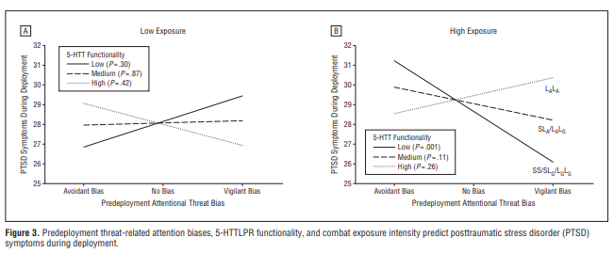
The Research
Prediction of PTSD that occur as a result of service in ILS.
The data is based on Wald I. 2009 army research.
T1 – 2 weeks after recruitment
T2 – pre-deployment, 24 weeks after recruitment
T3 – 1 year after recruitment
Notes:
The article
Our targer
The t’3
The diff targets

Slide 3
Basic Features
Single time sample features:
Genome data
Demographics
Trauma history
Time 1 & Time 2:
Coping mechanisms
Psychological inventories
- Computerized dot probe data

Slide 4
Engineering
symptomatic_cutoff = 2
intrusion_cuoff = 1
avoidance_cuoff = 3
hypertension_cuoff = 2
only_avoidance_cutoff = 1
depression_cutoff = 2
tred_cutoff = 1
Sum, mean, STD
((df['hypertention_cutoff']) & (df['avoidance_cutoff']) & (df['intrusion_cutoff']) & (df['PCL_score'] >= 49))

Slide 5
Engineering 2
Creating STD for some features
Creating delta between t1 and t2
Multiplying the genome by the ashkensi/Sephardi scale

Slide 6
PCL cutoff
df = df[(df['PCL_score'] < 42) | (df['PCL_score'] > 48) ]
Cause we really not sure about the others
df1 = df1[(df_t1.isna().astype(int).sum(axis=1)<38) | (df_t2.isna().astype(int).sum(axis=1)<38)]
df1["t1_missing"] = df_t1.isna().astype(int).sum(axis=1)==38
df1["t2_missing"] = df_t2.isna().astype(int).sum(axis=1)==38
features.extend(["t1_missing", "t2_missing"])

Slide 7
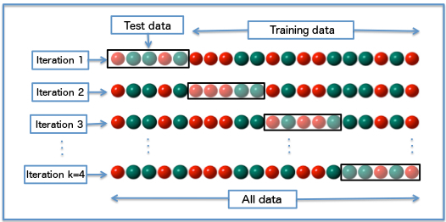
Test set – 25% stratified
Holdout set – 25% stratified
Cross-validation- stratified
5 folds cross validation
imputation
Recursive feature elimination
CatBoost
STD features

Slide 8
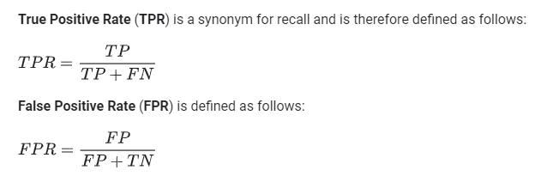
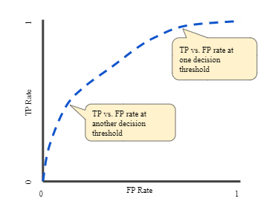

How to evaluate the model?

Slide 9
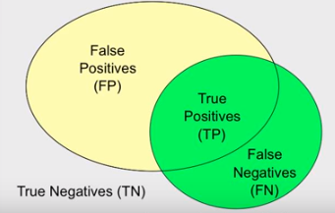
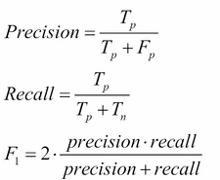
Results
Cross validation – precision – ~49%, recall – ~10%
Cross validation – precision – 10.6%, recall- 80.3%
Cross validation – precision – 22%, recall- 50%
Former results :
Cross Validation Results –
F1 – 38% precision – 35.6% Recall – 41.67%
Holdout Set Results
F1 Score – 44.45%
Precision Score – 40%
Recall Score – 50%

Slide 10
Questions
How to make a use for the unlabeled data?
How to improve our classifier?
How to deal with the classes unbalance?
Should we use other algorithms?

