Slide 1
PTSD risk calculator
28.1.19

Slide 2
The task
Original data – 1103 subjects, 179 columns
PCL3 strict == 0 is 681
PCL3 strict == 1 is 44

Slide 3
Describe data
Missing data column – 0.5 threshold
Missing data row – 0.9 threshold (None)
Features: 64
Stratified train test split – 0.1 test
Stratified train test split – 0.1 holdout

Slide 4
Features

Slide 5
Few features groups
Time dependent features:
Only T1 & T2
Coping mechanisms
Psychological quetioneers
- Dot probe
Generic features:
Genes
Army
Demographic
others

Slide 6
Time dependent features
Coping mechanimsms:
"active_coping", "planning", "positive_reframing", "acceptance", "humor", "religion", "emotional_support", "instrumental_support", "self_distraction", "denial1, "venting”, "substance_use”,"behavioral_disengagement", "self_blame",

Slide 7
Time dependent features
Psychological isssues:
"state”, "trait", "lot “, “phq", "PCL”

Slide 8
Time dependent features
Dot probe:
"T1Acc1t", "T1Acc1n", "T1bias"

Slide 9
Generic features
Genes :
"HML_5HTT", "HL_MAOA", "HML_NPY“, "HML_FKBP5“, "COMT_Hap1_recode", "COMT_Hap2_recode“, "COMT_Hap1_LvsMH"

Slide 10
Generic features
Army :
"military_exposure_unit“

Slide 11
Generic features
Demographic :
"Ashken_scale", "Sephar_scale", "Unknown“, "age", "highschool_diploma", "Hebrew

Slide 12
Generic features
others :
"dyslexia", "ADHD", "T1ETBE“, "trauma_history8_1“
"ptgi2", "cd_risc1"

Slide 13
Imputation & scaling
Mean imputation for numeric
Mode imputation for categoric
Standard scaler

Slide 14
Algorithm evaluation

Slide 15
Supervised learning

Slide 16
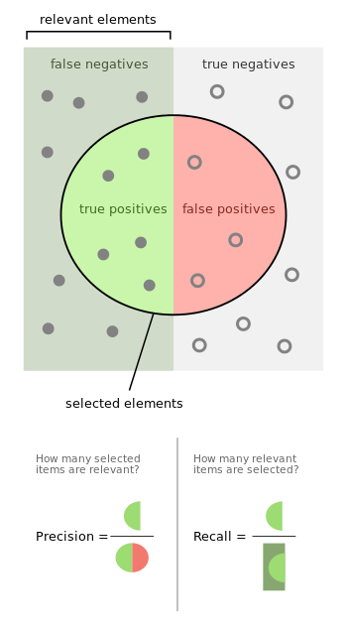

F1 Score

Slide 17
Pipeline
Impute missing data
Scaling
Training
Get cross validation score

Slide 18
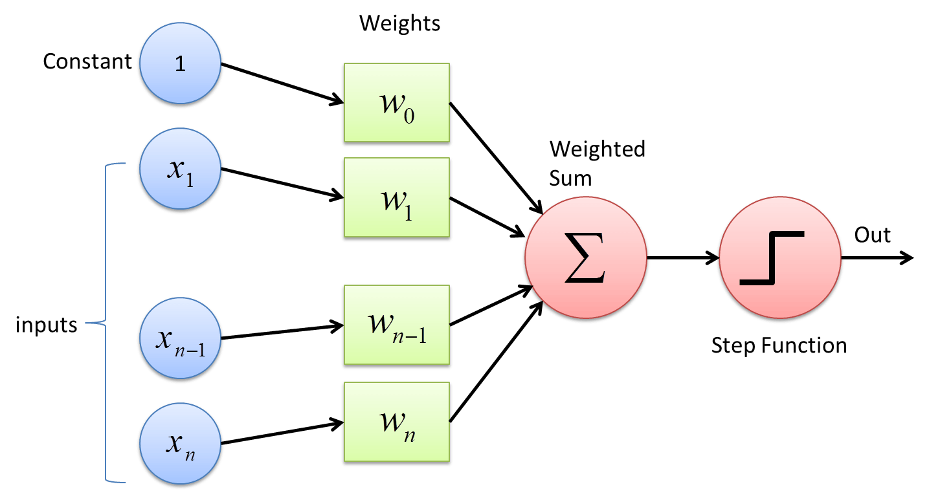
Perceptron

Slide 19
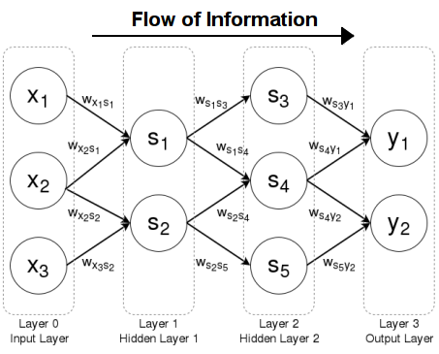
Neural network

Slide 20
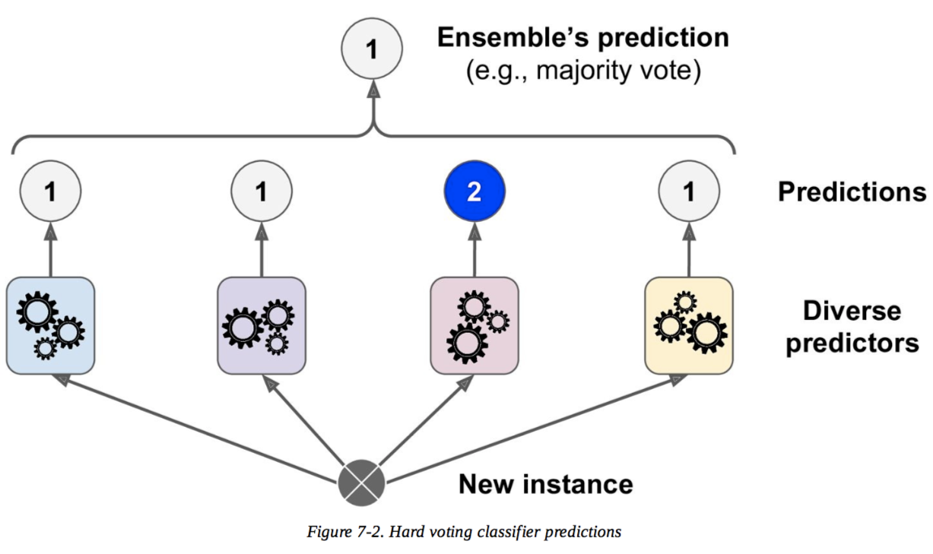
Ensemble

Slide 21
Results - אחוזים
Cross validation Score -
F1 0.38 precision 0.356 recall 0.41667
holdout set -
F1 0.4445 precision 0.4 recall 0.5

Slide 22
פייפליין + אלגוריתם

Slide 23
DRopOut classifier
תוצאות
בהולאאוט – 100 חיילים
11 באמת נושרים
תפס 7, טעה על 1

