Slide 1







Closed
Hashing
Done by: Noha Ezzat 221489

Slide 2

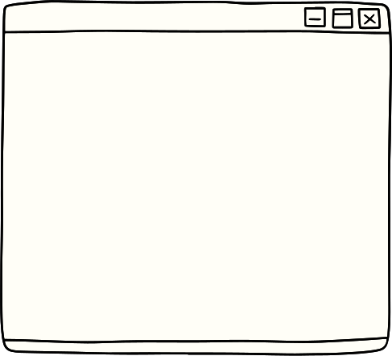





Introduction
THE IDEA OF HASHING IS TO MAP KEYS OF A GIVEN FILE OF SIZE N INTO A TABLE OF SIZE M, CALLED THE HASH TABLE, BY USING A PREDEFINED FUNCTION, CALLED THE
HASH FUNCTION
Hash Function: Maps key values to positions
HASH TABLE: A TABLE THAT HOLDS THE RECORDS

Slide 3


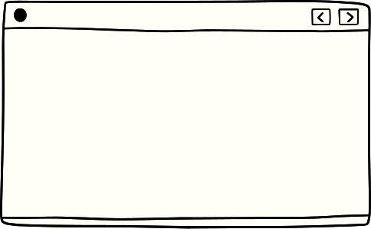

IF WE WANT TO SEARCH ABOUT AN ELEMENT WE DO A LINEAR SEARCH AS FOLLOWS
FOR EXAMPLE FIND 80
50
How did this idea appeared
60
WHAT IF I WANT TO FIND A SPECIFIC ELEMET IN AN ARRAY??
70
80
90
100

Slide 4
IF WE WANT TO SEARCH ABOUT AN ELEMENT WE DO A LINEAR SEARCH AS FOLLOWS
FOR EXAMPLE FIND 80
50
How did this idea appeared
60
WHAT IF I WANT TO FIND A SPECIFIC ELEMET IN AN ARRAY??
70
80
90
100

Slide 5
IF WE WANT TO SEARCH ABOUT AN ELEMENT WE DO A LINEAR SEARCH AS FOLLOWS
FOR EXAMPLE FIND 80
50
How did this idea appeared
60
WHAT IF I WANT TO FIND A SPECIFIC ELEMET IN AN ARRAY??
70
80
90
100

Slide 6

IF WE WANT TO SEARCH ABOUT AN ELEMENT WE DO A LINEAR SEARCH AS FOLLOWS
FOR EXAMPLE FIND 80
50
How did this idea appeared
60
WHAT IF I WANT TO FIND A SPECIFIC ELEMET IN AN ARRAY??
70
THEREFORE , THE TIME COMPLEXITY HERE IS O(N)
WHILE I CAN DO IT O(1) BY USING HASHING
80
90
100

Slide 7

Strategy
THIS STRATEGY IS CALLED SPACE-FOR-TIME TRADEOFF AS WE USE MORE SPACE TO CONSUME TIME
THERE ARE TWO VARIETIES OF SPACE-FOR-TIME ALGORITHM ONE OF THEM IS PRESTRUCTURING — PREPROCESS THE INPUT TO MAKE ACCESSING ITS ELEMENTS EASIER SO WE CAN RELATE THIS TO THE HASHING IDEA

Slide 8



Hahsing
Closed Hashing
CLOSED HASHING, ALSO KNOWN AS OPEN ADDRESSING, IS A COLLISION RESOLUTION TECHNIQUE IN HASH TABLES WHERE WHEN A COLLISION OCCURS, THE SYSTEM SEARCHES FOR AN OPEN SLOT IN THE SAME TABLE TO STORE THE COLLIDING ELEMENT, AVOIDING EXTERNAL DATA STRUCTURES.
LINEAR PROBING

Slide 9
collision
Collision in hashing occurs when two distinct keys are mapped to the same location in a hash table

Slide 10


SOLVE
Let’s Apply
Step by Step
01
Construct Hash Table
FOR THE INPUT 30, 20, 56, 75, 31, 19 AND HASH FUNCTION H(K) = K MOD 11
02
GET INDEX BY THE HASH FUNCTION
AND STORE IN THIS INDEX
03
SEARCH FOR 56

Slide 11
01
Let’s Apply
Step by Step
01
Construct Hash Table
DEF CONSTRUCT_CLOSED_HASH_TABLE(KEYS, TABLE_SIZE,ELEMENT):
table = [None] * table_sizE
INSERT_INTO_TABLE(TABLE,KEYS,TABLESIZE,ELEMENT)
02
GET INDEX BY THE HASH FUNCTION
AND STORE IN THIS INDEX
KEYS = [30, 20, 56, 75, 31, 19]
table_size = 11
03
SEARCH FOR 56
CONSTRUCT_CLOSED_HASH_TABLE(KEYS,TABLE_SIZE,56)

Slide 12
02
Let’s Apply
Step by Step
01
Construct Hash Table
DEF HASH_FUNCTION(KEY, TABLE_SIZE):
return key % table_size
DEF INSERT_INTO_TABLE(TABLE, KEY, TABLE_SIZE):
index = hash_function(key, table_size)
while table[index] is not None:
index = (index + 1) % table_size
table[index] = key
02
GET INDEX BY THE HASH FUNCTION
AND STORE IN THIS INDEX
02
SEARCH FOR 56

Slide 13
03
Let’s Apply
Step by Step
01
DEF SEARCH_IN_TABLE(TABLE, KEY, TABLE_SIZE):
index = hash_function(key, table_size)
comparisons = 1
while table[index] is not None:
if table[index] == key:
return index, comparisons
index = (index + 1) % table_size
comparisons += 1
return None, comparisons
Construct Hash Table
02
GET INDEX BY THE HASH FUNCTION
AND STORE IN THIS INDEX
03
SEARCH FOR 56
SEARCH_KEY = 56
index_found, comparisons = search_in_table(hash_table, search_key, table_size)

Slide 14






CONSTRUCT
N-1
N=TABLE_SIZE
1
UPPER-LOWER+1
N-1 -0+1
O(n)
I=0
HASH FUNCTION AND INSERT
Analysis
N-1
UPPER-LOWER+1
N-1 -0+1
O(N)
O(1)
1
I=0
BOTH:O(N)
SEARCH
N-1
UPPER-LOWER+1
N-1 -0+1
O(n)
BEST CASE: O(1)
WORSTCASE (COLLISION OCCURANCE):
1
I=0

Slide 15



Thank you
DONE

