Slide 1
기본 프로그래밍 01
자바에 삼 주만 빠져보자!
데이터융합SW과
김규석 교수
JAVA

Slide 2
Schedule
Day | Content | Day | Content | Day | Content
1 | Environmental Settings | 6 |  | 11
2 |  | 7 |  | 12
3 |  | 8 |  | 13 | Review/Assignment
4 |  | 9 | Review/Assignment | 14 | Review/Mini Project
5 | Review/Assignment | 10 |  | 15 | Review/Mini Project
Must do two of assignments everyday
Due time for the assignment : 9am on the class opening day(NAS)

Slide 3
Objective
What is Programming?
Procedural Programming(PP) vs Object-Oriented Programming(OOP)
Features of Java
Development Environment
Set up the development environment with JDK and Eclipse(IDE) on PC
Print “Hello World” and Try some basic functions
Write comments on source code
Try compiling Java source code on the web

Slide 4
What is Programming?
Computer Programming(=Coding)
The process of designing and building an executable computer program to accomplish a specific computing result or to perform a specific task
Q1 : What is a computer program?
Q2 : What does a computer consist of, then?
Q3 : How do we communicate with computers?
Source : https://en.wikipedia.org/wiki/Computer_programming

Slide 5
Answers to Q1 and Q2
Computer program
A collection of instruction that can be executed by a computer to perform a specific task.
Hardware(HW) and Software(SW)
Every computer is composed of two basic components: hardware and software
Software
Hardware
PROCESSOR(CPU)
INPUT
MEMORY 1010 0001…
OUTPUT
STORAGE
Source : https://en.wikipedia.org/wiki/Computer_program / https://www.wikilectures.eu/w/Computer_hardware_and_software

Slide 6
Answer to Q3
Software Category
Application : a program designed to end-users
Frameworks : a platform for developing software applications
Firmware : a program to operate a device’s hardware
Application
Frameworks
Firmware(System software)

Slide 7
Bitwise Operator
Bitwise Operation
Operates on a bit string, a bit array or a binary numeral at the level of its individual bits.
Q4* : Why are bits used for computer?
Q5* : What are units of measure for digital information used by computer?
Source : https://en.wikipedia.org/wiki/Bitwise_operation

Slide 8
Programming Process
Programming Process for Java
Human composes source code
Compiler translates code in human languages into one in programming lan
Compiler
Source Code
bytecode
Interpreter
(Linux)
Interpreter
(Windows)
Interpreter
(Mac OS)
Q6* : What is bytecode?
Q7* : What’s the role of JVM(Java Virtual Machine)?
Source : www2.hawaii.edu/~takebaya/ics111/process_of_programming/process_of_programming.html#:~:text=A compiler takes the program,to create an executable file.

Slide 9
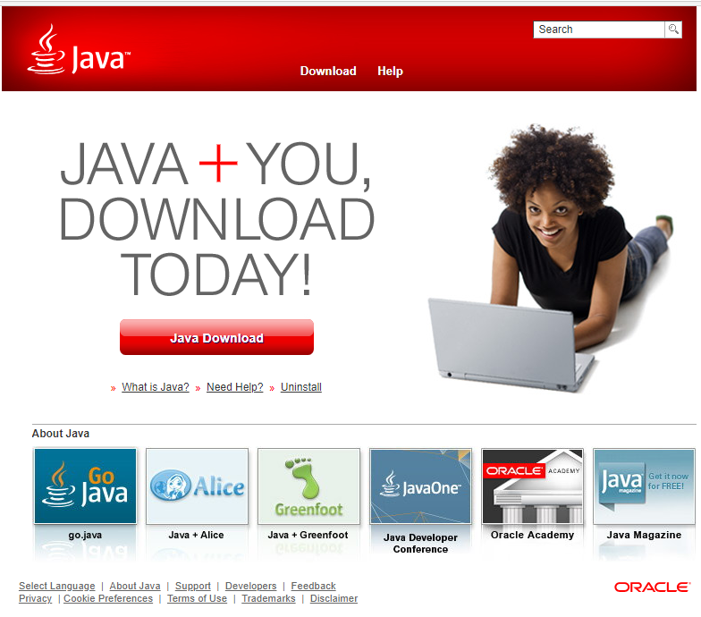
Preparation of Development Environment(Cont’d)
Install JDK(Java Development Kit)
A development environment for building applications and components using Java programming language.
1) Visit www.java.com
2) Download the file and install it
Click on it
Source : https://en.wikipedia.org/wiki/Bitwise_operation

Slide 10
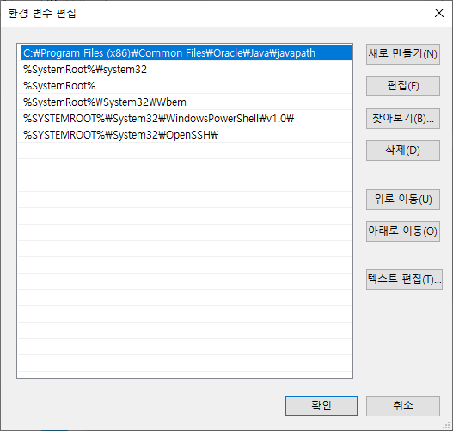
Preparation of Development Environment(Cont’d)
Install JDK(Java Development Kit)
3) After the installation,
the environment variables should include the path for Java
Path for Java installed

Slide 11

Preparation of Development Environment(Cont’d)
Install IDE(Integrated Development Environment)
A software application that provides facilities for software development.
1) Visit www.eclipse.org
2) Download the file and install it
Click on it
Source : www.eclipse.org

Slide 12
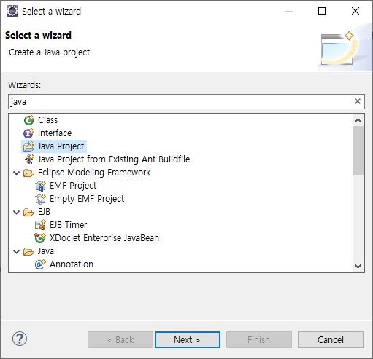
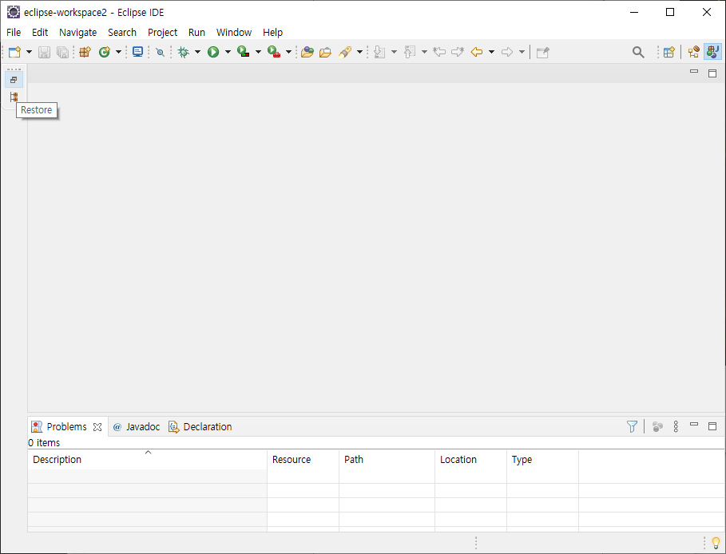
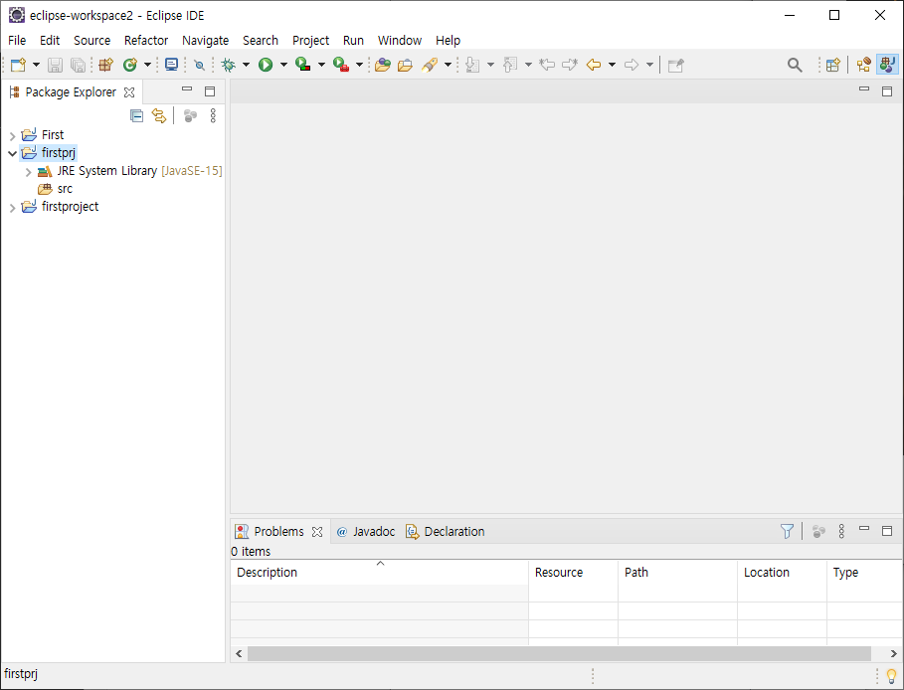
Beginning of Programming(Cont’d)
Create a Java Project
1) New > Other > Java Project
2) Input a Project Name > Next > Finish

Slide 13
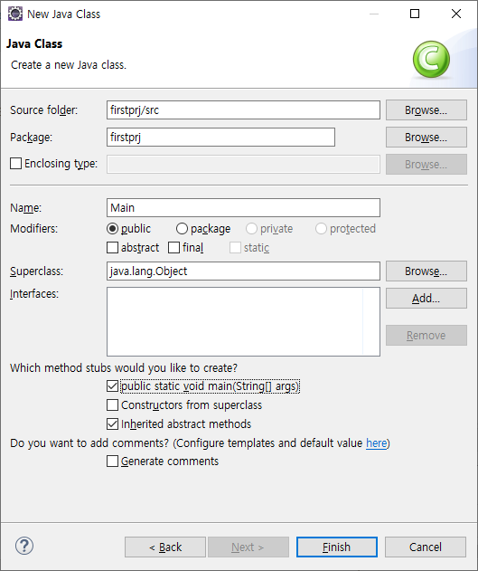
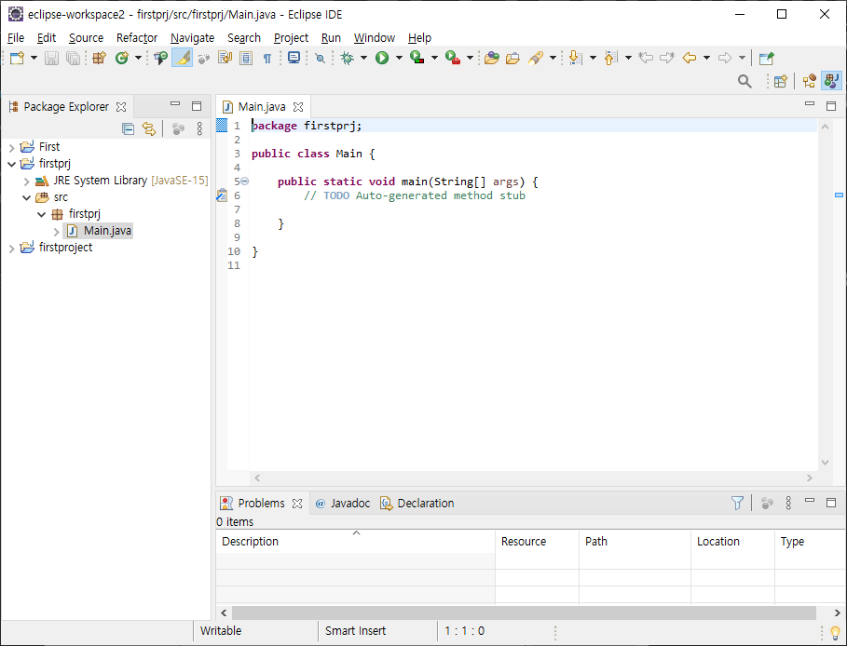
Beginning of Programming(Cont’d)
Create a Java Main Class
1) New > Other > Class
2) Input a Class Name > Check “public static void main” > Finish

Slide 14
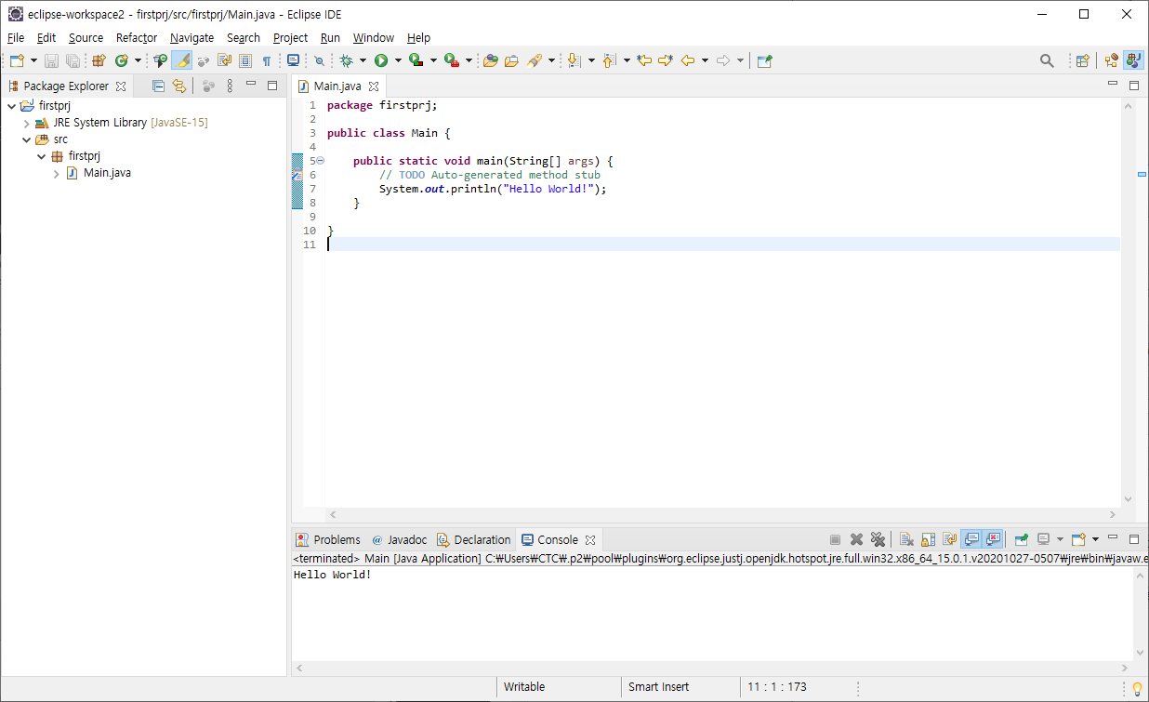
Beginning of Programming
Print “Hello World!”
1) Add a line, “System.out.println(“Hello World!”);”
2) Run > Run As > Java Application

Slide 15
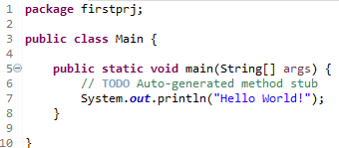
Review Source Code(Cont’d)
Print “Hello World!”
1) Project name that you entered
3) Class name you entered
5) Entry function → public static void main()
6) Single line comment
7) Call for function to print strings on the screen
8, 10) Brackets

Slide 16
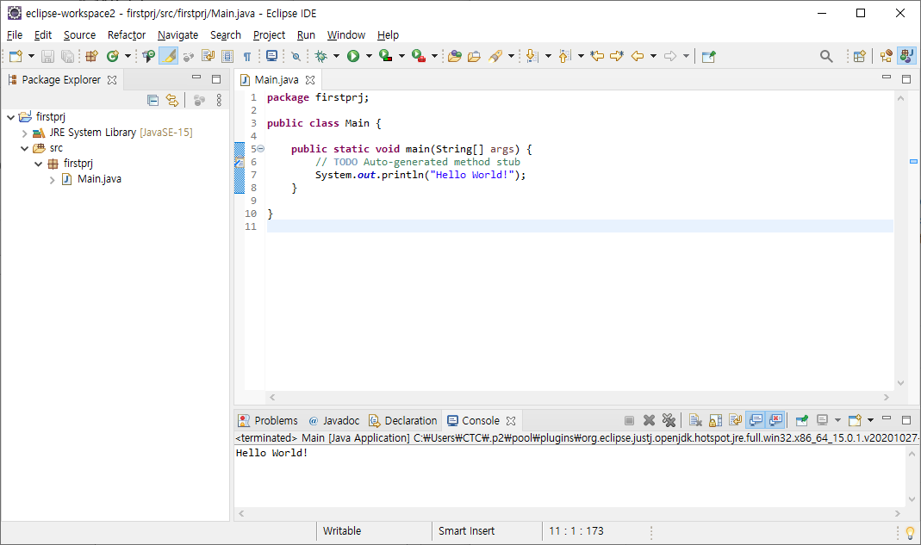
Review Source Code(Cont’d)
1) Package Name
“package” is a reserved word
A semicolon is needed at the end of a program line
Q8* : Search for Java reserved words and List them up
P1 : Change the package name and run it again
P2 : Remove the semicolon and run it again

Slide 17
Review Source Code(Cont’d)
3) Class Name
“public” is a controlling access modifier (cf. default, private, protected)
“Main” is the class name
Q9* : Search for Java access modifiers and List them up
P3 : Remove the bracket and run it again
Q10* : Where’s closed bracket to the line #3
P4 : Change the class name and run it again

Slide 18
Review Source Code(Cont’d)
5) Function
“static” is a variable belonging to the class and initialized only once (cf. final)
“main” is the name of the entry function.
Q11* : Search for Java attributes and List them up
P5 : Remove the bracket and run it again
Q12* : Where’s closed bracket to the line #5

Slide 19
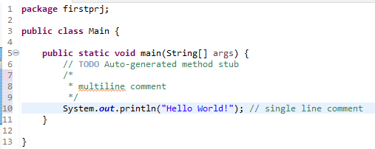
Review Source Code(Cont’d)
6) Comment
Used to explain Java code and make it more readable
P6 : Practice and Get used to the comments

Slide 20
Review Source Code
7) Print Strings on the Screen
Strings are surrounded by the double quotes
P7 : Print “Hello World!” three times in one line
P8 : Print “Hello World!” three times in three lines

Slide 21
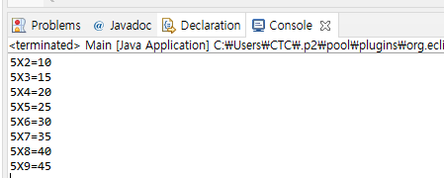
P9
Print N times table
Choose N and print the multiplication table N
Attach the source code and the console window

Slide 22
Escape Character
Escape Character
A character which is used to signal an alternative interpretation of a series of characters
Escape Sequence | Description
\t | Insert a tab
\b | Insert a backspace
\n | Insert a newline
\r | Insert a carriage return
\f | Insert a formfeed
\’ | Insert a single quote
\” | Insert a double quote
\\ | Insert a backslash
Source : https://docs.oracle.com/javase/tutorial/java/data/characters.html

Slide 23
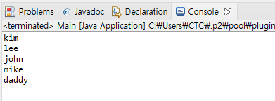
P10
Compose a program with the conditions below
Use the function, “System.out.print()” only once
And print the 5 lines of words as below

Slide 24
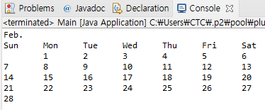
P11
Compose a program with the conditions below
Use the function, “System.out.print()” within 7 times
And print the calendar as below

Slide 25
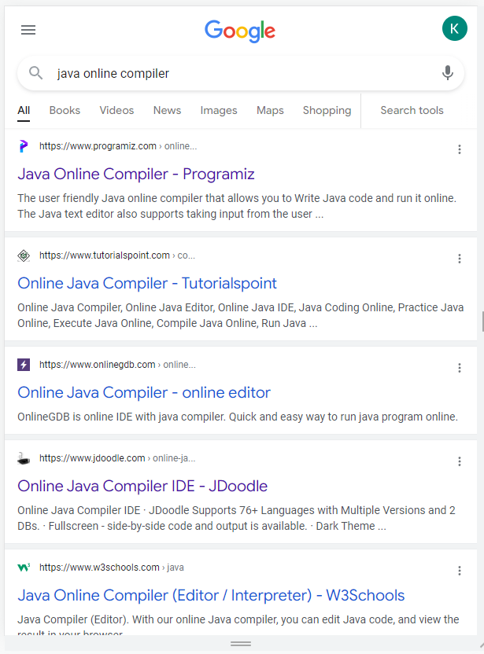
Development Environment on the Web(Cont’d)
Online Java Compiler
There are many Java compilers on the web

Slide 26
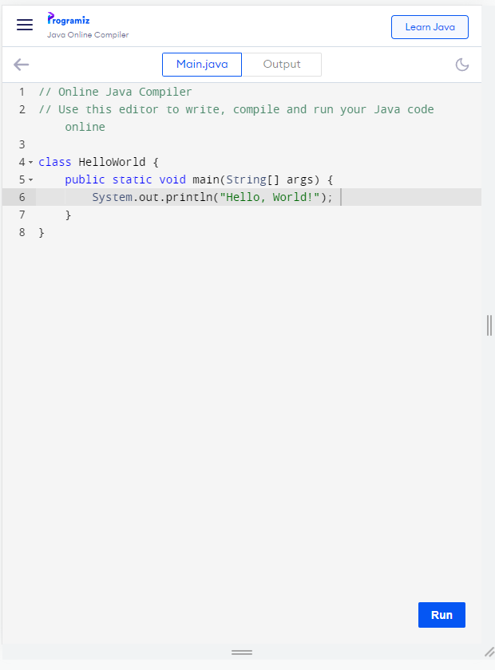
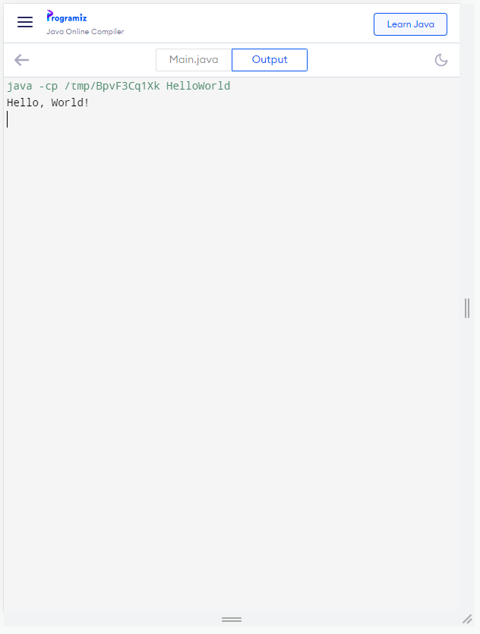
Development Environment on the Web
One Example for Online Java Compilers
https://www.programiz.com/java-programming/online-compiler/

Slide 27
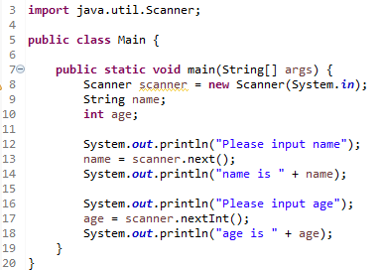
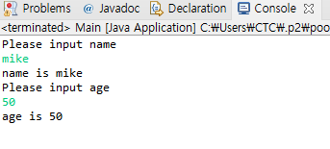
Input function
Input Function
In order to use the functions of “Scanner”, the related source code should be imported
The function is depending on the variable data type

Slide 28
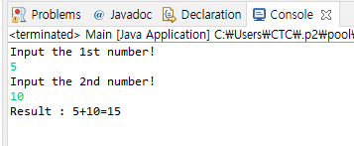
P12
Compose a program with the conditions below
User inputs the two numbers respectively
The screen shows the plus calculation process and the result

Slide 29
A1
Compose a program with the conditions below
Use the function, “System.out.println()” only once
And print the 5 lines of words as below

Slide 30
A2
Compose a program with the conditions below
Use the function, “System.out.println()” within 7 times
And print the calendar as below

Slide 31
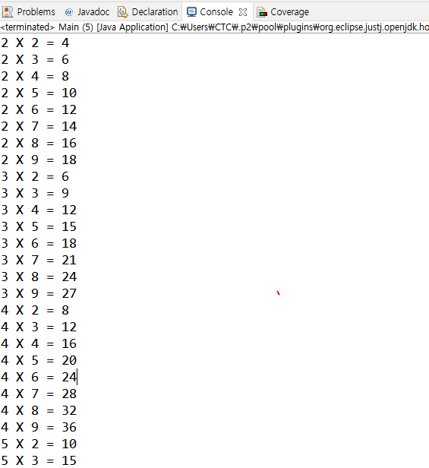
A3
Compose a program with the conditions below
Show the multiplication tables 2 – 9

Slide 32
A4
Let’s prepare what we will study tomorrow
Practice ‘Constant’ related examples
Practice ‘Variable’ related examples
Practice ‘Data type’ related examples
Practice ‘if’ and ‘switch’ related examples

Slide 33
A5
Compose a program with the conditions below
Show the self-introduction with calling the function, println() only once
(No format, just refer to the sample)
[Sample]
My name is John!
I majored in Economics in college.
After graduating from college, I used to work as an office worker for 2 years.
I got interested in AI, so I am here to learn the related skills.
What I want to do is to be a software engineer within this year!

Slide 34
A6
Compose a program with the conditions below
Gather at least 10 of the recent ICT related keywords
Show the self-introduction with calling the function, println() only once
(No format, just refer to the sample)
[Sample]
도커(Docker) : 리눅스의 응용 프로그램들을 소프트웨어 컨테이너 안에 배치시키는 일을 자동으로 하는 오픈소스 프로젝트
…

