Slide 1
기본 프로그래밍 03
자바에 삼 주만 빠져보자!
데이터융합SW과
김규석 교수
JAVA

Slide 2
Objective
Java Coding Convention
Character Encodings
Creating Object
Calling a Method
Java Library
Calendar
Math
TimeZone
String
Numeric Classes

Slide 3
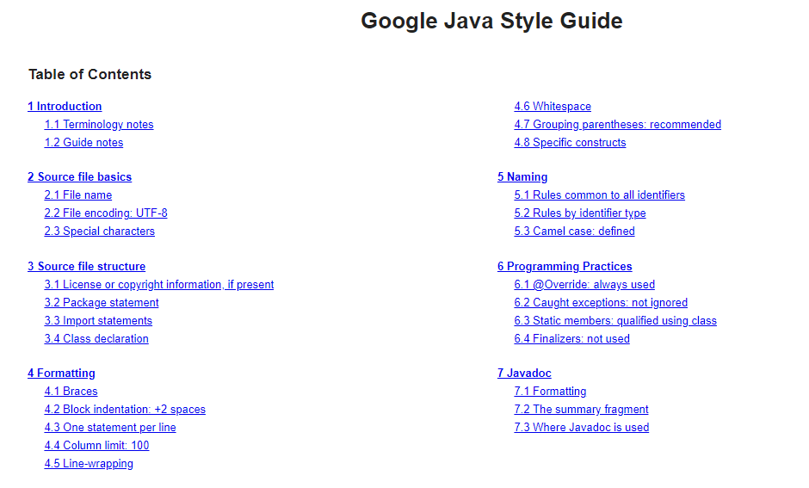
Java Coding Convention
Google Java Style Guide
Source : https://google.github.io/styleguide/javaguide.html

Slide 4
Character Encodings
ASCII and UNICODE
 | ASCII | UNICODE
Comparison Between ASCII and UNICODE | A character encoding standard for electronic communication | A computing industry standard for consistent encoding, representation, and handling of text expressed in most of the world’s writing systems
 | Stands for American Standard Code for Information Interchange | Stands for Universal Character Set
 | Supports 128 characters | Supports a wide range of characters
 | Uses 7 bits to represent a character | Uses 8bit, 16bit or 32bit depending on the encoding type
 | Requires less space | Requires more space
Source : https://medium.com/@vanvlymenpaws/ascii-vs-unicode-4174def5c09d#:~:text=ASCII%20has%20its%20equivalent%20in,English%2C%20Arabic%2C%20Greek%20etc.
Q1* : Find out “UTF-8” encoding

Slide 5


P1
Converting Character to ASCII Code
Print ASCII code converted numbers and alphabets
Hint, the sample code below

Slide 6
P2
Converting Characters to Opposite Case
User inputs a string
Print the converted characters
I am a boy
i AM A BOY

Slide 7

P3
Split Korean Characters into “First”, “Neutral” and “Final” Characters
User inputs a string in Korean
Print the split characters
Hint, Unicode and Eclipse configuration

Slide 8
Creating Object
General Way to Create an Object
Using new keyword is the most common and general way to create an object
ClassName objectName = new ClassName();
ex)
Computer computer = new Computer();
Internet internet = new Internet();
Phone phone = new Phone();

Slide 9
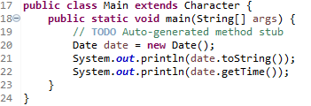

Calling a Method
Calling a Method from the Object
ObjectName.MethodName()

Slide 10
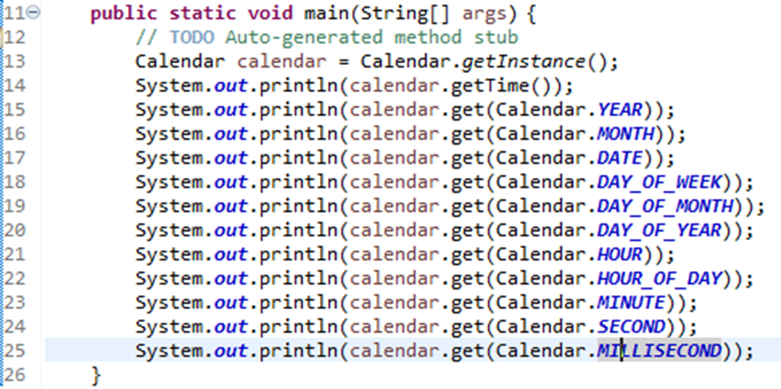
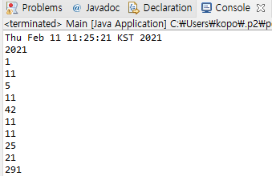
Calendar Class(Cont’d)
Calendar
An abstract class that provides methods for converting date between a specific instant in time and a set of calendar fields such as MONTH, YEAR, HOUR, etc.
P4 : Find out the range of the return values

Slide 11
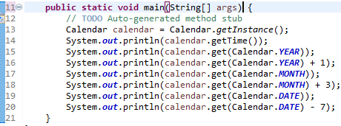
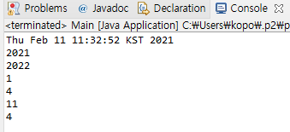
Calendar Class
Date and Time Calculation
P5 : Try this with the other parameters such as Calendar.HOUR

Slide 12
P6
Calendar Application
User inputs the two numbers for year and month
Print the calendar
2021
2
Sunday | Monday | Tuesday | Wednesday | Thursday | Friday | Saturday
 | 1 | 2 | 3 | 4 | 5 | 6
7 | 8 | 9 | 10 | 11 | 12 | 13
14 | 15 | 16 | 17 | 18 | 19 | 20
21 | 22 | 23 | 24 | 25 | 26 | 27
28

Slide 13
P7
Calendar Application II
User inputs the two dates
Print the days between the first and the second dates
(Calculate Duration)
20200203
20200212
8

Slide 14
P8
Calendar Application III
User inputs a date and a number for adding days
Print the new date after adding the input day to the start date
20200203
8
20200212

Slide 15
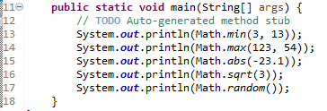
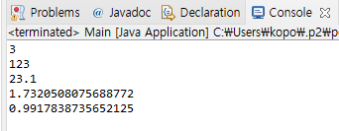
Math Class
Math Class
Perform mathematical tasks on numbers

Slide 16
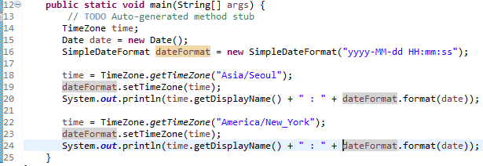

TimeZone Class
TimeZone Class
Perform mathematical tasks on numbers
P9 : add “z Z” at the end of dateFormat and print the time again

Slide 17
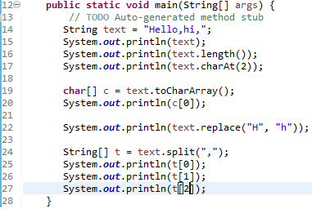
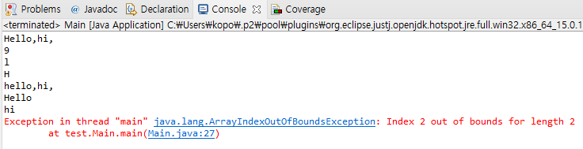
String Class
String Class
P10 : Explain the reason why this
exception occurred

Slide 18
P11
Currency Converter
Print menu for currency conversion
User selects a number from the menu
User input a number
Print the converted currency
The menu should have at least three more options
#Current Converter
1. South Korean won -> United States Dollar
2. United States Dollar -> South Korean won
3.
1
1500
1.36

Slide 19
P12
Temperature Converter
Print menu for temperature conversion
User selects a number from the menu
User input a number
Print the converted temperature
#Current Converter
1. Celsius -> Fahrenheit
2. Fahrenheit -> Celsius
1
20
68

Slide 20
P13
Extracting Word from String
User inputs one sentence and one word
Calculate how many input words can be made from the sentence
No need to change the font color as below, it just helps you understand
I go to school by subway but it takes a very long time to go to school.
cool
2

Slide 21
P14
Article before Consonant and Vowel
User inputs a sentence including at least an article
Check if the articles before consonants and vowels are correct
Modify the article if needed
This is a apple.
This is an apple.
This is a school.
This is a school.

Slide 22
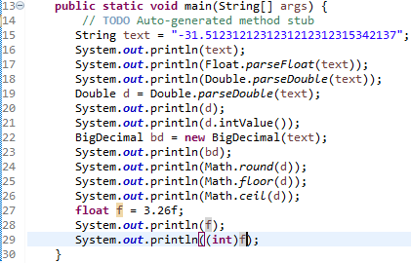
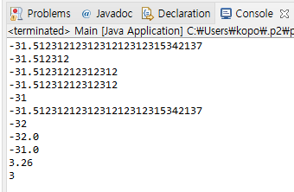
Numeric Class
Numeric Class

Slide 23
P15
Calculator
User inputs an equation
Print the calculated result
Hint, String.substring(), String.contains()
5*7.5
37.5
32/2
16

Slide 24
A1
Descriptive Statistics Calculation
User inputs a number
Prints the number of numbers, mean, maximum, minimum
This is performed indefinitely
5
Result : 1 - Mean 5, Max 5, Min 5
3
Result : 2 – Mean 4, Max 5, Min 3
1
Result : 3 – Mean 3, Max 5, Min 1

Slide 25
A2
Counting by Time of Number
User inputs a number
Prints the numbers of positive, negative, odd and even numbers
This is performed indefinitely
2
P – 1, N – 0, O – 0, E – 1
-3
P – 1, N – 1, O – 1, E - 1
4
P – 2, N – 1, O – 1, E - 2

Slide 26
A3
Compose a program with the conditions below
Compose a program calculating the number of alphabets
The string is declared as a variable, “I go to school”
C – 1
G - 1
H – 1
I – 1
L – 1
O – 4
S - 1
T - 1

