Slide 1
기본 프로그래밍 04
자바에 삼 주만 빠져보자!
데이터융합SW과
김규석 교수
JAVA

Slide 2
Objective
Method
Calling a Method from the Same Class
Parameter
Declaring a static final variable
Returning a Value
Overloading
Recursive Function
Class
Interface
Object
Constructor
this
Function vs Method
Inner Class
Inheritance
super
Overriding
Polymorphism

Slide 3
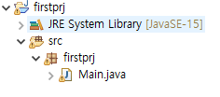
Class(Cont’d)
Object-Oriented Programming
Java is combined with Classes and Objects
Ex) A phone is an object, the functions such as Wi-Fi on it are methods
Class
Q1* : What’s the difference between PP and OOP?
Q2* : What’s the difference between “Class” and “Object”?

Slide 4
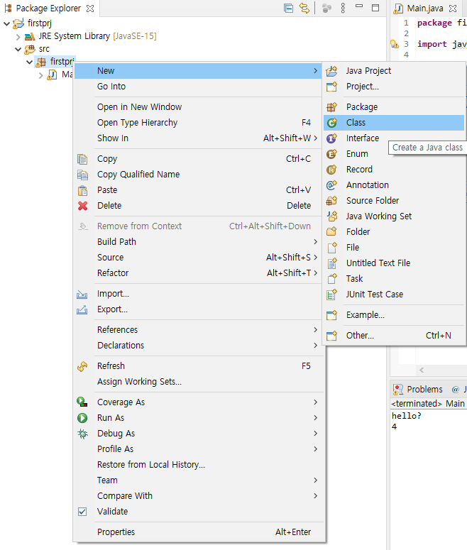
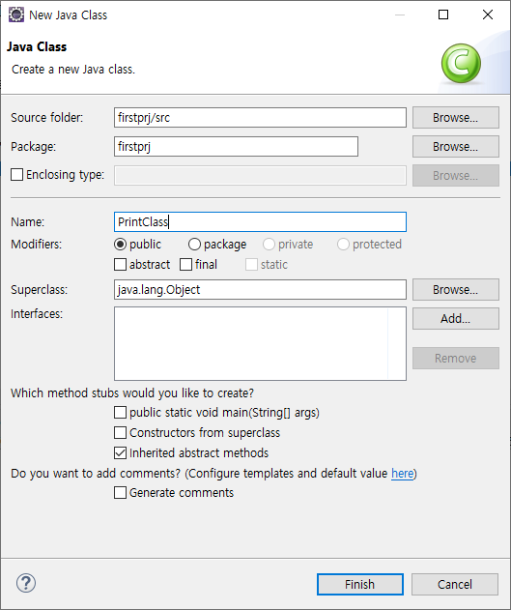
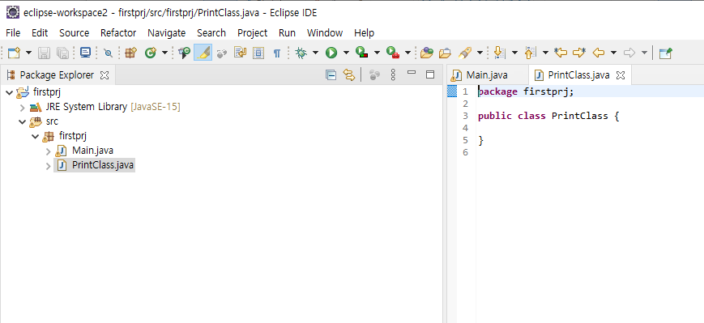
Class(Cont’d)
Create a New Class
Click on Package Name > Right-click > New > Class

Slide 5
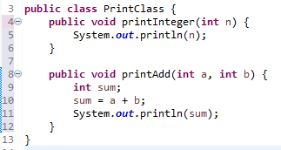
Class(Cont’d)
Create Methods
In the body of “PrintClass”, add some methods
Q3* : How do we call the functions?

Slide 6
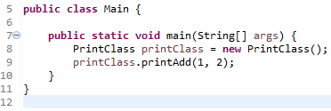
Class(Cont’d)
Create an Object and Call a Method of it
ClassName ObjectName = new ClassName();
Instance of a Class
A concrete occurrence of any object
Q4* : Explain “Class”, “Object” and “Instance”.
Q5* : Explain “Method” and “Function”.

Slide 7
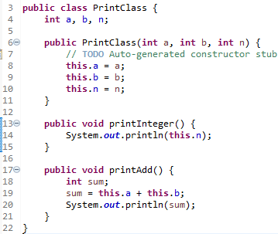
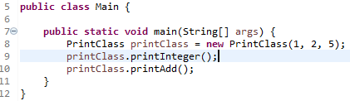

Class(Cont’d)
Constuctor
A block of code that initializes the newly created object
Return Type
Constructor

Slide 8
P1
Constructor Example
Price
1. Apple
2. Strawberry
3. Grape
4. Watermelon
User selects a number
The each operation should be done in separate functions
The name of the functions should be the same
The calculated value should be a return value

Slide 9
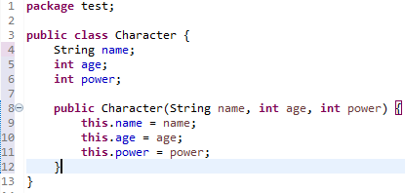
Class(Cont’d)
this
Refers to the current object in a method or constructor
Return Type

Slide 10
P2
Creating Game Characters
Refer to the example for “this”
Create a class which has a constructor
The constructor should have the parameters of “name”, “age”, “offense power” and “defense power”
Create more than 3 characters with using the character class above
Print the character introduction
A / 200 / 30.5 / 32.1
B / 123 / 47.1 / 18.9
C / 765 / 21.6 / 42.3

Slide 11
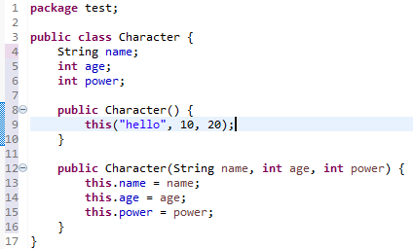
Class(Cont’d)
this()
Invoke the instructor of the current class
Return Type

Slide 12
P3
Creating Game Characters II
Adding some condition code block to P2
Add two more constructors which have one parameter and two parameters respectively
Print the character introduction
D / 260 / 35.5 / 42.1
E / 1213 / 46.1 / 38.9

Slide 13
Method
Access Modifiers
Public, Private, Protected
Public : Accessible from everywhere
Private : Accessible within the same class only
Protect : Accessible by the classes of the same package
P4 : Explain the meaning of the 12nd line

Slide 14
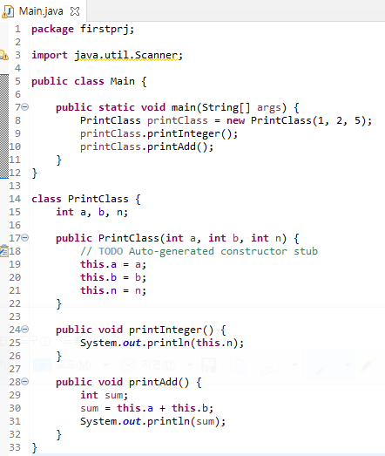

Class
Inner Class
Classes Nested in a Class
Return Type

Slide 15
P5
Inner Class Example
Compose a program without creating an object
(Hint, “static”)

Slide 16
P6
Regarding as P3
Change the created class of “P3” to an inner class
The other conditions are the same

Slide 17
P7
Descriptive Statistics
Make a record statistics for students
Format : Name, Korean Score, English Score, Math Score
Output : Number of students, average, minimum and maximum scores for each subject
#Menu
Input a record
Make descriptive statistics
Print all the records
1
Kim, 75, 100, 78
2
Number of Students : 5
Korean(Avg, Min, Max) : 75.5, 68.5, 100
…

Slide 18
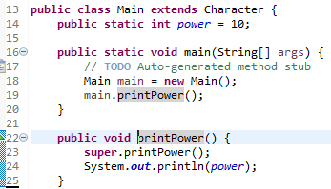
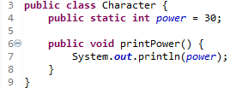

Interface(Cont’d)
Inheritance
Inherits attributes and method from one class to another
Superclass : the class being inherited from
Subclass : the class which inherits from another class
Return Type

Slide 19
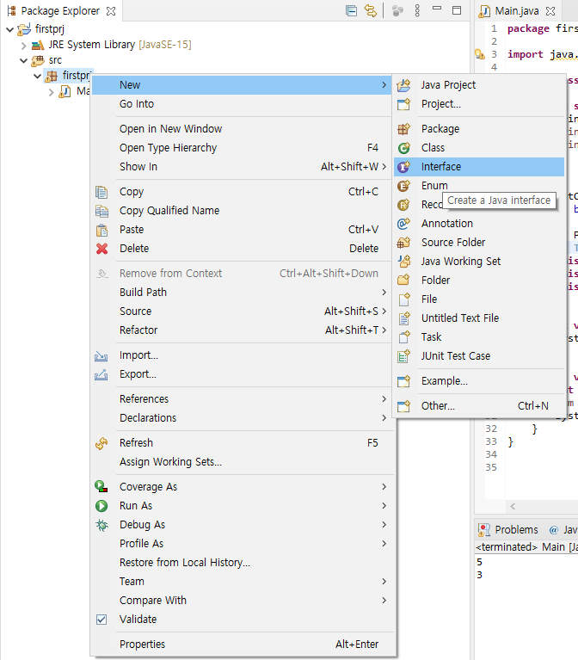
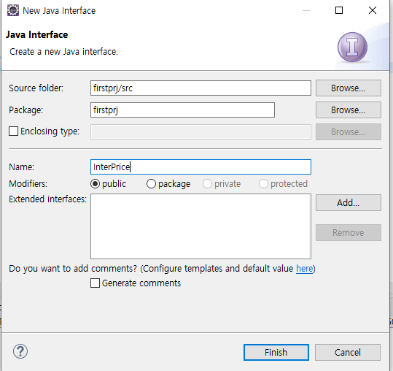
Interface(Cont’d)
Interfaces
Abstract class with empty bodies,
Return Type

Slide 20
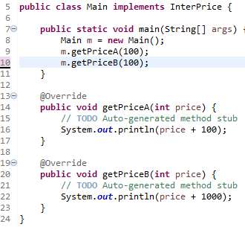


Interface(Cont’d)
Interfaces
A Group of Related Methods
Return Type
Q6* : Explain “Overload” and “Override”
Q7* : Explain the difference between “Abstract Class” and “Interface”

Slide 21
Interface
Polymorphism
Being able to be in many forms by inheritance
A
Draw()
Pen
Draw()
Pencil
Draw()
Highligher
Draw()
P8 : Compose a program as above

Slide 22
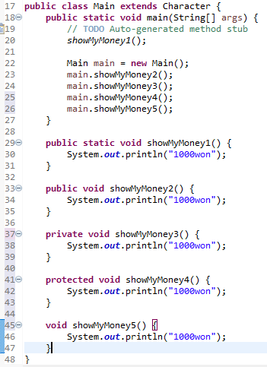
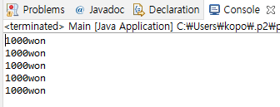
Method(Cont’d)
Calling a Method from the Same Class
A method is called in different ways as below
Keyword of Static and Access Modifiers

Slide 23
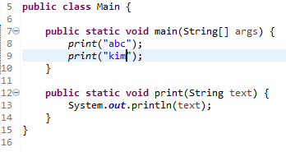
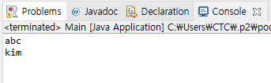
Method(Cont’d)
Method and Parameter
A method is a block code which runs when it is called.
Parameter
: Information can be passed to methods by this
Q1* : Explain the meaning of the 12nd line

Slide 24
P9
Printing a Name
User selects a number for a family member
Print the name of the family member
The program should include the following function
public void addition(int familyMember)
#Printing a Name
Father
Mother
Son
Daughter
-> 3
John

Slide 25
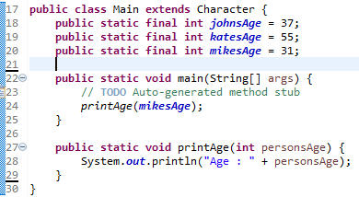

Method(Cont’d)
Declaring a static final Variable
A static final variable can’t be changed
P2 : Try changing the values for the static final variables in main function

Slide 26
P10
Printing a Name II
User selects a number for a family member
Print the name of the family member
The program should declare the static final variables for the names and include the function containing a parameter to print the name
#Printing a Name
Father
Mother
Son
Daughter
-> 3
John

Slide 27
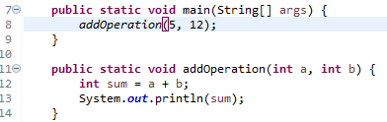

Method(Cont’d)
Multiple Parameters
Parameters can be separated by comma
Multiple Parameters

Slide 28
P11
Calculator
User inputs a formula including only one operator
The program calculates the formula by using the following 4 of functions
1) public static void addition(double num1, double num2)
2) public static void subtraction(double num1, double num2)
3) public static void multiplication(double num1, double num2)
4) public static void division(double num1, double num2)
3*7
21
6+9
15

Slide 29
P12
Multiplication Table
User inputs a number N
Print the N times table
(Use a separate method to print the N times table with a parameter)

Slide 30
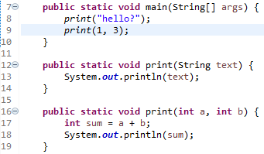

Method(Cont’d)
Overloading
A feature that allows a class to have many methods having the same name
The parameters are different from one another

Slide 31
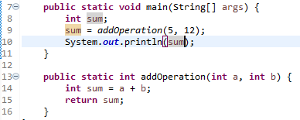
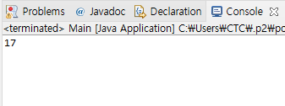
Method
Returning a Value
A method returns a value when reaching to a return statement, throwing an exception or completing all the statements in the method
Return Type
Return Value

Slide 32
P13
Calculator
User inputs a formula including only one operator
The program calculates the formula by using the following 5 of functions
1) public static double addition(double num1, double num2)
2) public static double subtraction(double num1, double num2)
3) public static double multiplication(double num1, double num2)
4) public static double division(double num1, double num2)
5) public static char getOperator(String formula)
3*7
21
6+9
15

Slide 33
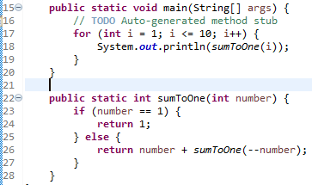
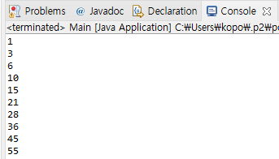
Recursive Function
Recursive Function
A function which calls itself

Slide 34
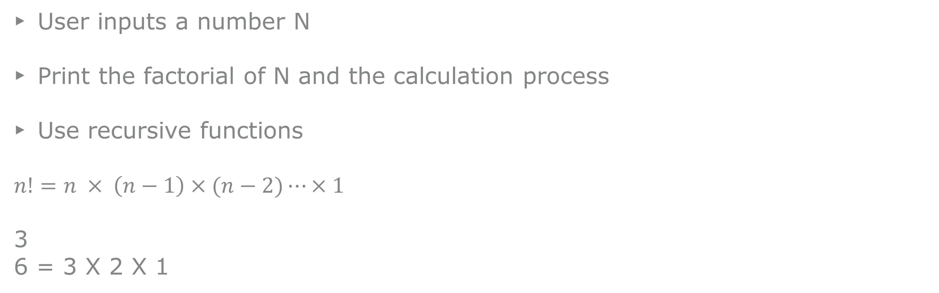
P14
Factorial
User inputs a number N
Print the factorial of N and the calculation process
Use recursive functions
$n!=n × \left(n−1\right)×(n−2)⋯×1$
3
6 = 3 X 2 X 1

Slide 35
A1
Program to Calculate the Probabilities
User inputs the numbers N and M
Print all the cases when the sum is M when throwing N of dice
2
6
(1, 5)
(2, 4)
(3, 3)
(4, 2)
(5, 1)

Slide 36
A2
Banking System
This program runs indefinitely until the user tries terminating it
#Menu
Deposit
Withdrawal
Balance : 0
-> 1
10000
#Menu
Deposit
Withdrawal
Balance : 10000
-> 2
2000
#Menu
Deposit
Withdrawal
Balance : 8000

Slide 37
A3
Program to Calculate the Sum of Multiples of N
User inputs the two numbers for the M and N respectively
Calculate the sum of multiples of N from 1 to M
20
5
SUM : 50(5, 10, 15, 20)

Slide 38
A4
Encryption and Decryption
Create your own encryption algorithm
e.g., a->b, b->c, c->d, d->e
#Menu
Encryption
Decryption
-> school
Result : tdippm
2. Encryption
3. Decryption
-> tdippm
Result : school

Slide 39
A5
Data Confirmation
Set up your conditions
The number of conditions should be at least 5
e.g.,
#1 : The string length should be over 10
#2 : The string should contains the character ‘k’
….
-> abdefewqqwer
FAIL
-> kdefkdie123
PASS

Slide 40
A6
Compose a program with the conditions below
Use your smartphone and compose the program on the web
Compose a program counting the number of consonants and vowels
This program should operate dynamically according to the user’s input string
This is an apple
Num. of Consonant : 8
Num. of Vowels : 5
I am fine
Num. of Consonant : 3
Num. of Vowels : 4

Slide 41
A7
Grade Calculator
User inputs a number(number of subjects)
User inputs the unit for each subject
User inputs the grade for each subject(A+, A0, B+, … ,F)
*Prints the average grade using Float data type
3
2
3
3
A+
B+
C0
3.1875

Slide 42
A8
Encoding and Decoding Program
Prints a menu
User chooses the menu
The encoder and decoder follow the rules below.
0123456789
abcdefghij
#Menu
Encoder
Decoder
Exit
1
01012345678
ababcdefghi
2
add
033

Slide 43
A9
Time Calculator
User inputs the two time information
Print the calculated time interval between them in seconds
163227
163558
211s

Slide 44
A10
Comparing the two strings
User inputs the two strings
Show the result if those two strings are the same after relocation
[Example]
abcdefg
fgdceba
Yes
Abbbccd
Bbbccda
No
Abc
cbA
Yes

Slide 45
A11
Comparing the velocities in different units
User inputs the three values
Each is m/s, km/h, m/ms in order
Comparing the values and print the quickest one
[Example]
190
780
0.19
780km/h

