Slide 1
Java 과제 제출
데이터융합sw과
노을
2023.03.10

Slide 2
목차
A9
A10
A11

Slide 3
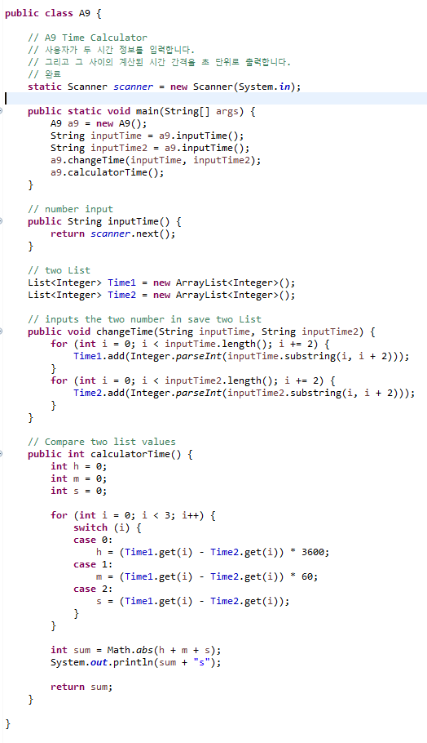
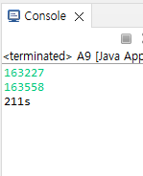
A9 Time Calculator
User inputs the two time information
Print the calculated time interval between them in seconds

Slide 4
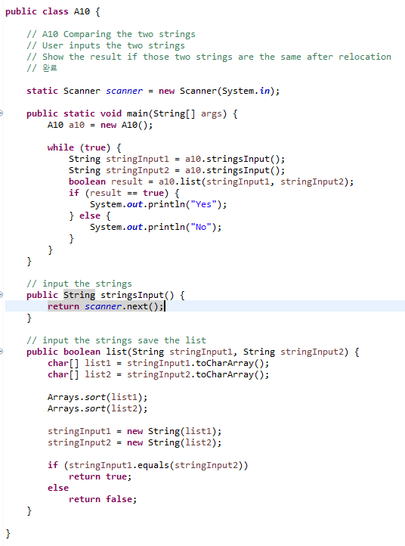
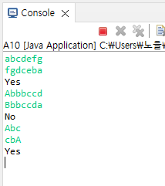
A10 Comparing the two strings
User inputs the two strings
Show the result if those two strings are the same after relocation

Slide 5
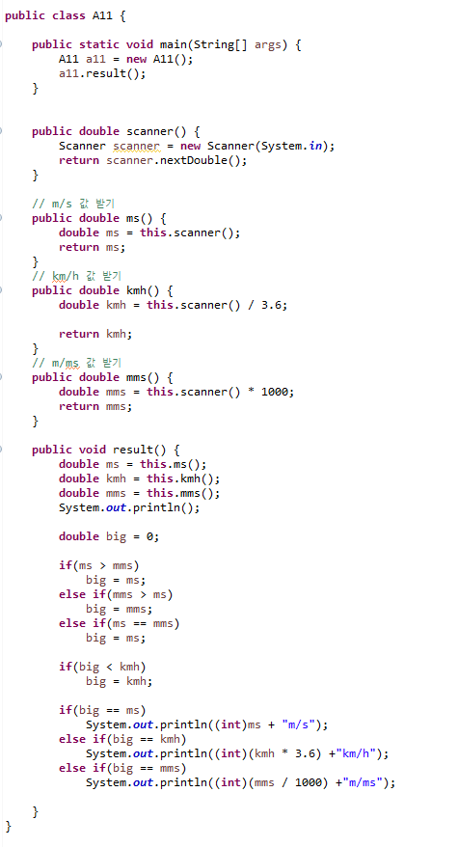
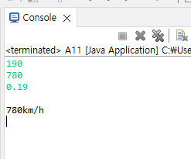
A11 Comparing the velocities in different units
User inputs the three values
Each is m/s, km/h, m/ms in order
Comparing the values and print the quickest one

