Slide 1
기본 프로그래밍 05
자바에 삼 주만 빠져보자!
데이터융합SW과
김규석 교수
JAVA

Slide 2
Objective
Array
Singledimensional Array
Multidimensional Array
Collection
List
Set
Queue
Stack

Slide 3
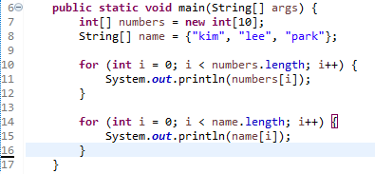
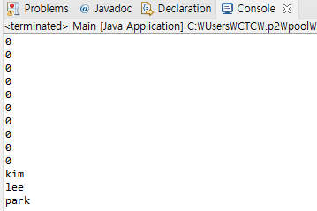
Array(Cont’d)
Singledimensional Array
Arrays are used to store multiple values in a single variable
int[] n = new int[3];
→ n[0], n[1], n[2]
[0]
[1]
[2]
P1 : Print “number[10]” and “name[3]”

Slide 4
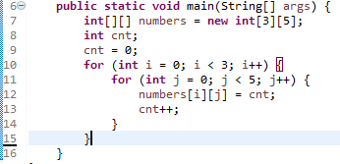
Array(Cont’d)
Multidimensional Array
Arrays are used to store multiple values in a single variable
int[][] n = new int[3][4];
→
[0][0]
[0][1]
[0][2]
[0][3]
[1][0]
[1][1]
[1][2]
[1][3]
[2][0]
[2][1]
[2][2]
[2][3]
P2 : Print the array “numbers[][]”

Slide 5

Array
Multidimensional Array II
Each Row could have different size of columns
P3 : Print the array “numbers[][]”

Slide 6
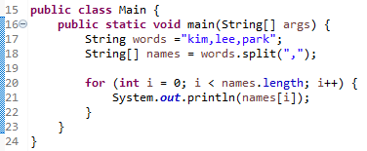
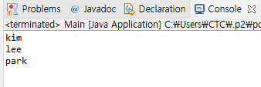
P4
split()
[Background]
split() is used to split the string against given regular expression
[Background]
The following is the example
User inputs a string
Split the input string against a black(“ “) and print the result

Slide 7
Collection(Cont’d)
Java Collections Framework
A set of classes and interfaces that implement commonly reusable collection data structures
Collection
Set
List
Queue

Slide 8
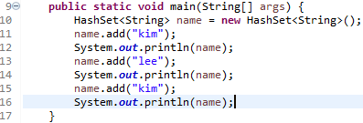
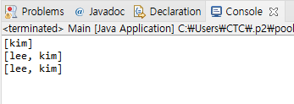
Set
Hashset
A collection of items and the items are unique

Slide 9
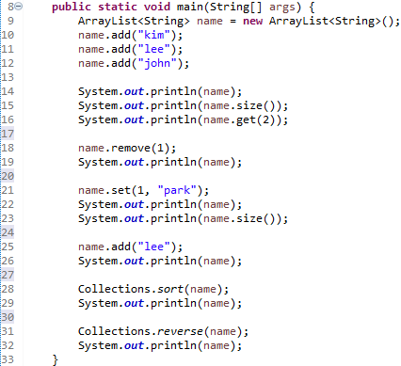
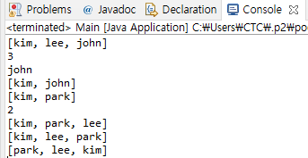
List(Cont’d)
ArrayList
A resizable array
P5 : What’s the difference between “Hashset” and “ArrayList”?

Slide 10
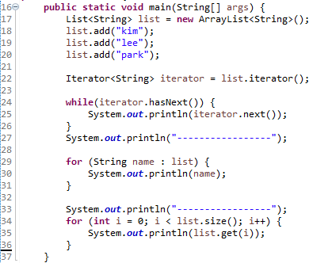
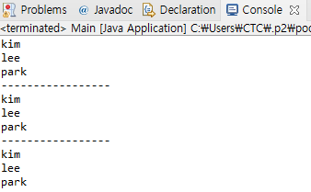
List
Iterator
An object that can be used to loop through collections

Slide 11
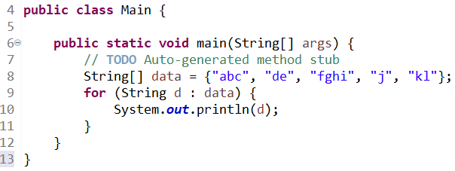
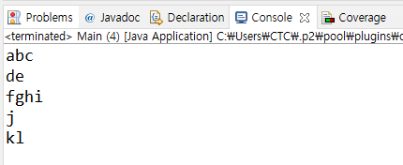
List
for-each loop
An array traversing Technique like for and while loops

Slide 12
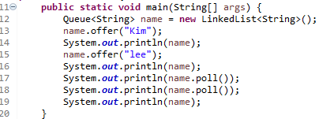
Queue
Queue
A data structure designed to have elements inserted at the end of the queue, and elements removed from the beginning of the queue
“Kim”
“Kim”
“lee”
“lee”
P6 : Explain FIFO and FILO
Source : http://tutorials.jenkov.com/java-collections/queue.html#:~:text=The%20Java%20Queue%20interface%2C%20java,of%20the%20Java%20Collection%20interface.

Slide 13
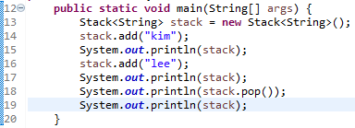
Collection+
Stack
A linear data structure that is used to store the collection of objects.
Based on LIFO(Last-In-First-Out)
“lee”
“kim”
“kim”
“kim”
P7 : What’s the difference between “Queue” and “Stack”?
Source : https://www.javatpoint.com/java-stack#:~:text=The%20stack%20is%20a%20linear,store%20the%20collection%20of%20objects.&text=The%20stack%20data%
20structure%20has,the%20top%20of%20the%20stack.

Slide 14
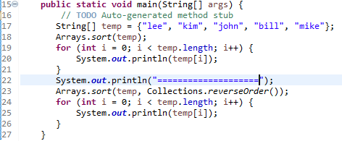
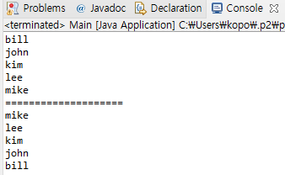
Sort
Sort

Slide 15
P8
Sort
Initialize an array with the elements below
{2, 33, 7, 5, 12, 34, 99, 25, 28, 53, 20}
Sort the array in ascending order and print
Sort the array in descending order and print

Slide 16
P9
Grade Card
User inputs more than 10 sets of a name and a score
Print the list by name in ascending order
Print the list by name in descending order
Print the list by score in ascending order
Print the list by score in descending order
Add exception statements

Slide 17
A1
Descriptive Statistics
Create a two dimensional string array
Calculate the summation, average, minimum, maximum of scores for each subject and person
Hint, Integer.parseInt();
Name | Korean | English | Math
Jeong | 70 | 80 | 100
Pyo | 60 | 70 | 86
Choi | 54 | 100 | 82
Mike | 87 | 95 | 79

Slide 18
A2
Counting a Specified Character
User inputs a string and assign it into an array
User inputs a word and assign it into an array
Count how many are the input words included in the string
I go to school. Where are you going?
o
6
I go to school. Where are you going?
go
3

Slide 19
A3
Encryption
User inputs a string
Print the encrypted string
To encrypt the string, use an array to match characters one to one
(ex, original = {1, 2, 3}, encrypted = {a, b, c})
Write a scenario and compose it
abcd
zyxw

Slide 20
A4
Decryption
Regarding as the previous practice, user inputs a string
Print the decrypted string
zyxw
abcd

Slide 21
A5
Split a String and Sort
User inputs a string
Print the words after splitting it against by a black(“ “)
Sort them by in descending order and print them again

Slide 22
A6
Fibonacci Numbers
The formula for this is as below
F₀ = 0, F₁ = 1
F_{n} = F_{n-1} + F_{n-2}
0, 1, 1, 2, 3, 5, 8, 13, 21, 34, 55 …
Use a list
User inputs a number
Print the number of elements from the Fibonacci Numbers

