Slide 1
기본 프로그래밍 06
자바에 삼 주만 빠져보자!
데이터융합SW과
김규석 교수
JAVA

Slide 2
Objective
Thread
Two ways to create and run a thread
Exception
try … catch
File Handling
Write
Read
Update
Delete

Slide 3
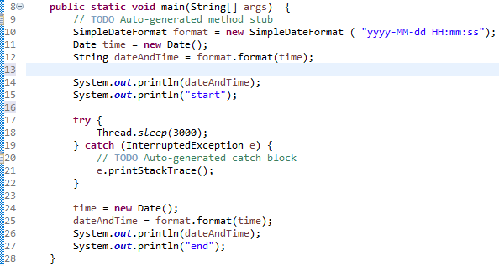
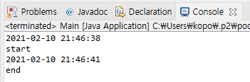
Thread(Cont’d)
Thread.sleep()
Pause the execution of current thread for specific time in milliseconds
P1 : Print a number from 1 to 100 every second

Slide 4
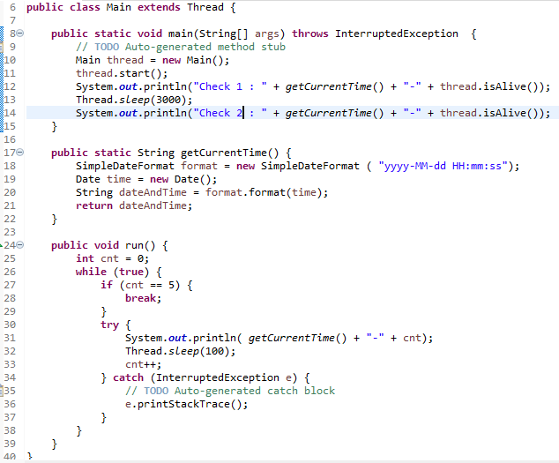
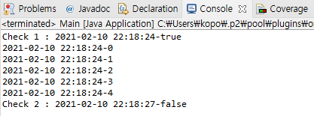
Thread(Cont’d)
Thread
Allows the program to operate multiple things at the same time
Create a thread
Run a thread
P2 : A thread is naturally destroyed

Slide 5
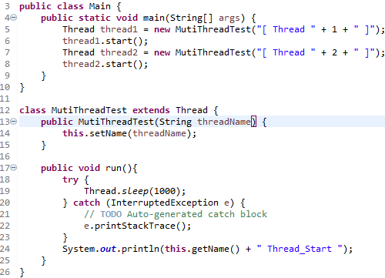

Thread(Cont’d)
setPriority()
This method is used to change the thread’s priority

Slide 6
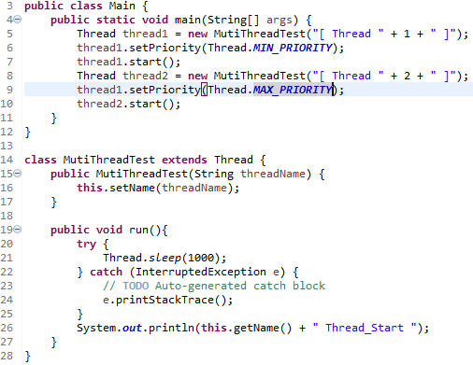

Thread(Cont’d)
setPriority()
This method is used to change the thread’s priority
P3 : Change the parameter of “setPriority()”

Slide 7
Thread(Cont’d)
Syncronization
A synchronized blocks can only have one thread executing at the same time
“synchronized” < Keyword
P4 : Find out and execute an example of “synchronized”

Slide 8
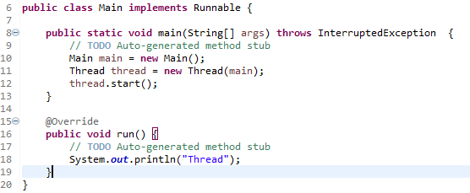
Thread
Thread II
The following code is the other way to use a thread
Create a thread
Run a thread
P5 : Implement the same program as P1

Slide 9
P6
Timer
Print the current time on the screen
User inputs a time in second
The program prints out “time is over” after the input time
12:34:45
30
time is over(12:35:15)

Slide 10
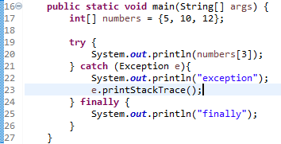
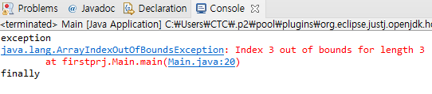
Exception(Cont’d)
try ... catch
try : a block of code to be executed
catch : a block of code when an error occurs
finally : a block of code that is executed, regardless of the result
P7 : According to the error logs, change the error type
Error Type
Return Value

Slide 11
Exception(Cont’d)
Type of Exceptions
▶ ArithmeticException : when an exceptional condition has occurred in an arithmetic operation.
▶ ArrayIndexOutOfBoundsException : when n array has been accessed with an illegal index. The index is either negative or greater than or equal to the size of the array.
▶ ClassNotFoundException : when trying to access a class whose definition is not found
▶ FileNotFoundException : when a file is not accessible or does not open.
▶ IOException : when an input-output operation failed or interrupted
▶ InterruptedException : when a thread is waiting, sleeping, or doing some processing, and it is interrupted.
Source : https://www.geeksforgeeks.org/types-of-exception-in-java-with-examples/

Slide 12
Exception
Type of Exceptions
▶ NoSuchFieldException : when a class does not contain the field specified
▶ NoSuchMethodException : when accessing a method which is not found.
▶ NullPointerException : when referring to the members of a null object. Null
represents nothing
▶ NumberFormatException : when a method could not convert a string into a numeric format.
▶ RuntimeException : any exception which occurs during runtime.
▶ StringIndexOutOfBoundsException : thrown by String class methods to indicate that an index is either negative or greater than the size of the string
Source : https://www.geeksforgeeks.org/types-of-exception-in-java-with-examples/

Slide 13
P8
Exception Handling
User inputs a number and the number defines the size of an array
User inputs numbers more than the defined size
In this case, this program prints “error” and starts again from the beginning,
Otherwise, assign the numbers into the array, sort and print them
5
1 3 4 5 7 8
error
4
1 22 6 12
1 6 12 22

Slide 14
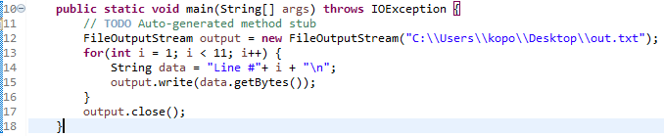
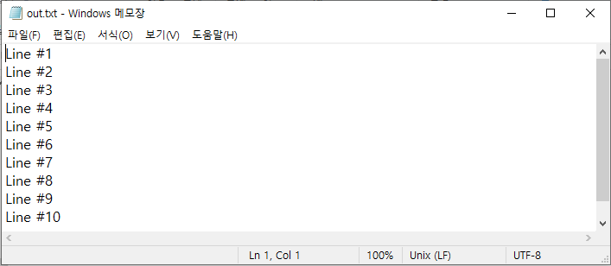
File Handling(Cont’d)
FileOutputStream
Write a file

Slide 15
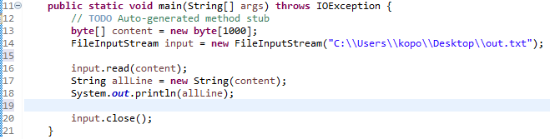
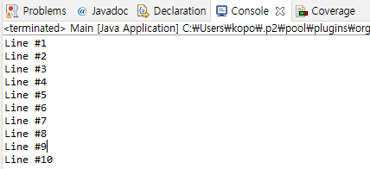
File Handling(Cont’d)
FileInputStream
Read a file I

Slide 16
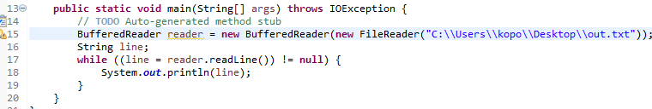
File Handling(Cont’d)
BufferedReader
Read a file II

Slide 17
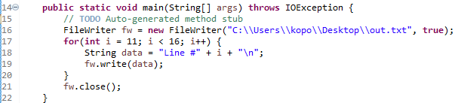
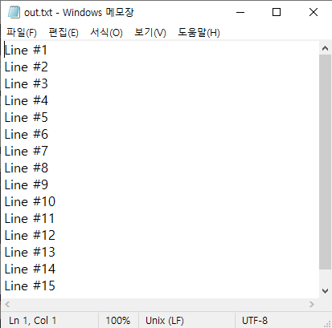
File Handling(Cont’d)
FileWriter
Append lines to the file
The second parameter refers to “Append”

Slide 18
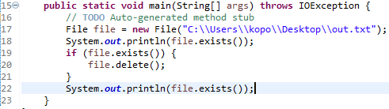

File Handling(Cont’d)
File
Check if the file exists, Delete the file
Check if the file exists
Delete the file

Slide 19
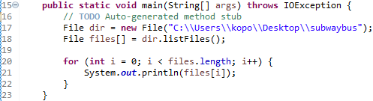
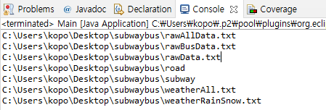
File Handling
listFiles
Print the file list in a directory

Slide 20
P9
Database for Rock-Paper-Scissors Game
Write a text file including the game results of P6
The game result should be appended to the end of the file in real-time

Slide 21
A1
Numbering
User inputs a series of numbers and assign them to a queue
User input a number from the series of numbers
Print the number in order of output
Add exception statements
1 21 13 34 15 16
13
3

Slide 22
A2
Numbering II
User inputs a series of numbers and assign them to a stack
User input a number from the series of numbers
Print the number in order of output
Add exception statements
1 21 13 34 15 16
13
4

Slide 23
A3
Grade Card
User inputs more than 10 sets of names and scores
Print the list by name in ascending order
Print the list by name in descending order
Print the list by score in ascending order
Print the list by score in descending order
Add exception statements

Slide 24
A4
Finding a Character
User inputs a string and a character
Find the character from the string and show the order of the first found(case sensitive)
Add exception statements
[Example]
South Korea has a earned a reputation as a leading global ICT center
s
15
South Korea has a earned a reputation as a leading global ICT center
S
1

Slide 25
A5
Printing Numbers Matching the Condition
Initialize an integer array
Print the numbers with N in each digit
Add exception statements
[Code]
int[] numbers = {123, 32, 356, 53, 2, 67, 31, 78, 41, 9, 29};
[Example]
5
356 53
2
123 32 2 29

Slide 26
A6
Compose a program with the conditions below
User inputs the numbers N and M
Print all the cases made by the combination of 1 to N and 1 to M
Add exception statements
->
2
3
1,1
1,2
1,3
2,1
2,2
2,3

Slide 27
A7
Fibonacci Numbers
The formula for this is as below
F₀ = 0, F₁ = 1
F_{n} = F_{n-1} + F_{n-2}
0, 1, 1, 2, 3, 5, 8, 13, 21, 34, 55 …
Use a list
User inputs a number
Print the number of elements from the Fibonacci Numbers
Add exception statements
7
0 1 1 2 3 5 8

Slide 28
A8
Comparing Strings
User inputs the two words and assign them to lists
Print the following information
1. Size of the first word
2. Size of the second word
3. Number of the same characters
*Add exception statements
school
scholar
1 : 6
2 : 7
3 : 5

Slide 29
A9
Descriptive Statistics Calculation
User inputs a number, and assign it to a list
Prints the number of numbers, mean, maximum, minimum
This is performed indefinitely
Add exception statements
5
Result : 1 - Mean 5, Max 5, Min 5
3
Result : 2 – Mean 4, Max 5, Min 3
1
Result : 3 – Mean 3, Max 5, Min 1

