Slide 1
Java 과제 제출
데이터융합sw과
노을
2023.03.06

Slide 2
목차
P3 Calculating Change
P6 Calculator
P7 Multiplication Table
P8 Multiplication Table

Slide 3
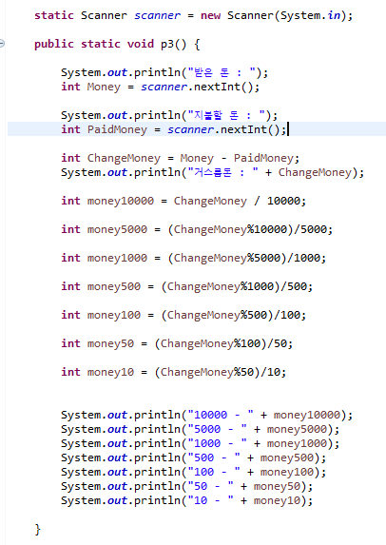
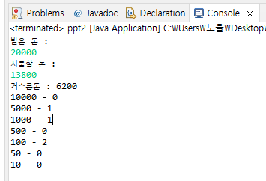
P3 Calculating Change
User inputs the two numbers which are the paid money and the change
Print the calculation of how many coins and bills are needed for the change

Slide 4
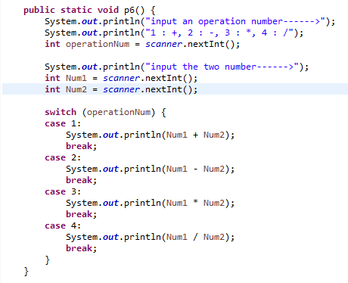
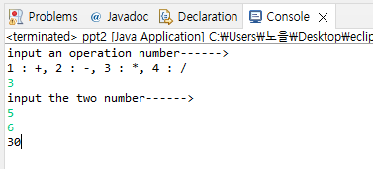
P6 Calculator
User inputs an operation number
(1 : +, 2 : -, 3 : *, 4 : /)
User inputs the two numbers
Print the calculated result

Slide 5
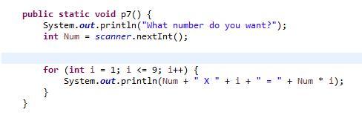
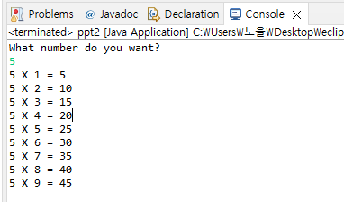
P7 Multiplication Table
User inputs a number
N from 2 to 9
Print the N times table

Slide 6
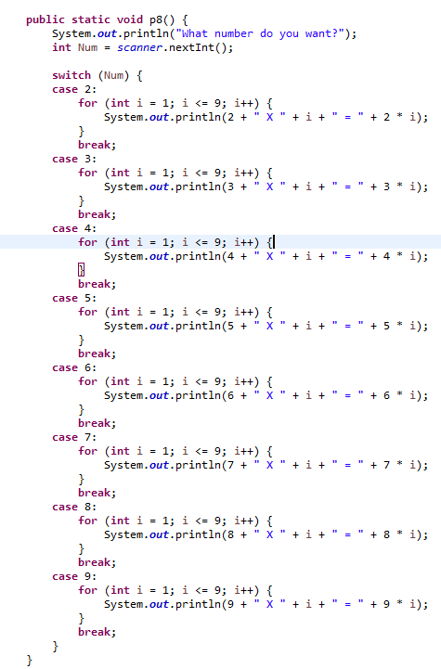
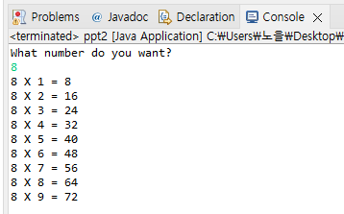
P8 Multiplication Table
User inputs a number
N from 2 to 9
Print the N times table
In order to compose a condition statement, use the “switch” statement

