Slide 1
Java 과제 제출
데이터융합sw과
노을
2023.03.09

Slide 2
목차
A1
A2
A3
A4
A5
A6
A7
A8

Slide 3
A1 Program to Calculate the Probabilities
User inputs the numbers
N and M
Print all the cases when the sum is M when throwing N of dice

Slide 4
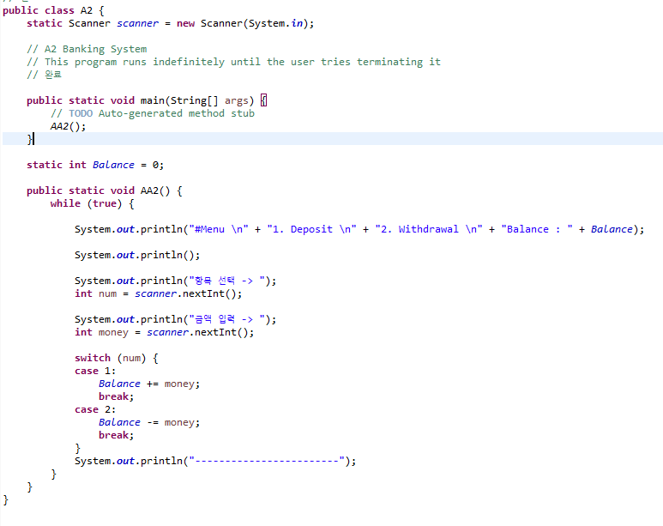
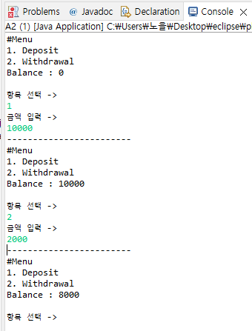
A2 Banking System
This program runs indefinitely until the user tries terminating it

Slide 5
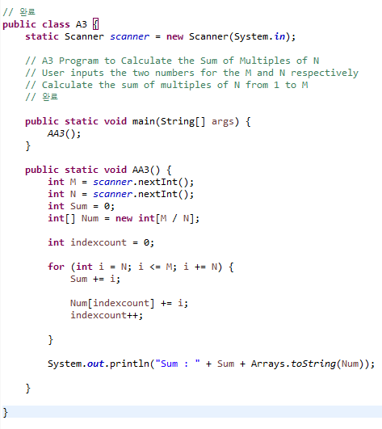
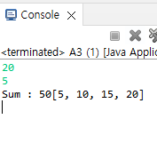
A3 Program to Calculate the Sum of Multiples of N
User inputs the two numbers for the M and N respectively
Calculate the sum of multiples of N from 1 to M

Slide 6
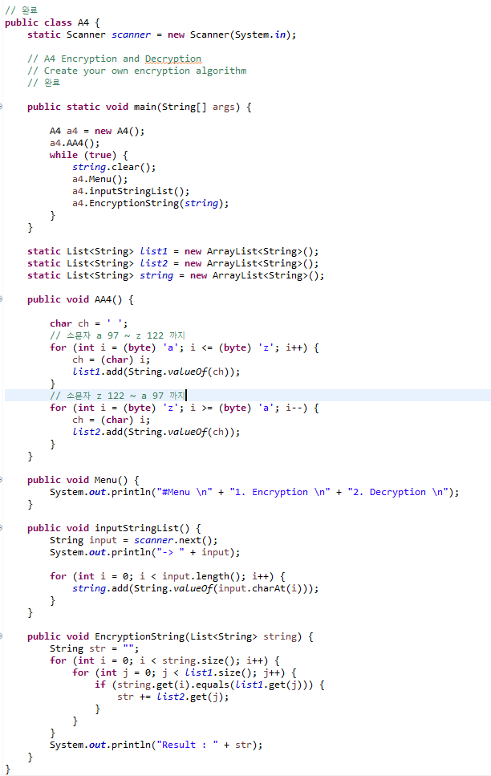
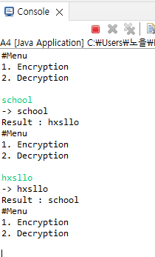
A4 Encryption and Decryption
Create your own encryption algorithm

Slide 7
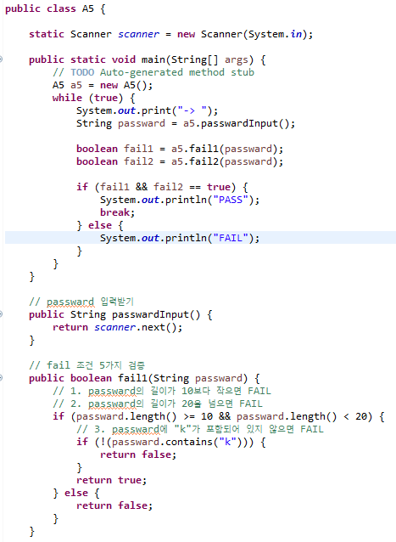
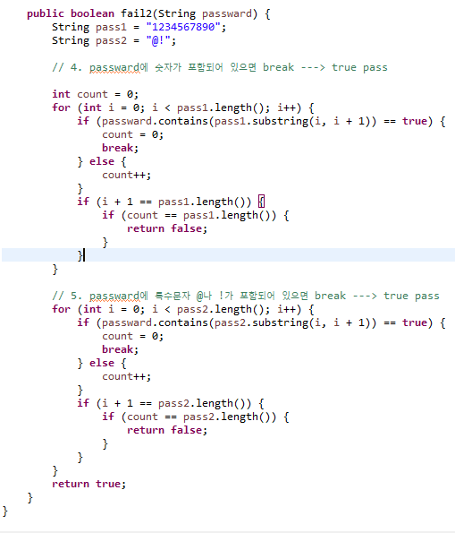
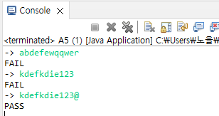
A5 Data Confirmation
Set up your conditions
The number of conditions should be at least 5

Slide 8
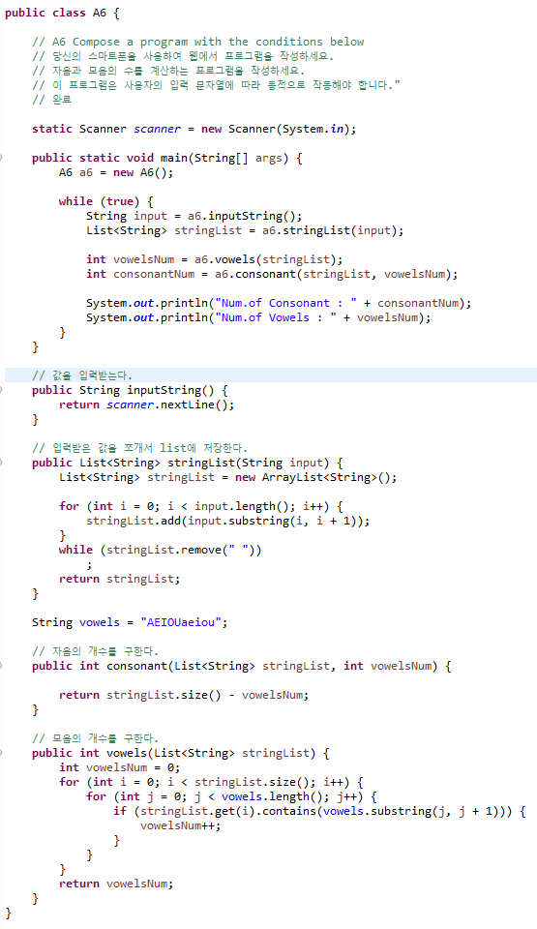
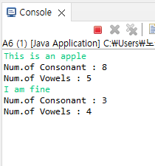
A6 Compose a program with the conditions below
Use your smartphone and compose the program on the web
Compose a program counting the number of consonants and vowels
This program should operate dynamically according to the user’s input string

Slide 9
A7 Grade Calculator
User inputs a number(number of subjects)
User inputs the unit for each subject
User inputs the grade for each subject(A+, A0, B+, … ,F)

Slide 10
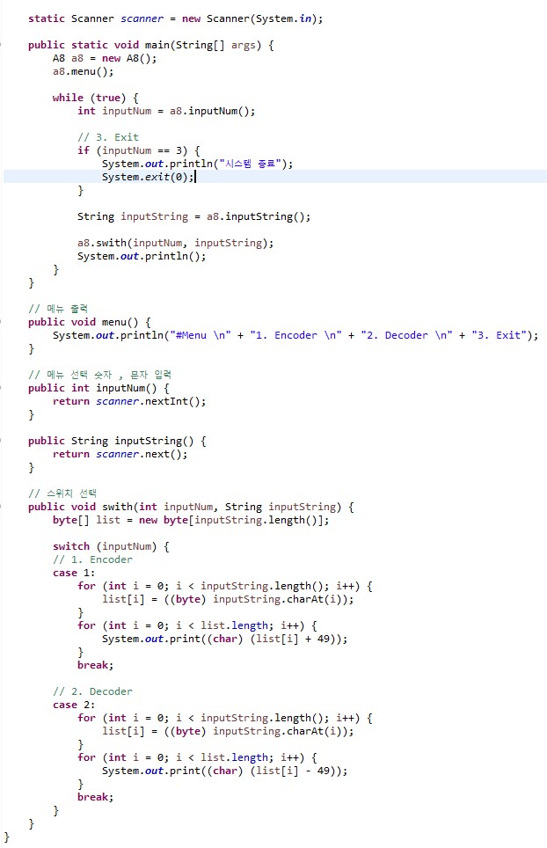
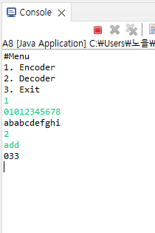
A8 Encoding and Decoding Program
Prints a menu
User chooses the menu
The encoder and decoder follow the rules below.

