Slide 1
기본 프로그래밍 02
자바에 삼 주만 빠져보자!
데이터융합SW과
김규석 교수
JAVA

Slide 2
Objective
Data Type and Variable
Declaration and Types of Variable
Variable Type Casting
Operator
Use Operators to Manipulate Variables
Condition
if … else
switch
Loop
for
while

Slide 3
Data Type and Variable(Cont’d)
Java Data Types
Variables are containers for storing data values
“main” is the name of the entry function.
Data Type | Size | Description
byte | 1 byte | Numbers from -128 to 127
short | 2 bytes | Numbers from -32,768 to 32,767
int | 4 bytes | Numbers from -2,147,483,648 to 2,147,483,647
long | 8 bytes | Numbers from -9,223,372,036,854,775,808 to 9,223,372,036,854,775,807
float | 4 bytes | Fractional numbers, 6 to 7 decimal digits
double | 8 bytes | Factional numbers, 15 decimal digits
boolean | 1 bit | true or false values
char | 2 bytes | A single character/letter or ASCII values
String | N | Multiple character set
Source : https://www.w3schools.com/java/java_data_types.asp

Slide 4
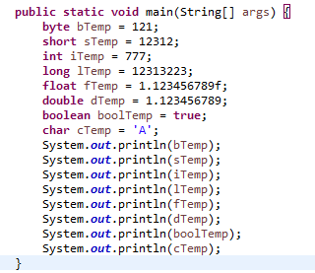
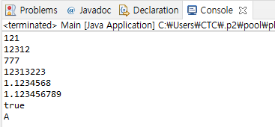
Data Type and Variable(Cont’d)
Variable
Variables can be initialized with a default value
The variables can be automatically casted to String type and printed.

Slide 5
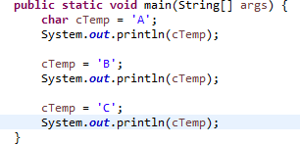
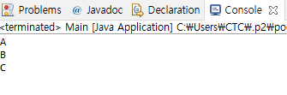
Data Type and Variable
Variable
Variables can be changed
P1 : Practice this process with all the other data types

Slide 6
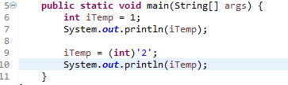
Data Type and Variable
Object Type Casting
Converting the value of one data type to another data type
P2 : Practice this process with all the other data types

Slide 7
Operator(Cont’d)
Java Operators
Operators are used to perform operations with variables and values
The kinds of Java operators are as below:
1) Arithmetic operators
2) Assignment operators
3) Comparison operators
4) Logical operators
5) Bitwise operators

Slide 8
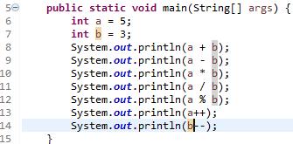
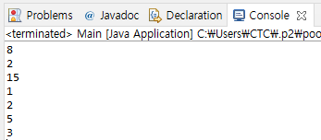
Operator(Cont’d)
Arithmetic Operators
Operator | Name | Description
+ | Addition | Adds the two values
- | Subtraction | Subtracts one from another
* | Multiplication | Multiplies the two values
/ | Division | Divides one by another
% | Modules | Returns the division remainder
++ | Increment | Increases the values of a variable by 1
-- | Decrement | Decreases the values of a variable by 1
Source : https://www.w3schools.com/java/java_operators.asp

Slide 9
P3
Calculating Change
User inputs the two numbers which are the paid money and the change
Print the calculation of how many coins and bills are needed for the change
20000
13800
6200
10000 - 0
5000 – 1
1000 – 1
500 – 0
100 – 2
50 – 0
10 – 0

Slide 10
P4
Base 10 to Base 3 Converter
User inputs a number of base 10
Print the number of base 3 which is the same as the input number
10
101

Slide 11
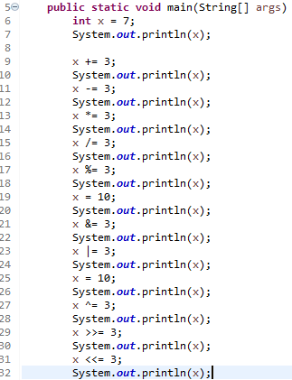
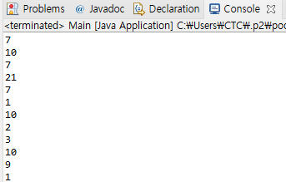
Operator(Cont’d)
Assignment Operators
Operator | Example | Same As
= | x = 5 | x = 5
+= | x += 3 | x = x + 3
-= | x -= 3 | x = x – 3
*= | x *= 3 | x = x * 3
/= | x /= 3 | x = x / 3
%= | x %= 3 | x = x % 3
&= | x &= 3 | x = x & 3
!= | x |= 3 | x = x | 3
^= | x ^= 3 | x = x ^ 3
>>= | x >>= 3 | x = x >> 3
<<= | x <<= 3 | x = x << 3
Source : https://www.w3schools.com/java/java_operators.asp

Slide 12
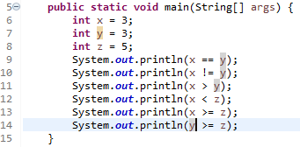
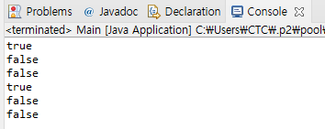
Operator(Cont’d)
Comparison Operators
Operator | Name
== | Equal to
!= | Not Equal to
> | Greater than
< | Less than
>= | Greater than or equal to
<= | Less than or equal to
Source : https://www.w3schools.com/java/java_operators.asp

Slide 13
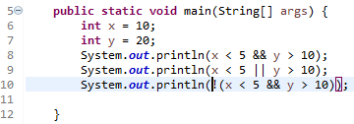
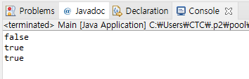
Operator
Logical Operators
Operator | Name | Description
&& | Logical and | Returns true if both statements are true
|| | Logical or | Returns true if one of the statements is true
! | Logical not | Reverse the result, returns false if the result is true
Source : https://www.w3schools.com/java/java_operators.asp

Slide 14
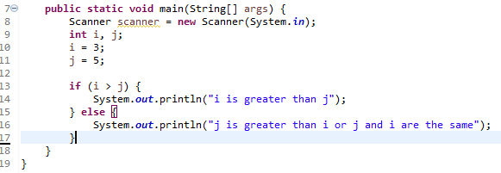
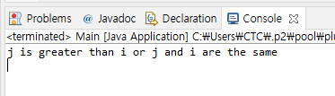
Condition(Cont’d)
if … else
A “if statement” is used to specify a block of code

Slide 15


P5
Compose a program that distinguishes the input number
User inputs a number
Print “One!” if the input number is 1,
Otherwise, print “Not One!”

Slide 16
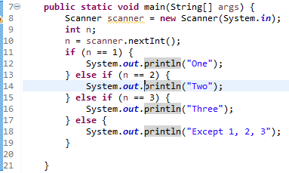

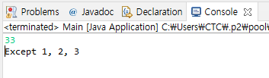
Condition(Cont’d)
if … else if … else
You can use “if statements” to specify a block of code

Slide 17
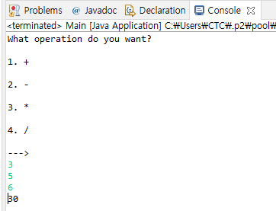
P6
Calculator
User inputs an operation number(1 : +, 2 : -, 3 : *, 4 : /)
User inputs the two numbers
Print the calculated result

Slide 18
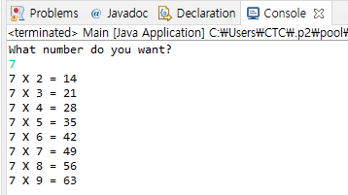
P7
Multiplication Table
User inputs a number N from 2 to 9
Print the N times table

Slide 19
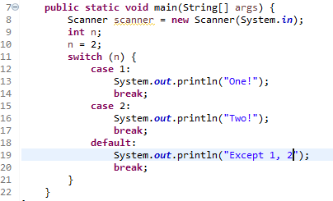

Condition
switch
A “switch” statement is used to select one of the code blocks to be executed
The “default” keyword is option and executed when there’s no matched case

Slide 20
P8
Multiplication Table
User inputs a number N from 2 to 9
Print the N times table
In order to compose a condition statement, use the “switch” statement

Slide 21
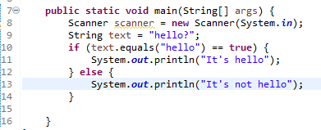

Condition+
String equals()
Compare the two strings to find out if they are equal
Q1* : Why aren’t they equal to each other?

Slide 22
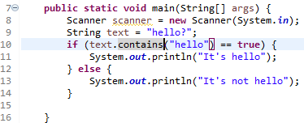

Condition+
String contains()
Check if a string contains the specific set of characters

Slide 23
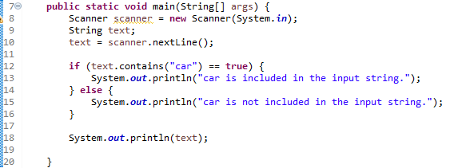
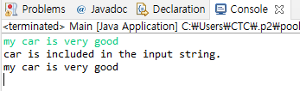
P9
Word Containing Program
User inputs a sentence
Print if the word, “car” is included or not

Slide 24

P10
Word Containing Program II
User inputs a sentence
Print if the word, “car” is included or not, regardless of upper case or lower case

Slide 25

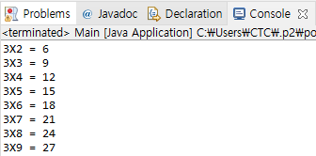
Loop(Cont’d)
for
A “for” loop is used to execute a set of code repeatedly

Slide 26
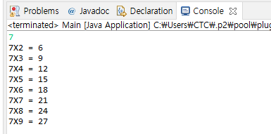
P11
Multiplication Table II
User inputs a number N from 2 to 9
Print the N times table
Use an “if” or “switch” statement
Use a “for” loop

Slide 27
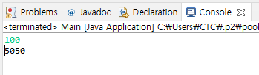
P12
Arithmetic Progression
User inputs a number N
The program adds 1 to N
Print the summation

Slide 28
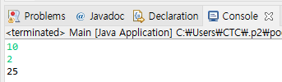
P13
Arithmetic Progression II
User inputs the two number N and M
The program adds 1 to N by M(ex : 10, 2, 1 + 3 + 5 + 7 + 9 = 25)
Print the summation

Slide 29
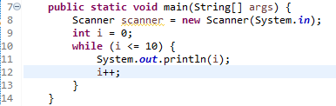
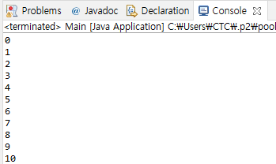
Loop(Cont’d)
while
An “while” loop is used to execute a set of code repeatedly while satisfying the conditions
P15 : Check the result with “while(true)” statement

Slide 30
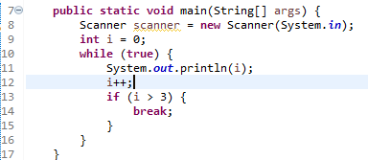
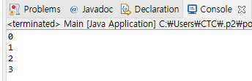
Loop(Cont’d)
while
An “while” loop is used to execute a set of code repeatedly while satisfying the conditions

Slide 31
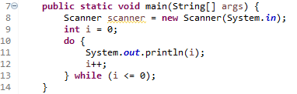

Loop
do … while
A “do while” loop is used to execute a part of code before “while” loop

Slide 32
A1, A2
Multiplication Table III
Use an “if” statement
Use a double “for” loop
Print 2 to 9 times table
Multiplication Table IV
Use an “switch” statement
Use a double “while” loop
Print 2 to 9 times table

Slide 33
A3
Draw a Right Triangle
User inputs a number, N
Print an N height of the right triangle with “*”
Use a “for” loop
5
*
**
***
****
*****

Slide 34
A4
Draw an Equilateral Triangle
User inputs a number, N
Print an N height of the equilateral triangle with “*”
Use a “for” loop
5
*
***
*****
*******
*********

Slide 35
A5
Draw an Inverted Equilateral Triangle
User inputs a number, N
Print an N height of the inverted equilateral triangle with “*”
Use a “for” or “while” loop
5
*********
*******
*****
***
*

Slide 36
A6
Find the Factors of N
User inputs a number, N
Print the factors of N
10
1
2
5

Slide 37
A7
Find the LCM(Least Common Multiple)
User inputs the two numbers, N and M
Print the LCM
5
7
35

Slide 38
A8
Find the GCD(Greatest Common Divisor)
User inputs the two numbers, N and M
Print the GCD
24
18
6

Slide 39
A9
Find the Prime Numbers
User inputs a numbers, N
Print the prime number to N
11
2
3
5
7
11

Slide 40
A10
Compose a program with the conditions below
Compose a vending machine assuming the input money is 1,000won
[Example]
#Menu
Coke - 340
Orange Juice – 500
Milk – 650
Water – 290
Coffee – 170
-> 3
“The change is 350(100 X 3, 50 X 1, 10 X 0)”

