Slide 1
기본 프로그래밍 Robocode
데이터융합SW과
김규석 교수
JAVA

Slide 2
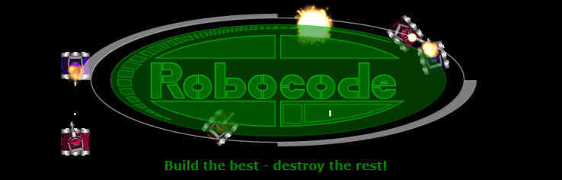
What is Robocode?
Robocode
Robocode is a programming game, where the goal is to develop a robot battle tank to battle against other tanks in Java or .NET.
Source : https://robocode.sourceforge.io/

Slide 3
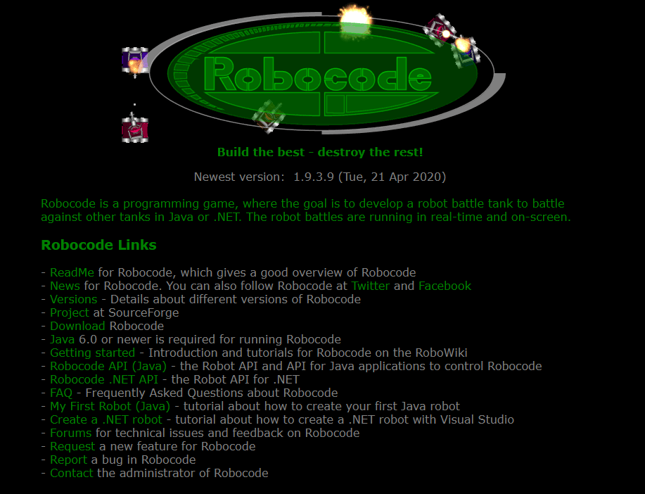
Robocode
Download and Install the program
Visit at https://robocode.sourceforge.io/
Download the program
Source : https://robocode.sourceforge.io/

Slide 4
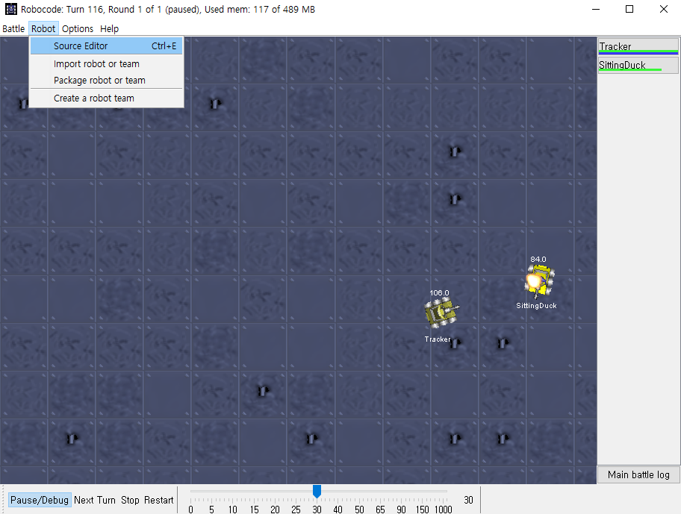
Robocode(Cont’d)
How to create my own robot
Source : https://robocode.sourceforge.io/

Slide 5
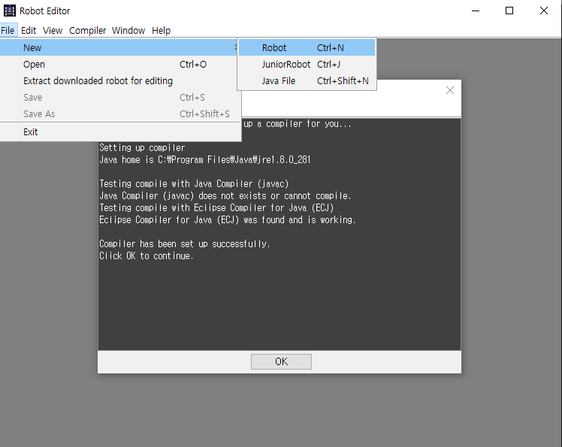
Robocode(Cont’d)
How to create my own robot
Source : https://robocode.sourceforge.io/

Slide 6
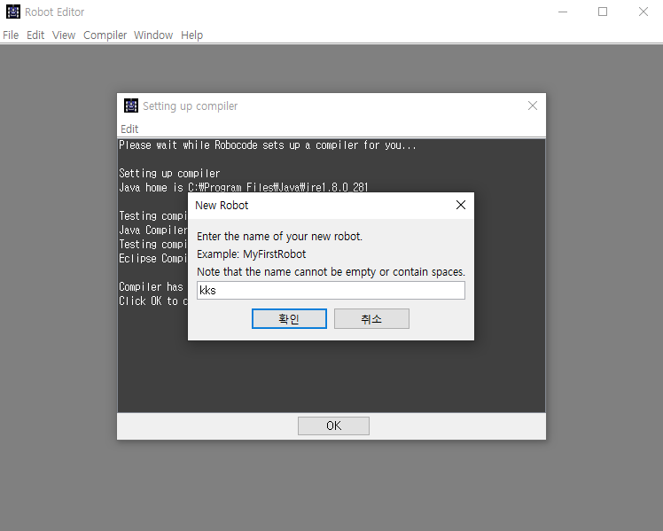
Robocode(Cont’d)
How to create my own robot
Source : https://robocode.sourceforge.io/

Slide 7
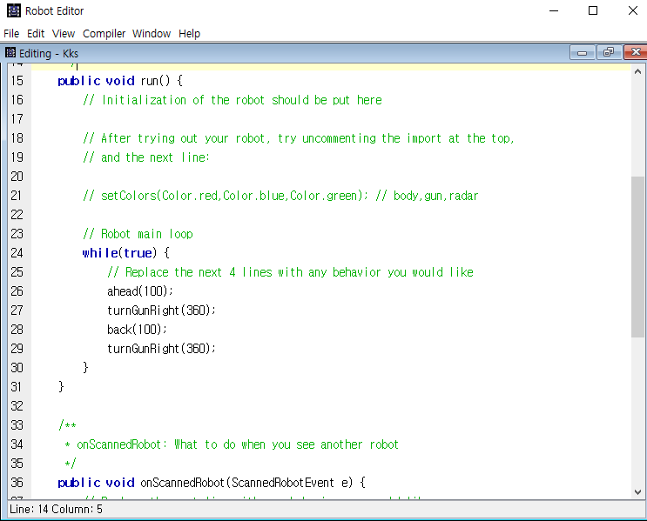
Robocode
How to create my own robot
Source : https://robocode.sourceforge.io/

Slide 8
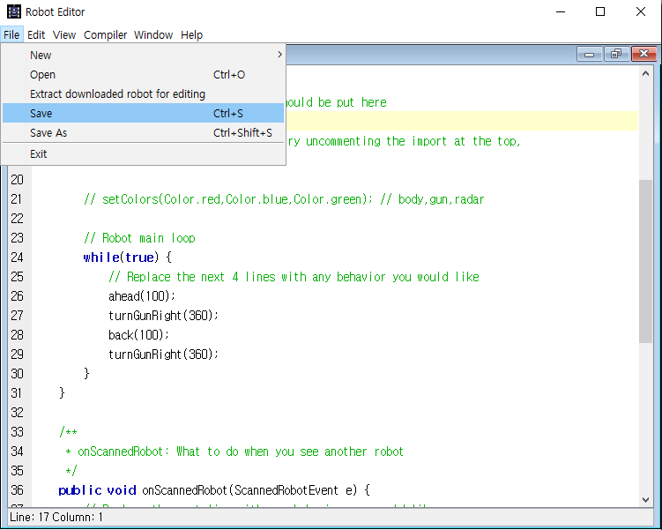
Robocode(Cont’d)
How to create my own robot
Source : https://robocode.sourceforge.io/

Slide 9
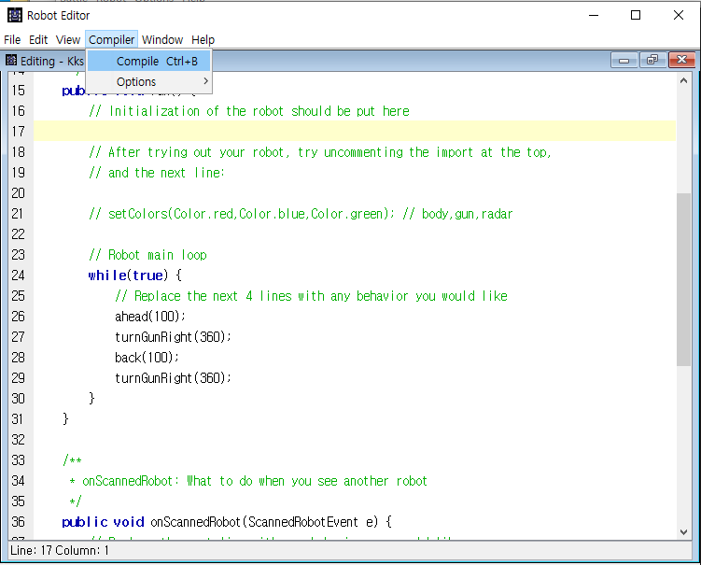
Robocode(Cont’d)
How to create my own robot
Source : https://robocode.sourceforge.io/

Slide 10
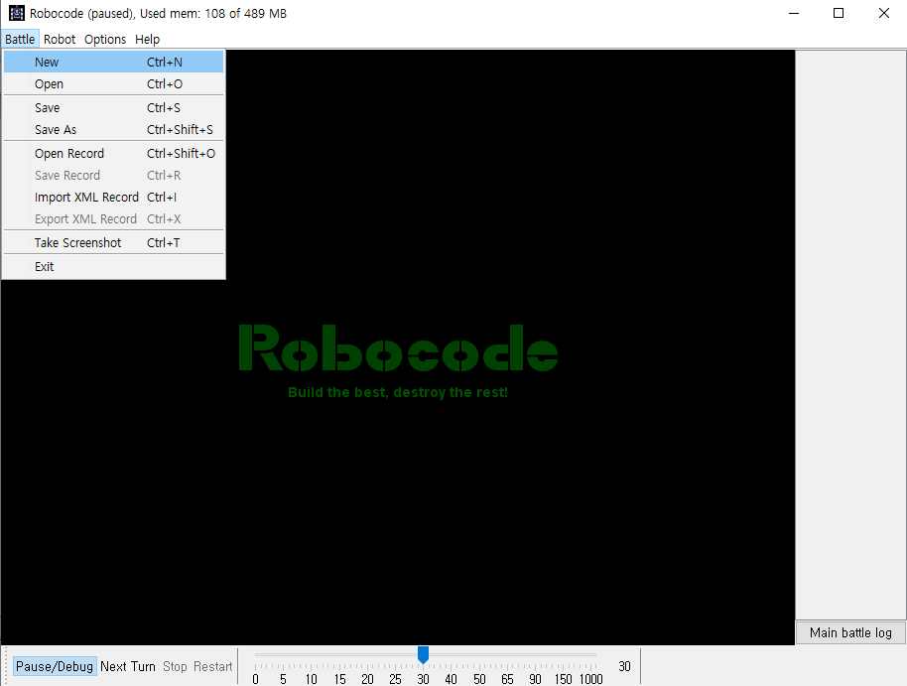
Robocode(Cont’d)
How to battle with my robot
Source : https://robocode.sourceforge.io/

Slide 11
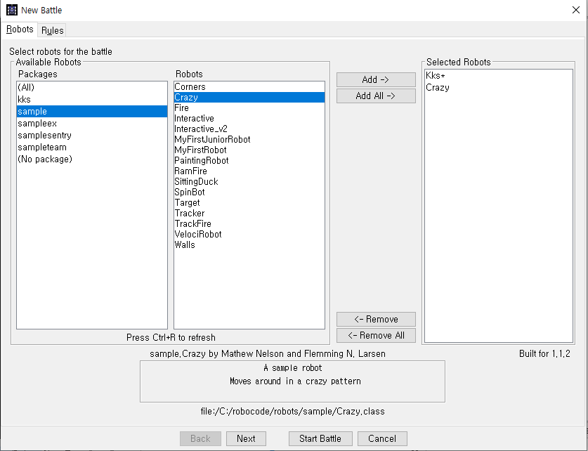
Robocode(Cont’d)
How to battle with my robot
Source : https://robocode.sourceforge.io/

Slide 12
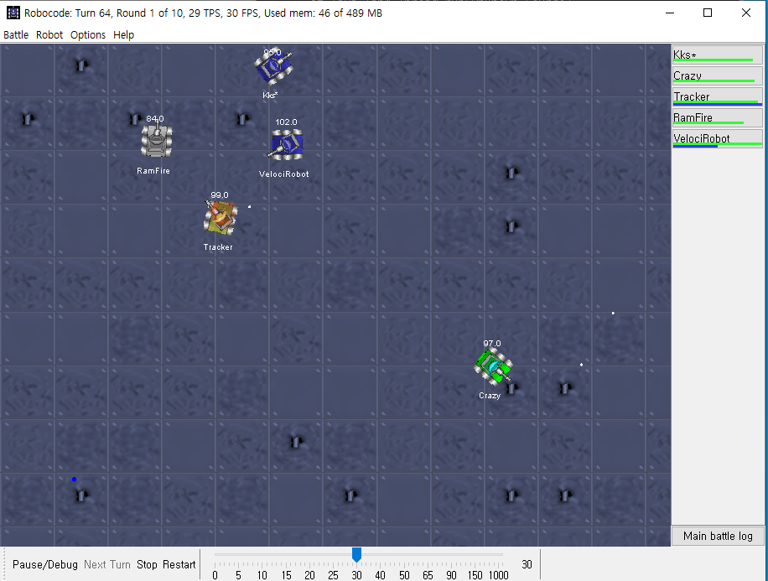
Robocode
How to battle with my robot
Source : https://robocode.sourceforge.io/

