Slide 1
Java 과제 제출
데이터융합sw과
노을
2023.03.13

Slide 2
목차
A1
A2
A3
A4
A5
A6

Slide 3
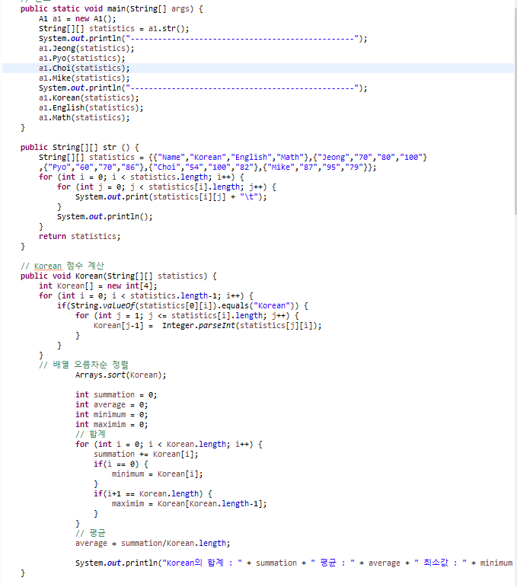
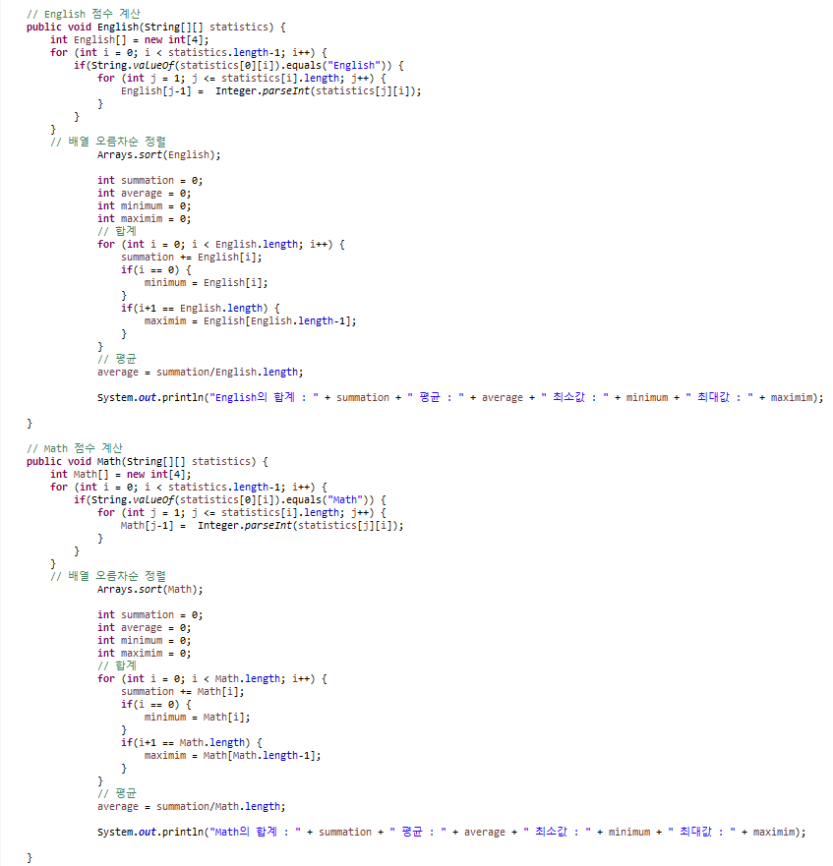
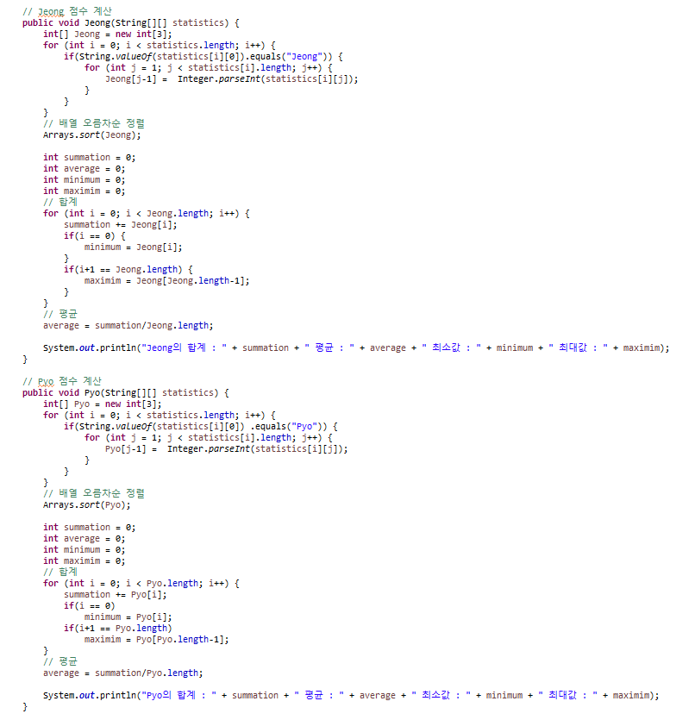
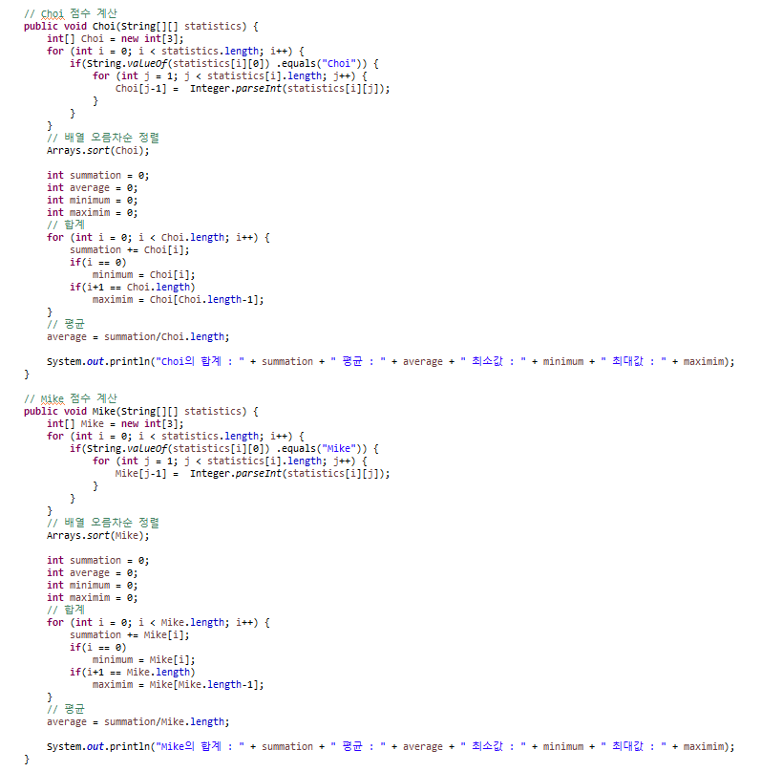
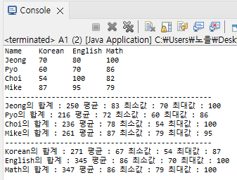
A1 Descriptive Statistics

Slide 4
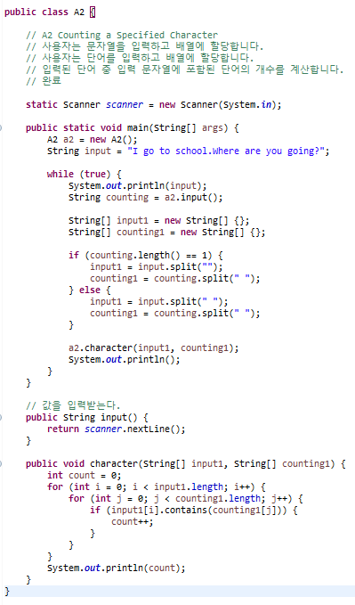
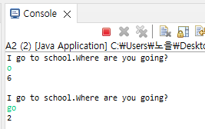
A2 Counting a Specified Character
User inputs a string and assign it into an array
User inputs a word and assign it into an array
Count how many are the input words included in the string

Slide 5
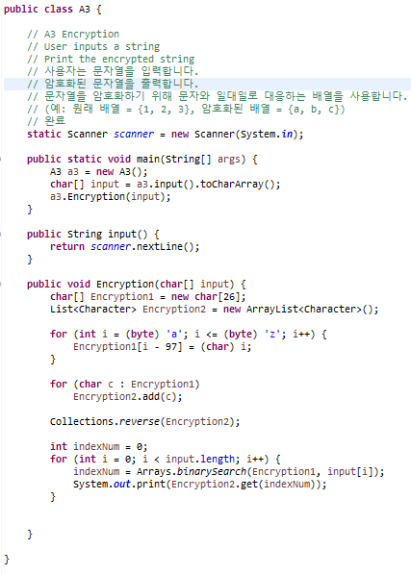
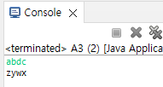
A3 Encryption
User inputs a string
Print the encrypted string
To encrypt the string, use an array to match characters one to one
(ex, original = {1, 2, 3}, encrypted = {a, b, c})
Write a scenario and compose it

Slide 6
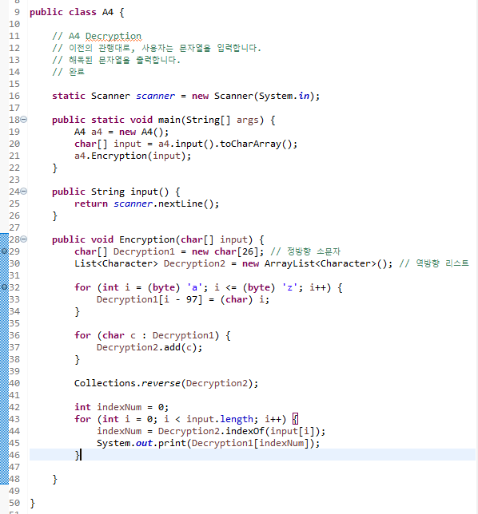
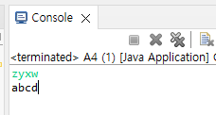
A4 Decryption
Regarding as the previous practice, user inputs a string
Print the decrypted string

Slide 7
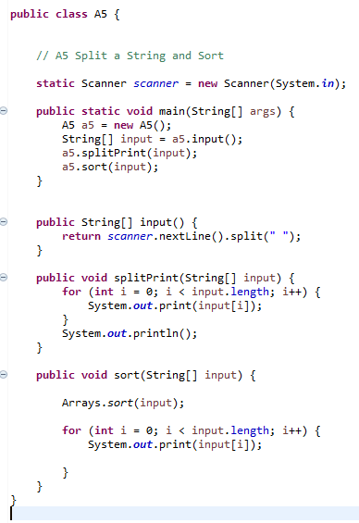
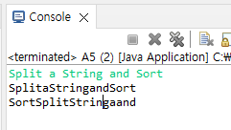
A5 Split a String and Sort
User inputs a string
Print the words after splitting it against by a black(“ “)
Sort them by in descending order and print them again

Slide 8
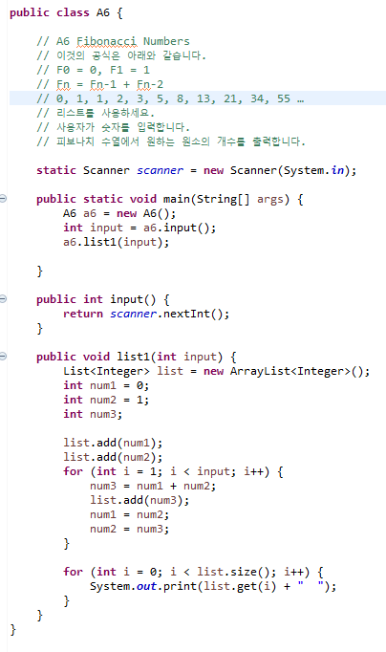
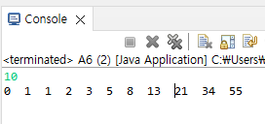
A6 Fibonacci Numbers
The formula for this is as below
F₀ = 0, F₁ = 1
F_{n} = F_{n-1} + F_{n-2}
0, 1, 1, 2, 3, 5, 8, 13, 21, 34, 55
Use a list
User inputs a number
Print the number of elements from the Fibonacci Numbers

