Slide 1
Java 과제 제출
데이터융합sw과
노을
2023.03.14

Slide 2
목차
A1
A2
A3
A4
A5
A6
A7
A8
A9

Slide 3
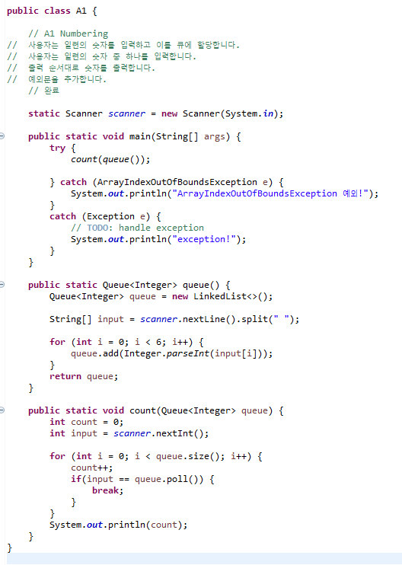
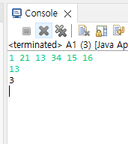
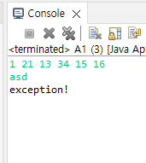
A1 Numbering
User inputs a series of numbers and assign them to a queue
User input a number from the series of numbers
Print the number in order of output
Add exception statements

Slide 4
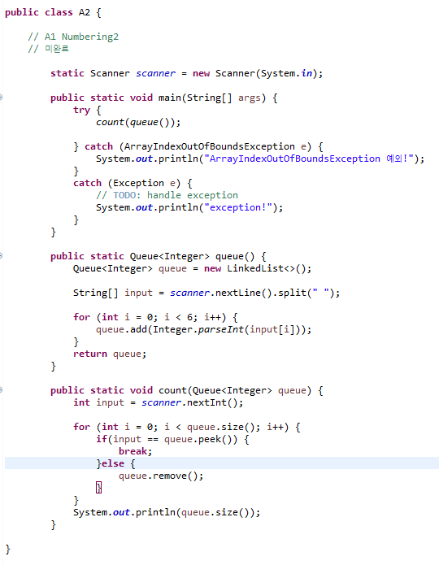
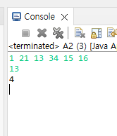
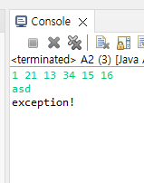
A2 Numbering II
User inputs a series of numbers and assign them to a stack
User input a number from the series of numbers
Print the number in order of output
Add exception statements

Slide 5
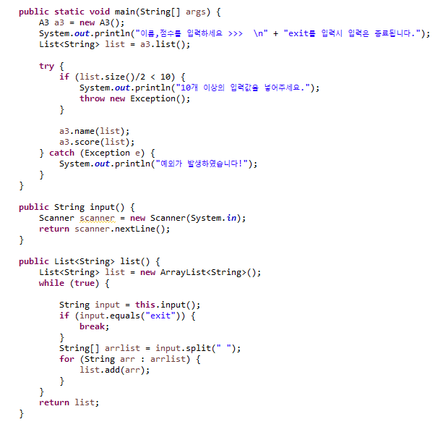
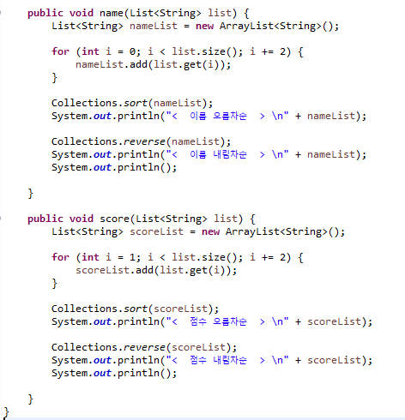
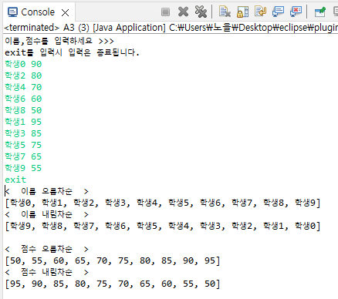
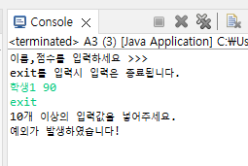
A3 Grade Card
User inputs more than 10 sets of names and scores
Print the list by name in ascending order
Print the list by name in descending order
Print the list by score in ascending order
Print the list by score in descending order
Add exception statements

Slide 6
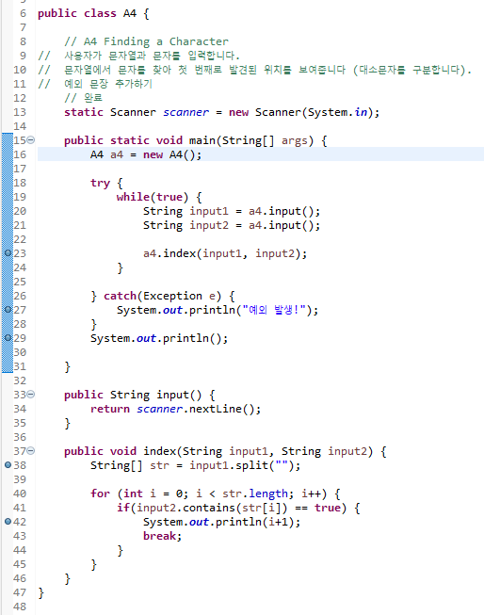
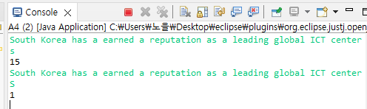
A4 Finding a Character
User inputs a string and a character
Find the character from the string and show the order of the first found(case sensitive)
Add exception statements

Slide 7
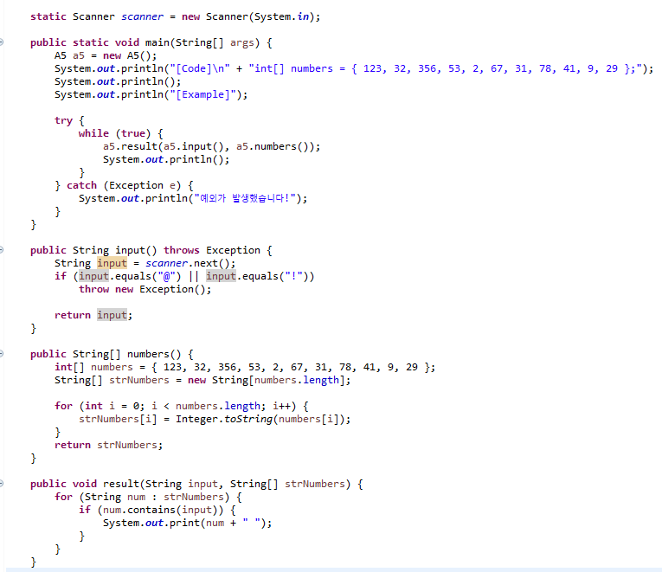
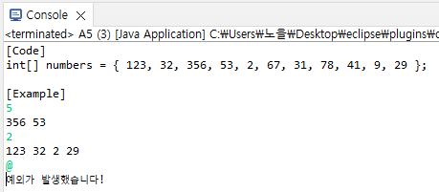
A5 Printing Numbers Matching the Condition
Initialize an integer array
Print the numbers with N in each digit
Add exception statements

Slide 8
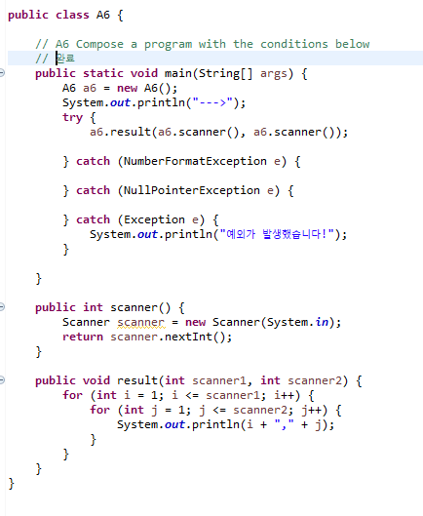
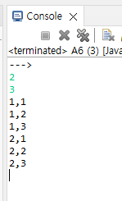
A6 Compose a program with the conditions below
User inputs the numbers N and M
Print all the cases made by the combination of 1 to N and 1 to M
Add exception statements

Slide 9
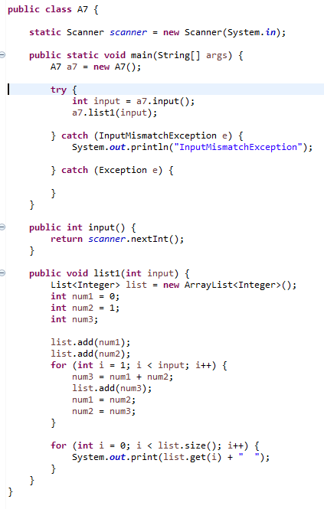
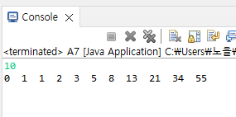
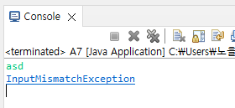
A7 Fibonacci Numbers
The formula for this is as below
F₀ = 0, F₁ = 1
F_{n} = F_{n-1} + F_{n-2}
0, 1, 1, 2, 3, 5, 8, 13, 21, 34, 55
Use a list
User inputs a number
Print the number of elements from the Fibonacci Numbers
Add exception statements

Slide 10
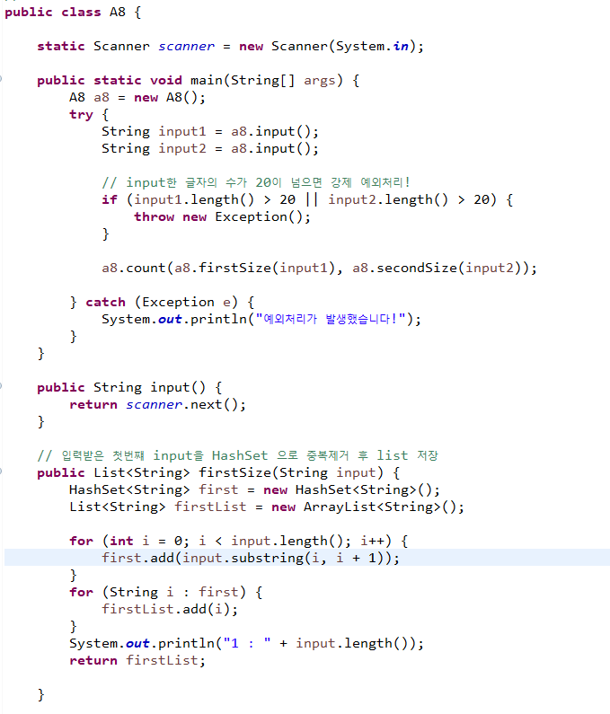
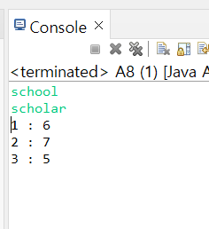
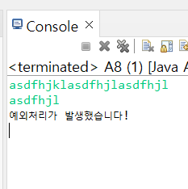
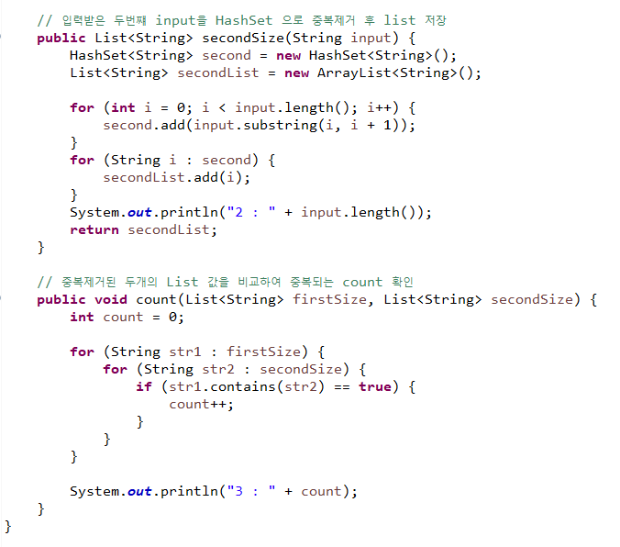
A8 Comparing Strings
User inputs the two words and assign them to lists
Print the following information
1. Size of the first word
2. Size of the second word
3. Number of the same characters
Add exception statements

Slide 11
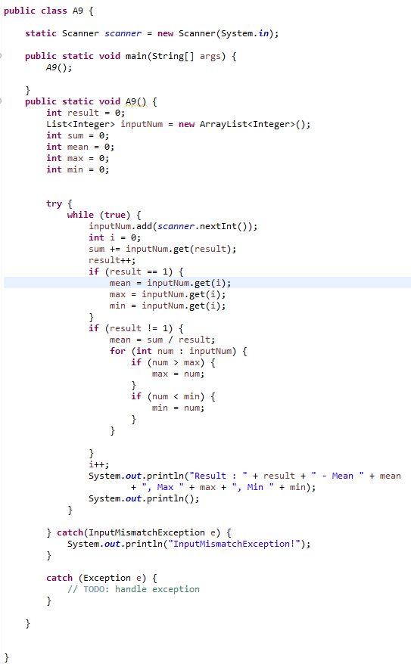
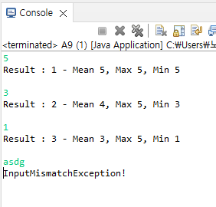
A9 Descriptive Statistics Calculation
User inputs a number, and assign it to a list
Prints the number of numbers, mean, maximum, minimum
This is performed indefinitely
Add exception statements
5
Result : 1 - Mean 5, Max 5, Min 5
3
Result : 2 – Mean 4, Max 5, Min 3
1
Result : 3 – Mean 3, Max 5, Min 1

